Slide 1





Lesson toolkit card
Weather Together – Flooding: Sharing ways to prepare
30 Minutes
Success
criteria
Must create a resource to help someone prepare for a flood emergency.
Could share your resource with people in your community.
Independent
Creative
Note: this activity can be repeated – just choose a different resource to make each time.
Invite learners to take a pause [3].
Introduce the session and the big question [4,5].
Let learners know that they will now create something to help share information about how to prepare for and cope with a flood. As a class, select one option from slide 5 and ask learners to create the resource. Discuss how to share the resource they create safely [6].
Explain/recap the Weather Together award and progress trackers [7-9].
Encourage learners to reflect and decide how they will take action from today [10].
Refer back to the big question to review progress [11].
Share your learning to help others prepare and cope.
How to run the activity
What you need
Optional: Pens, paper, colouring pencils/pens.
Optional: laptops/tablets.
If possible, use laptops/tablets/a computer suite for this activity to enable learners to design their resource digitally. If you think it's appropriate, learners could share/save a copy of their work to take home. Remind learners again of the need to seek permission and ask for a responsible adult to share the resources.
Allow learners more agency by asking them to think of a list of resources they could make (rather than selecting from the list on slide) [6].
Ways to adapt
Curriculum links
England: PSHE, Language and literacy, Citizenship
Scotland: Health and wellbeing, Literacy
Wales: Health and Wellbeing, Languages, Literacy and Communication
Northern Ireland: Communication, Thinking skills and personal capabilities,
Language and literacy
The British Red Cross Society © 2023 incorporated by Royal Charter 1908, is a charity registered in England and Wales (220949), Scotland (SC037738) and Isle of Man (0752)
Notes:
As Weather Together is about emergencies, it has the potential to affect learners who have been impacted by trauma in their lives. This trauma may have been related to an emergency event, or it may relate to something else. Careful consideration should be given before deciding to ask learners to share their personal feelings about past or future emergencies or traumas. If a learner brings up personal feelings, you could validate their feelings and then redirect them back to the discussion or activity.
Please always refer to your organisation’s safeguarding policy should you have any concerns about learner wellbeing.

Slide 2

Weather Together title page
Notes:
This is a screen saver which you could use while settling the group.

Slide 3



Connect with yourself through movement
Pause
Connect with yourself through movement
Place your feet firmly on the ground.
Lean your body forwards as you breathe in, and then lean backwards as you breathe out. Repeat 3 times.
Lean your body left as you breathe in, and then lean to the right as you breathe out. Repeat 3 times.
Then, sit up straight.
Notice how your body is feeling after the grounding exercise.
Take a pause
mindful moving
Notes:
This grounding activity can be done either seated or standing.
You can explain that it can be distressing to listen to other’s experience of the challenges they’re facing, especially if we have similar experiences and challenges. A way of coping with this is to take a pause. Remind learners this is a way of being kind to ourselves which is important. How our body feels matters.
Prompt learners to move through the steps.

Slide 4

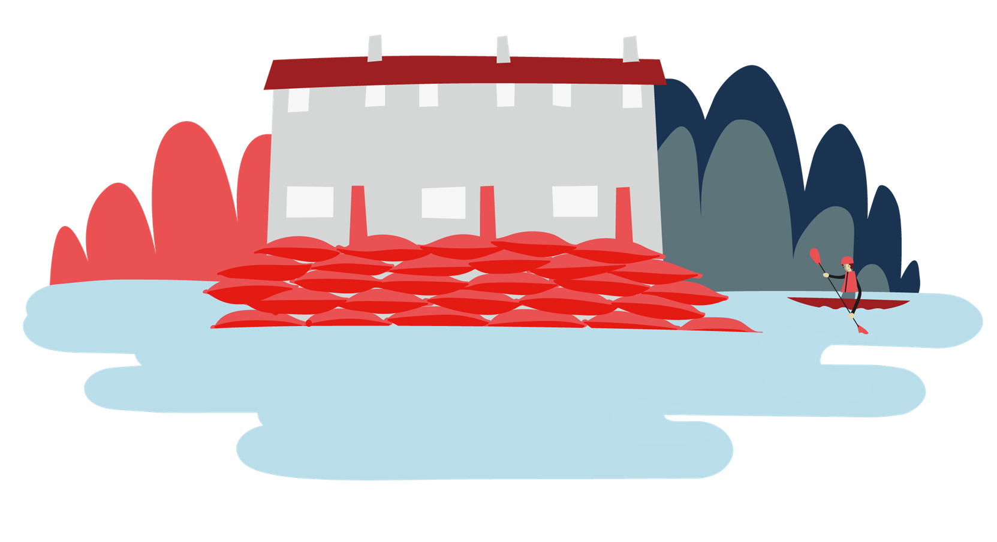

Objective: Share your learning to help others prepare and cope.
Welcome
Objective: Share your learning to help others prepare and cope.
To meet this objective, you’ll create a resource to help somebody else understand why and how to prepare for a flood.
Earn points for sharing your resource at home!

Slide 5
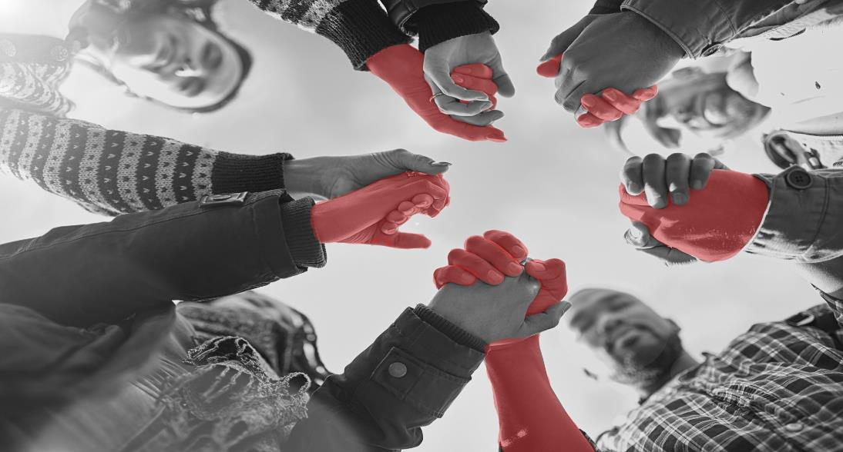

Why is it important to share ways to prepare and cope with a flood with the people you know?
Big question
Why is it important to share ways to prepare and cope with a flood with the people you know?
Notes:
Big questions are an assessment tool for educators and learners to demonstrate progress through an activity.​​
Share this slide with learners and give them a moment to reflect on the question.​​
Then, ask them to discuss with a partner before sharing their ideas with the group.​​
At this point in the activity, it is expected that learners may not have many ideas or know how to answer this question. ​​
The question will be reviewed at the end of the activity. This is an opportunity for learners to see how much progress they’ve made and how many more ideas they now have. ​​
​​
DETAILS
Credit:
Cecilie_Arcurs
Creative #:
623901114
Licence type:
Royalty-free
Collection:
E+
Release info:
Model and property release

Slide 6
Sharing ways to prepare
Sharing ways to prepare
Share
Choose how you could share ways to prepare. You could create a:
  leaflet
  poster
  social media post (script, storyboard for a video, plain text, video recording)
  letter.
Many people don’t think they can be affected by flooding.
How will you convince them? to
Think about how you will share this resource:
  Ask a responsible adult to share with your neighbours.
  Ask a responsible adult to post in local groups on social media.
  Ask a responsible adult to share on your family’s group chat.
Notes:
Each part of this page will appear in sequence when in full-screen mode.
Choose/vote on one resource that the class will make and ask learners to individual/collaboratively create the resource.
Encourage learners to think about how they will share the resource and who with. Knowing the audience will help them in their designs.

Slide 7
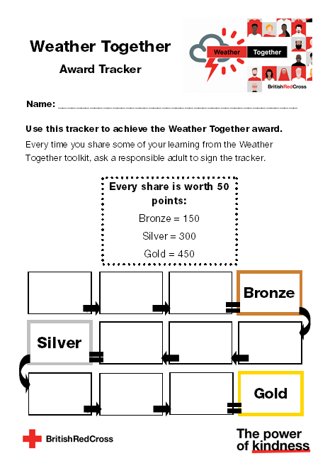
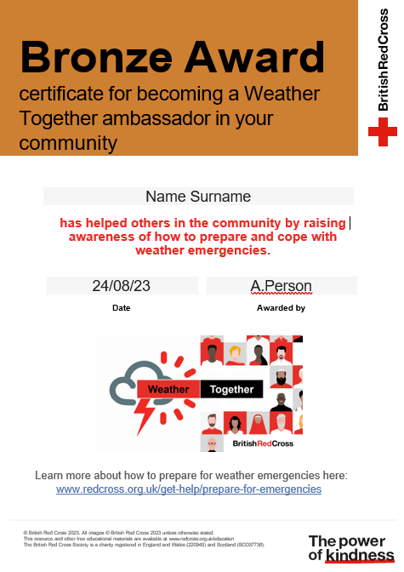
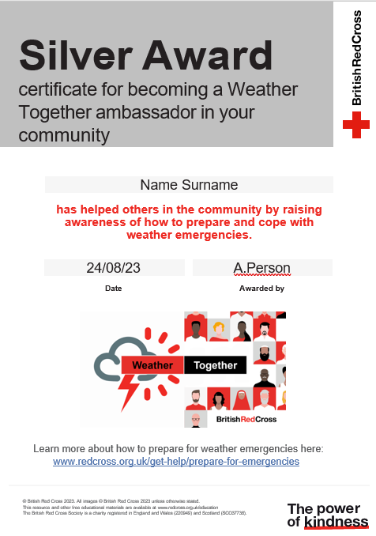
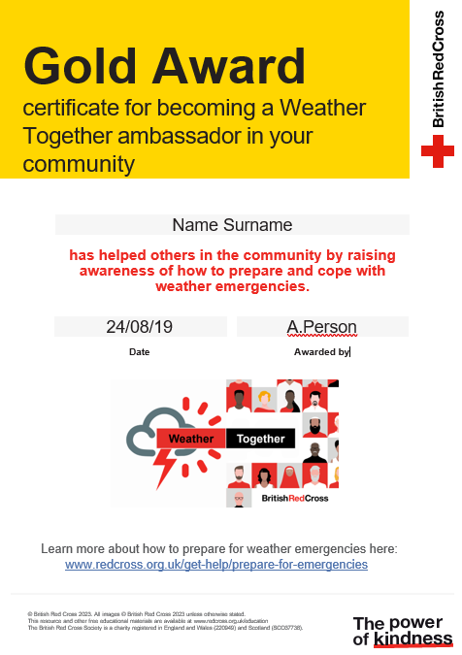
Achieve the Weather Together award
Award
By sharing ways to prepare for and cope with flooding, you can become a Weather Together ambassador.
Every time you share, earn 50 points.
Use the Weather Together award tracker to keep a record of your points. Ask a responsible adult to sign the tracker each time you share some advice.
Notes:
Use this as homework. A way for learners to take their learning beyond the classroom.
You may need to encourage older learners to engage by explaining this can be used to support applications. It is a way of showing learners have supported their community.

Slide 8
Achieve the Weather Together award
Certificates

Slide 9
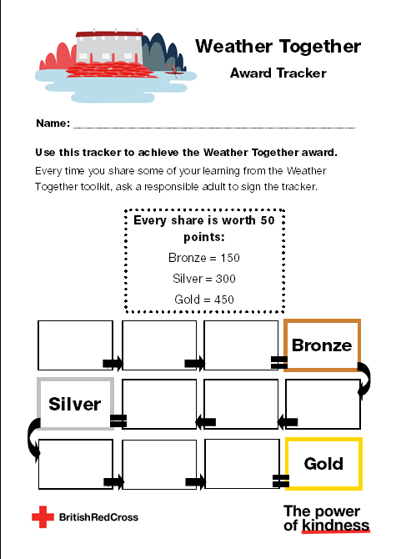
Weather Together award – how’s it going?
Review
If you’ve already made a start at working towards the award, take a moment to review how it’s going.
  How have you shared information?
  What worked?
  What are you pleased with?
  Is there anything you’d change for next time?
  How is your progress towards the next certificate?

Slide 10




Take a moment to reflect
Reflect
First, decide what you will do today to prepare yourself for a flood emergency.
Next, decide how you will earn points and help others by sharing your work.
Then, share your ideas with the group.
Notes:
Ask learners to think of 1 example of something they will do for themselves and others and discuss this with a partner before sharing with the group.

Slide 11
Why is it important to share ways to prepare and cope with a flood with the people you know?
Big question
Notes:
Give learners a few moments to reflect on this question before inviting them to discuss with a partner. Then, encourage feedback as a group.​
Referring back to the big question should enable you and your learners to see how much they have learned from the activity. Answers to this question should be more detailed and varied at this point.​
​​
​​
DETAILS
Credit:
Cecilie_Arcurs
Creative #:
623901114
Licence type:
Royalty-free
Collection:
E+
Release info:
Model and property release

Slide 12

Thank you
End

Slide 13
Resources and support

Slide 14
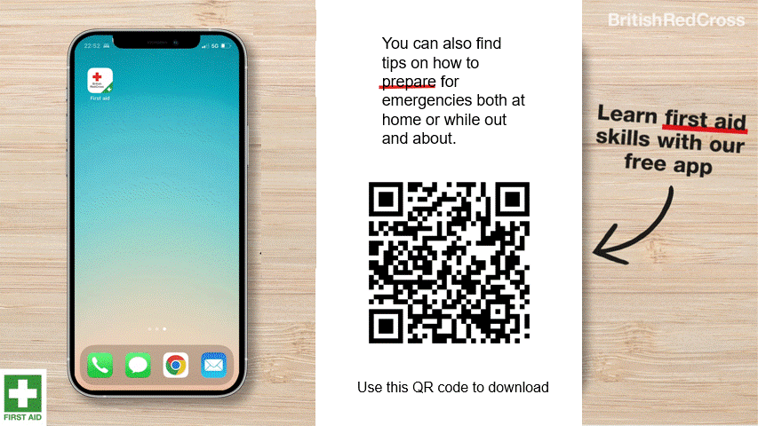
First aid app

Slide 15
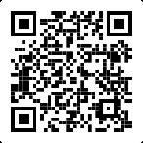
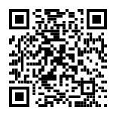
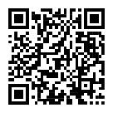
Where to find more information
Resources
Get advice and information in a flood by calling Floodline.
Telephone: 0345 988 1188
Textphone: 0345 602 6340
24-hour service
Sign up for free alerts
https://www.gov.uk/sign-up-for-flood-warnings
Learn how the British Red Cross is ready to help in a crisis
Visit the British Red Cross website to learn more about how to prepare for and cope in a flood.
www.redcross.org.uk/get-help/prepare-for-emergencies/how-to-prepare-for-floods-and-flooding
www.redcross.org.uk/stories/disasters-and-emergencies/uk/how-the-british-red-cross-helps-during-a-flood

Slide 16
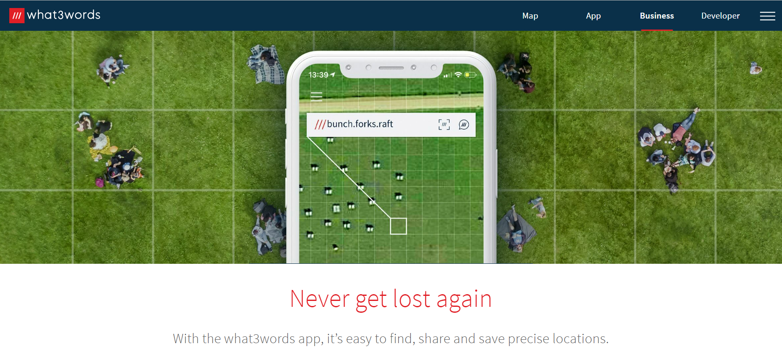
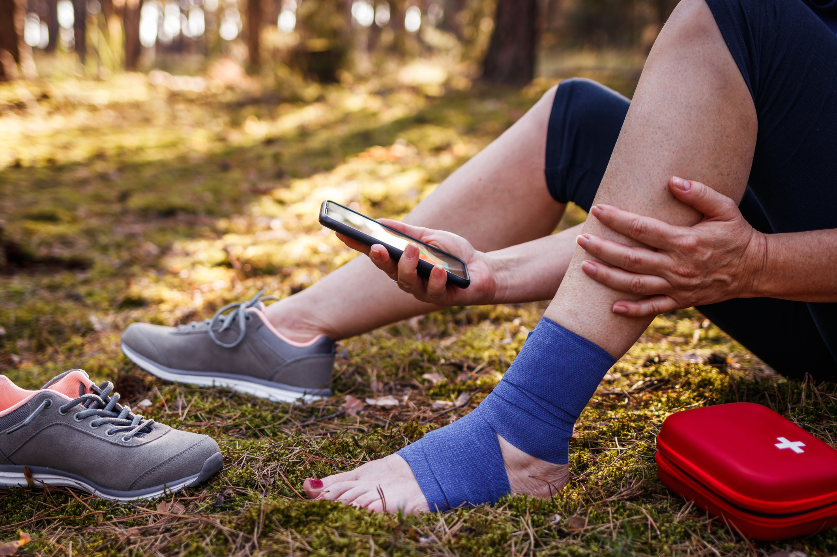
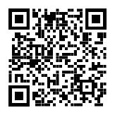
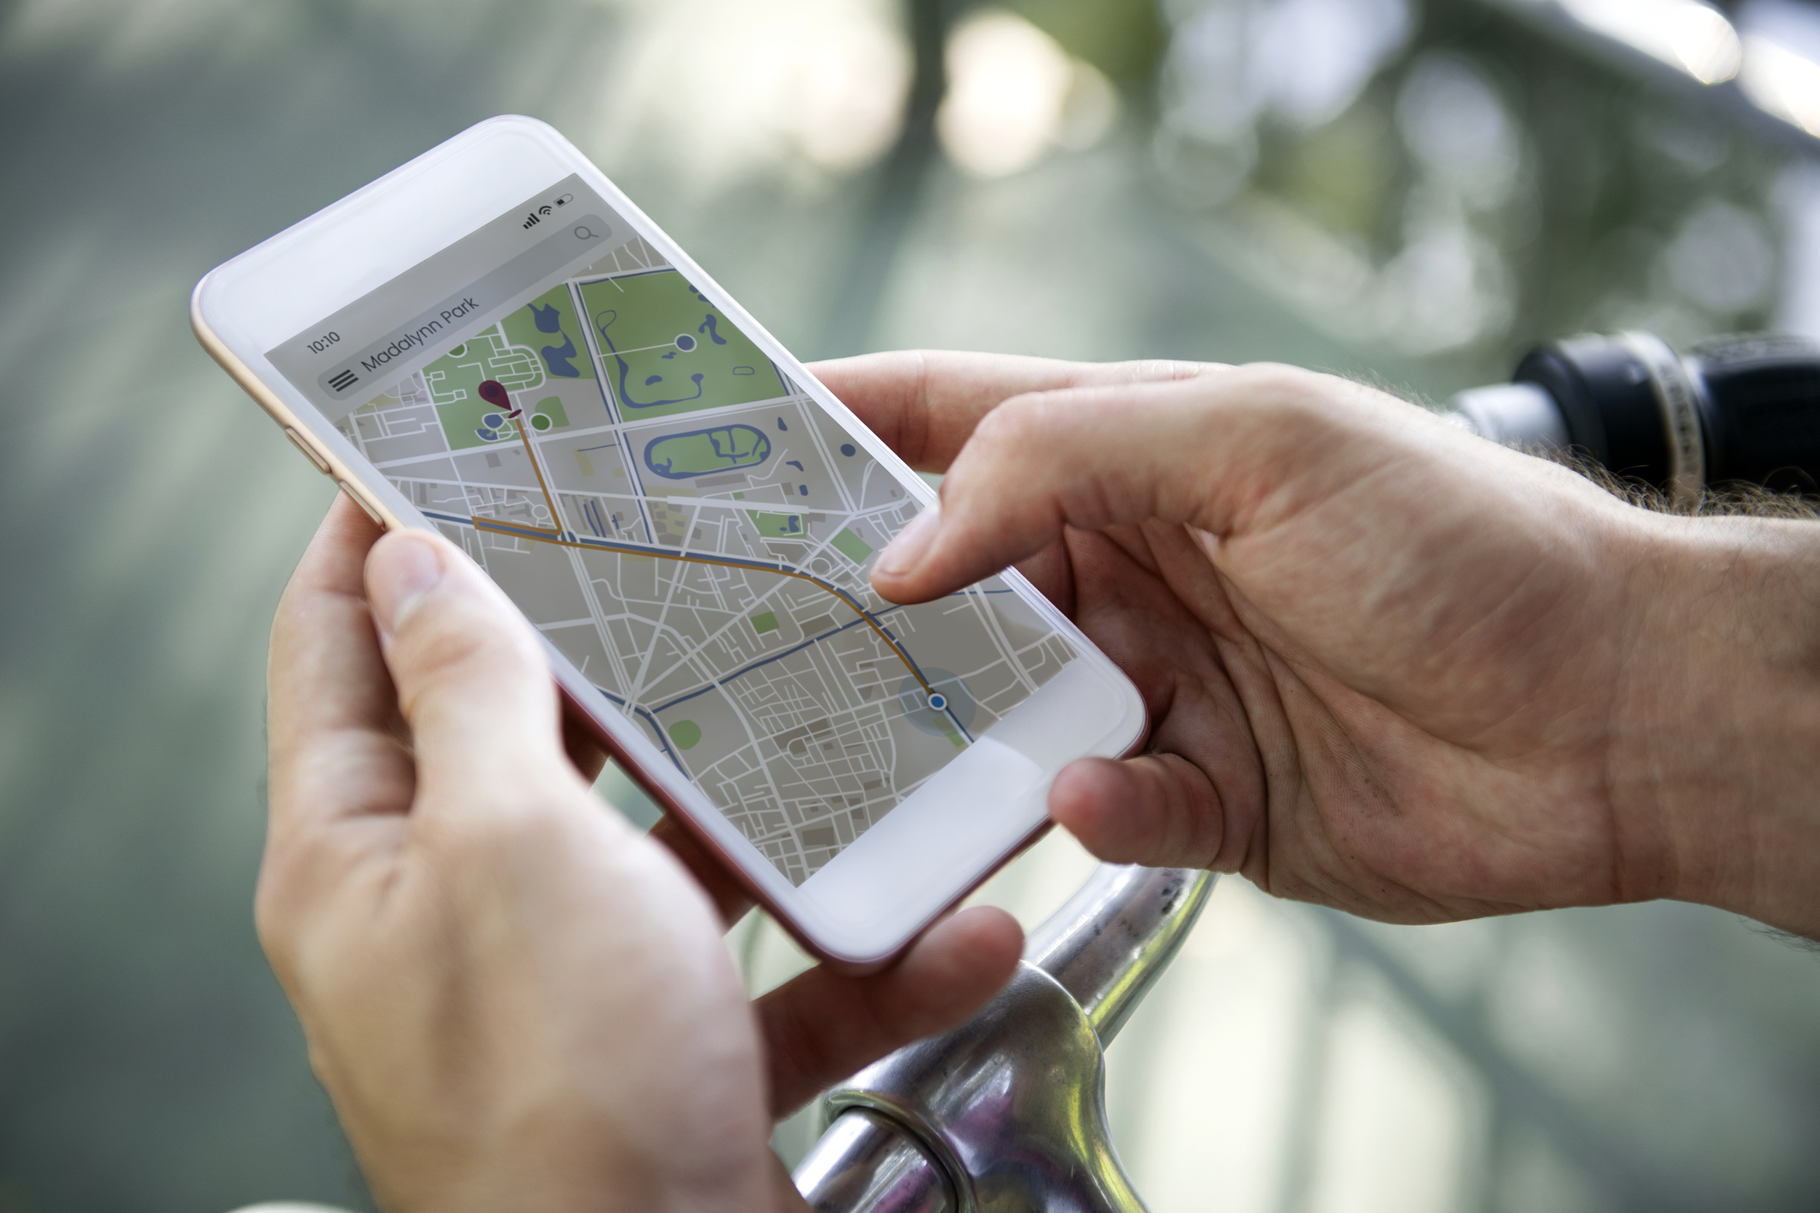
How to tell the emergency services where you are
2. Some smartphones have a built-in feature to call the emergency services and share your location. Find out how to use this on your phone.
3. You could also use a maps app to pinpoint and share your location. Learn how to do this so you’re ready for an emergency.
Resources
1. You could get the what.three.words app
what3words.com/products/what3words-app

Slide 17







Flooding
Heatwaves
Eco-anxiety
Read 3 characters’ flood stories and discuss how they could be affected.
Find out about the effects of heatwaves through completing a quiz.
Worksheet: heatwave facts to print
Read a character’s experience of eco-anxiety and use this to define what it is.
Look at local flood maps and the role of the emergency services to explore how flooding can affect us all.
Worksheet: note writing help
Examine a list of ways to cope and apply this to yourself and others.
Worksheet: coping with eco-anxiety
Learn how heatwaves affects our body and the first aid to help. Apply these to different scenarios.
Poster: heatwaves scenarios
Poster: heatwaves first aid
Create a video/script for social media of how to cope with eco-anxiety to share with friends and family.
Worksheet: eco-anxiety video script
Examine images of flooding and identify the dangers.
Create a decision flowchart to share with friends and family to help them prepare for a heatwave.
Worksheet: decision flowcharts
Play a scenario game to find out about bug out bags and why it is important to have one ready.
For use across all topics
Starters
Plenaries
Weather Together
award tracker
Bronze certificate
Silver certificate
Gold certificate
Play a ‘choose your own adventure’ game to learn how to respond to flood alerts and warnings.
Create resources to share with friends and family. This activity is designed to be repeated.
Rate these resources
Open another activity
Link
Link
Fill in this quick survey to help us improve Weather Together.
Click here to open the full web index.

