Slide 1





Weather Together: Flooding – the dangers of flooding
Weather Together: Flooding – the dangers of flooding
20 Minutes
Success criteria
Must know that flooding can affect anyone.
Should examine the dangers of flooding and identify safe actions to take.
Whole group
Discussion
Invite learners to take a pause [3].
Introduce the objective and big question [4-5].
Let learners know they will see a series of images of flooding which they will discuss with a partner or a small group. Explain that, for each image, they should come up with ideas for what they think the dangers of flooding might be and how they could affect a person. Then, learners will work out and discuss what they think the safe actions might be, based on their analysis and common sense. See the ‘notes’ section of each slide for support [6-13].
Refer back to the big question to review progress [14].
Learn why you need to prepare for a flood emergency
How to run the activity
What you need
Ask learners to choose an image and create a roleplay of the danger and safe action. Invite learners to present to the group and encourage peer review.
Instead of discussing each image, give learners one minute to write the dangers/safe action and bring them to the front. Review the responses together.
Ways to adapt
England: PSHE, Language and literacy
Scotland: Health and wellbeing, Literacy
Wales: Health and Wellbeing, Languages, Literacy and Communication
Northern Ireland: Communication, Thinking skills and personal capabilities,
Language and literacy
Curriculum links
The British Red Cross Society © 2022 incorporated by Royal Charter 1908, is a charity registered in England and Wales (220949), Scotland (SC037738) and Isle of Man (0752)
Notes:
As Weather Together is about emergencies, it has the potential to affect learners who have been impacted by trauma in their lives. This trauma may have been related to an emergency event, or it may relate to something else. Careful consideration should be given before deciding to ask learners to share their personal feelings about past or future emergencies or traumas. If a learner brings up personal feelings, you could validate their feelings and then redirect them back to the discussion or activity.
Please always refer to your organisation’s safeguarding policy should you have any concerns about learner wellbeing.

Slide 2

Screensaver
Notes:
This is a screen saver which you could use while settling the group.

Slide 3



Pause
This activity can be done either seated or standing.
Place your feet firmly on the ground.
Lean your body forwards as you breathe in, and then lean backwards as you breathe out. Repeat 3 times.
Lean your body left as you breathe in, and then lean to the right as you breathe out. Repeat 3 times.
Then, sit up straight.
Notice how your body is feeling after the grounding exercise.
Take a pause
grounding
Notes:
You can explain that it can be distressing to listen to other’s experience of the challenges they’re facing, especially if we have similar experiences and challenges. A way of coping with this is to take a pause. Remind learners this is a way of being kind to ourselves which is important. How our body feels matters.
Prompt learners to move through the steps.

Slide 4

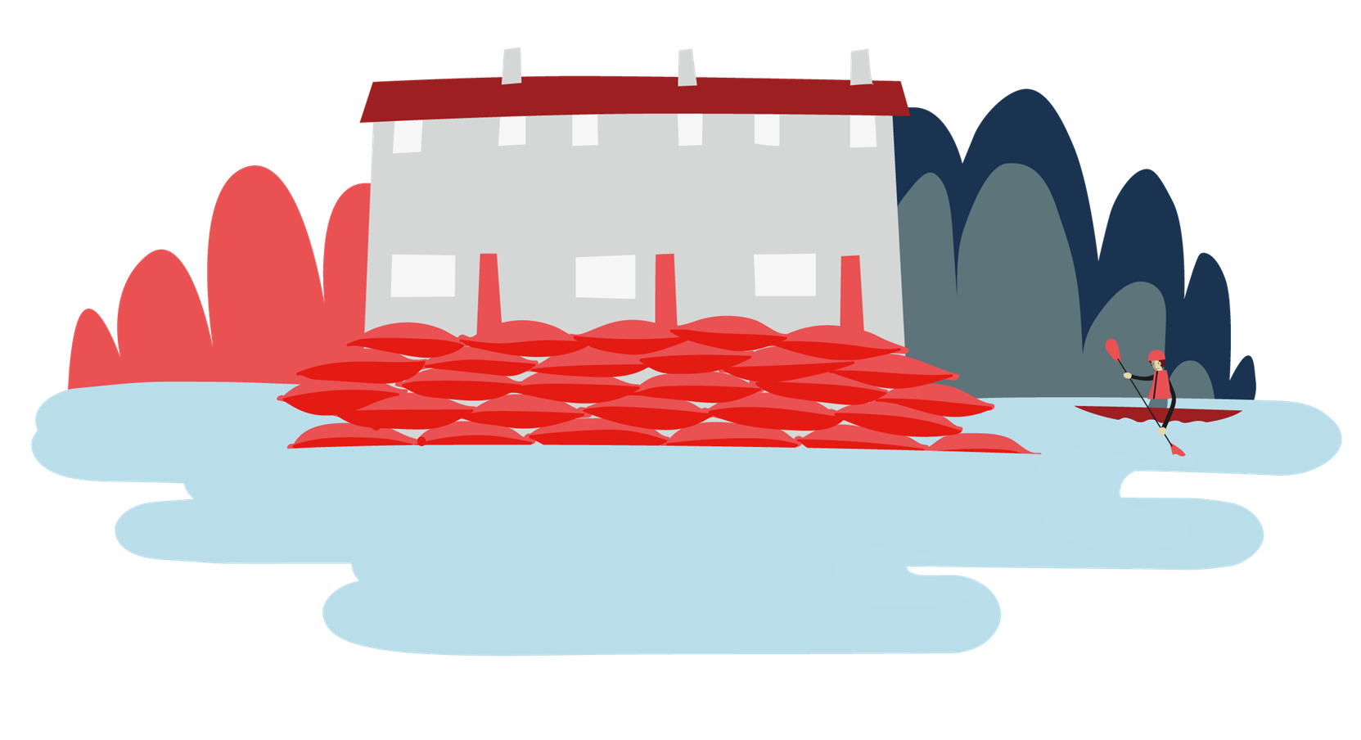

Objective: Learn why you need to prepare for a flood emergency.
Welcome
Objective: Learn why you need to prepare for a flood emergency.
To meet this objective, you’ll examine images of flooding and identify the dangers and safe actions for each.

Slide 5
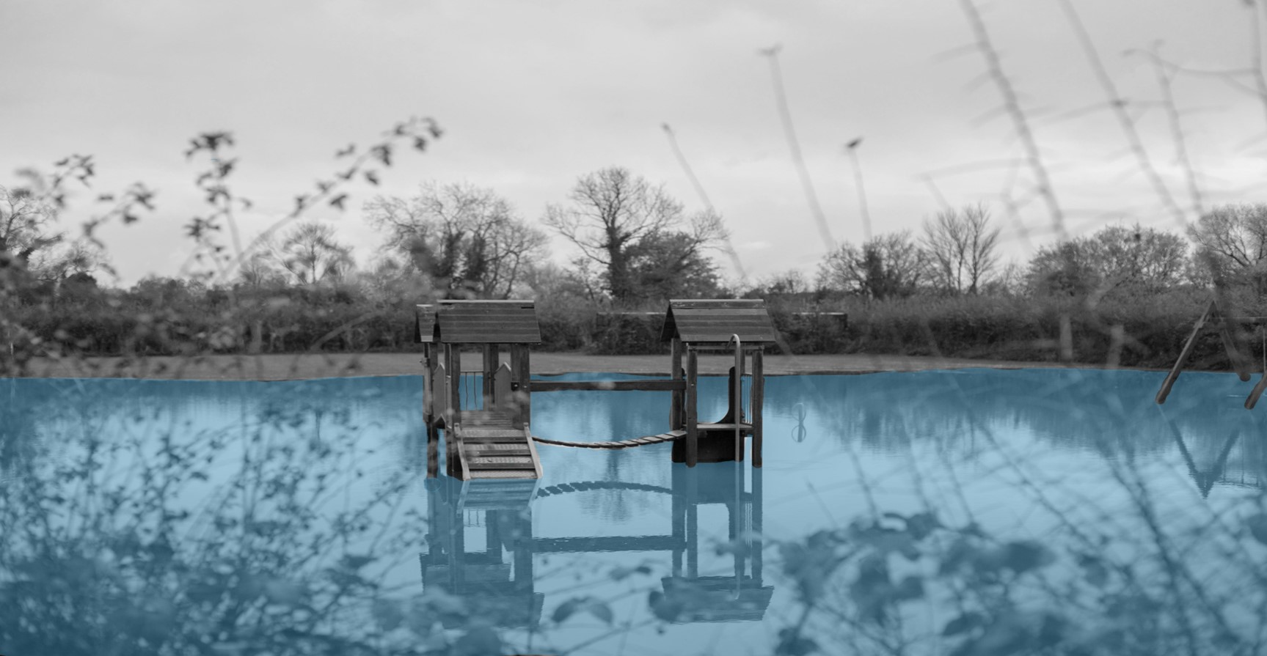

Big question
How can flooding be dangerous?
Notes:
This is the big question. Big questions are an assessment tool for educators and learners to demonstrate progress through an activity.​​
Share this slide with learners and give them a moment to reflect on the question.​​
Then, ask them to discuss with a partner before sharing their ideas with the group.​​
At this point in the activity, it is expected that learners may not have many ideas or know how to answer this question. ​​
The question will be reviewed at the end of the activity. This is an opportunity for learners to see how much progress they’ve made and how many more ideas they now have. ​​

Slide 6
Big question
The dangers of flooding
Flooding is dangerous and can affect everyone.
To help you answer the big question, six images of flooding will be shared with you.
How can flooding be dangerous?
Notes:
Introduce the activity to learners by sharing the information on this slide.

Slide 7


What to do?
For each one:
Identify the dangers and how they could affect a person.
Suggest some ways a person could stay safe.
Notes:
You may need to recap/explain to learners that flooding can affect everyone, even if their home isn’t directly flooded.
IMAGE: DETAILS
Credit: BremecR
Creative #: 157680150
Licence type: Royalty-free
Collection: E+
Release info: No release required

Slide 8
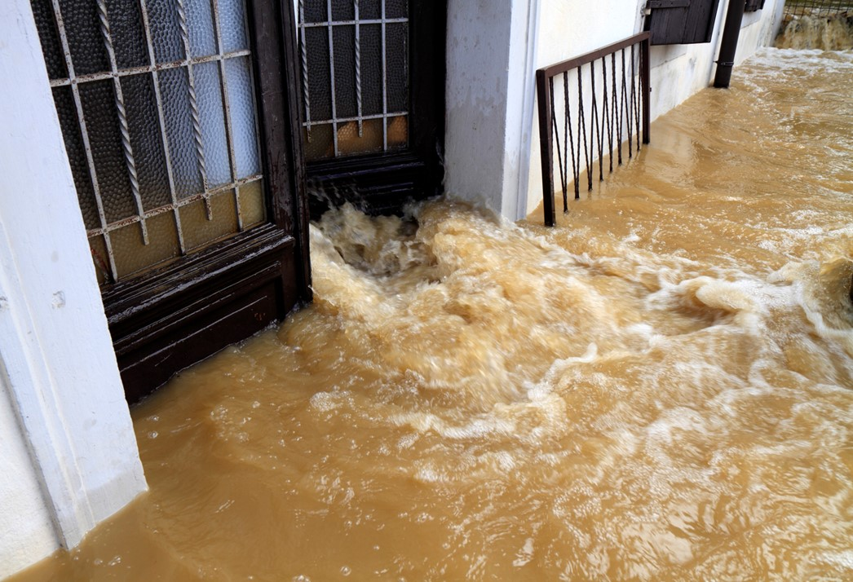
What to do?
Flood water is flowing into the house.
What are the dangers and how can they affect a person?
What safe actions could a person take?
Notes:
Dangers: Electrocution, disease due to sewage contamination, hidden hazards, emotional distress.
Safe actions: Call 999 immediately to get help if you are unsafe.
If safe, ensure the water, gas, and electricity is switched off.
Do not try to ‘save’ any possessions. If possible, to move out of the floodwater to somewhere more safe immediately.
Prepare by learning first aid to help somebody in a flood emergency, download the British Red Cross’ first aid app. Download the what.three.words app so you can always share where you are with the emergency services.
IMAGE: DETAILS
Credit: BremecR
Creative #: 157680150
Licence type: Royalty-free
Collection: E+
Release info: No release required

Slide 9
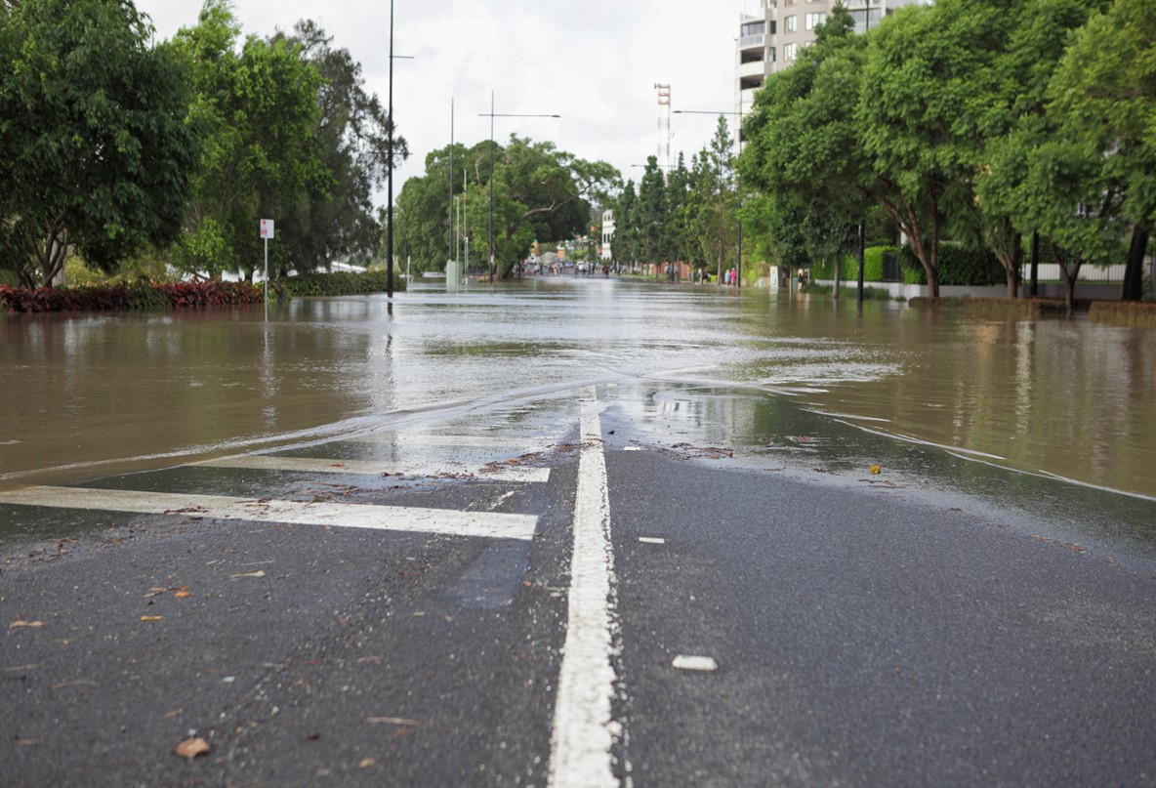
What to do?
Flood water is covering the road and path on the way to a school.
What are the dangers and how can they affect a person?
What safe actions could a person take?
Notes:
Dangers: 15cm of fast flowing flood water can knock a person over, 60cm can move a car. Flood water can be contaminated by sewage, it can hide hazards like deep holes, objects to fall over, and sharp objects.
Safe actions: Do not go through flood water, by any means. Remind adults not to drive through flood water. Find a way around. This may take more time, but it is the safe thing to do. If a person has been in flood water, tell them to wash thoroughly. Prepare by learning first aid to help somebody in a flood emergency, download the British Red Cross’ first aid app. Download the what.three.words app so you can always share where you are with the emergency services.
IMAGE: DETAILS
Credit: secablue
Creative #: 154919588
Licence type: Royalty-free
Collection: E+
Release info: No release required

Slide 10
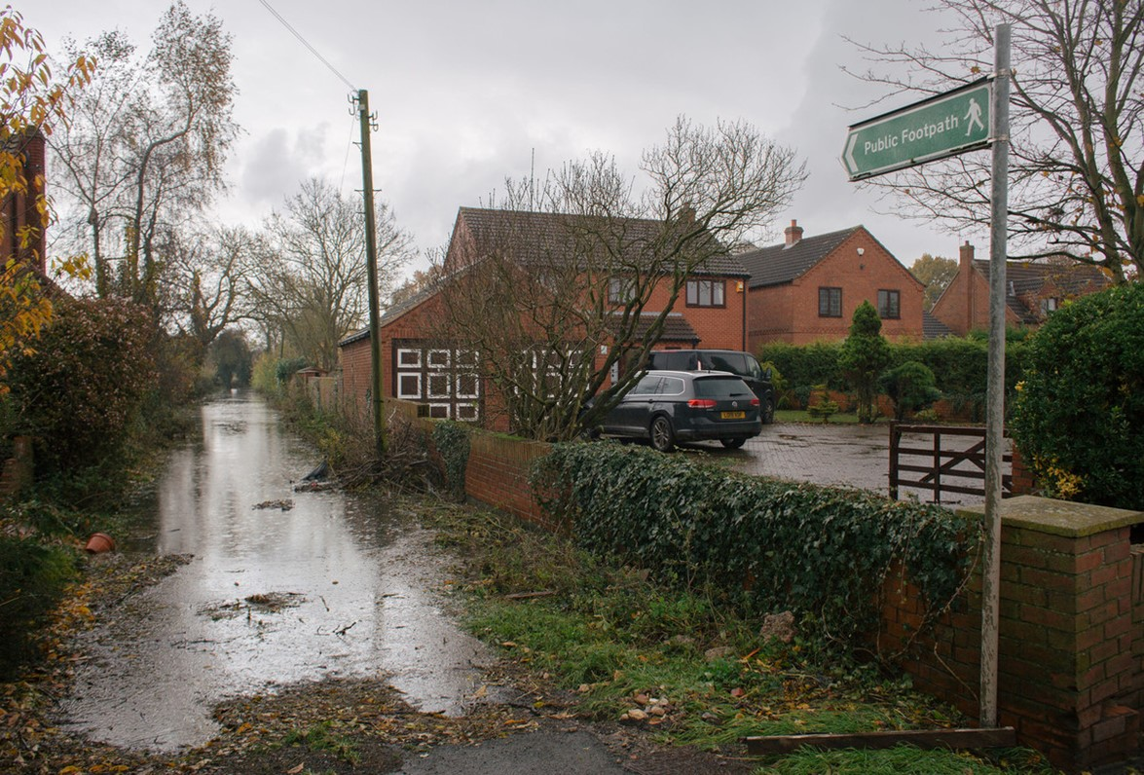
What to do?
The water level of the river is very high and starting to cover the path where a person wants to walk their dog.
What are the dangers and how can they affect a person?
What safe actions could a person take?
Notes:
Dangers: Even shallow, fast flowing flood water can knock a person over. A dog may be able to swim but is at risk of being hurt. Flood water can be contaminated by sewage, it can hide hazards like deep holes, objects to fall over, and sharp objects. All of these can affect the person and their dog.
Safe actions: Do not go through flood water, by any means. Find an alternative route to walk. This may take more time, but it is the safe thing to do. If a person or their dog has been in flood water, tell them to wash thoroughly. If there is an emergency, call 999. Prepare by learning first aid to help somebody in a flood emergency, download the British Red Cross’ first aid app. Download the what.three.words app so you can always share where you are with the emergency services.
IMAGE: DETAILS
BRC Storieshub RS21429_B25A7433-scr

Slide 11
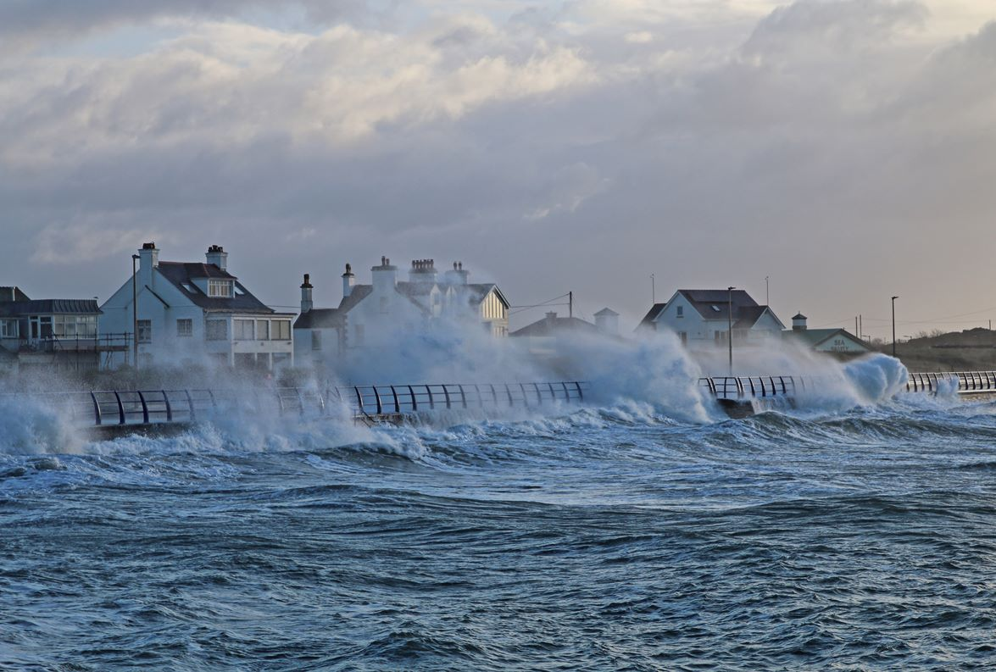
What to do?
Large waves are coming over the top of the sea wall and flooding the road and path.
What are the dangers and how can they affect a person?
What safe actions could a person take?
Notes:
Dangers: Large waves can knock a person over, causing a first aid emergency. The cold water from the sea could lead to a person becoming hypothermic (dangerously cold). A person may risk falling into the sea and needing to be rescued. If the waves land on a car, the driver may lose control and cause an accident. Sand washed up onto the road can cause the surface to become slippery which may cause a road accident.
Safe actions: Do not walk along the seafront in these conditions. Tell the driver not to go along the seafront in their car. Find a way around. This may take more time, but it is the safe thing to do. If there is an emergency situation, phone 999. Prepare by learning first aid to help somebody in a flood emergency, download the British Red Cross’ first aid app.
IMAGE: DETAILS
Credit: EOSdude
Creative #: 923405276
Licence type: Royalty-free
Collection: iStock / Getty Images Plus
Location: United Kingdom
Release info: No release required

Slide 12
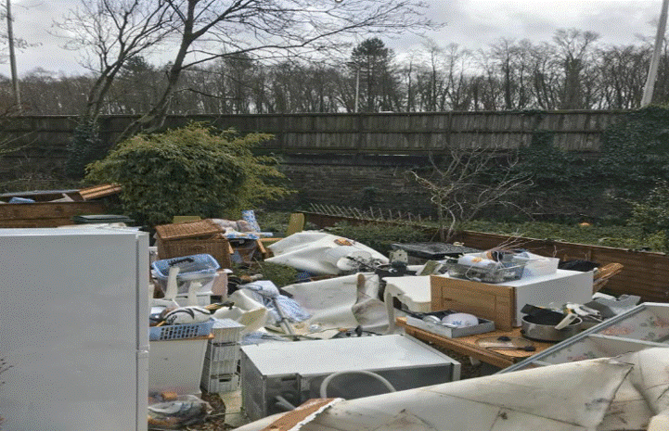
What to do?
After flood waters have gone, a family are looking to see what they can save in the kitchen.
What are the dangers and how can they affect a person?
What safe actions could a person take?
Notes:
Dangers: Flood water can be contaminated with sewerage and chemicals and cause illness. Every item in the home may have been exposed to the water so is unclean and hazardous.
Safe actions: Throw away all food. Ensure everything is thoroughly cleaned with hot water and detergent. Wash clothes you have used for cleaning separately to your usual clothes. Follow the advice from the government linked in this PowerPoint in the resources and support section.
Learners may mention electricity and gas supplies being affected – these should not be used again until they have been checked and confirmed safe.
IMAGE: DETAILS
Credit: secablue
Creative #: 154919588
Licence type: Royalty-free
Collection: E+
Release info: No release required

Slide 13
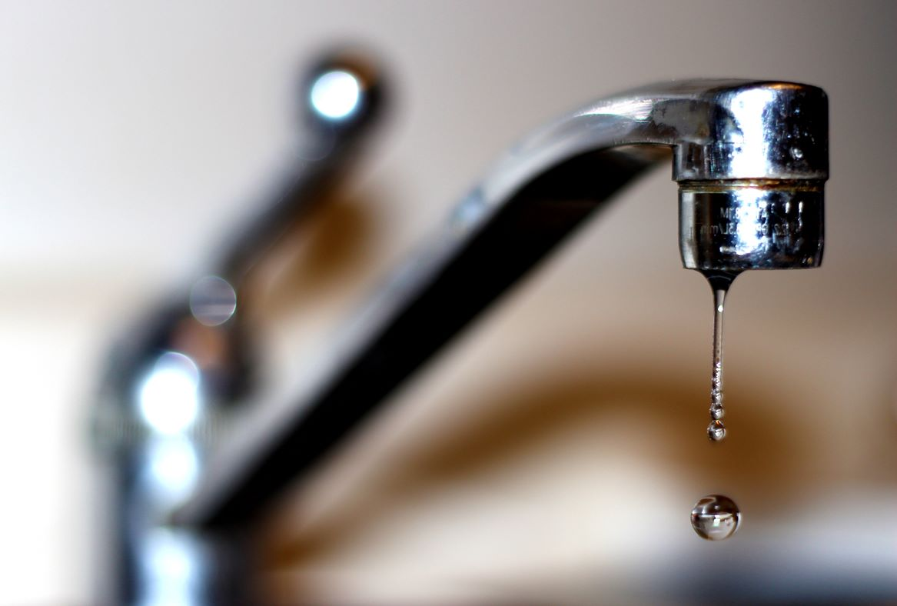
What to do?
After the floodwaters have gone, a person returns to their house. They want to drink some water from the tap.
What are the dangers and how can they affect a person?
What safe actions could a person take?
Notes:
Dangers: Contaminated flood water may affect the supply to your house. Drinking contaminated water will make a person ill.
Safe actions: Do not drink tap water until it has been checked and you have confirmation it is safe. Drink bottled water instead.
IMAGE: DETAILS
Credit: caristo
Creative #: 486929190
Licence type: Royalty-free
Collection: iStock / Getty Images Plus
Release info: No release required

Slide 14
Big question
How can flooding be dangerous?
Notes:
This is the big question. Big questions are an assessment tool for educators and learners to demonstrate progress through an activity.​​
Share this slide with learners and give them a moment to reflect on the question.​​
Then, ask them to discuss with a partner before sharing their ideas with the group.​​
At this point in the activity, it is expected that learners may not have many ideas or know how to answer this question. ​​
The question will be reviewed at the end of the activity. This is an opportunity for learners to see how much progress they’ve made and how many more ideas they now have. ​​

Slide 15

End
Thank you

Slide 16
Resources and support

Slide 17

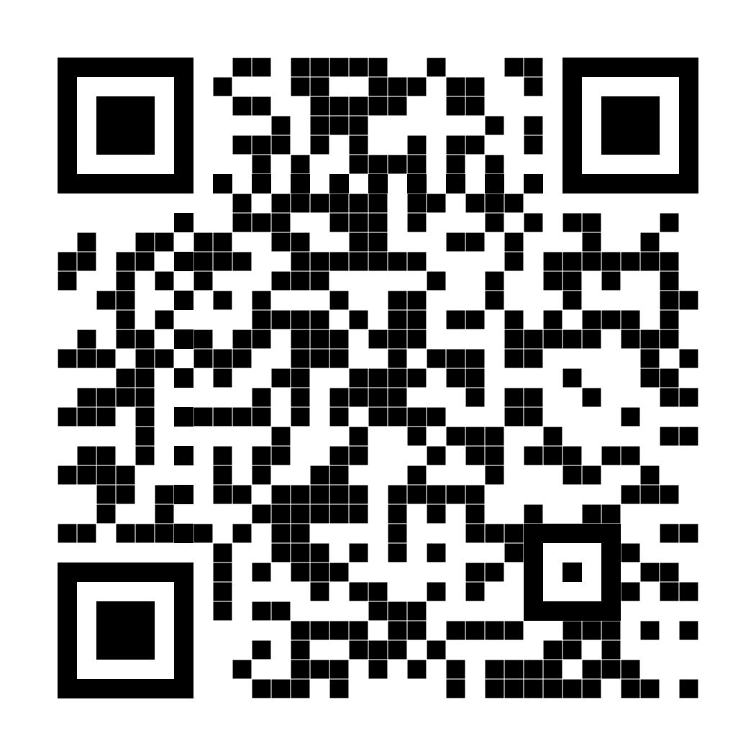
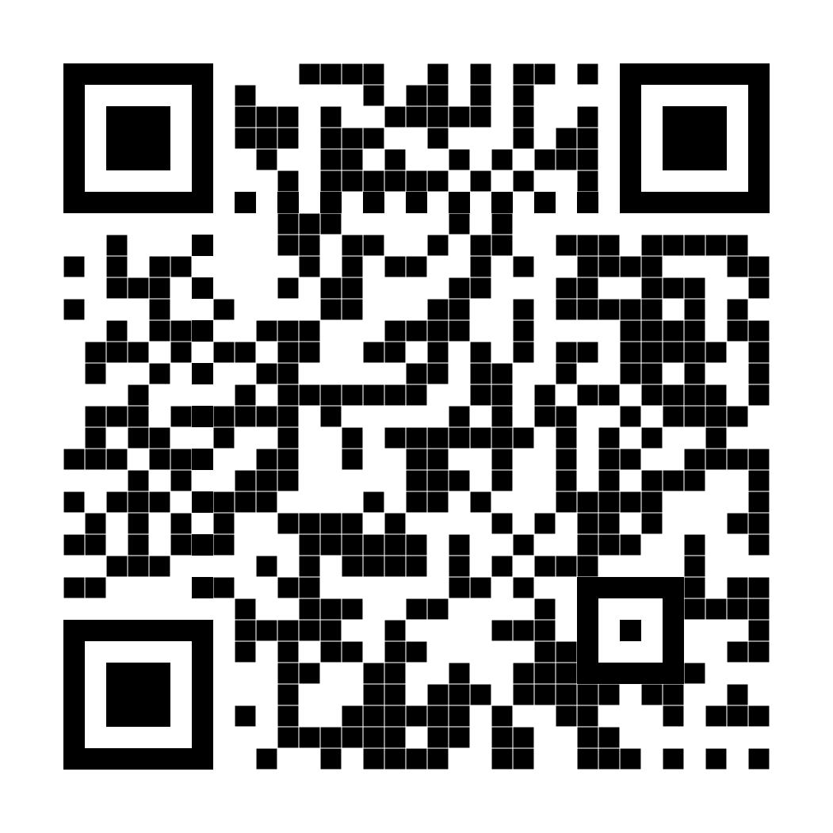
Resources
Where to find more information
Get advice and information in a flood by calling Floodline.
Telephone: 0345 988 1188
Textphone: 0345 602 6340
24-hour service
Sign up for free alerts
https://www.gov.uk/sign-up-for-flood-warnings
Learn how the British Red Cross is ready to help in a crisis
Visit the British Red Cross website to learn more about how to prepare for and cope in a flood.
www.redcross.org.uk/get-help/prepare-for-emergencies/how-to-prepare-for-floods-and-flooding
www.redcross.org.uk/stories/disasters-and-emergencies/uk/how-the-british-red-cross-helps-during-a-flood

Slide 18
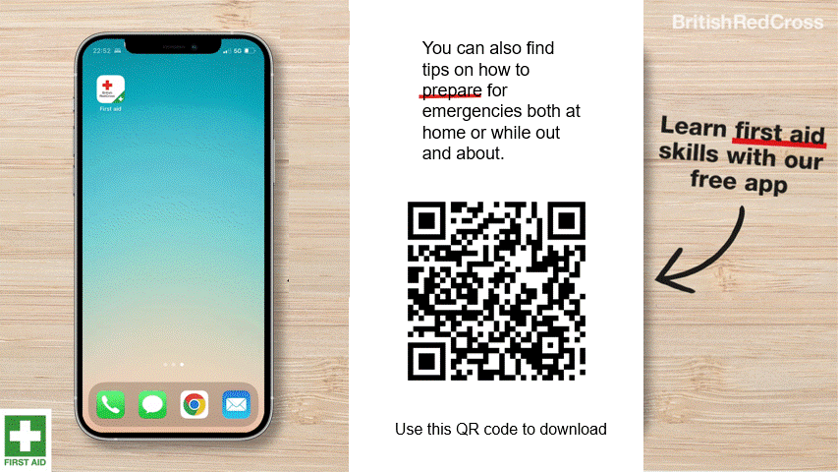
First aid app

Slide 19
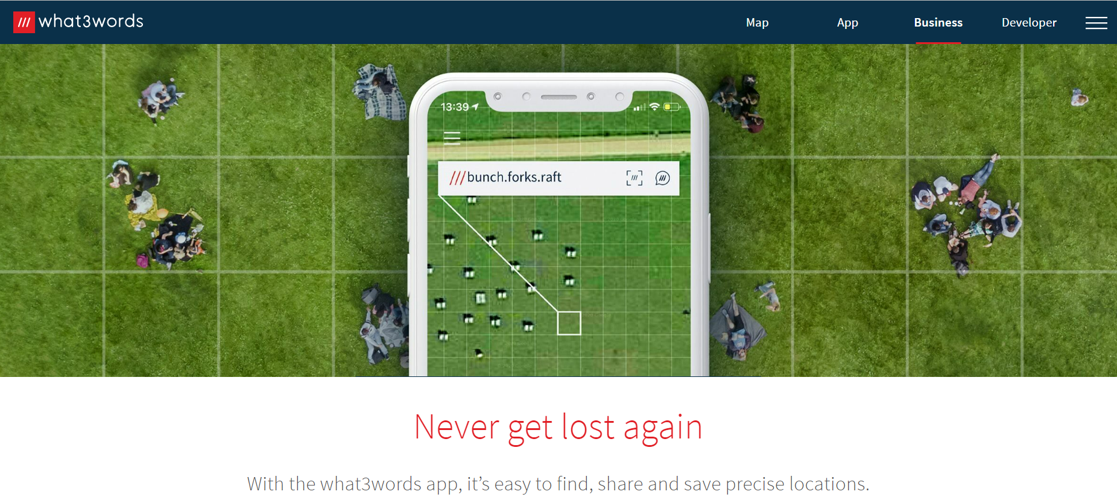
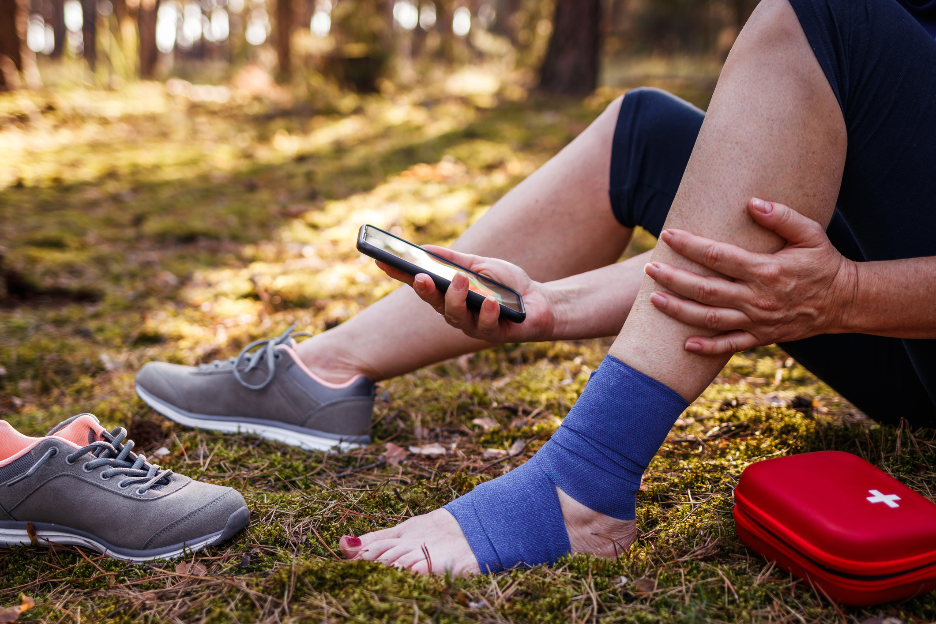
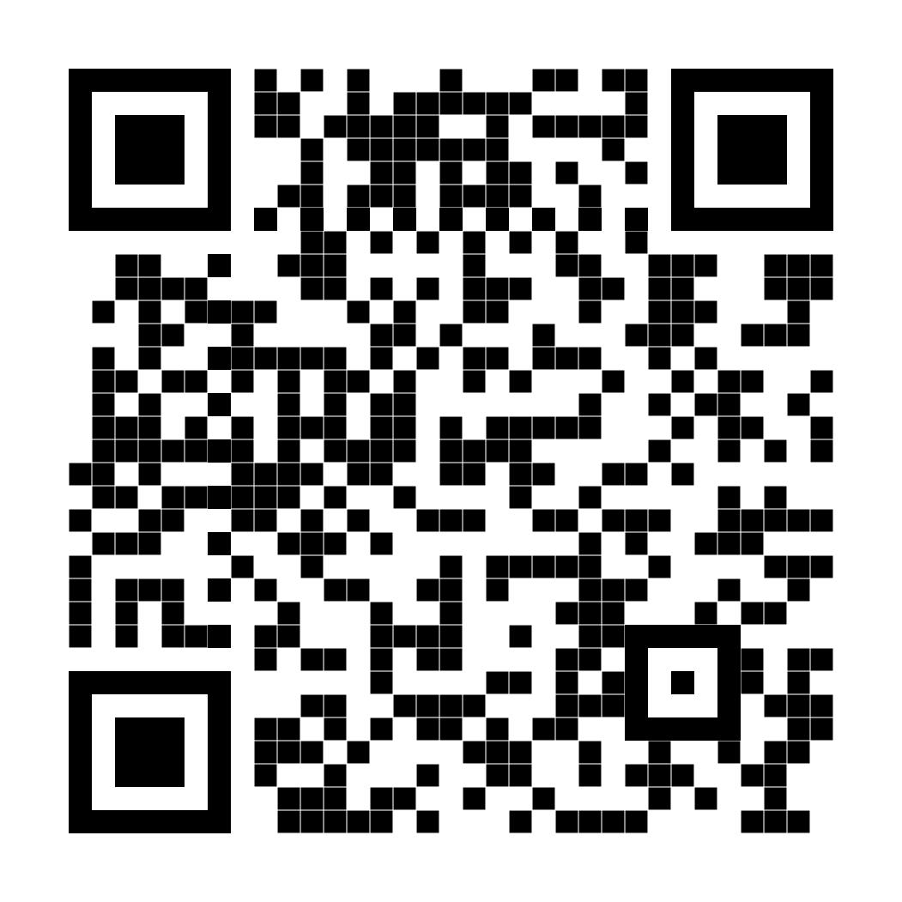
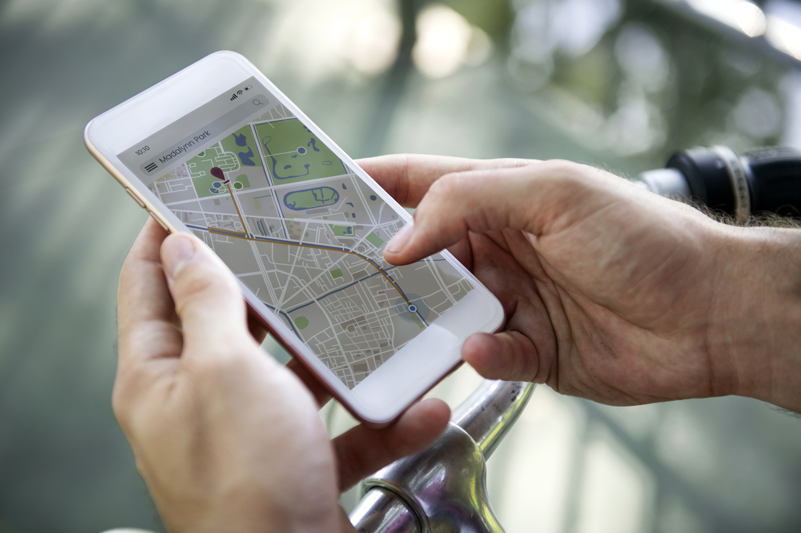
How to tell the emergency services where you are
2. Some smartphones have a built-in feature to call the emergency services and share your location. Find out how to use this on your phone.
3. You could also use a maps app to pinpoint and share your location. Learn how to do this so you’re ready for an emergency.
Resources
1. You could get the what.three.words app
what3words.com/products/what3words-app

Slide 20







Flooding
Heatwaves
Eco-anxiety
Read 3 characters’ flood stories and discuss how they could be affected.
Find out about the effects of heatwaves through completing a quiz.
Worksheet: heatwave facts to print
Read a character’s experience of eco-anxiety and use this to define what it is.
Look at local flood maps and the role of the emergency services to explore how flooding can affect us all.
Worksheet: note writing help
Examine a list of ways to cope and apply this to yourself and others.
Worksheet: coping with eco-anxiety
Learn how heatwaves affects our body and the first aid to help. Apply these to different scenarios.
Poster: heatwaves scenarios
Poster: heatwaves first aid
Create a video/script for social media of how to cope with eco-anxiety to share with friends and family.
Worksheet: eco-anxiety video script
Examine images of flooding and identify the dangers.
Create a decision flowchart to share with friends and family to help them prepare for a heatwave.
Worksheet: decision flowcharts
Play a scenario game to find out about bug out bags and why it is important to have one ready.
For use across all topics
Starters
Plenaries
Weather Together
award tracker
Bronze certificate
Silver certificate
Gold certificate
Play a ‘choose your own adventure’ game to learn how to respond to flood alerts and warnings.
Create resources to share with friends and family. This activity is designed to be repeated.
Rate these resources
Open another activity
Link
Link
Fill in this quick survey to help us improve Weather Together.
Click here to open the full web index.

