Slide 1





Instructions
Weather Together: Heatwaves – facts
20 Minutes
Success criteria
Must know the dangers of heatwaves.
Should discuss some of the consequences of heatwaves.
Whole group
Quiz
Invite learners to start by taking a pause [3].
Introduce the objective and big question [4,5].
Ask learners to review the images and outline what they think a heatwave is [6].
Share the definition with them and ask them to reflect on theirs [7].
Encourage learners to think about heat and temperatures by completing the warm-up [8].
Explain that learners will take part in a quiz but first they will learn the facts [9,10].
Work through the quiz slides [11-27].
Review how learners did [28].
Refer back to the big question to review progress. Encourage learners to reflect on how their views of heatwaves may have changed now [29].
Learn why you need to prepare for heatwaves.
How to run the activity
What you need
Heatwave facts – printed and cut into cards, enough for 1 card per learner
Play the Kahoot version of the quiz. Divide learners into teams and give each team a device they can use to answer the questions.
Ways to adapt
England: PSHE, Language and literacy
Scotland: Health and wellbeing, Literacy
Wales: Health and Wellbeing, Languages, Literacy and Communication
Northern Ireland: Communication, Thinking skills and personal capabilities,
Language and literacy.
Curriculum links
The British Red Cross Society © 2022 incorporated by Royal Charter 1908, is a charity registered in England and Wales (220949), Scotland (SC037738) and Isle of Man (0752)

Slide 2
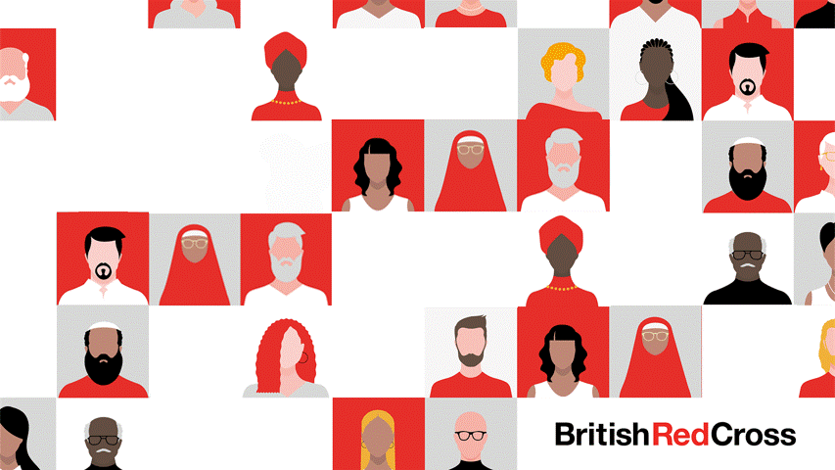
Screensaver
Notes:
This is a screen saver which you could use while settling the group.

Slide 3



Take a pause
Your happy place
Pause
Imagine a place you love, that makes you feel happy. Focusing on something positive when we feel anxious can help us cope.
Sit up straight, close your eyes if you want to, take a few deep breaths and imagine a place that makes you feel relaxed and happy.
What can you smell?
What can you hear?
Is anyone with you?
Take a pause
happy place
Notes:
You can explain that it can be distressing to listen to other’s experience of the challenges they’re facing, especially if we have similar experiences and challenges. A way of coping with this is to take a moment and focus on our breathing.
Remind learners this is a way of being kind to ourselves which is important. How our body feels matters.
Prompt learners to move through the steps.
You could invite learners to share, if they choose, how they found this breathing activity. Reassure learners that everyone’s body is different so everyone will respond to this activity differently.

Slide 4

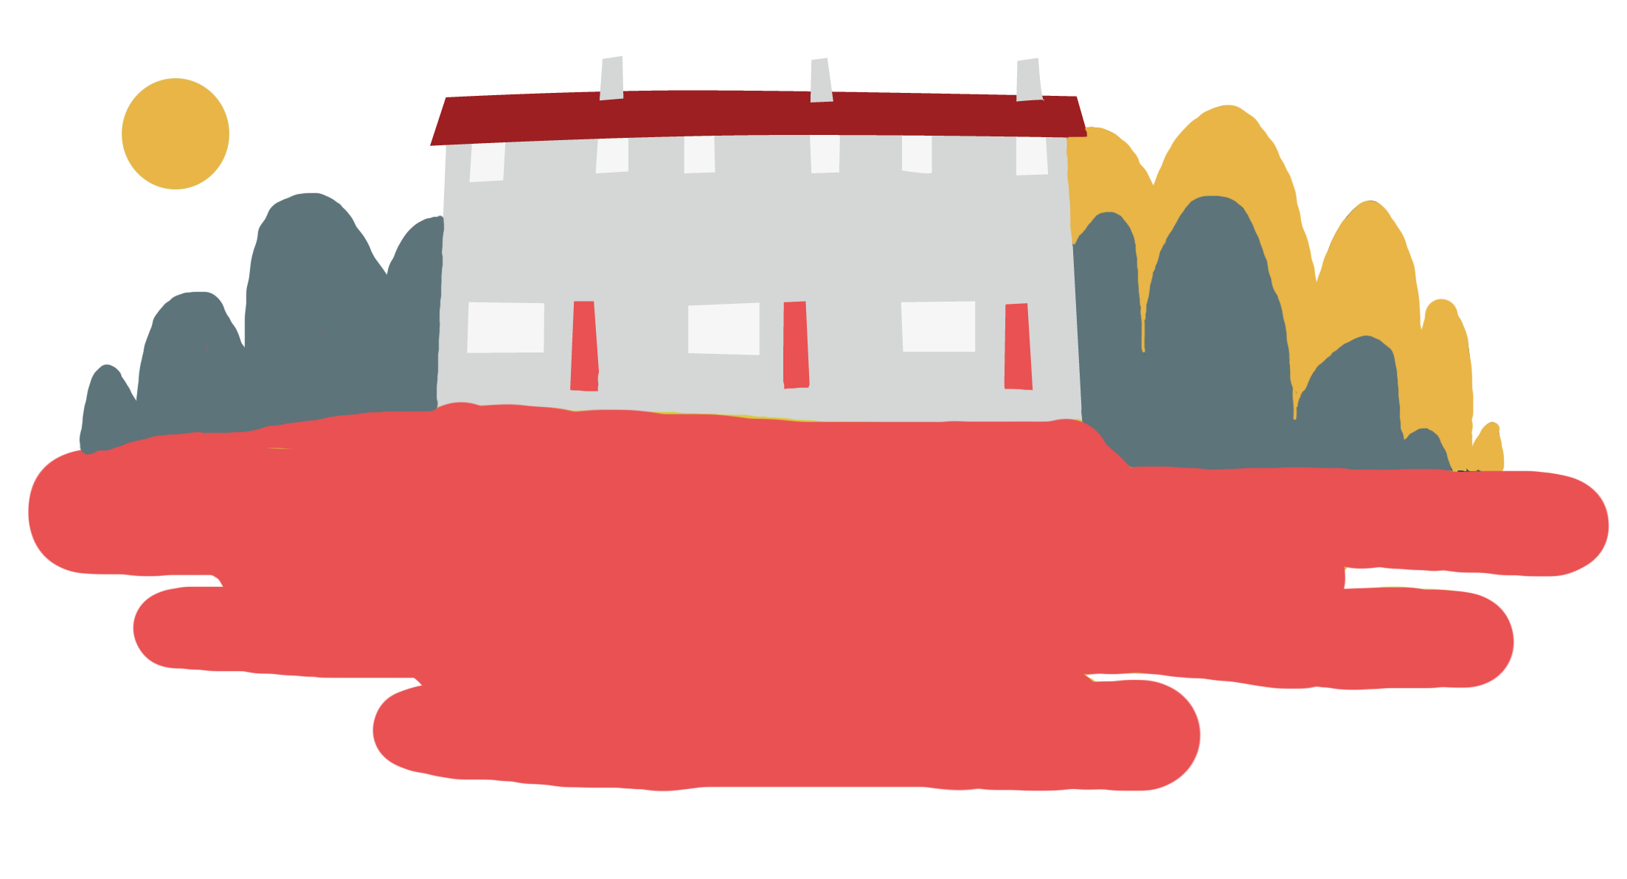

Objective
Heatwaves
Objective: Learn why you need to prepare for a heatwave.
To meet this objective, you’ll learn what a heatwave is and why they can be dangerous. You'll complete a quiz to help you remember the information.

Slide 5


Big question
Big question
How do heatwaves affect people?
Notes:
Big questions are an assessment tool for educators and learners to demonstrate progress through an activity.
Share this slide with learners and give them a moment to reflect on the question.
Then, ask them to discuss with a partner before sharing their ideas with the group.
At this point in the activity, it is expected that learners may not have many ideas or know how to answer this question.
The question will be reviewed at the end of the activity. This is an opportunity for learners to see how much progress they’ve made and how many more ideas they now have.

Slide 6
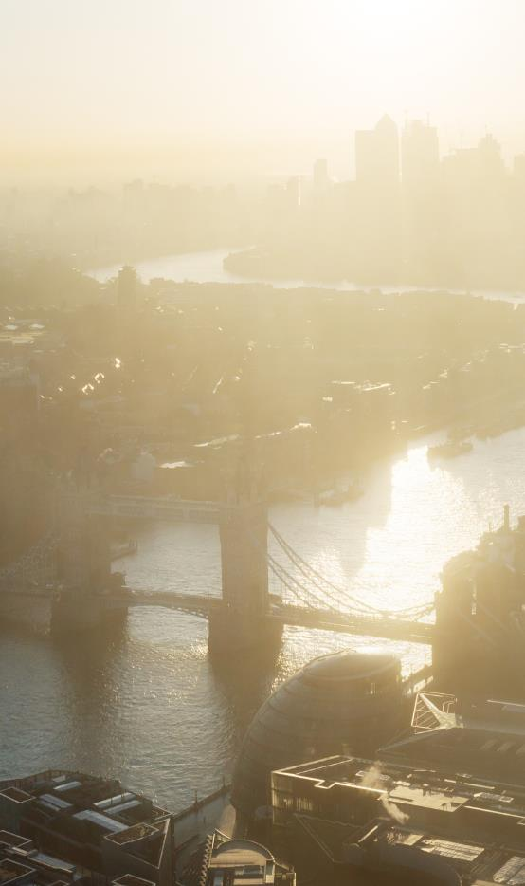
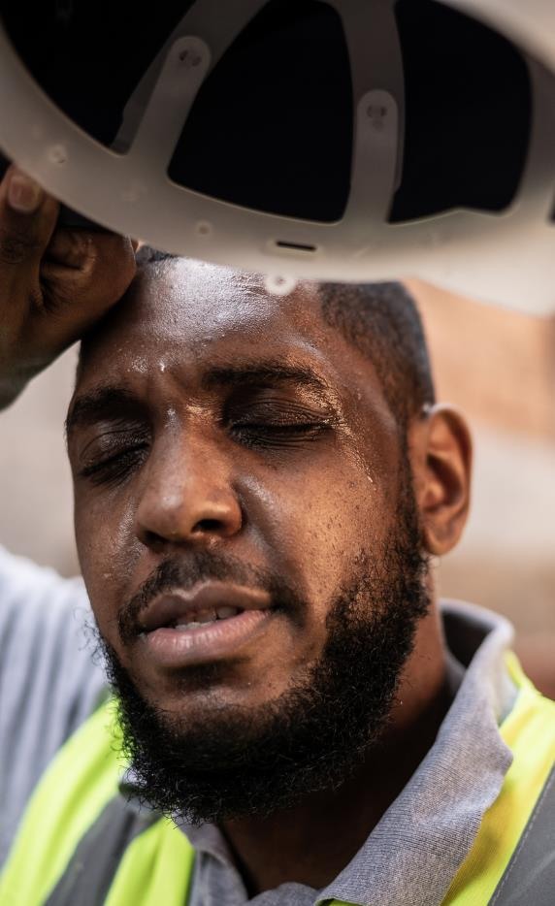
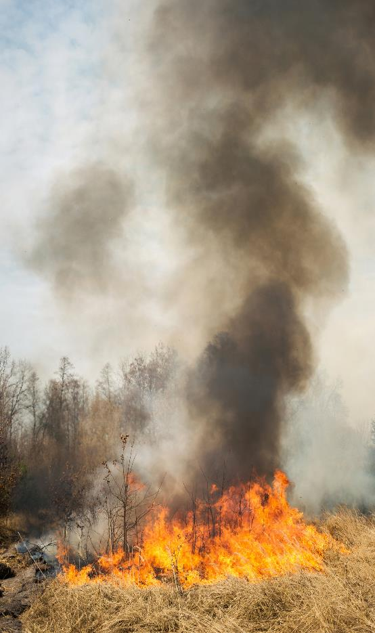
What is a heatwave?
What do these images show?
Use your ideas to talk to a partner about what you think a heatwave is.
Make notes on your ideas and get ready to share them with the group.
What is a heatwave?
Notes:
Explain to learners that they will use these images to help them explain what a heatwave is and what can happen.
In the first image, they should identify hot and hazy weather.
In the second image they should identify that the person is too hot and sweating. They could identify that the person is feeling tired and uncomfortable.
The third image is a wildfire. Learners may identify that there is a fire, it looks like burning plants.
Once learners have scrutinised the images and shared their ideas, you could look together as a class at this website to learn more about what a heatwave is: https://www.metoffice.gov.uk/weather/learn-about/weather/types-of-weather/temperature/heatwave.

Slide 7

What is a heatwave?
Heatwaves
Heatwaves are periods of unusually high temperatures that last for 3 or more days.

Slide 8

Warm-up: How hot does it need to be…
Did any of these surprise you?
For an ice cube to melt?
To cook an egg?
For a walk to be dangerous to a dog’s health?
For a road to melt?
For the number of people needing heat-related medical help to increase?
0°C
Heatwaves
74°C
25°C and over depending on the dog.
50°C – roads absorb heat and can reach this temperature in direct sun.
24.7°C across 2 days
Notes:
Use this to get learners thinking about temperatures and what different temperatures can mean and do.
0°C
74°C
https://www.fda.gov/food/retail-food-industryregulatory-assistance-training/key-temperatures-egg-safety-food-service-operations-and-retail-food-stores
Most dogs are okay at temperatures between 15-25°C, but this depends on their age, breed, size, fur, whether they are fit and healthy and the kind of exercise they are doing.
https://www.thekennelclub.org.uk/health-and-dog-care/health/health-and-care/a-z-of-health-and-care-issues/walking-your-dog-on-warm-days/
Tarmac melts at 50°C. Roads that are in direct sunlight with an air tempt at 21°C can reach this temperature.
https://www.bbc.co.uk/news/magazine-23315384
24.7°C across 2 days.
https://www.redcross.org.uk/about-us/what-we-do/we-speak-up-for-change/feeling-the-heat-a-british-red-cross-briefing-on-heatwaves-in-the-uk?gclid=EAIaIQobChMIp76rhKjy_QIVxbTtCh0V6wPqEAAYASAAEgJdavD_BwE

Slide 9

Heatwaves facts
Today you are going to take part in a heatwaves quiz.
But first, you’re going to learn the answers!
Read your heatwave fact and discuss it with a partner to make sure you understand it.
Then, join up with a different partner and share your facts.
Repeat this until you have shared your fact with lots of partners.
Learn facts
Notes:
Ensure you have printed out the facts and cut them up, enough for each learner to have one fact.
Explain the instructions on the slide to the group.

Slide 10
Heatwaves quiz
Heatwaves quiz
The quiz is out of 10.
Write 1 to 10 on a piece of paper.
As you hear each question, write the answer ‘yes’ or ‘no’.
Get ready!
Bonus points!
Answer the questions in the thought bubbles.
Each one is worth a bonus point.

Slide 11

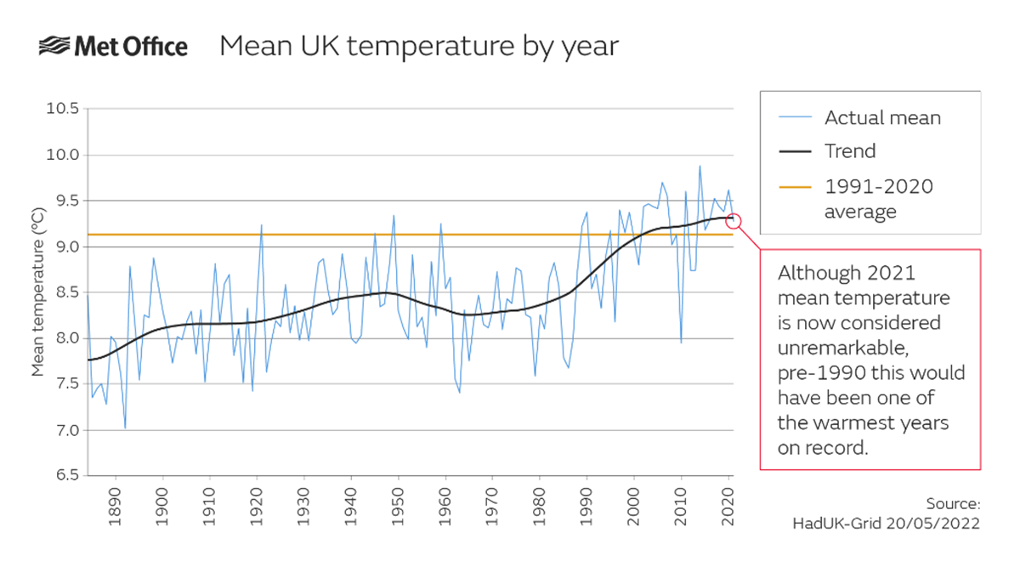
1. Are temperatures in the UK going up?
Tap for
bonus
points.
What could this mean for heatwaves?
Heatwaves quiz
You selected no.
Have a look at the graph and try again.
Correct
Tap your
answer.
Yes
No
Notes:
You may need to explain to learners what ‘mean’ is. It is a kind of average.
Encourage learners to interpret the graph to find the answer to this question.
Bonus points: Heatwaves are becoming more frequent.
If you’d like to explore this further with your group, the BBC has a visualisation tool to examine climate change in local areas: https://www.bbc.co.uk/news/resources/idt-d6338d9f-8789-4bc2-b6d7-3691c0e7d138

Slide 12
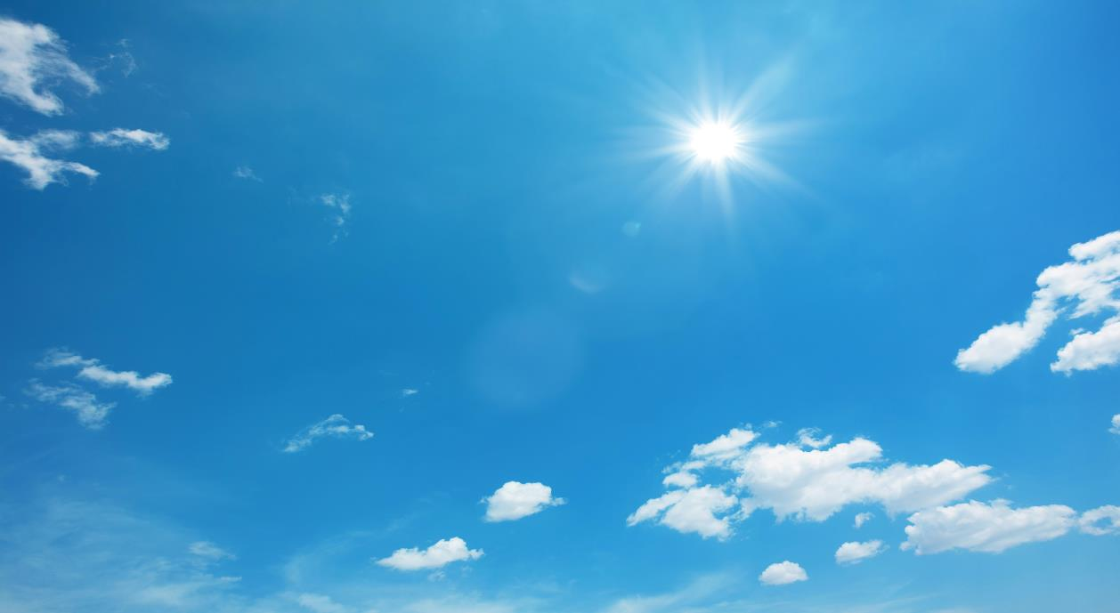
2. Are heatwaves something to look forward to?
Tap for
bonus
points.
Many people enjoy warm, sunny days
with temperatures in the normal range,
but heatwaves are getting more
frequent, longer, hotter and more dangerous.
Lots of people think they’re something to look forward to. Why could this be dangerous?
Heatwaves quiz
You selected yes.
Have a look at the statement and try again.
Correct
Tap your
answer.
Yes
No
Notes:
Thought bubble: It could be dangerous because people don’t think they’re dangerous. This could mean that many people do not prepare for heatwaves. If people aren’t prepared they’re more likely to be negatively affected. If lots of people are negatively affected by heatwaves, this could have consequences for the emergency services.

Slide 13
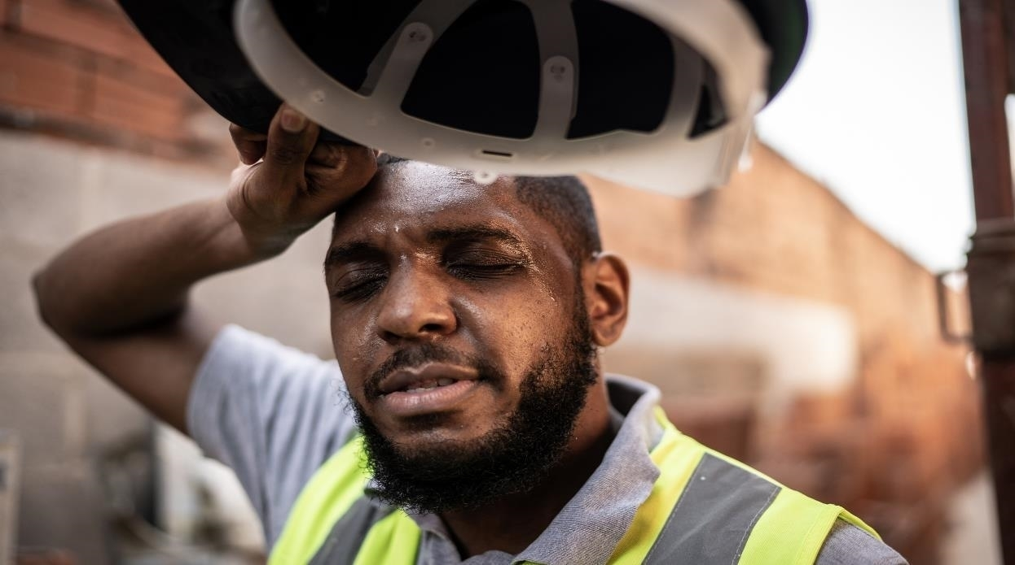
3. Can heatwaves be dangerous to a person’s health?
Tap for
bonus
points.
How could they affect pets?
Correct
You selected no.
Try again.
Tap your
answer.
Yes
No
Notes:
Thought bubble: Pets can suffer in the same way as people.

Slide 14
3. Can heatwaves be dangerous to a person’s health?
Dehydration
Heat exhaustion
Sunburn
How could they affect pets?
When your body loses too much water.
When sweating causes loss of fluids and salts.
Skin damage caused by too much sun.
Heatstroke
Emotional distress
Tap for
definition.
When your body temperature gets dangerously high.
When a person is extremely upset by a heatwave.
Yes
No
Notes:
Thought bubble: Pets can suffer in the same way as people.

Slide 15
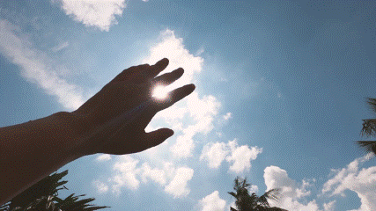
4. Do different groups of people respond differently in a heatwave?
Tap for
bonus
points.
Why do you think 18-34 year olds needed medical help more?
Correct
You selected no.
Try again.
Tap your
answer.
Yes
No
Notes:
Thought bubble: Young people might be more likely to have to work during heatwaves, whereas older people may be able to stay inside, in cooler places. It is also possible that older people may be less likely to seek medical attention, so the number of people 75+ year-olds seeking medical attention may be lower for this reason. Part of this may be because some older people may not see themselves as vulnerable to the risks of heatwaves, even if they are.

Slide 16
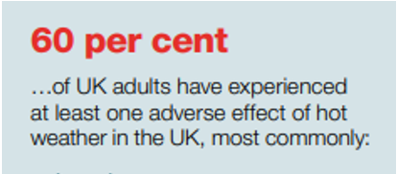
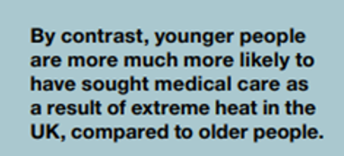
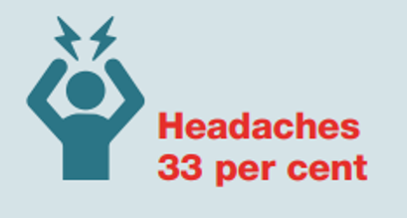
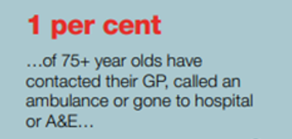
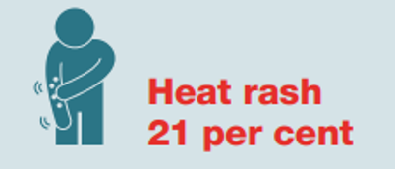
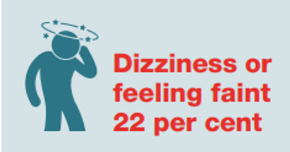
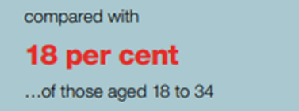
4. Do different groups of people respond differently in a heatwave?
Why do you think 18-34 year olds needed medical help more?
Information
Yes
No
Notes:
Thought bubble: Young people might be more likely to have to work during heatwaves, whereas older people may be able to stay inside, in cooler places. It is also possible that older people may be less likely to seek medical attention, so the number of people age 75+ seeking medical attention may be lower for this reason. Part of this may be because some older people may not see themselves as vulnerable to the risks of heatwaves, even if they are.

Slide 17
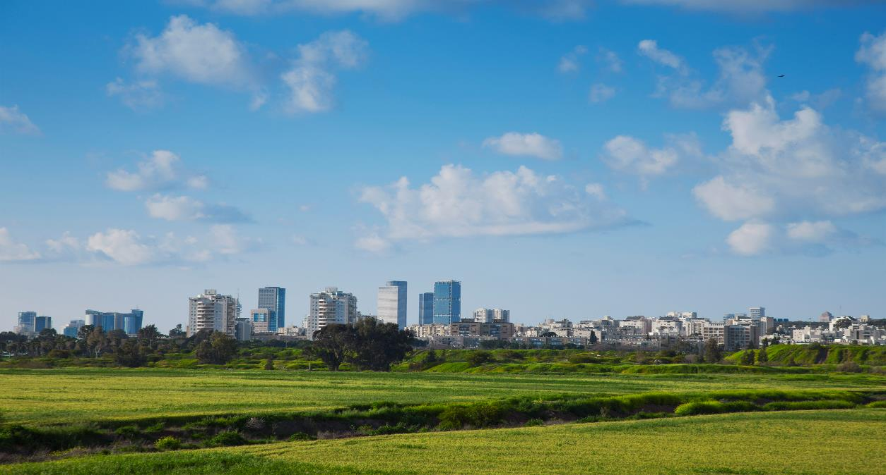
5. During a heatwave, do cities get hotter than the countryside?
Tap for
bonus
points.
Think of all the people that live in cities. Who do you think would be most affected by this?
Heatwaves quiz
Urban areas can reach temperatures up to 10°C hotter than the nearby countryside.
Buildings, roads and pavements tightly packed together absorb heat.
Correct
You selected no.
Try again.
Tap your
answer.
Yes
No
Notes:
Thought bubble: Of all the people who live in cities, it is people who are homeless, people who live in a top floor flat or a flat with large windows that face south (with the most direct sunlight coming in), people living in high-rise buildings tend to experience higher temperatures, people who have little access to greenspaces (greenspaces tend to be cooler) who are most affected by heatwaves.

Slide 18

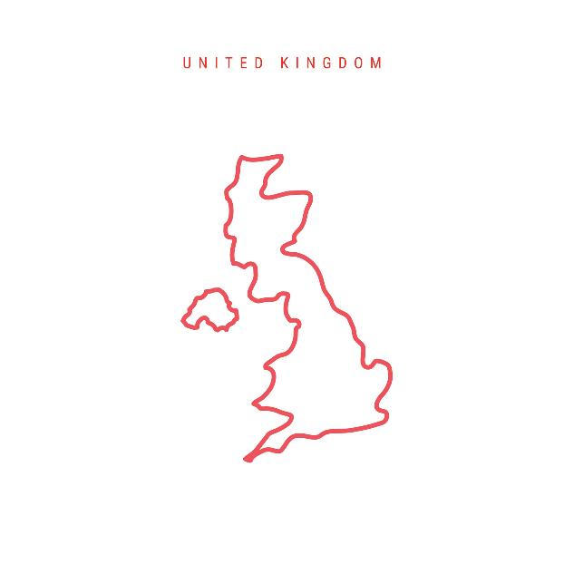
6. Was the hottest ever recorded temperature in the UK in 2022?
Tap for
bonus
points.
Why are temperatures getting hotter?
Heatwaves quiz
Correct
You selected no.
Try again.
Tap your
answer.
Yes
No
Notes:
Thought bubble: due to climate change global temperatures are increasing. By 2050 it is 50% more likely the UK will experience hot summers.
https://www.redcross.org.uk/about-us/what-we-do/we-speak-up-for-change/feeling-the-heat-a-british-red-cross-briefing-on-heatwaves-in-the-uk?gclid=EAIaIQobChMIh43nxKjy_QIVh63tCh3sSwc7EAAYASAAEgJ2OfD_BwE

Slide 19

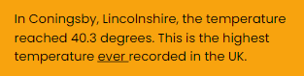

6. Was the hottest ever recorded temperature in the UK in 2022?
1st
hottest day ever recorded
(click to reveal)
Why are temperatures getting hotter?
Heatwaves quiz
You selected no.
Try again.
19 July 2022
25 July 2019
Tap 1st,2nd,3rd
Information.
2nd
hottest day every recorded
(click to reveal)
19 July 2021
3rd
hottest day ever recorded
(click to reveal)
Yes
No
Notes:
Thought bubble: due to climate change global temperatures are increasing. By 2050 it is 50% more likely the UK will experience hot summers.
https://www.redcross.org.uk/about-us/what-we-do/we-speak-up-for-change/feeling-the-heat-a-british-red-cross-briefing-on-heatwaves-in-the-uk?gclid=EAIaIQobChMIh43nxKjy_QIVh63tCh3sSwc7EAAYASAAEgJ2OfD_BwE

Slide 20
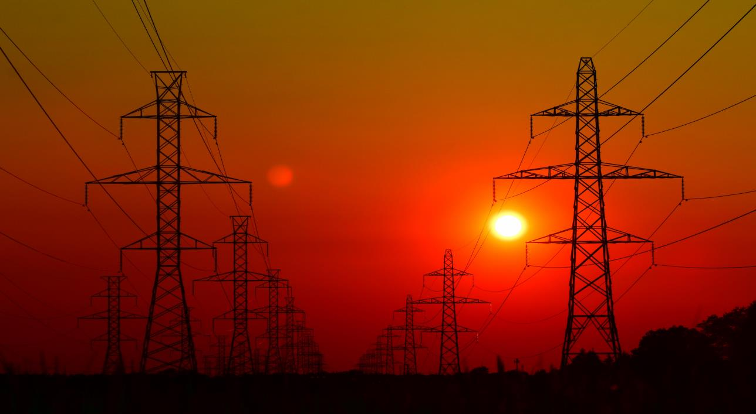
7. Can mobile phones be affected by heatwaves?
Tap for
bonus
points.
How would this affect you?
Heatwaves quiz
Correct
You selected no.
Try again.
Tap your
answer.
Yes
No
Notes:
Thought bubble:
Electricity demand is increased due to everyone switching on their fans and running air conditioning units.
Sensitive equipment such as computer parts.
When power stations overheat, the electricity they produce is reduced.
Electricity flows through cables, when they break the electricity cannot reach where it needs to go.

Slide 21
7. Can mobile phones be affected by heatwaves?
Heatwaves can cause power cuts.
How would this affect you?
Heatwaves quiz
In heatwaves, demand for electricity can increase.
Sensitive equipment can be damaged by the heat.
Power stations may have difficulty staying cool.
Tap image for
information.
High temperatures cause electrical cables to swell and break.
Yes
No
Notes:
Thought bubble:
Electricity demand is increased due to everyone switching on their fans and running air conditioning units.
Sensitive equipment such as computer parts.
When power stations overheat, the electricity they produce is reduced.
Electricity flows through cables, when they break the electricity cannot reach where it needs to go.

Slide 22
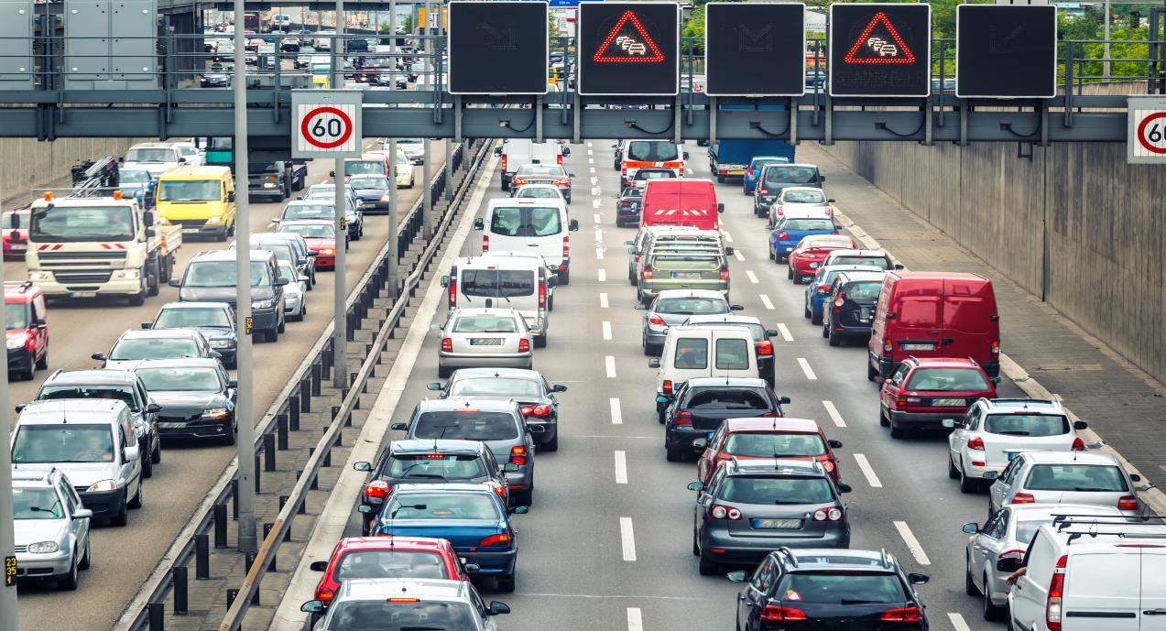
8. Do heatwaves damage cars?
Tap for
bonus
points.
How could this affect a person walking on a pavement?
Heatwaves quiz
Correct
You selected no.
Try again.
Tap your
answer.
Yes
No
Notes:
Thought bubble: as roads are busier in heatwaves, there could be more danger to a person walking by a road, especially if they needed to cross.
There could be more pollution from traffic.

Slide 23
8. Do heatwaves damage cars?
More cars break down during heatwaves.
How could this affect a person walking on a pavement?
Heatwaves quiz
Roads can melt and buckle.
Melted tarmac flicks up at cars, damaging them.
Tap image for
information.
Melted tarmac damages tyres.
Yes
No
The roads tend to be busier, leading to more crashes.
Notes:
Thought bubble: as roads are busier in heatwaves, there could be more danger to a person walking by a road, especially if they needed to cross.
There could be more pollution from traffic.

Slide 24
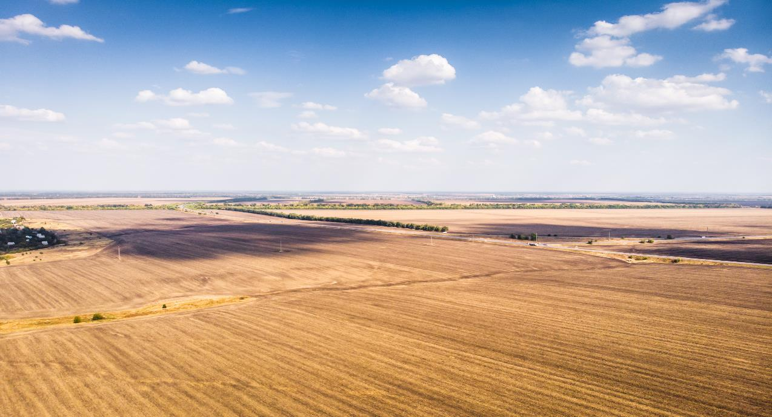
9. Heatwaves are good for plants including fruits and vegetables on farms?
Tap for
bonus
points.
How could this affect the UK’s food supply?
Heatwaves quiz
You selected yes.
Try again.
Correct
Tap your
answer.
Yes
No
Notes:
Bonus points: there could be a shortage of some foods or food could be more expensive. If food manufacturers had had to buy ingredients from further away they could cost more.

Slide 25
9. Heatwaves are good for plants including fruits and vegetables on farms?
Heatwaves can cause farmers' crops to die.
How could this affect the UK’s food supply?
Heatwaves quiz
Field fires caused by heatwaves kill crops.
What is produced tends to be much smaller and lower quality.
Tap image for
information.
Farm animals also struggle in the heat, especially when the grass turns brown and stops growing.
Yes
No
Notes:
Bonus points: there could be a shortage of some foods or food could be more expensive. If food manufacturers had had to buy ingredients from further away they could cost more.

Slide 26
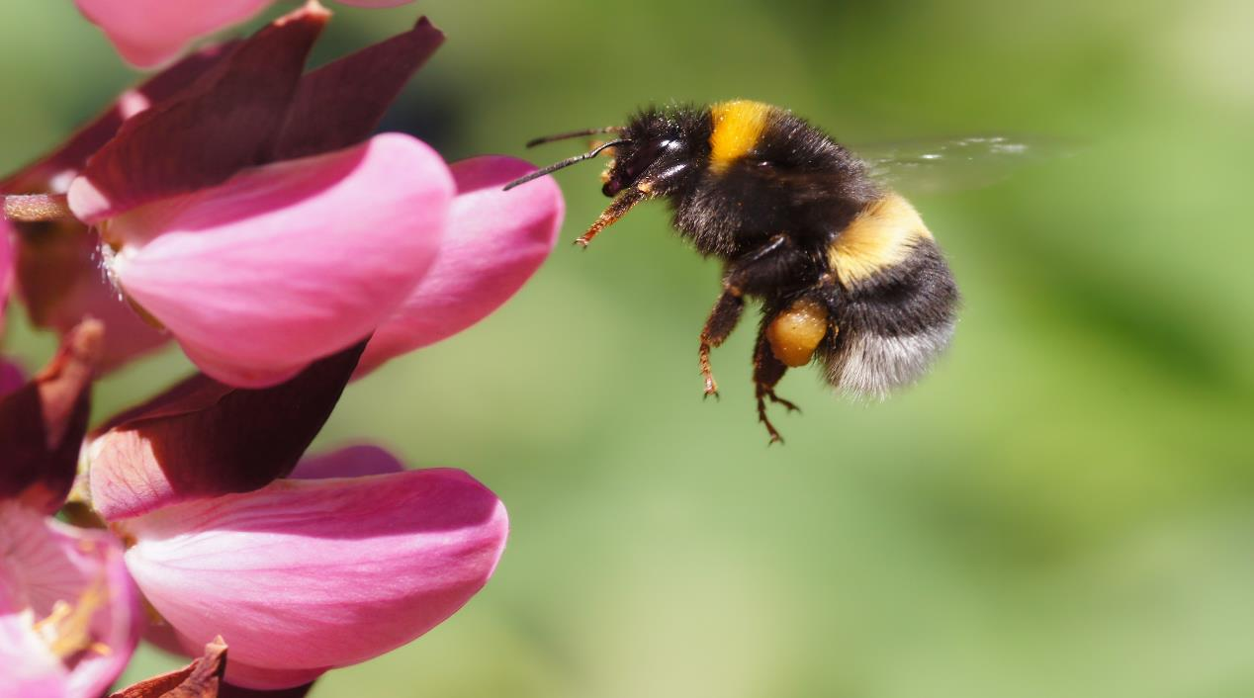
10. Are heatwaves good for bumblebees as they can collect lots of nectar?
Tap for
bonus
points.
How could damage to plants affect bees?
Heatwaves quiz
You selected yes.
Try again.
Correct
Tap your
answer.
Yes
No
Notes:
Bonus points: Bees need nectar to survive. They get this from flowers. If heatwaves change when flowers bloom, or kill them early, then bees will no have access to their essential food.
https://www.woodlandtrust.org.uk/blog/2022/08/how-heatwaves-affect-wildlife/?gclid=EAIaIQobChMIqrfkkqvy_QIVGsbtCh3bnwLnEAAYASAAEgLlNfD_BwE

Slide 27

10. Are heatwaves good for bumblebees as they can collect lots of nectar?
Heatwaves are bad for bumblebees.
How could damage to plants affect bees?
Heatwaves quiz
Their thick fur means they struggle to stay cool.
If they are too hot, they can’t fly which means they can’t find food.
Tap image for
information.
They keep some food in their nests but this only lasts for a short time.
Yes
No
Notes:
Bonus points: Bees need nectar to survive. They get this from flowers. If heatwaves change when flowers bloom, or kill them early, then bees will no have access to their essential food.

Slide 28
Heatwaves quiz
Heatwaves quiz
Count up your points.
Add together your correct ‘yes’ and ‘no’ answers and any bonus points you earned.
You could score a maximum of 20 including the bonus answers.
How did you do?

Slide 29
Big question
Big question
How do heatwaves affect people?
Notes:
Give learners a few moments to reflect on this question before inviting them to discuss with a partner. Then, encourage feedback as a group.
Referring back to the big question should enable you and your learners to see how much they have learned from the activity. Answers to this question should be more detailed and varied at this point.

Slide 30
Resources and support

Slide 31
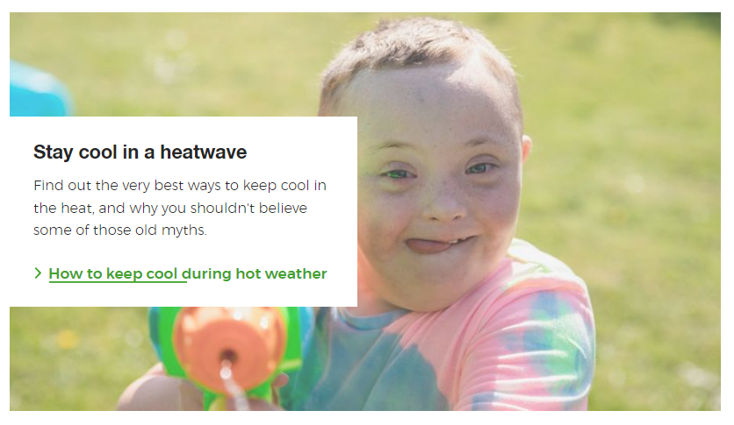



Where to find more information
Learn how to stay cool in hot weather.
Visit the British Red Cross website to read the Feeling the Heat report.
Resources
https://www.redcross.org.uk/stories/health-and-social-care/first-aid/beat-the-hot-weather-top-tips-for-staying-cool
Visit the British Red Cross website to learn more about how to prepare for and cope with heatwaves.
https://www.redcross.org.uk/get-help/prepare-for-emergencies/heatwaves-uk
https://www.redcross.org.uk/about-us/what-we-do/we-speak-up-for-change/feeling-the-heat-a-british-red-cross-briefing-on-heatwaves-in-the-uk

Slide 32
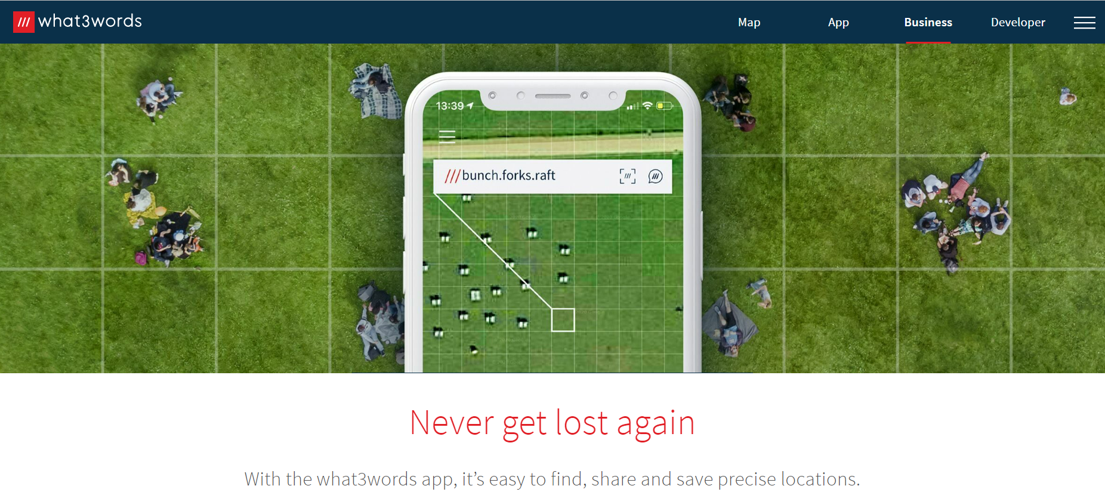
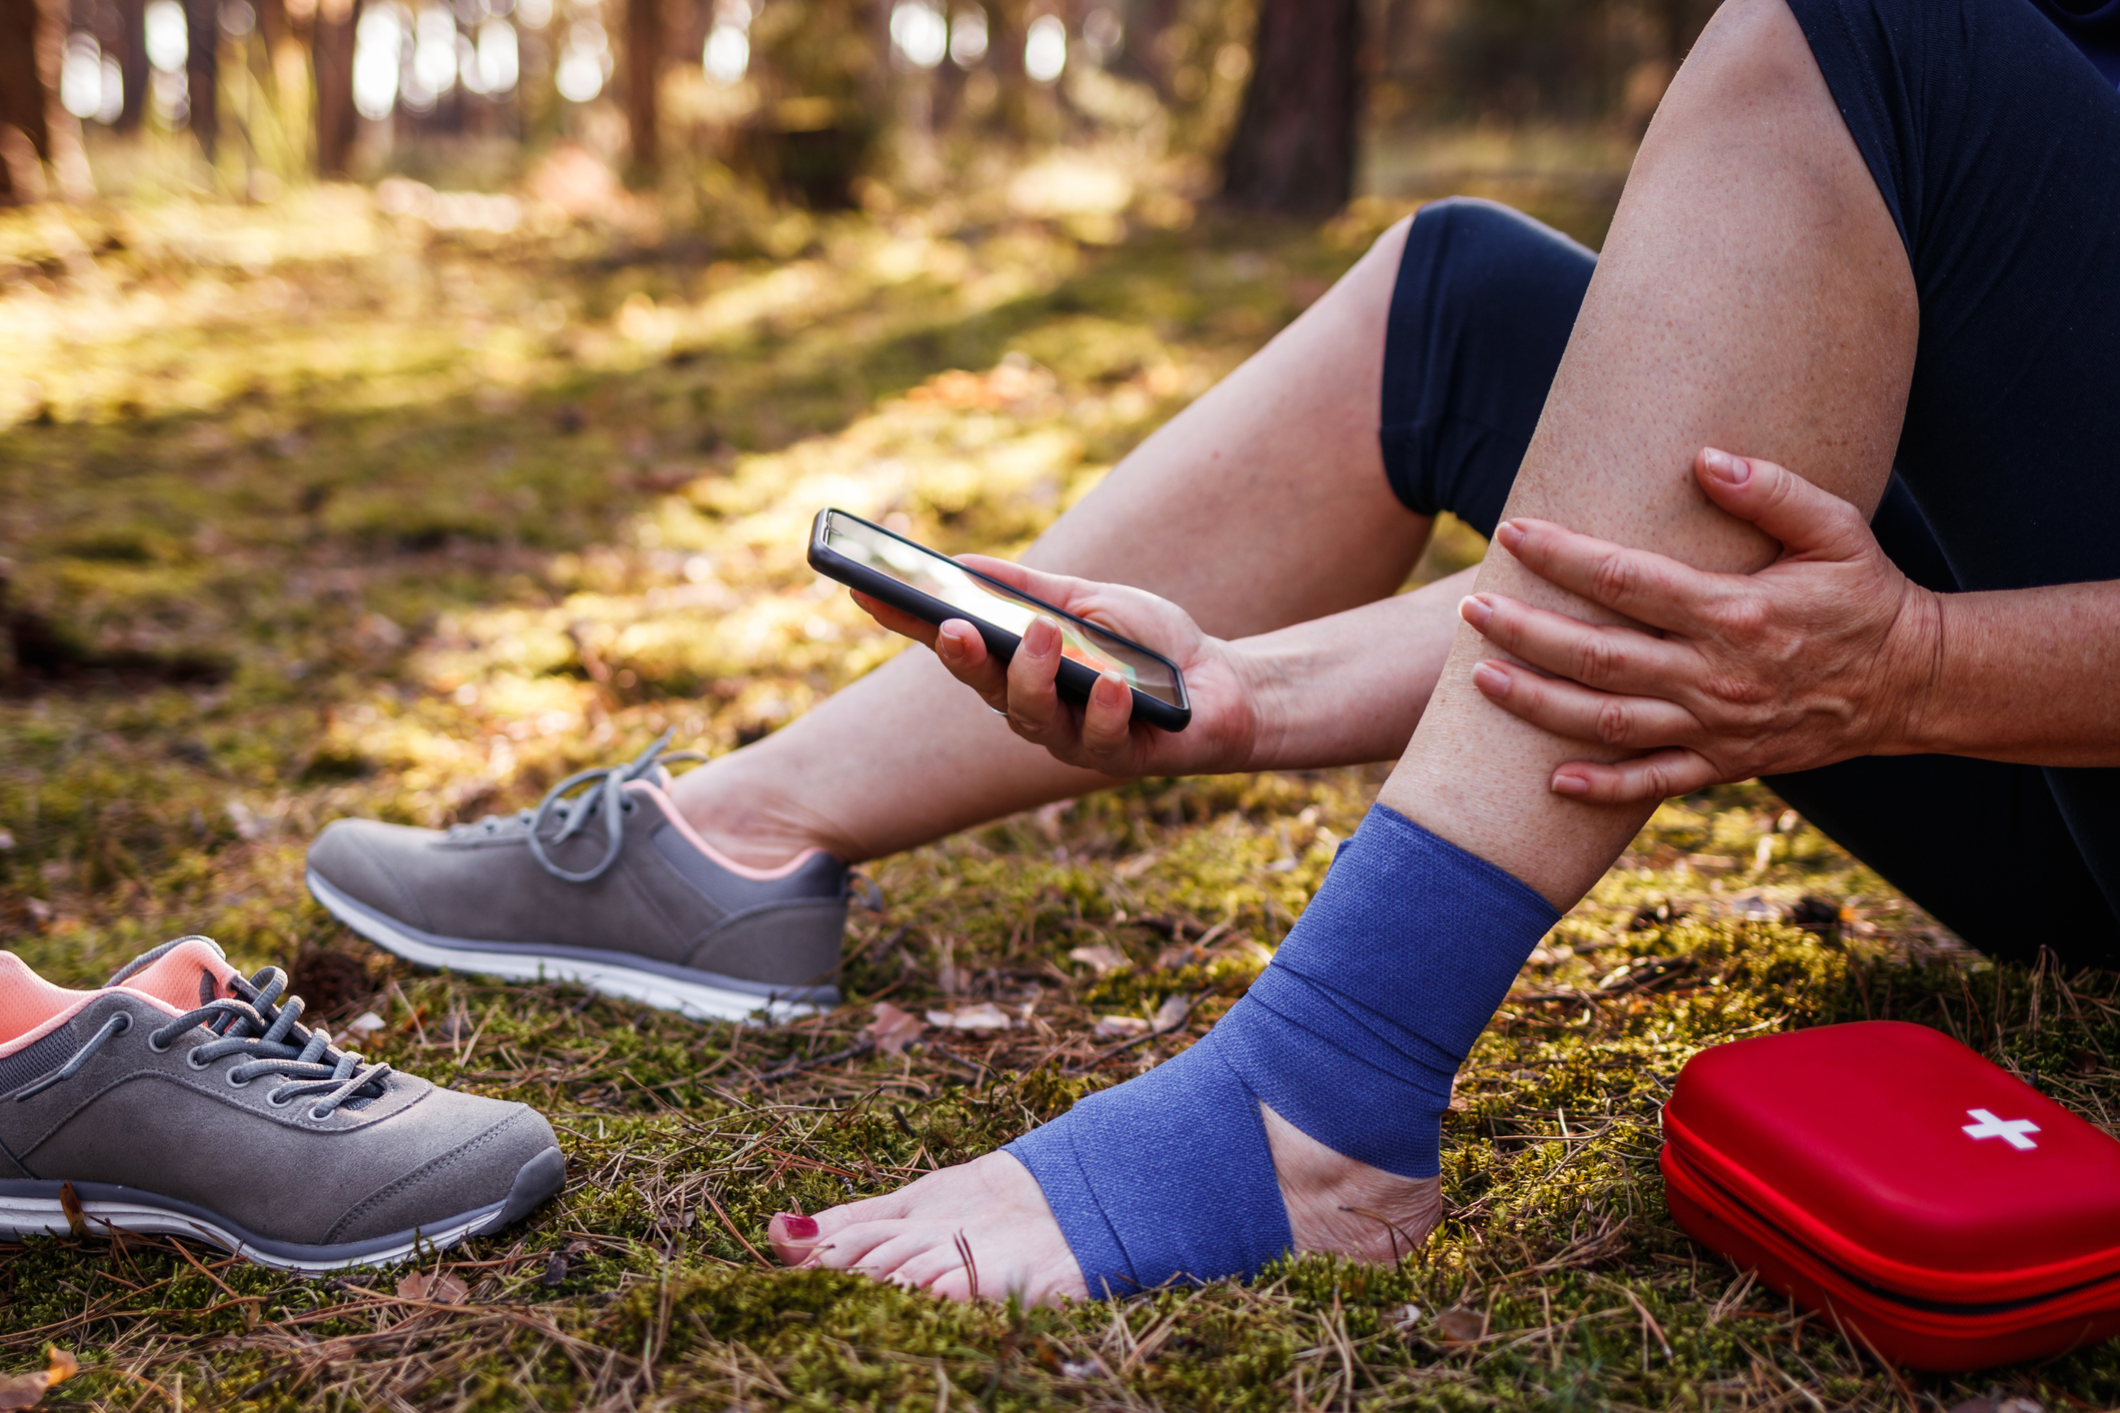
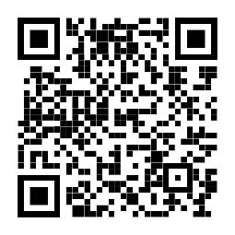
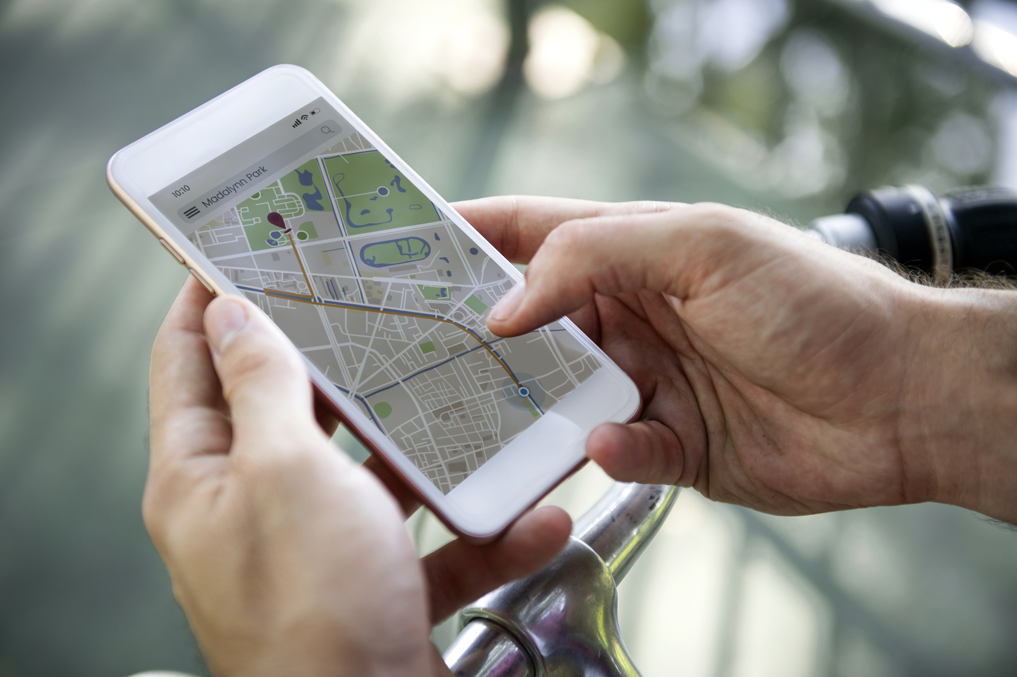
How to tell the emergency services where you are
2. Some smartphones have a built-in feature to call the emergency services and share your location. Find out how to use this on your phone.
3. You could also use a maps app to pinpoint and share your location. Learn how to do this so you’re ready for an emergency.
Resources
1. You could get the what.three.words app
what3words.com/products/what3words-app

Slide 33
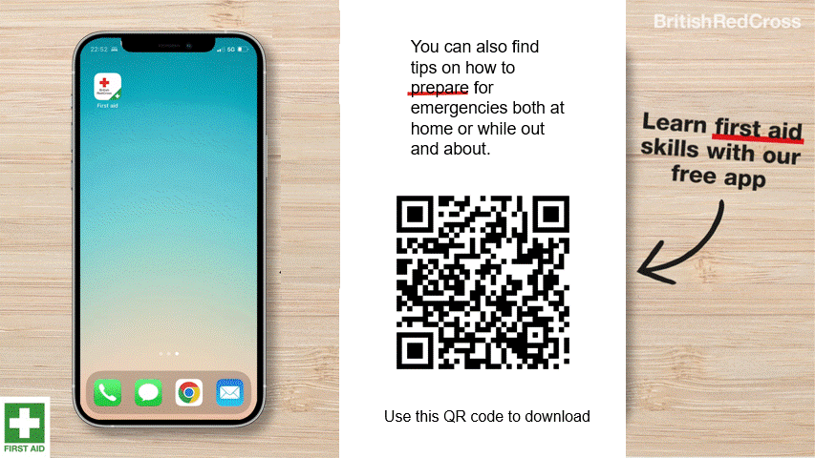
First aid app information
First aid app

Slide 34







Flooding
Heatwaves
Eco-anxiety
Read 3 characters’ flood stories and discuss how they could be affected.
Find out about the effects of heatwaves through completing a quiz.
Worksheet: heatwave facts to print
Read a character’s experience of eco-anxiety and use this to define what it is.
Look at local flood maps and the role of the emergency services to explore how flooding can affect us all.
Worksheet: note writing help
Examine a list of ways to cope and apply this to yourself and others.
Worksheet: coping with eco-anxiety
Learn how heatwaves affects our body and the first aid to help. Apply these to different scenarios.
Poster: heatwaves scenarios
Poster: heatwaves first aid
Create a video/script for social media of how to cope with eco-anxiety to share with friends and family.
Worksheet: eco-anxiety video script
Examine images of flooding and identify the dangers.
Create a decision flowchart to share with friends and family to help them prepare for a heatwave.
Worksheet: decision flowcharts
Play a scenario game to find out about bug out bags and why it is important to have one ready.
For use across all topics
Starters
Plenaries
Weather Together
award tracker
Bronze certificate
Silver certificate
Gold certificate
Play a ‘choose your own adventure’ game to learn how to respond to flood alerts and warnings.
Create resources to share with friends and family. This activity is designed to be repeated.
Rate these resources
Open another activity
Link
Link
Fill in this quick survey to help us improve Weather Together.
Click here to open the full web index.

