Slide 1





Weather Together: Flooding - Investigating your risk
30 Minutes
Success criteria
Must know that flooding can affect anyone.
Should discuss how flooding can affect people who are not in direct risk of flooding.
Whole group
Reading
Invite learners to start by taking a pause. Read the Take a pause prompts to learners (their eyes will be shut) [3].
Introduce the objective and big question [4,5].
Explain that learners will look at a flood map for their area and answer the challenge question. Spend some time exploring the map as a group. Use the question prompts in the ‘notes’ section of the slide for support [6].
Explain that now learners will hear Femi’s story which will help them answer the challenge question. Work through the story [7-11].
Then, invite learners to discuss the challenge question and share ideas [12].
Next focus learners on the role of the emergency services in a flood and discuss how this could affect all of us [13-17].
Finally, refer back to the big question to review progress [18].
Learn why you need to prepare for a flood emergency.
How to run the activity
What you need
Before the activity, open and check the flood maps for your area
Optional: laptops/tablets
Optional: note writing help, printed as required for learners.
If examining the map will be too emotionally challenging for your learners, skip slide 6 and instead focus on Femi’s story as a case study [7-9].
To extend the activity, ask learners to create a news story about flooding in their area. Encourage them to perform to their peers and gain feedback.
Ways to adapt
England: PSHE, Language and literacy
Scotland: Health and wellbeing, Literacy
Wales: Health and Wellbeing, Languages, Literacy and Communication
Northern Ireland: Communication, Thinking skills and personal capabilities,
Language and literacy
Curriculum links
The British Red Cross Society © 2022 incorporated by Royal Charter 1908, is a charity registered in England and Wales (220949), Scotland (SC037738) and Isle of Man (0752)
Notes:
As Weather Together is about emergencies, it has the potential to affect learners who have been impacted by trauma in their lives. This trauma may have been related to an emergency event, or it may relate to something else. Careful consideration should be given before deciding to ask learners to share their personal feelings about past or future emergencies or traumas. If a learner brings up personal feelings, you could validate their feelings and then redirect them back to the discussion or activity.
Please always refer to your organisation’s safeguarding policy should you have any concerns about learner wellbeing.

Slide 2

Weather Together title page
Notes:
This is a screen saver which you could use while settling the group.

Slide 3



Pause
Imagine a place you love, that makes you feel happy.
Focussing on something positive when we feel anxious can help us cope.
Sit up straight, close your eyes if you want to, take a few deep breaths and imagine a place that makes you feel relaxed and happy.
What can you see there? Who?
What can you smell?
What can you hear?
Take a pause your happy place
Notes:
You can explain that it can be distressing to listen to other’s experience of the challenges they’re facing, especially if we have similar experiences and challenges. A way of coping with this is to take a pause. Remind learners this is a way of being kind to ourselves which is important. How our body feels matters.
Prompt learners to move through the steps.
You could invite learners to share, if they choose, how they found this breathing activity.

Slide 4

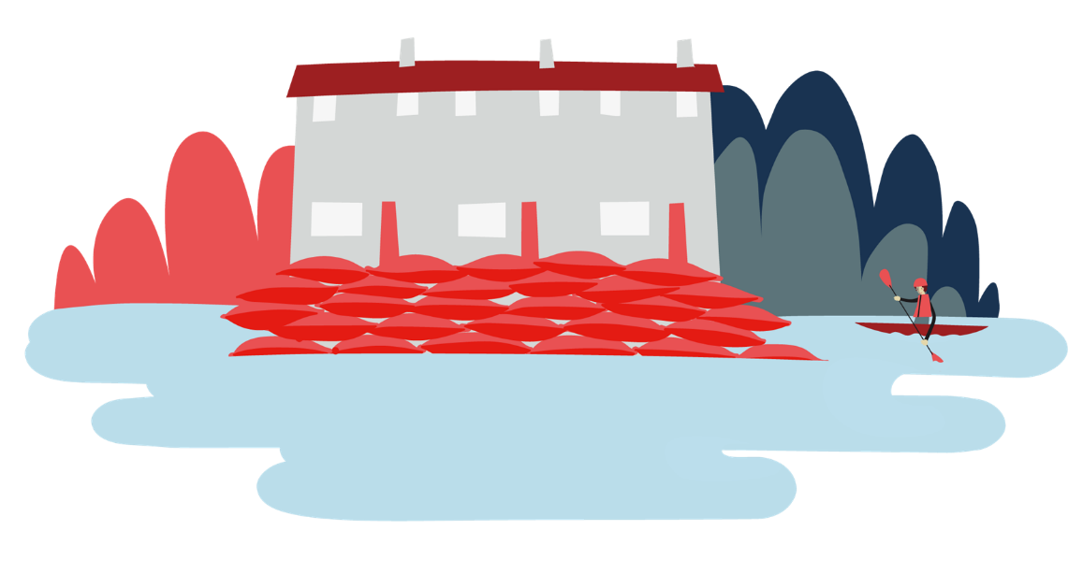

Welcome
Objective: Learn why you need to prepare for a flood emergency.
To meet this objective, you will examine a map of flood risks in your area. You will read Femi’s story of how he was affected by a flood.

Slide 5
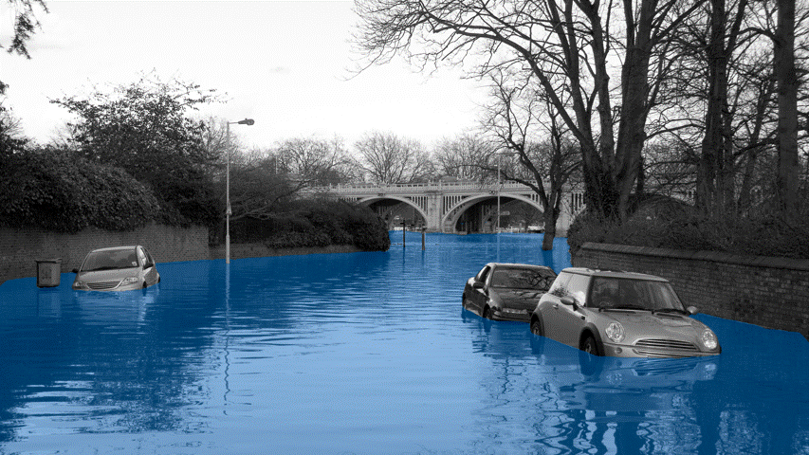

Big question
Flooding can affect people even if their home isn’t flooded. How?
Notes:
Big questions are an assessment tool for educators and learners to demonstrate progress through an activity.​​
Share this slide with learners and give them a moment to reflect on the question.​​
Then, ask them to discuss with a partner before sharing their ideas with the group.​​
At this point in the activity, it is expected that learners may not have many ideas or know how to answer this question. ​​
The question will be reviewed at the end of the activity. This is an opportunity for learners to see how much progress they’ve made and how many more ideas they now have. ​​
​​

Slide 6
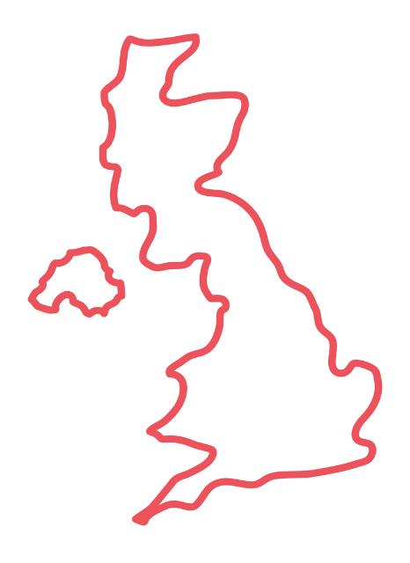
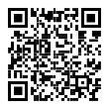
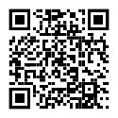

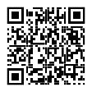
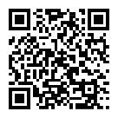
Flood maps
Flood maps in the UK
Visit your nation’s website and examine the map to learn about the flood risk in your area.
Scotland
Northern Ireland
Some areas will appear not to have a direct flood risk.
Challenge question: how can flooding affect people living in all areas?
England
Wales
Select for websites
Notes:
Click the links to the website, you will need to find your local area. We suggest starting with the location of your organisation as a reference point for learners.
Learners may need support to answer this question. Scaffold their thinking by asking these questions:
Where are the hospitals, schools, fire and police stations?
If a river floods, or there is surface water flooding affecting the roads, how could people be affected?
If lots of people need help from the emergency services due to being directly affected by flooding, how could this affect those people not directly affected?
If someone has family in the area who need their support, how could flooding cause difficulty with this?

Slide 7



Femi’s story
Read Femi’s story to learn more about how flooding can affect someone indirectly.
Where I live, it’s high up on a hill.
As you read, make some notes to help you answer the challenge question.
Last year there was this really stormy day. It was incredible.
The sky went dark and there was strike after strike of lightening.
Challenge question: how can flooding affect people living in all areas?
It chucked it down for about 3 hours.
Notes:
This activity is designed to address the misconception that people who live high up, or on hills can’t be affected by flooding. Femi’s story illustrates some of the indirect ways we could be affected by a flood.
Ask learners to make notes to help them answer the challenge question as you read Femi’s story.
Optionally, support learners by encouraging them to use Note writing handout.

Slide 8

Femi’s story
Read Femi’s story to learn more about how flooding can affect someone indirectly.
I watched it out of my window.
As you read, make some notes to help you answer the challenge question.
The town centre got completely flooded. That’s never happened before!
Challenge question: how can flooding affect people living in all areas?
It was just from the amount of water that fell, the drains couldn’t take it all away fast enough.
Notes:
Ask learners to make notes to help them answer the challenge question as you read Femi’s story.
Optionally, support learners by encouraging them to use note writing handout.

Slide 9

Femi’s story
Read Femi’s story to learn more about how flooding can affect someone indirectly.
My dad was actually at work in an office in the centre.
As you read, make some notes to help you answer the challenge question.
He ended up staying the night there.
Challenge question: how can flooding affect people living in all areas?
So many roads were blocked with floodwater; no buses were running.
It all caused a power cut.
Notes:
Ask learners to make notes to help them answer the challenge question as you read Femi’s story.
Optionally, support learners by encouraging them to use Note writing handout.

Slide 10
Femi’s story
Read Femi’s story to learn more about how flooding can affect someone indirectly.
I was using my phone to keep in touch with my dad.
As you read, make some notes to help you answer the challenge question.
I have a battery pack to keep it charged, but my dad didn’t.
Challenge question: how can flooding affect people living in all areas?
It was really stressful for both of us.
Notes:
Ask learners to make notes to help them answer the challenge question as you read Femi’s story.
Optionally, support learners by encouraging them to use Note writing handout.

Slide 11

Femi’s story
Read Femi’s story to learn more about how flooding can affect someone indirectly.
That meant I had to stay home on my own.
As you read, make some notes to help you answer the challenge question.
I was worrying about him a lot.
Challenge question: how can flooding affect people living in all areas?
Notes:
Ask learners to make notes to help them answer the challenge question as you read Femi’s story.
Optionally, support learners by encouraging them to use Note writing handout.

Slide 12
Femi’s story
Femi’s flood story
Use what you learned from reading Femi’s flood story to answer the challenge question.
First, compare your notes with a partner.
Then, share your ideas with the group.
Femi shows us how somebody can be affected by flooding, even if their house isn’t flooded.
Challenge question: how can flooding affect people living in all areas?
Notes:
Learners may identify:
Even people who live up a hill can be affected by flooding by:
A flood causing a power cut. This could mean people can’t communicate with each other if mobile phones no longer work. People may not be able to have heating or the ability to make food to eat.
A flood making transport difficult, people could get stuck or struggle to get the things they need.
A flood being stressful or scary.
You could build on this story and discussion by asking:
What could Femi and his dad have done before this weather emergency that would have helped them to cope?
How do you think Femi might have been feeling? How might this feel in his body? What could Femi do to cope emotionally?
If there are power cuts and difficulty travelling, how could this affect the emergency services? (This could be an opportunity to gather initial thoughts. The next part of the activity goes into detail about this.)

Slide 13
What are the emergency services?
Emergency services
Emergency
What do the emergency services do in a flood?
Select to reveal
Select to reveal
Select to reveal
The fire and rescue service
The police force
The ambulance service
How can this affect anyone?
Notes:
Ask learners to name the emergency services, then tap to reveal and see if they were correct.
Continue by asking about the role of each service, their role in a flood, and how this could affect people.

Slide 14
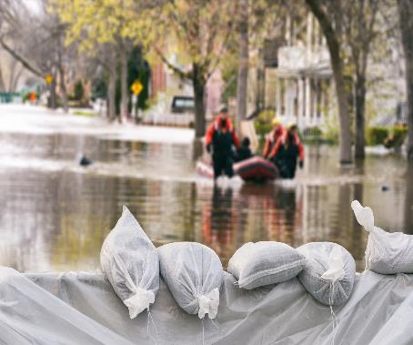
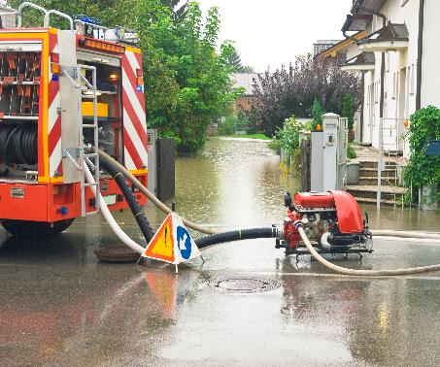
Fire
The fire and rescue service
During a flood emergency, the fire service:
Select to reveal
Rescue people in danger
Select to reveal
Pump out flood water
Challenge question:
how could this affect you?
Notes:
Invite learners to compare this to their ideas from the discussion of Femi’s experience.
You could prompt learners by asking them ‘if the fire and rescue service is busy dealing with the flood, what could this mean for people having other emergencies?’

Slide 15


Police
The police force
During a flood emergency, the police force:
Organise evacuations (tell people when they need to leave their homes and helping them go)
Coordinate the emergency services
Select to reveal
Select to reveal
Challenge question:
how could this affect you?
Notes:
Invite learners to compare this to their ideas from the discussion.
You could prompt learners by asking ‘what challenges could there be for the police service if they are also busy coordinating the emergency services’ response to a flood?’

Slide 16
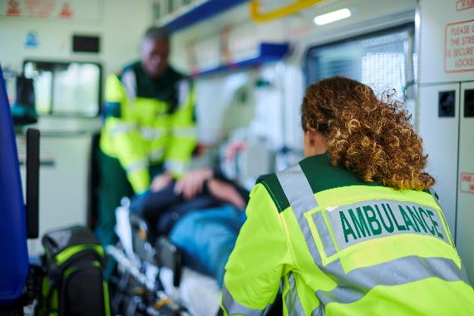
Ambulance
The ambulance service
During a flood emergency, the ambulance service:
Helps people by providing treatment where the accident happened.
Select to reveal
Challenge question:
how could this affect you?
Notes:
Invite learners to compare this to their ideas from the discussion.
You could prompt learners by asking ‘do you think the number of people needing emergency medical help would go up or down in a flood? What could this mean for those who need help?’

Slide 17

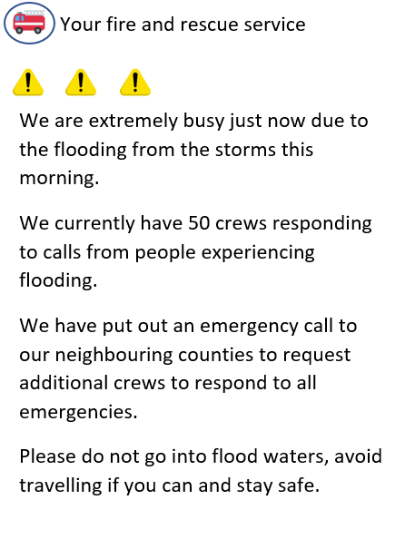
How flooding affects us all
Flooding
If there is a flood, getting help will take longer. The emergency services will be sent to where there is the most need.
Even if someone’s area hasn’t been flooded, it will still affect them.
What if they had an accident and needed help?
Learning first aid skills can be lifesaving! Try using the British Red Cross first aid app.
Notes:
Guide learners to find the conclusion that during floods the emergency services are extremely busy. This may mean that response times are significantly increased. When help is needed, it may take longer to come.
They can be prepared by knowing how to stay safe during a flood and learning some first aid skills.

Slide 18
Big question
Flooding can affect people, even if their home isn’t flooded. How?
Notes:
Give learners a few moments to reflect on this question before inviting them to discuss with a partner. Then, encourage feedback as a group.
Referring back to the Big Question should enable you and your learners to see how much they have learned from the activity. Answers to this question should be more detailed and varied at this point.

Slide 19

End
Thank you

Slide 20
Resources and support

Slide 21
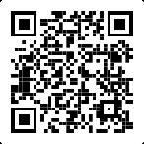
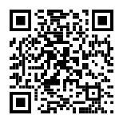
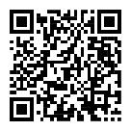
Resources
Where to find more information
Get advice and information in a flood by calling Floodline. Telephone: 0345 988 1188 Textphone: 0345 602 6340 24-hour service Sign up for free alerts
https://www.gov.uk/sign-up-for-flood-warnings
Learn how the British Red Cross is ready to help in a crisis
Visit the British Red Cross website to learn more about how to prepare for and cope in a flood.
www.redcross.org.uk/get-help/prepare-for-emergencies/how-to-prepare-for-floods-and-flooding
www.redcross.org.uk/stories/disasters-and-emergencies/uk/how-the-british-red-cross-helps-during-a-flood

Slide 22
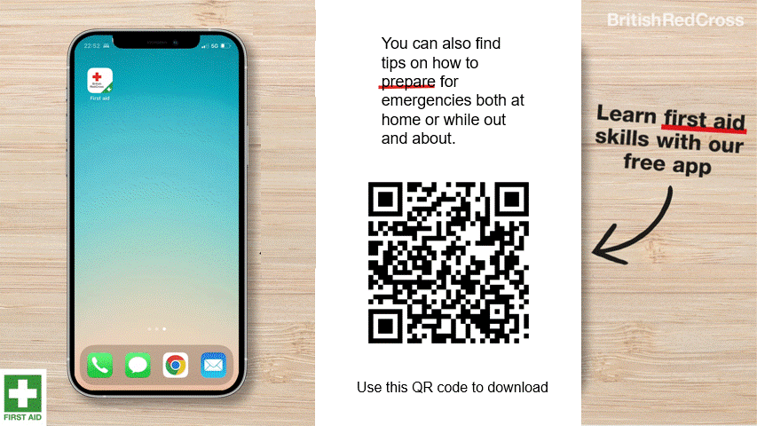
First aid app

Slide 23
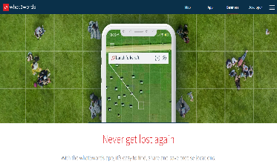
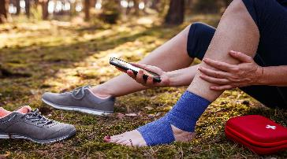
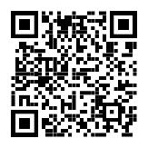
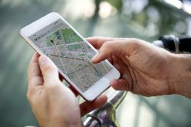
Resources
How to tell the emergency services where you are
2. Some smartphones have a built-in feature to call the emergency services and share your location. Find out how to use this on your phone.
3. You could also use a maps app to pinpoint and share your location. Learn how to do this so you’re ready for an emergency.
1. You could get the what.three.words app
what3words.com/products/what3words-app

Slide 24

Support
Sources of support
Contact Childline
You can contact Childline about anything. Whatever your worry, it's better out than in. They are here to support you.
You can reach them by:
Call 0800 1111 for free
Have a 1-2-1 chat with a counsellor on their website
Email them by following the instructions on their website
Contact YoungMinds
YoungMinds are the UK’s leading charity fighting for children and young people's mental health.
You can reach them by:
For 24/7 crisis support you can text YM to 8525
Find out about CAMHS, who's who in mental health services and who you can call if you need to talk to someone at their website
Contact Samaritans
Samaritans is not only for the moment of crisis, they are taking action to prevent the crisis.
You can reach them by:
Call them for free, 24/7 on 116 123
Email them: jo@samaritans.org
Notes:
Talking about floods may be distressing to some learners. Use this slide to signpost learners on to further support for challenges they may be facing and need help with.

Slide 25



Flooding
Heatwaves
Eco-anxiety
Read 3 characters’ flood stories and discuss how they could be affected.
Find out about the effects of heatwaves through completing a quiz.
Worksheet: heatwave facts to print
Read a character’s experience of eco-anxiety and use this to define what it is.
Look at local flood maps and the role of the emergency services to explore how flooding can affect us all.
Worksheet: note writing help
Examine a list of ways to cope and apply this to yourself and others.
Worksheet: coping with eco-anxiety
Learn how heatwaves affects our body and the first aid to help. Apply these to different scenarios.
Poster: heatwaves scenarios
Poster: heatwaves first aid
Create a video/script for social media of how to cope with eco-anxiety to share with friends and family.
Worksheet: eco-anxiety video script
Examine images of flooding and identify the dangers.
Create a decision flowchart to share with friends and family to help them prepare for a heatwave.
Worksheet: decision flowcharts
Play a scenario game to find out about bug out bags and why it is important to have one ready.
For use across all topics
Starters
Plenaries
Weather Together
award tracker
Bronze certificate
Silver certificate
Gold certificate
Play a ‘choose your own adventure’ game to learn how to respond to flood alerts and warnings.
Create resources to share with friends and family. This activity is designed to be repeated.
Rate these resources
Open another activity
Link
Link
Fill in this quick survey to help us improve Weather Together.
Click here to open the full web index.

