Slide 1
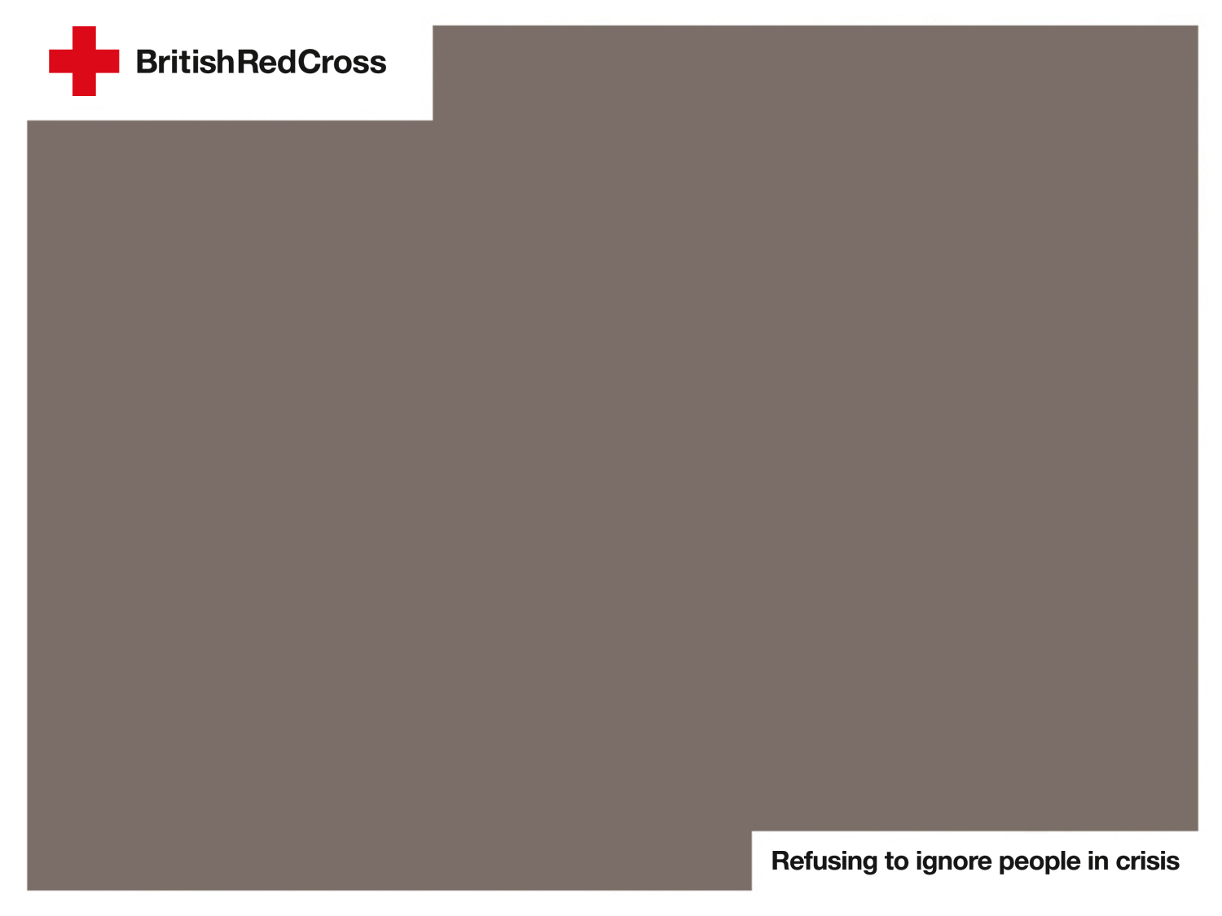
Which of these actions is cool in a heatwave emergency?
Notes:
Explain to the children that you are going to describe some things that people might do during a heatwave emergency.
Tell the children that:
If the action is safe, they need to give a thumbs up and say “That’s cool!”
If the action is unsafe, they give a thumbs down and say “No way!”

Slide 2
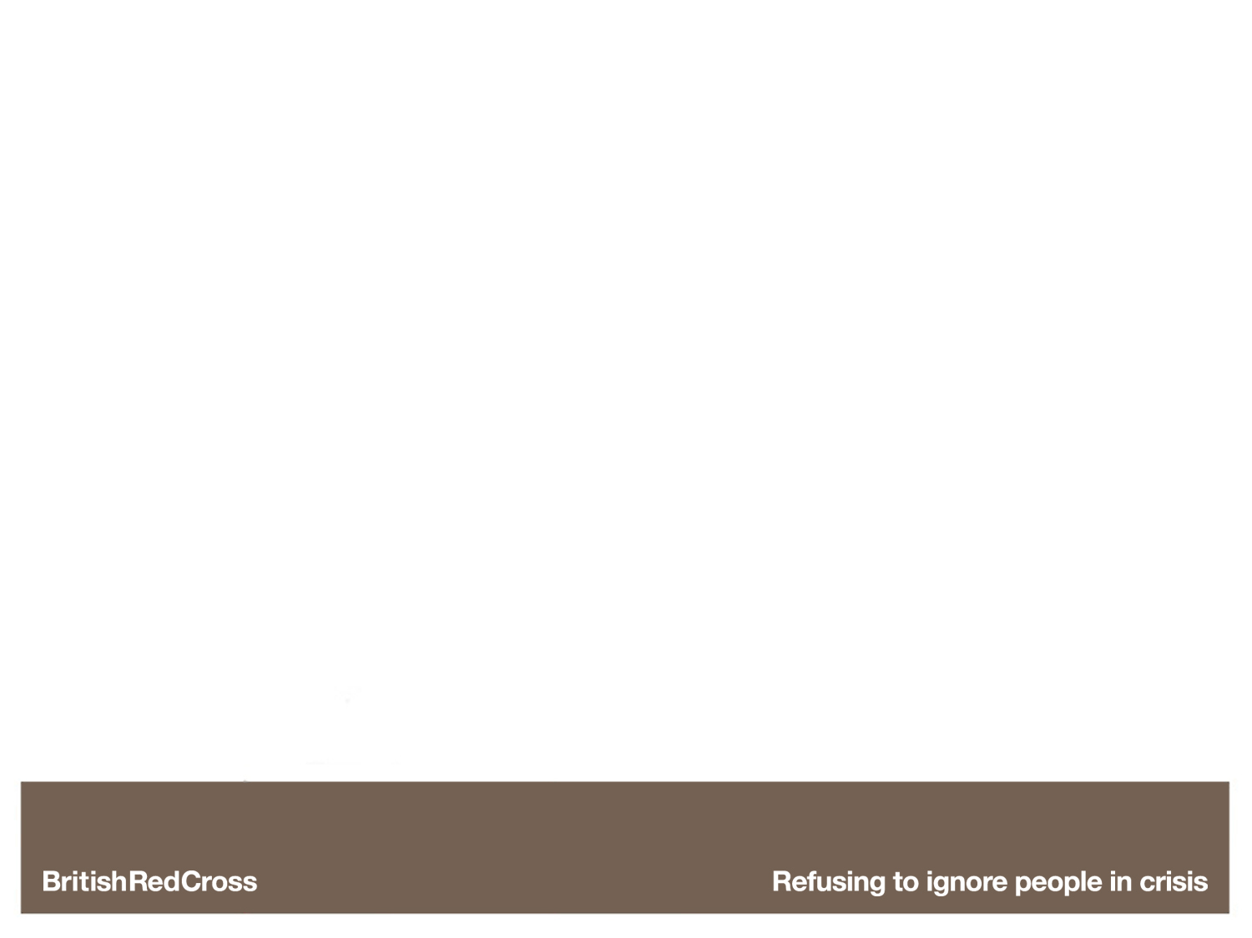

Running around and playing lots.
Notes:
Thumbs down:
Too much physical activity can cause you to dehydrate (lose water) and feel ill.

Slide 3

Staying in the shade as
much as possible.
Notes:
Thumbs up:
Sitting in the shade can help keep you cooler. It can also reduce the chance of getting sunburnt.

Slide 4
Wearing suncream.
Notes:
Thumbs up:
Regularly apply suncream to protect your skin from sunburn. Sunburn is skin damage that can happen if you stay in the sun too long without protection.

Slide 5
Not drinking very much water.
Notes:
Thumbs down:
It is important to stay hydrated on hot days as your body will lose more water than normal.

Slide 6
Splashing yourself with cold water.
Notes:
Thumbs up:
Splashing yourself with cold water can help keep you cool that will help prevent you getting any heat-related health conditions.

Slide 7
Wearing dark-coloured, tight-fitting clothes.
Notes:
Thumbs down:
To stay cool, it is better to wear light-coloured, loose-fitting clothes – preferably cotton or linen as they are both natural fabrics that will allow your skin to breathe.

Slide 8
Staying up to date with the weather forecast.
Notes:
Thumbs up:
It is important to listen for any updates in the weather so you can be prepared.

