Slide 1
East Africa facing hunger
Refugees through time
Full lesson plan from redcross.org.uk/education
Full lesson plan from redcross.org.uk/education
Notes:
1

Slide 2
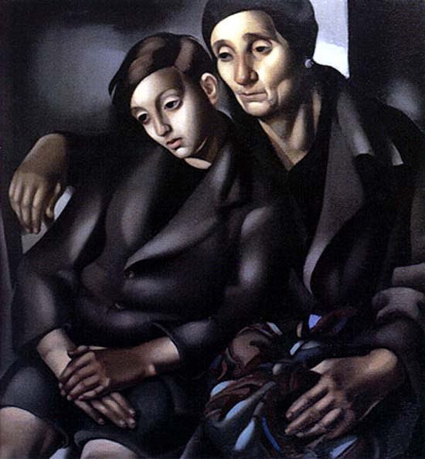

Slide 3
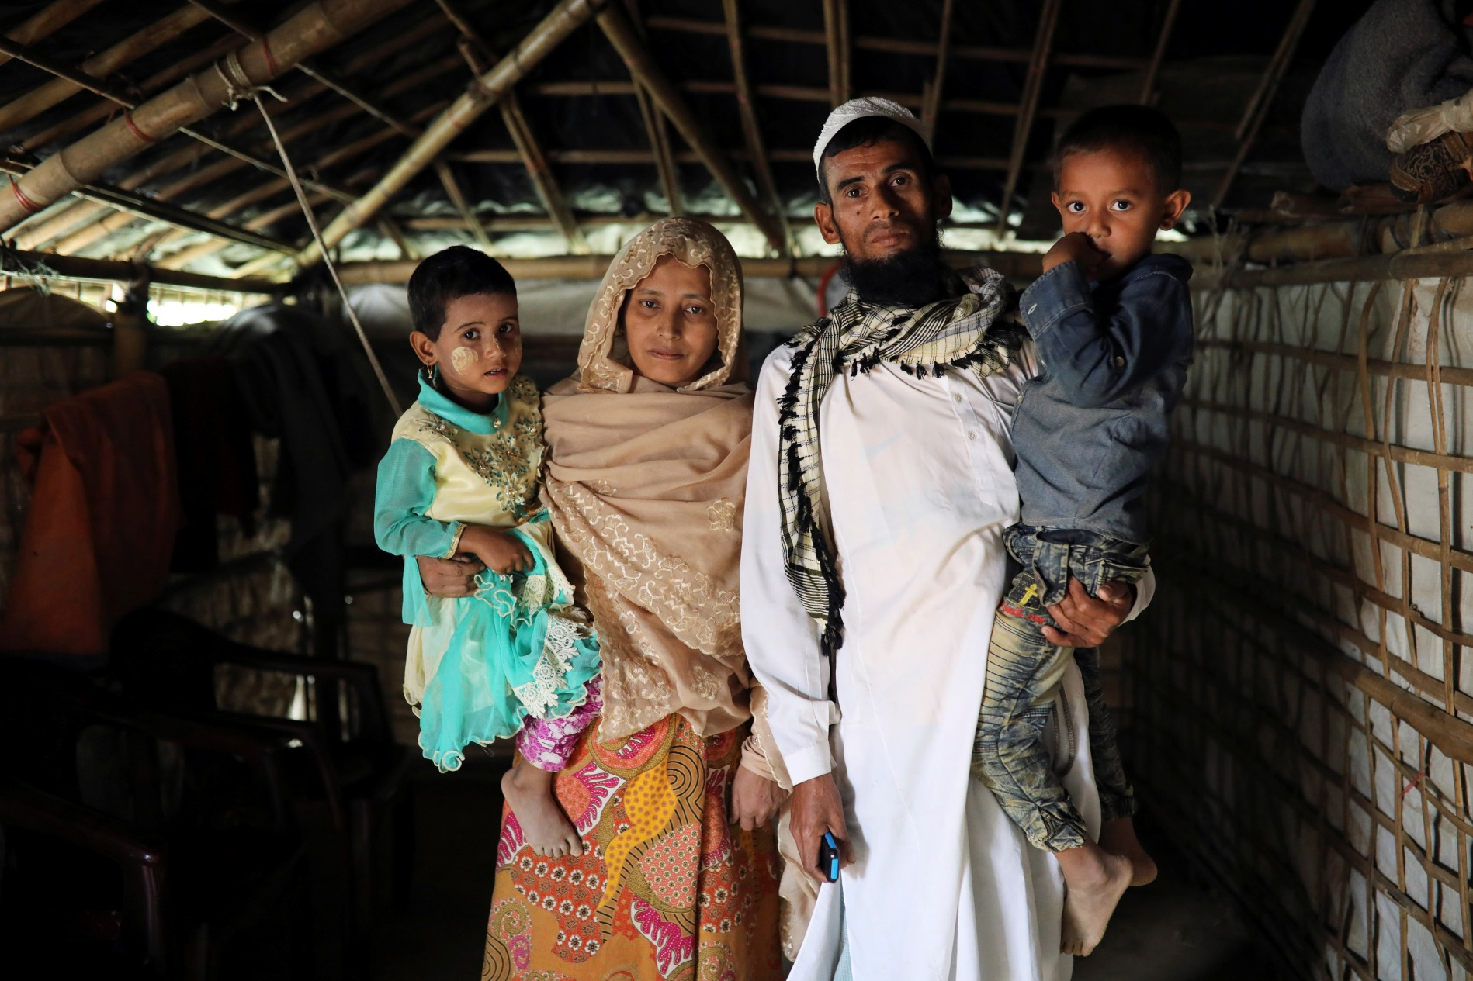

Slide 4


Slide 5
Photo credits
Slide 1: ‘The Refugees’ by Tamara de Lempicka (1937) © Tamara de Lempicka
Slide 2:
Caption: Kalim Ullah, his wife Taiyeba Begum and their children who take shelter in their relatives' tent to avoid forced repatriation, pose for a picture at a camp in Cox's Bazar, Bangladesh, November 14, 2018.
Copyright: © Mohammad Ponir Hossain/Reuters
This resource and other free educational materials are available at redcross.org.uk/education
The British Red Cross Society is a charity registered in England and Wales (220949) and Scotland (SCO37738).
Notes:
1

