Slide 1

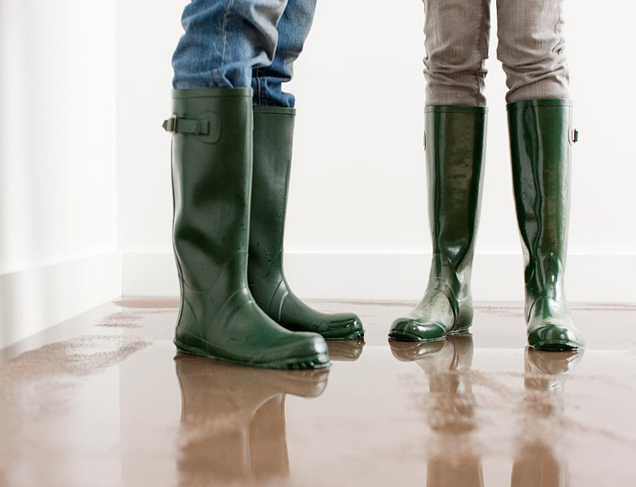

Starter
Starter
Flooding
What's
the
image?
Select a box to show more.
Notes:
Adapt the starter by asking pairs to play the word association game. One learner starts with a word that this image makes them think of, then the other learner says a word linking to their word and so on.
How to use? Tap/click/select a box to reveal. When all the boxes are gone, use the arrow on the keyboard to advance the slide and show the questions.

Slide 2

Starter
Reflect:
What does this image have to do with your learning?
Flooding
Consider:
What do you think might have happened to cause this?
Challenge:
Make a list of all the words you can think of that link to this topic.
Notes:
Adapt the starter by asking pairs to play the word association game. One learner starts with a word that this image makes them think of, then the other learner says a word linking to their word and so on.

Slide 3
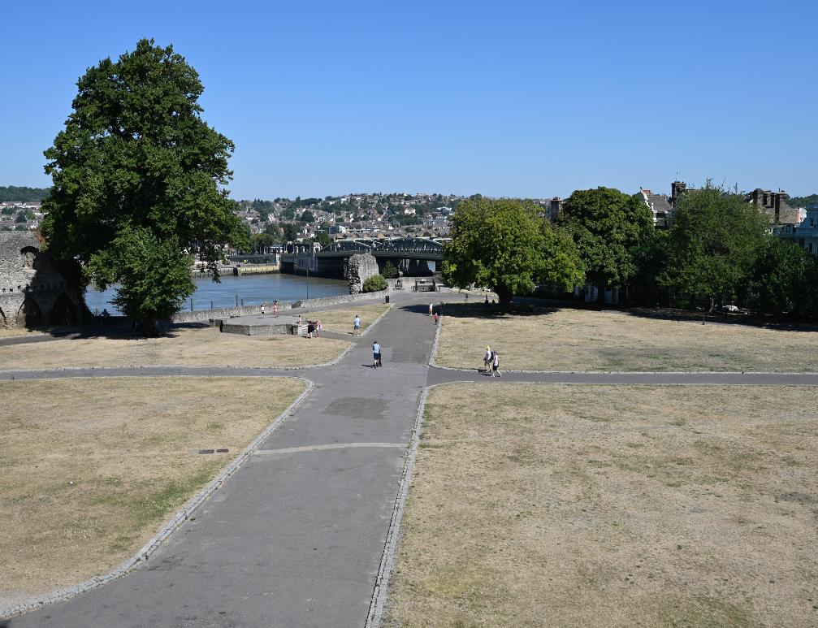
Starter
Heatwaves
What’s
the
image?
Select a box to show more.
Notes:
Adapt the starter by asking pairs to play the word association game. One learner starts with a word that this image makes them think of, then the other learner says a word linking to their word and so on.
How to use? Tap/click/select a box to reveal. When all the boxes are gone, use the arrow on the keyboard to advance the slide and show the questions.

Slide 4
Starter
Reflect:
What does this image have to do with your learning?
Heatwaves
Consider:
How do you think this could affect a person?
wat’s
Challenge:
Make a list of all the words you can think of that link to this topic.
Notes:
Adapt the starter by asking pairs to play the word association game. One learner starts with a word that this image makes them think of, then the other learner says a word linking to their word and so on.

Slide 5
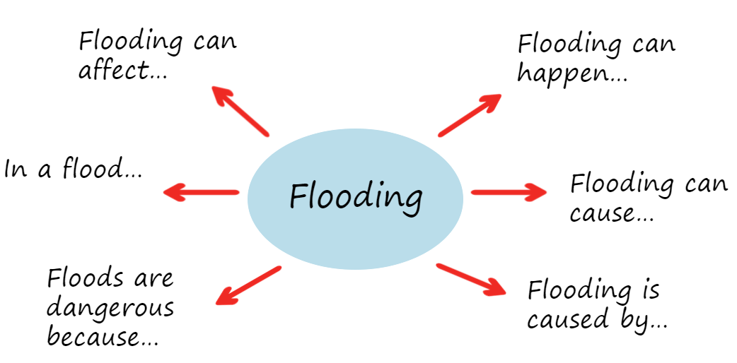

Create a spider diagram
Use these to get you started
Starter
Flooding
Flooding
What do you know about ...
Notes:
A spider diagram has a word in the middle, in a circle. Then, coming from the circle, learners draw a line and write an idea or piece of knowledge they have about the word in the middle.
Adjust the slide depending on the knowledge you would like to check. E.g. community, resilience, empathy, preparedness, emergency, humanitarian.
Optionally, ask learners to use two different colours. First, they’ll add their ideas in one colour. Then when the spider diagrams are shared with the group, learners can add new ideas in a different colour. You could also return to this spider diagram at the end of the lesson and add any new ideas in a third colour.
This could be completed collaboratively or independently.

Slide 6
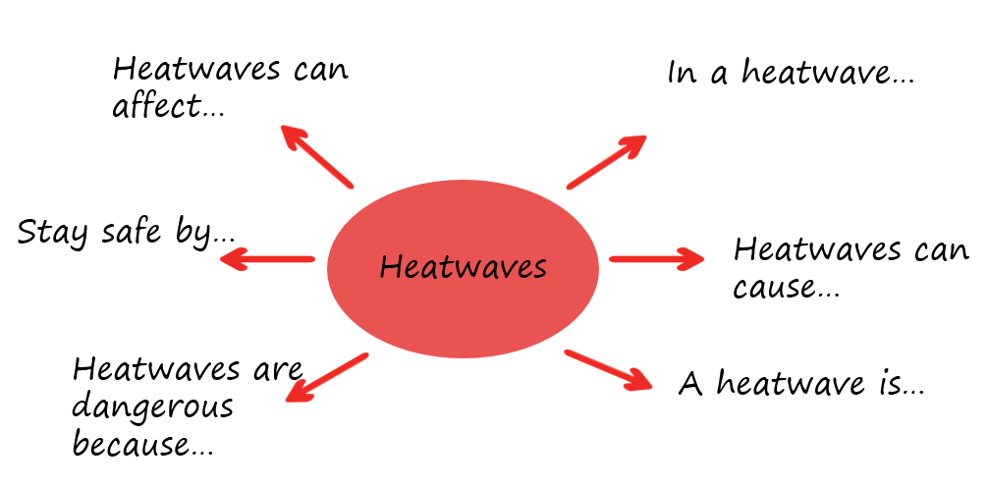
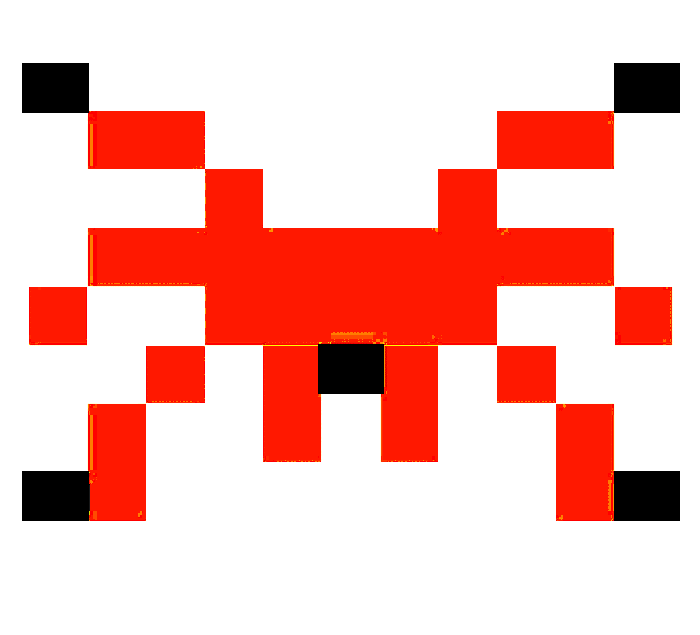
Create a spider diagram
Use these to get you started
Starter
Heatwaves
Heatwaves
What do you know about ...
Notes:
A spider diagram has a word in the middle, in a circle. Then, coming from the circle, learners draw a line and write an idea or piece of knowledge they have about the word in the middle.
Adjust the slide depending on the knowledge you would like to check. E.g. community, resilience, empathy, preparedness, emergency, humanitarian.
This could be completed collaboratively or independently.
Optionally, ask learners to use two different colours. First, they’ll add their ideas in one colour. Then when the spider diagrams are shared with the group, learners can add new ideas in a different colour. You could also return to this spider diagram at the end of the lesson and add any new ideas in a third colour.

Slide 7
Draw or describe the keyword to a partner.
Weather
Kindness
Emergency
Starter
Give clues
allow them only 2 guesses...
Community
Prepare
Support
Resilience
Together
Humanitarian
Notes:
Adjust the keywords depending on the needs of your learners.
Have learners work in pairs or threes. One partner secretly chooses a word and without saying it, they give clues to their partner by either drawing or describing the keyword. Only three guesses are allowed. Invite learners to keep a track of their scores. Ask learners to take it in turns guessing or giving clues.

Slide 8



Fact
Starter
Write a sentence about weather emergencies such as heatwaves and flooding. It can be true or false.
Share your statement with the people near you.
Ask them whether they think it is fact or fiction and encourage them to explain why.
Examples:
Flooding can affect us all.
Fact or fiction?
Heatwaves
It is good to spend time outdoors in a heatwave.
Notes:
If time, you can ask learners to prepare these for the class and then when ready, they can take it in turns to read their statement and have the whole class vote either true or false. This would be a good opportunity to address misconceptions.

Slide 9
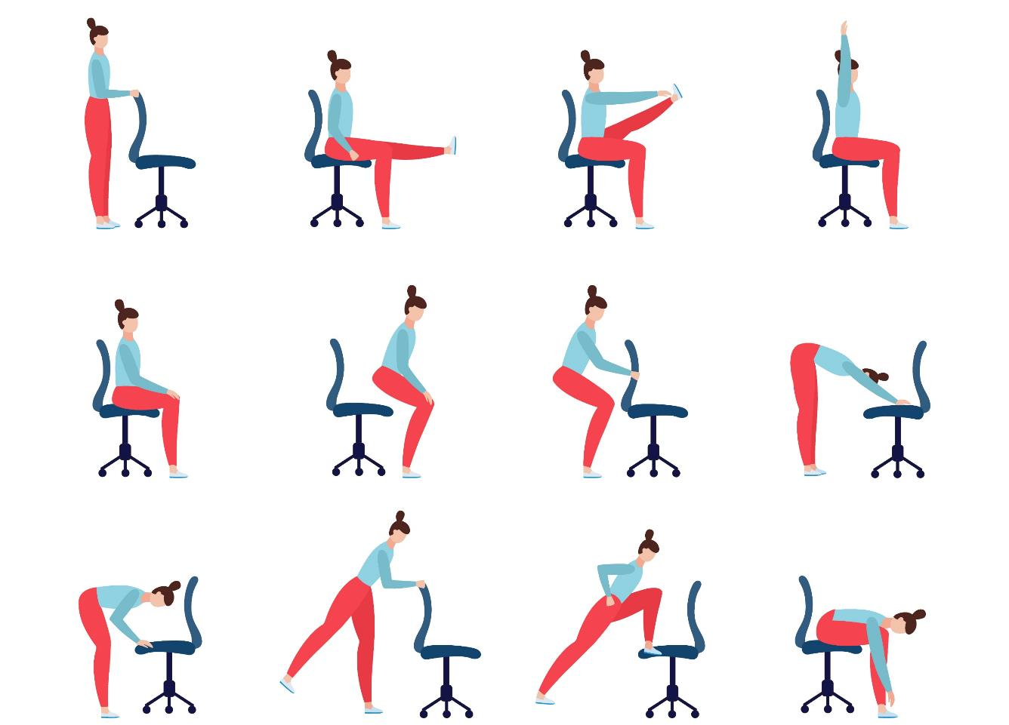
Chair yoga
Chair yoga
Try poses
Take a moment to settle into today’s lesson with some chair yoga. Spend a few moments in each pose. As you try the poses, notice how your body is feeling.
Notes:
Remind learners to find a space and try the poses carefully and safely.

Slide 10
Agree or disagree?
Agree or disagree?
Starter
Quiz time
1. Weather emergencies are happening more often in the UK.
2. There’s nothing you can do about weather emergencies.
3. In a weather emergency, you should always look after yourself first.
4. Being prepared for a weather emergency will help you cope.
5. Sharing your learning about weather emergencies with others will help them cope.
Notes:
You could use these statements for a class vote for a quick starter. However, to develop knowledge and learning, if time permits, you could develop discussion on each point.

Slide 11
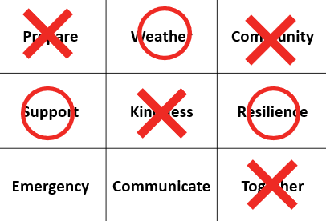
Game rules:
Work with a partner
Together, make one copy of the grid.
One player puts an X on a word
The other player puts an O.
Keep going until one player makes a line.
They are the winner.
Starter
Prepare | Weather | Community
Support | Kindness | Resilience
Emergency | Communicate | Together
Make a line
Notes:
Develop this by inviting students to create their own grids with keywords relating to the topic. They can share them around.
Differentiate this activity for learners who need less complex language e.g. flood, water, river, help, kind, together, ready, home, worry.

Slide 12







Flooding
Heatwaves
Eco-anxiety
Read 3 characters’ flood stories and discuss how they could be affected.
Find out about the effects of heatwaves through completing a quiz.
Worksheet: heatwave facts to print
Read a character’s experience of eco-anxiety and use this to define what it is.
Look at local flood maps and the role of the emergency services to explore how flooding can affect us all.
Worksheet: note writing help
Examine a list of ways to cope and apply this to yourself and others.
Worksheet: coping with eco-anxiety
Learn how heatwaves affects our body and the first aid to help. Apply these to different scenarios.
Poster: heatwaves scenarios
Poster: heatwaves first aid
Create a video/script for social media of how to cope with eco-anxiety to share with friends and family.
Worksheet: eco-anxiety video script
Examine images of flooding and identify the dangers.
Create a decision flowchart to share with friends and family to help them prepare for a heatwave.
Worksheet: decision flowcharts
Play a scenario game to find out about bug out bags and why it is important to have one ready.
For use across all topics
Starters
Plenaries
Weather Together
award tracker
Bronze certificate
Silver certificate
Gold certificate
Play a ‘choose your own adventure’ game to learn how to respond to flood alerts and warnings.
Create resources to share with friends and family. This activity is designed to be repeated.
Rate these resources
Open another activity
Link
Link
Fill in this quick survey to help us improve Weather Together.
Click here to open the full web index.

