Slide 1

That’s what I call an emergency
Notes:
Explain to the children that there are two signs on either side of the classroom. One says ‘This is an emergency’ and the other says ‘This is not an emergency’.
Show the photos one at a time and ask children to move towards the sign they think best describes what is happening. If they are unsure, they can stand in the middle of the room.

Slide 2

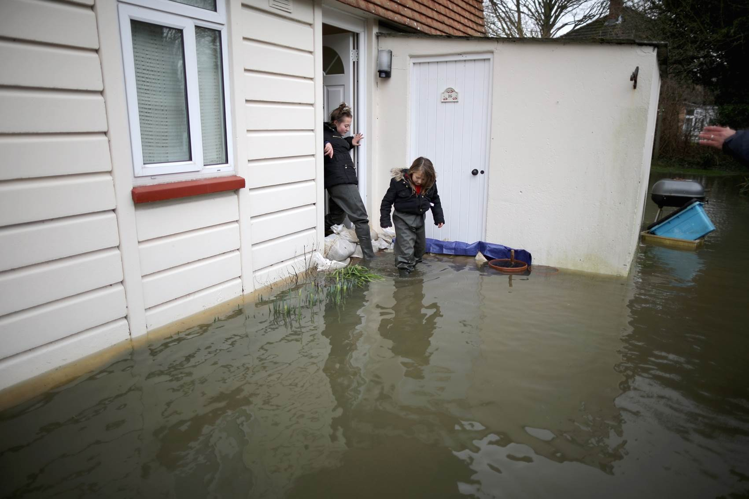
Source: © Photo by Christopher Furlong/Getty Image
Notes:
This is an emergency.
Why is this an emergency?
The photo shows a flood which has filled a family’s home and garden with water.
The family will need to leave their home as it is not safe to live in at the moment.
Does anyone know what type of emergency this photo shows?
Flooding
Where do you think this has happened?
UK - Staines 2014
What could you do to ensure you are prepared if you were in this situation?

Slide 3
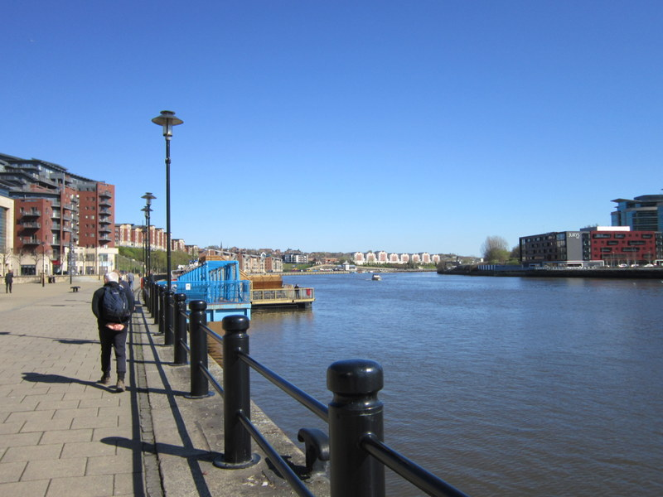
Source: © Photo by Ian S, CC BY-SA 2.0
Notes:
This is not an emergency.
This photo shows the River Tyne, in north England.
How could this become an emergency?
If it starts to rain a lot and the river floods.
What might you need to do to ensure you are prepared if this became an emergency?

Slide 4
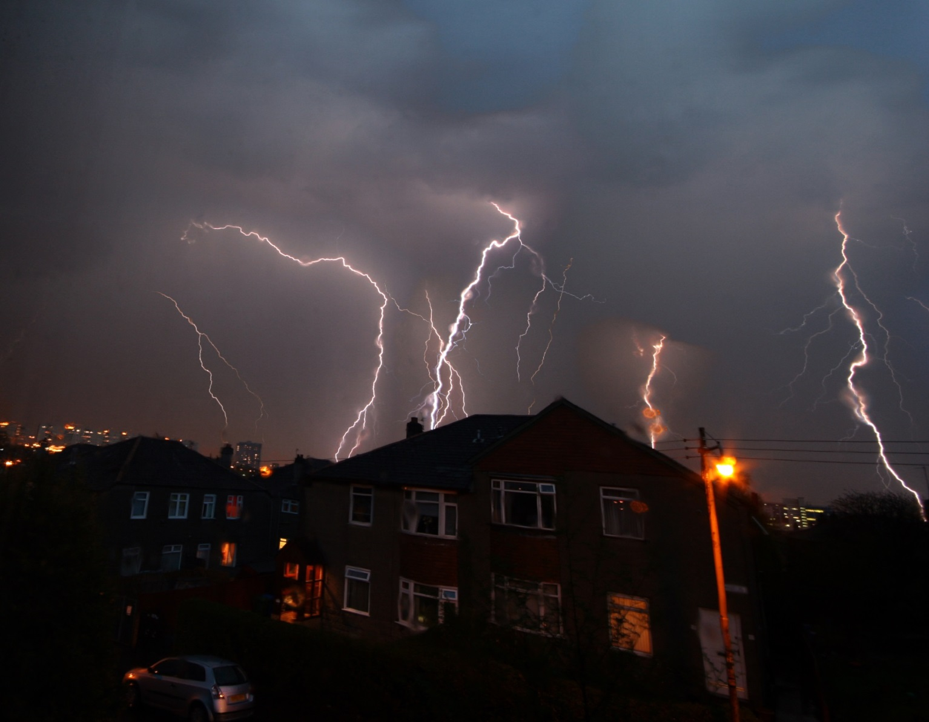
Source: © Photo by Martin McCarthy/iStock
Notes:
This is an emergency.
Why is this an emergency?
This photo shows a large storm. Storms often include thunder, lightning, lots of rain and strong winds that make it unsafe to be outdoors.
Lightning can harm a person if they are hit, and can cause power cuts.
Does anyone know what type of emergency this photo shows?
Thunderstorm
Where do you think this has happened?
This can happen in many places around the UK.
What could you do to ensure you are prepared if you were in this situation?

Slide 5
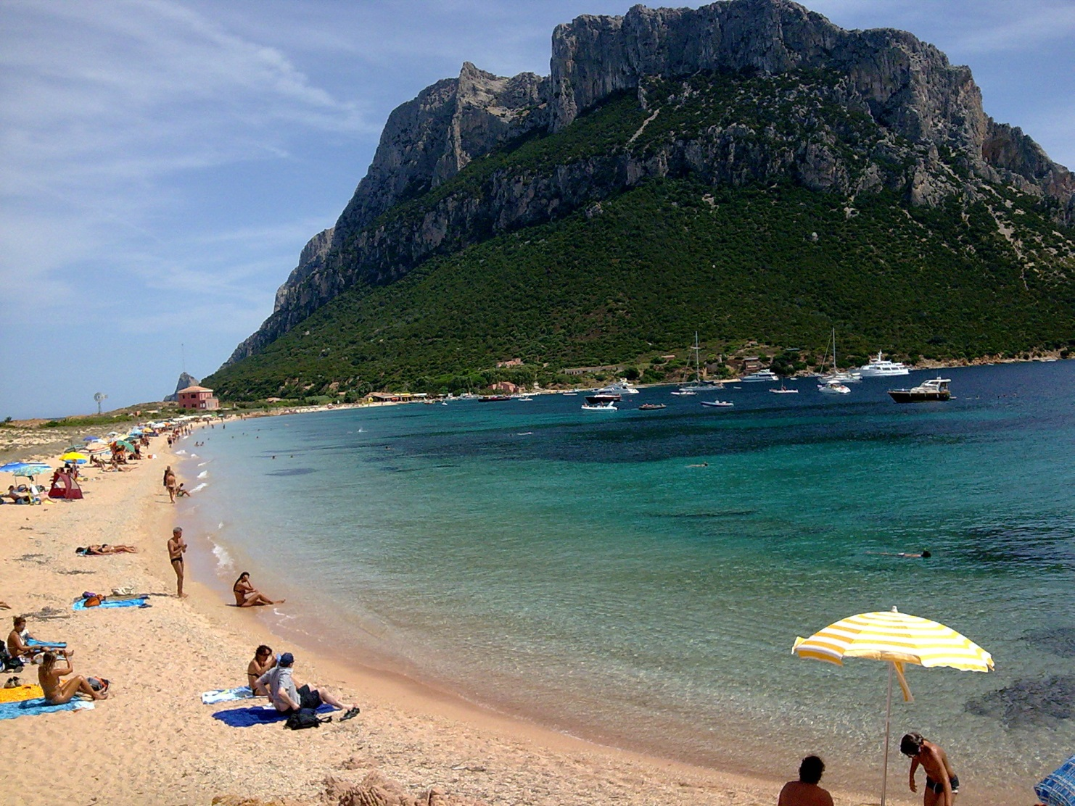
Source: Photo by Lupanino, Wikimedia Commons
Notes:
This is not an emergency.
This photo shows a beach in Italy.
How could this become an emergency?
If it gets very hot and the people stay in the heat for too long without drinking enough water, they could get heat exhaustion.
If a thunderstorm suddenly happened and there was lightning, the people could be in danger.
What could you do to ensure you are prepared if this became an emergency?

Slide 6
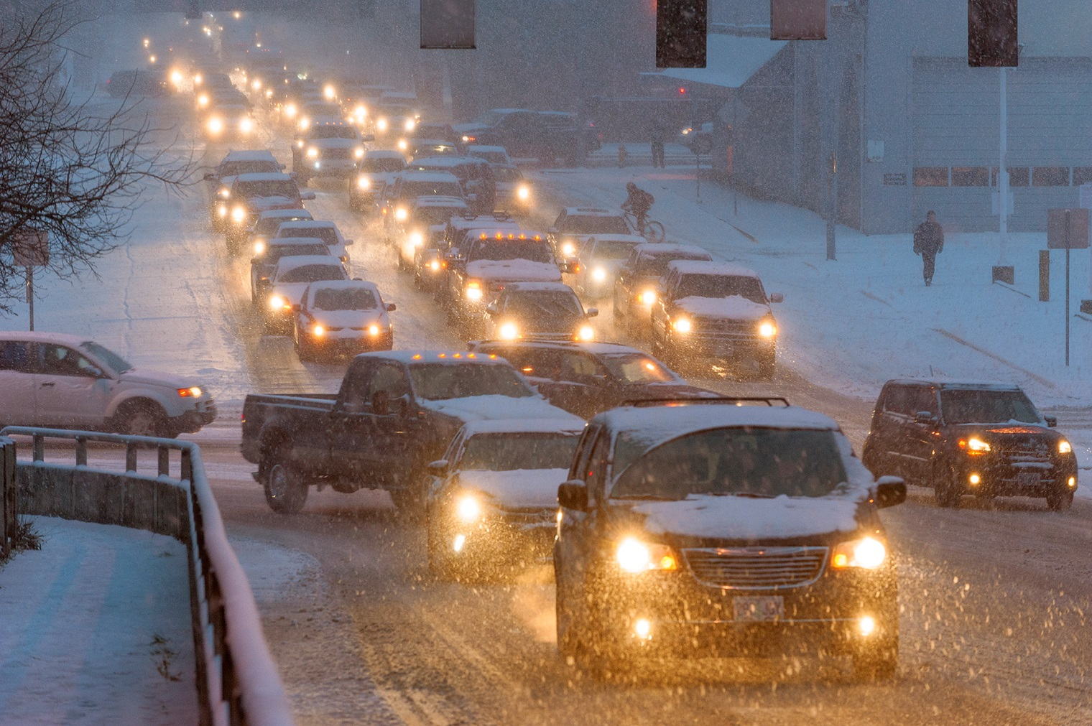
Source: © Photo by Oregon Department of Transportation, CC BY 2.0
Notes:
This is an emergency.
Why is this an emergency?
This photo shows heavy snow being blown around by strong winds.
If people are in cars, they might not be able to see the road. If they get stuck in a traffic jam, they could possibly be stranded for a long time with no access to food, water, toilets or warmth.
Does anyone know what type of emergency this photo shows?
Snowstorm
Where do you think this has happened?
Snowstorms can happen in many places in and outside of the UK. This photo shows a snowstorm in Oregon, in the USA.
What could you do to ensure you are prepared if you were in this situation?

Slide 7
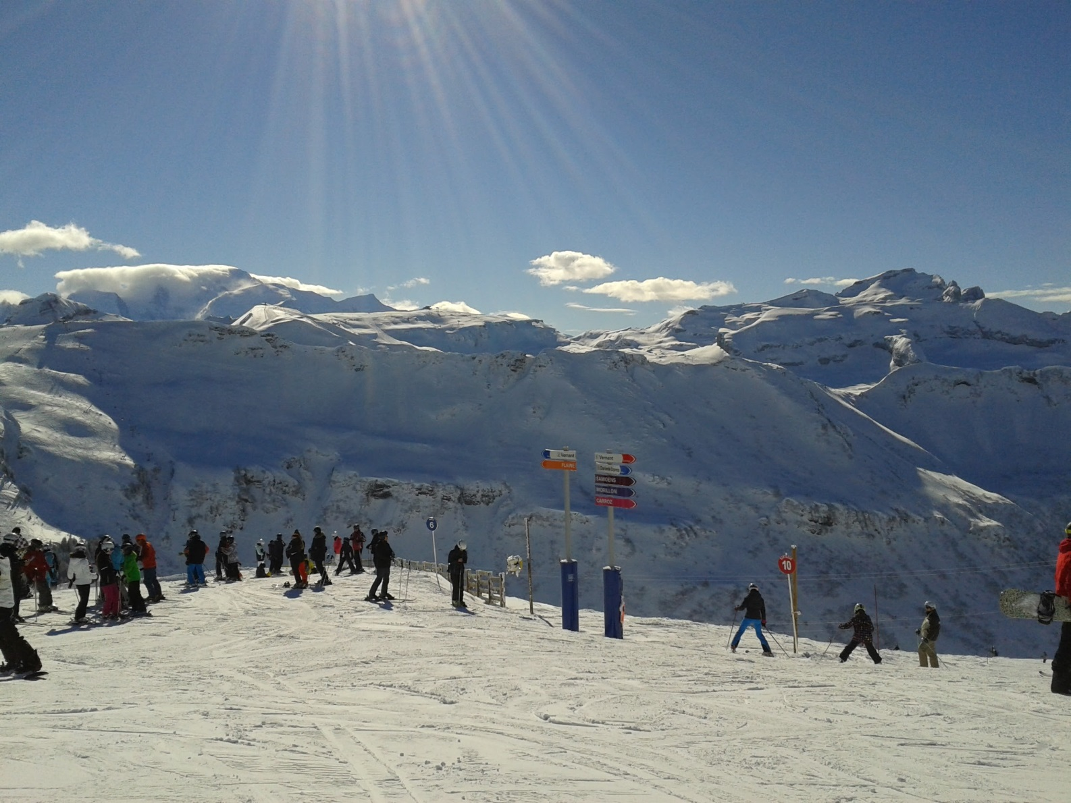
Source: © Photo by Susanna Grenga
Notes:
This is not an emergency.
This photo shows a ski resort in the Alps, in France.
How could this become an emergency?
If there is a snowstorm, people may get lost and could become very cold and disorientated.
What could you do to ensure you are prepared if this became an emergency?

Slide 8
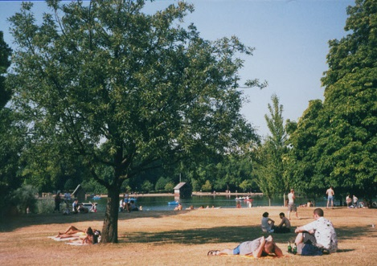
Source: © Photo by Stephen Craven, CC BY-SA 2.0
Notes:
This is an emergency.
Why is this an emergency?
This photo shows a very hot day. You can see this as the grass is brown, it is very sunny and people are wearing summer clothes.
When it is very hot, the heat can make people feel unwell – especially babies, older people and people who have serious illnesses.
If people don’t drink enough water, they may become dehydrated.
It is estimated that in the 2003 European heatwave, there were over 30,000 heat-related deaths, more than in any other heatwave in recorded history.
Does anyone know what type of emergency this photo shows?
Heatwave
Does anyone recognise where this emergency was?
This photo shows Hyde Park in London in August 2003.
What could you do to ensure you are prepared if you were in this situation?

