Slide 1

How to build your resilience

Slide 2


Pause
Today we are going to be talking about some challenges young people face.
You do not have to share anything personal if you do not feel comfortable doing so.
Take time to check in with how you are feeling today.
Notes:
Emotional check in with your learners
Let learners know in the session you will be covering topics that can be hard to discuss and to listen to.
If needed, come to an arrangement with the learners, allowing them a safe space to go to if they need time out. This could be a certain space in the classroom, an outdoor area, or space in the corridor if applicable.
Ensure that there is a space for learners who may be in discomfort to remove themselves if they are unable to participate in the remainder of the session.

Slide 3











Tap home to return here.
Case
Studies
Select
Select
Select
Select
Tap Select to go to those slides.
Notes:
Click on the activity you would like to use.
In the top right-hand corner on the slides, you will see an image of a house.
This can be found on all slides and will take you back to the home page.
This is activities can be completed in an order of your choice or can be used as bitesized activities to do as and when you are able to.

Slide 4

The Big Questions
What does the word challenge mean to you?
Resilience is the ability to adapt and grow after facing a challenge.
What is resilience?
Notes:
Ask your learners the questions above. Ask them to think about their answers independently. This gives the learners time to reflect on challenges they have seen without having to share these with other learners straight away.

Slide 5
Think about challenges young people face today.
Discuss your ideas with a partner.
Look at the next slide and see whether any of your ideas fit into the categories.

Slide 6

Climate change
Rising cost of bills
Littering around school
Global
Revising for a test
National
Local
Personal
Notes:
Ask learners to decide which categories their ideas fit into.
Ask them if their ideas can fit into more than one category?
Ask learners to consider who these challenges may affect.

Slide 7
Read through the game rules for the game Snakes and Ladders.
Complete the challenge and positivity cards.
Show resilience by completing the game!

Slide 8

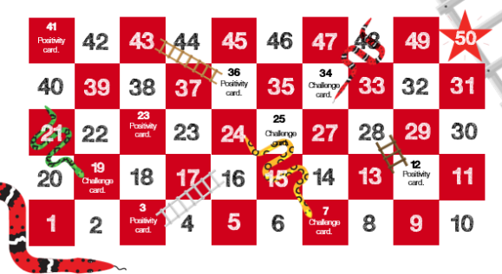
Rules
Each team starts on square 1. In teams, take it in turns to roll a dice. Whichever number the dice lands on is the amount of square they need to move forward.
If you land at the bottom of a ladder, complete a task on a positivity card before moving up to the next square.
If you land on a snake’s tail, travel to the snake’s head and complete a challenge card before moving on.
Notes:
Game play option 1:
Print off the board game and have enough for one between two or one between 4.
Ask learners to get into pairs or groups of 4.
Give each group a dice and enough counters for players in the game.
Give each group a selection of challenge and positivity cards.
Go through the rules of the game before they start. At the end of the game, select some cards to discuss with the learners as a whole group.
Game play option 2:
Display the game on an interactive board. Place the learners into two groups.
Use post it notes as counters to move along the interactive board.
Use a real dice or the interactive dice on slide 9.
When a challenge card or positivity card is picked up, ask learners to discuss in their teams and share ideas with the other group.

Slide 9






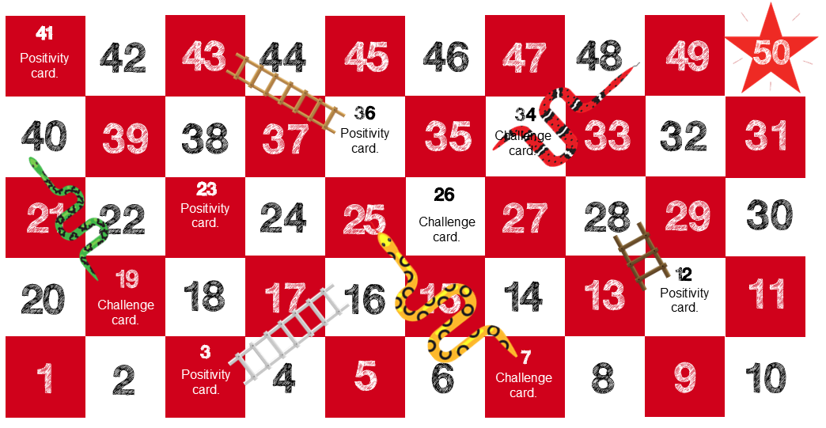
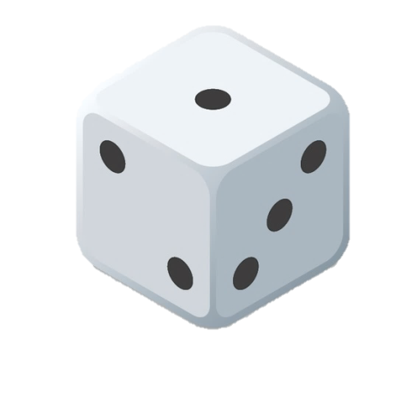


Tap to clear
Challenge cards >
Positivity cards >
Notes:
This can be printed off and given to learners either one between two or one between four.
This can be displayed on the screen and the learners can be split into two groups, using post it notes as counters to move along the board.
To use the interactive dice, click on the dice under the ‘tap to clear’ button. When rolling, make sure you click around the edge of the dice in different places each time to allow the dice to roll a variety of numbers.
The dice will roll, and the given number will appear above. To roll again, press the ‘tap to clear’ button and then the dice underneath.
If you do not clear the dice, the same number will be rolled again.

Slide 10

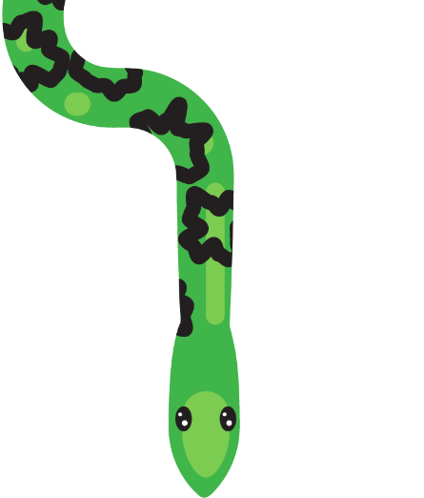









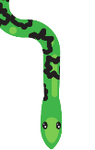

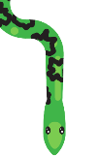
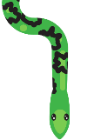

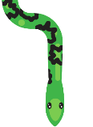





















x
Challenge card 20 Seasonal affective disorder
x
Challenge card 14
Sleep
x
Challenge card 17
Panic attacks
x
Challenge card 15
Anger
x
Challenge card 13
Sleep
x
Challenge card 8
Feeling low
x
Challenge card 9
Anxiousness
x
Challenge card 2
Self-esteem
x
Challenge card 6
Loneliness
x
Challenge card 5
Loneliness
x
Challenge card 12
Stress
x
Challenge card 18
Panic attacks
x
Challenge card 16
Anger
x
Challenge card 11
Stress
x
Challenge card 1
Self-esteem
x
Challenge card 19
Seasonal affective disorder
x
Challenge card 3
Self confidence
x
Challenge card 7
Self-esteem
x
Challenge card 4
Self confidence
x
Challenge card 10
Anxiousness
Felix witnessed a traumatic event two months ago and relives the experience whenever they close their eyes. They’re frightened to be in a dark room on their own and when they finally fall asleep, they wake up sweating after having nightmares. They are too scared to speak to anyone about this.
What could Felix do to support themselves?
Abbie hasn’t been feeling herself for a while. She is worrying about things at home getting worse. She is now struggling to fall asleep, and when she does, she keeps waking up. She averages around 3 hours of sleep a night.
She is so tired at school she cannot focus.
Where could she go for help?
Recently, Kaira has been struggling more than usually in large, busy spaces. She went shopping last week and could felt her heart rate increasing, she felt faint and started sweating. All these things made it hard for her to breathe. She doesn’t want to go out again.
What could Kaira do to support herself?
During the winter, Ben struggles to focus and always feels tired. It is dark when he leaves for school and dark when he comes home. He struggles to wake up in the morning and feels tired throughout the day. This doesn’t happen in the summer, and it is really bringing him down.
What could Ben do to make himself feel better?
Tyler is struggling with the summer season. They are struggling to sleep as it is still light when they go to bed and the sunrise at 3:30am wakes them up. They feel too hot to eat. They are now only eating one meal a day and are starting to lose concentration.
What could Tyler do to cope with this challenge?
Remi has been struggling to control their anger recently. They struggle when they’re asked too many questions, and they feel like they are lashing out at things they shouldn’t be. They shouted at their little brother last week and made him cry. They are struggling to keep friends at school.
What advice would you give Remi?
Javier has exams coming up. They feel like they are going to fail so are spending all their free time revising. They feel like this isn’t working and the stress is affecting their relationships at home. Javier is now not eating properly as they feel too sick to eat.
What could Javier’s family do to support them?
Ishmael has been feeling low for a few months now. He feels as though there is a dark cloud hanging over him and he doesn’t know why. He feels like sometimes he wants to scream and shout, and other times he locks himself in his room.
How would you support Ishmael?
Tom has found it hard to control his anger recently. He feels like he is not being listened to and feels overlooked. He has a lot of anger that he doesn’t know how to control. He hit his friend last week and is scared it will happen again.
What could Tom do to support himself?
Amari started at a new school three days ago and is yet to speak to anyone. Amari sat on his own during lunch time and couldn’t bring himself to make eye contact with anyone in his class. He is scared nobody will like him.
How would you help Amari in this situation?
Milo has had a lot of changes in his life in the past few months. He has moved country, home and school and is struggling to make friends. He hasn’t spoken to somebody his own age in three weeks. He feels desperately lonely.
What would you do to support Milo?
Whenever Ashleigh leaves the house, she feels as though people are watching her. She is scared she will do something silly, and people will laugh at her. She is scared people will talk about her when they see her.
How would you help Ashleigh in this situation?
Marie is looking for a part-time job now that she has turned 16 but she is struggling to find work. She has applied for over 30 different jobs and has only had rejections. She feels like she is not good enough and has given up trying.
What would you suggest that Marie does to help her find work?
Elli had to leave home in the early hours of the morning last week because a river had burst near his home. His home is now flooded, and he and his family are currently sleeping in the local community centre. He is struggling to sleep and has exams in a few weeks.
What could Elli do to cope with the stress he is feeling?
AJ is being picked on because of the way he looks. He feels silly for being upset and doesn’t know who to talk to.
What advice would you give AJ?
Arnie is struggling to get to school as recently they have started having panic attacks on the bus. When on public transport, they feel they are enclosed and can’t escape. They begin to feel dizzy, and their legs start shaking.
How could you help Arnie?
Alanah is struggling at school. She is getting lower grades than expected in her tests and she is embarrassed to ask for help. She feels worthless and doesn’t want to face another test again.
What could she do to get support?
Rani has been feeling sad for a while.
She doesn’t want to go out when her friends ask her to. She would rather sit alone in her room in the dark.
How could her friends support her?
Amir recently lost his grandad, the person who he was closest to and the only person who understood him. He feels alone and as though he has no one he can talk to.
What could Amir do?
Clara is feeling down because she doesn’t look like the girls she sees on social media. She has started skipping breakfast.
What could Clara do to make herself feel better?
Notes:
Ask learners to discuss the challenge card either in their pairs or their team.
They should think about what they could do to help this person and the effect the challenge may have on them. Learners can write down their ideas, discuss them, or even act them out.

Slide 11


























x
Positivity card 2
x
Positivity card 6
x
Positivity card 3
x
Positivity card 1
x
Positivity card 7
x
Positivity card 12
x
Positivity card 4
x
Positivity card 10
x
Positivity card 5
x
Positivity card 8
x
Positivity card 11
x
Positivity card 9
Write down or draw three places that make you feel at peace.
Write down or draw three people who inspire you.
Write down or draw three things that make you feel safe.
Write down or draw three things that make you feel calm.
Write down or draw three things that make you feel happy.
Write down or draw two of your favourite songs.
Write down or draw two of your favourite animals.
Write down or draw three people who you can talk to.
Write down or draw two of your favourite foods.
Write down or draw two of your favourite smells.
Write down or draw two things you love to see.
Write down or draw two of your favourite films.
Notes:
Ask learners to complete the activity on the positivity card.
These activities have been designed so that learners can think about appreciating the smaller things in life.
By acknowledging their senses and the things they enjoy, they are thinking about those little things that can have a positive impact on their mood when they are coping with a challenge. These activities also allow learners to share ideas with others, therefore building connections and a support network around them.

Slide 12

Think about some goals you would like to set yourself.
Write down or draw these goals on one side of the box.
Think about the barriers you may face whilst trying to achieve these goals.
Write down or draw the things that may help you overcome these barriers.

Slide 13


Notes:
Explain to the learners that they will be making a self-achievement box
This activity is used to help learners think of what they want to achieve and what barriers may stand in the way of achieving these goals.
Ask learners what the word achievement means to them.
Ask them to discuss in pairs or small groups their goals and aspirations.
This could be an academic goal such as getting a certain mark on a test, a personal goal such as joining a new extracurricular club, or a goal for where they see themselves in five years' time.

Slide 14




On the inside…
Write or draw the things that will help you achieve your goals and aspirations.
On the outside…
Write or draw your goals and aspirations.
When you get home – make a real box with these things in it!
Notes:
Ask learners to cut around the outside of their box template.
On one side, ask them to write down or draw their goals and aspirations.
On the other side, ask them to write down or draw what will help them achieve their goals.

Slide 15
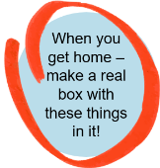

Cut around the outside of the box template
glue here
glue here
glue here
glue here
glue here
Notes:
Use this slide to display to learners when they are assembling their box.
The box template can be found on slide 35.

Slide 16












Spend time relaxing watching a favourite film
Going for a dog walk
Reading a book
Extra lessons
Mindfulness activities
Spending time outside
Support lines
Eating health meals
Talking to a professional
Writing down ideas
Talking to friends or family
Personal research
Notes:
This slide can be used to scaffold ideas for learners. Learners may see a picture and make the links to their own support networks and what they may need to help them achieve their goals.

Slide 17
Case
Studies
Read through the case studies on the next few slides.
Think about the challenges the characters are facing.
Think about what you could do to support them to overcome this challenge.
Finish off the comic strip showing how you would help the character.

Slide 18
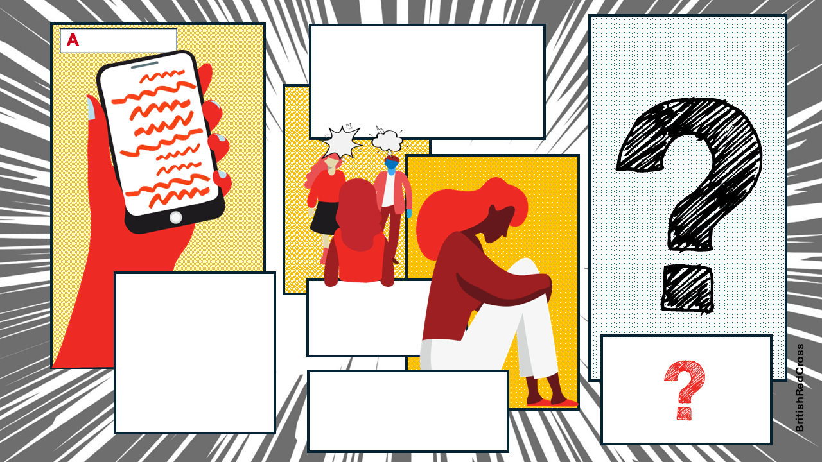
few weeks ago,
The next day, when walking home from college, a group of people in her year started shouting abuse at Amy.
She then started to receive hateful messages on social media.
Amy was tagged in a post online publicly embarrassing her.
It was shared around college, even by people she thought were her ‘friends’.
She felt isolated and anxious.
When Amy got home, she went straight to her room.
She told a teacher about it a while ago and was told that “everything would be OK”, but right now, nothing is.

Slide 19
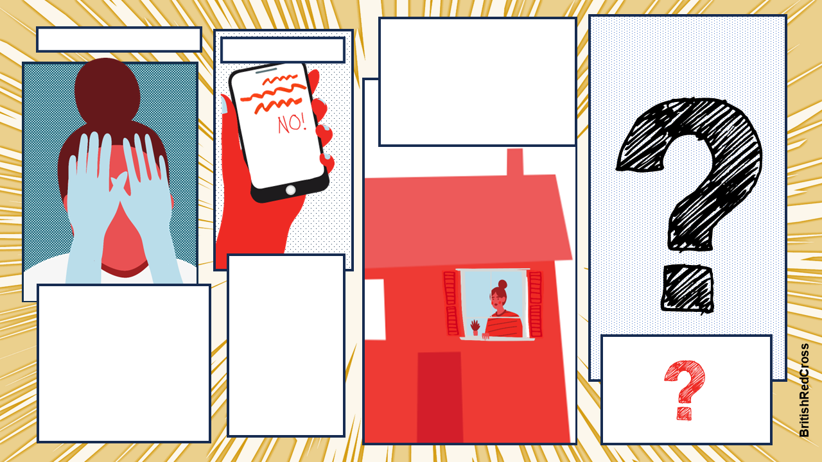
F
or the past two months
Asha has rarely attended school since the summer holidays ended. They sit in their room all day in silence. They don’t know what to do to make their days feel bright again.
T
hree weeks ago,
Asha’s friends asked them to the cinema. They said no because they couldn’t face leaving the house as they wanted to be alone.
Asha has been feeling low. They have noticed that they have been crying more than usual and have felt some rapid changes in their emotions. They are starting to find it hard to sleep.

Slide 20
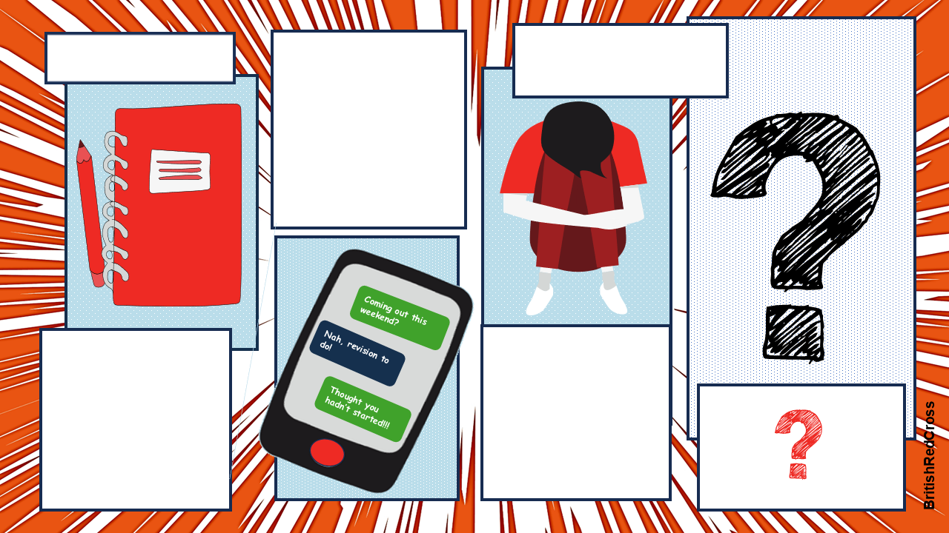
M
Max feels like there isn’t enough time to squeeze in all of his revision.
ax is finding it hard
to study for his exams.
As the weeks draw closer to Max’s exams, he becomes stressed and is starting to regret not revising sooner. It turns out, his friends had started to revise weeks back but just didn’t admit it.
He has workbooks and notes from class, but he keeps putting off his revision. His friends said they haven’t revised yet, so he doesn’t see the need to start just now.
He feels weighed down and like there is too much to do. This leads to more procrastination and no revision. His first exam is in 8 days, and he does not feel prepared.

Slide 21
Case
Studies
You have been sent a message from a friend.
Think about how they may be feeling.
Think about the reactions your friend may have to this challenge.
What could you do to help them?

Slide 22

Monday 1st August
Today, the messages got worse. Not only were they on WhatsApp, but people are now sending me pictures on Snapchat of myself that they have edited. One person messaged me and said that they will make sure that
nobody talks to me because that is what I deserve. They said I was ugly and worthless. I don’t know what I have done wrong. This has been going on for too long now. Maybe they are right…
Notes:
Choose a case study or case studies from ‘A message to a friend’.
Discuss ways in which people can communicate with one another. Explain that not every communication has to be face-to-face and sometimes people aren't comfortable sharing their feelings face-to-face with others.
Read through the journal entry with the learners. Discuss what is happening and ask the learners how the character may be feeling. Make a note of the different feelings the character may be displaying and the impact it may have on that person’s life. Discuss with the learners that it is important to connect with those we have around us when we are coping with a challenge.
We may not want to connect with them and discuss our challenges face-to-face, but there are other ways we can get our feelings across such as writing a letter or journal entry for others to read and respond to.

Slide 23







Suzie
Last seen 2hrs ago
You have one voice note.
Listen to voice note.
Notes:
Choose a case study or case studies from ‘A message to a friend’.
Discuss ways in which people can communicate with one another. Explain that not every communication has to be face-to-face and sometimes people aren't comfortable sharing their feelings face-to-face with others.
Listen to the voice note with the learners. Discuss what is happening and ask the learners how the character may be feeling. Make a note of the different feelings the character may be displaying and the impact it may have on that person’s life. Discuss with the learners that it is important to connect with those we have around us when we are coping with a challenge.
We may not want to connect with them and discuss our challenges face-to-face, but there are other ways we can get our feelings across such as sending a voice note to a friend.

Slide 24


Felix:
Hi Sam
Felix:
Ye all good
DELETED
Sam:
Alright mate how you doing
DELETED
Sam: You sure? You haven’t been to practice in weeks. Barely seen you at school and none of the others have had a proper response from you either so just wanted to check in
Felix:
In all honesty, I don’t know what it is. I just feel so down.
Felix:
All good you?
Sam:
I’m sound mate. Listen I’ve noticed you’ve not been yourself recently and just wanted to check if everything was ok
Notes:
Choose a case study or case studies from ‘A message to a friend’.
Discuss ways in which people can communicate with one another. Explain that not every communication has to be face-to-face and sometimes people aren't comfortable sharing their feelings face-to-face with others.
Read through the messages with the learners. Discuss what is happening and ask the learners how the character may be feeling. Make a note of the different feelings the character may be displaying and the impact it may have on that person’s life. Discuss with the learners that it is important to connect with those we have around us when we are coping with a challenge.
We may not want to connect with them and discuss our challenges face-to-face, but there are other ways we can get our feelings across such as sending a message to a friend.

Slide 25
Learning the skill of resilience can be done in many ways.
A surprising way to build resilience is by helping someone else.
Think of ways in which you can show kindness to someone coping with a challenge.
Write down or draw these ideas and pop them into a jar.

Slide 26


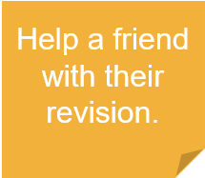





Go for a walk with a friend.
Plan a movie night with friends.
Celebrate a family members successes.
Message a friend you haven’t spoken to recently.
Notes:
Discuss what the term ‘acts of kindness’ means to the learners.
Explain that acts of kindness do not have to be grand gestures and can be something as simple as making a cup of tea for a family member or messaging a friend they haven’t spoken to in a while. Actively seeking out these interactions with others can improve one's connections with others and can also make the person they are supporting feel listened to and cared for.
Ask learners discuss some small acts of kindness and the impact they may have on someone. Once they have discussed their ideas, ask them to write them down and place them in a jar if available. These ideas can be revisited by learners who would like to spend some time supporting themselves and others.
Learners could draw a jar and write ideas inside their box. These ideas could be ticked off as they’re complete.
Learners can use the jar template in the print outs document to write or draw their ideas in.

Slide 27





You can contact Childline about anything for free. Whatever your worry, they are here to support you.
Call 0800 1111
Have a 1-2-1 chat
Email a counsellor on their website: childline.org.uk/get-support
YoungMinds are the UK’s leading charity fighting for children and young people's mental health.
Text YM to 8525
Visit their website youngminds.org.uk/young-person
Samaritans is not only for the moment of crisis. they also take action to prevent the crisis.
Call 116 123 for free, 24/7
Write an email to them: jo@samaritans.org
Notes:
Display the different sources of support learners can use If needed,
Have a discussion around the source of support in your local area and how these can be accessed.

Slide 28
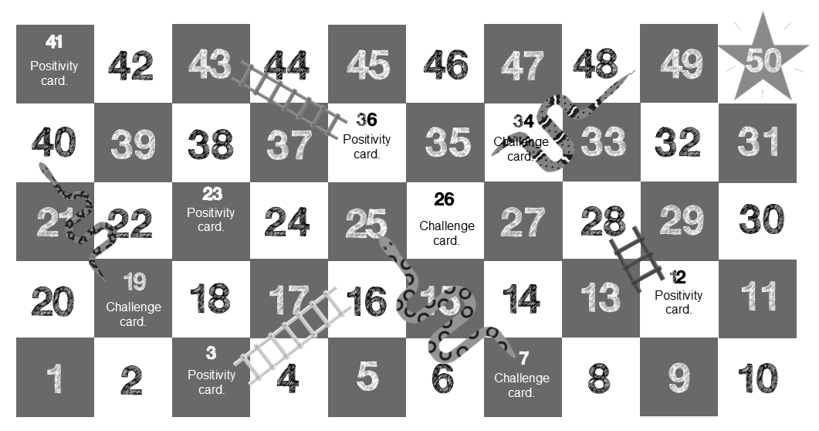
Notes:
This can be printed off and given to learners either one between two or one between four.
This can be displayed on the screen and the learners can be split into two groups, using post it notes as counters to move along the board.

Slide 29
Challenge card 1
Self-esteem
Challenge Card 2
Self-esteem
Clara is feeling down because she doesn’t look like the girls she sees on social media. She has started skipping breakfast.
What could Clara do to make herself feel better?
AJ is being picked on because of the way he looks. He feels silly for being upset and doesn’t know who to talk to.
What advice would you give AJ?
Challenge Card 3
Self confidence
Challenge Card 4
Self confidence
Marie is looking for a part-time job now that she has turned 16 but she is struggling to find work. She has applied for over 30 different jobs and has only had rejections. She feels like she is not good enough and has given up trying.
What would you suggest that Marie does to help her find work?
Alanah is struggling at school. She is getting lower grades than expected in her tests and she is embarrassed to ask for help. She feels worthless and doesn’t want to face another test again.
What could she do to get support?
Notes:
Challenge cards used for snakes and ladders At the end of a snake, players will land on a challenge card and will have opportunities to read the case study and give advice
Cards relate to different mental health worries.
These can be printed off and given to each group, or can be kept with educator to read out if learners are split into two groups.
https://www.mind.org.uk/information-support/types-of-mental-health-problems/

Slide 30
Challenge card 5
Loneliness
Challenge card 6
Loneliness
Amir recently lost his grandad, the person who he was closest to and the only person who understood him.
He feels alone and as though he has no one he can talk to.
What could Amir do?
Milo has had a lot of changes in his life in the past few months. He has moved country, home and school and is struggling to make friends. He hasn’t spoken to somebody his own age in three weeks. He feels desperately lonely.
What would you do to support Milo?
Challenge card 7
Feeling low
Challenge Card 8
Feeling low
Ishmael has been feeling low for a few months now. He feels as though there is a dark cloud hanging over him and he doesn’t know why. He feels like sometimes he wants to scream and shout, and other times he locks himself in his room.
How would you support Ishmael?
Rani has been feeling sad for a while.
She doesn’t want to go out when her friends ask her to. She would rather sit alone in her room in the dark.
How could her friends support her?
Notes:
Challenge cards used for snakes and ladders At the end of a snake, players will land on a challenge card and will have opportunities to read the case study and give advice
Cards relate to different mental health worries.
These can be printed off and given to each group, or can be kept with educator to read out if learners are split into two groups.
https://www.mind.org.uk/information-support/types-of-mental-health-problems/

Slide 31
Challenge Card 9
Anxiousness
Challenge Card 10
Anxiousness
Amari started at a new school three days ago and is yet to speak to anyone. Amari sat on his own during lunch time and couldn’t bring himself to make eye contact with anyone in his class. He is scared nobody will like him.
How would you help Amari in this situation?
Whenever Ashleigh leaves the house, she feels as though people are watching her. She is scared she will do something silly, and people will laugh at her. She is scared people will talk about her when they see her.
How would you help Ashleigh in this situation?
Challenge Card 11
Stress
Challenge Card 12
Stress
Elli had to leave home in the early hours of the morning last week because a river had burst near his home. His home is now flooded, and he and his family are currently sleeping in the local community centre. He is struggling to sleep and has exams in a few weeks.
What could Eli do to cope with the stress he is feeling?
Javier has exams coming up. They feel like they are going to fail so are spending all their free time revising. They feel like this isn’t working and the stress is affecting their relationships at home. Javier is now not eating properly as they feel too sick to eat.
What could Javier’s family do to support them?
Notes:
Challenge cards used for snakes and ladders At the end of a snake, players will land on a challenge card and will have opportunities to read the case study and give advice
Cards relate to different mental health worries.
These can be printed off and given to each group, or can be kept with educator to read out if learners are split into two groups.
https://www.mind.org.uk/information-support/types-of-mental-health-problems/

Slide 32
Challenge Card 13
Sleep
Challenge Card 14
Sleep
Abbie hasn’t been feeling herself for a while. She is worrying about things at home getting worse. She is now struggling to fall asleep, and when she does, she keeps waking up. She averages around 3 hours of sleep a night. She is so tired at school she cannot focus.
Where could she go for help?
Felix witnessed a traumatic event two months ago and relives the experience whenever they close their eyes. They’re frightened to be in a dark room on their own and when they finally fall asleep, they wake up sweating after having nightmares. They are too scared to speak to anyone about this.
What could Felix do to support themselves?
Challenge Card 15
Anger
Challenge Card 16
Anger
Remi has been struggling to control their anger recently. They struggle when they’re asked too many questions, and they feel like they are lashing out at things they shouldn’t be.
They shouted at their little brother last week and made him cry. They are struggling to keep friends at school.
What advice would you give Remi?
Tom has found it hard to control his anger recently. He feels like he is not being listened to and feels overlooked. He has a lot of anger that he doesn’t know how to control. He hit his friend last week and is scared it will happen again.
What could Tom do to support himself?
Notes:
Challenge cards used for snakes and ladders At the end of a snake, players will land on a challenge card and will have opportunities to read the case study and give advice
Cards relate to different mental health worries.
These can be printed off and given to each group, or can be kept with educator to read out if learners are split into two groups.
https://www.mind.org.uk/information-support/types-of-mental-health-problems/

Slide 33
Challenge Card 17
Panic Attacks
Challenge Cards 18
Panic Attacks
Recently, Kaira has been struggling more than usually in large, busy spaces.
She went shopping last week and could felt her heart rate increasing, she felt faint and started sweating. All these things made it hard for her to breathe. She doesn’t want to go out again.
What could Kaira do to support herself?
Arnie is struggling to get to school as recently they have started having panic attacks on the bus. When on public transport, they feel they are enclosed and can’t escape. They begin to feel dizzy, and their legs start shaking.
How could you help Arnie?
Challenge Cards 19
Seasonal Affective Disorder
Challenge Cards 20
Seasonal Affective Disorder
During the winter, Ben struggles to focus and always feels tired. It is dark when he leaves for school and dark when he comes home. He struggles to wake up in the morning and feels tired throughout the day. This doesn’t happen in the summer, and it is really bringing him down.
What could Ben do to make himself feel better?
Tyler is struggling with the summer season. They are struggling to sleep as it is still light when they go to bed and the sunrise at 3:30am wakes them up. They feel too hot to eat and are now only eating one meal a day and they are starting to lose concentration during the day.
What could Tyler cope with this challenge?
Notes:
Challenge cards used for snakes and ladders At the end of a snake, players will land on a challenge card and will have opportunities to read the case study and give advice
Cards relate to different mental health worries.
These can be printed off and given to each group, or can be kept with educator to read out if learners are split into two groups.
https://www.mind.org.uk/information-support/types-of-mental-health-problems/

Slide 34
Positivity Card
Positivity Card
Positivity Card
Write down or draw three things that make you feel happy.
Write down or draw three people who inspire you.
Write down or draw two of your favourite animals.
Positivity Card
Positivity Card
Positivity Card
Write down or draw three things that make you feel safe.
Write down or draw three people who you can talk to.
Write down or draw two of your favourite songs.
Positivity Card
Positivity Card
Positivity Card
Write down or draw three things that make you feel calm.
Write down or draw two of your favourite foods.
Write down or draw two of your favourite smells.
Positivity Card
Positivity Card
Positivity Card
Write down or draw three places that make you feel at peace.
Write down or draw two of your favourite films.
Write down or draw two things you love to see.
Notes:
Positivity cards to be used for snakes and ladders When a player lands on a square at the bottom of a ladder, they must pick and complete a positivity card activity. Once they have completed the activity, they can then move up the ladder.
Their answers can be written, drawn, discussed or even acted out.
https://www.mind.org.uk/information-support/types-of-mental-health-problems/

Slide 35
Fold
Cut
Notes:
Cut around the outside of the shape, ensuring learners do not cut off the flaps. Learners should only cut along the dotted lines.
On one side, ask the learners to write or draw their goals and aspirations.
Ask learners to think about and discuss what barriers may stand in their way of achieving that goal. It may be money, self-confidence, local issues such as lack of opportunities.
Ask learner to think about what they can use to help them overcome those barriers. This could be talking to a friend or family member, getting a part time job, taking a walk every afternoon/evening to get some fresh air.
Ask learners to write or draw the things that can help them achieve their goals on the opposite side of the box.
Learners should have their goals and aspirations on one side, and what they can use to overcome any barriers on the flip side.
Once learners have written or drawn their ideas, ask them to fold the solid edges towards the centre.
Glue the flaps to the inside of the box so no one can see them.
Do not glue the top flap if you want the box to be able to open and close.

Slide 36

Spend time relaxing, watching a favourite film
Going for a dog walk
Reading a book
Extra lessons
Mindfulness activities
Spending time outside
Support lines
Eating health meals
Talking to a professional
Writing down ideas
Talking to friends or family
Personal research
Notes:
This slide can be used to scaffold ideas for learners. Learners may see a picture and make the links to their own support networks and what they may need to help them achieve their goals.

Slide 37
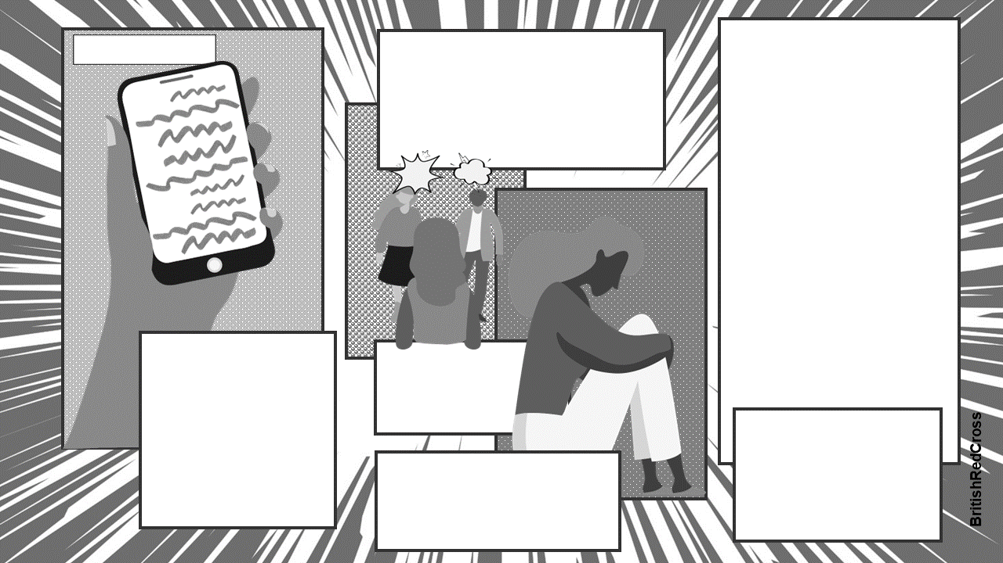
A
few weeks ago,
The next day, when walking home from college, a group of people in her year started shouting abuse at Amy.
She then started to receive hateful messages on social media.
Amy was tagged in a post online publicly embarrassing her.
It was shared around college, even by people she thought were her ‘friends’.
She felt isolated and anxious.
When Amy got home, she went straight to her room.
She told a teacher about it a while ago and was told that “everything would be OK”, but right now, nothing is.

Slide 38
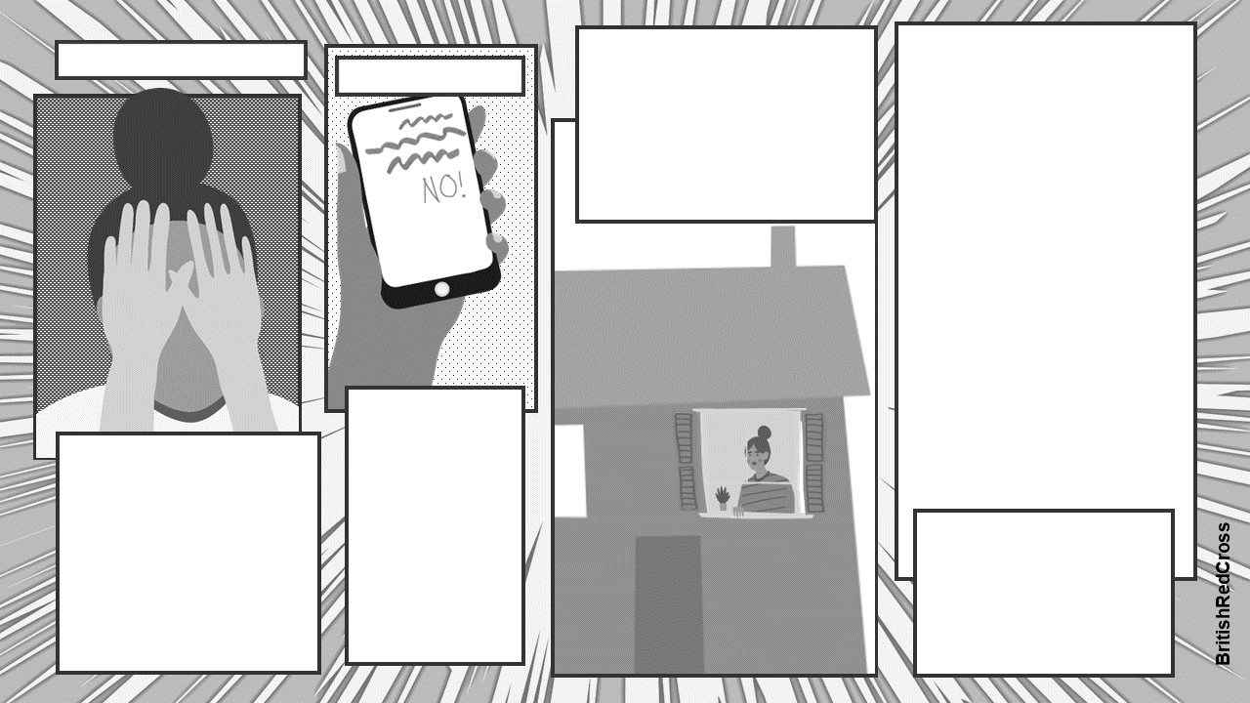
F
or the past two months
Asha has rarely attended school since the summer holidays ended. They sit in their room all day in silence. They don’t know what to do to make their days feel bright again.
T
hree weeks ago,
Asha’s friends asked them to the cinema. They said no because they couldn’t face leaving the house as they wanted to be alone.
Asha has been feeling low. They have noticed that they have been crying more than usual and have felt some rapid changes in their emotions. They are starting to find it hard to sleep.

Slide 39
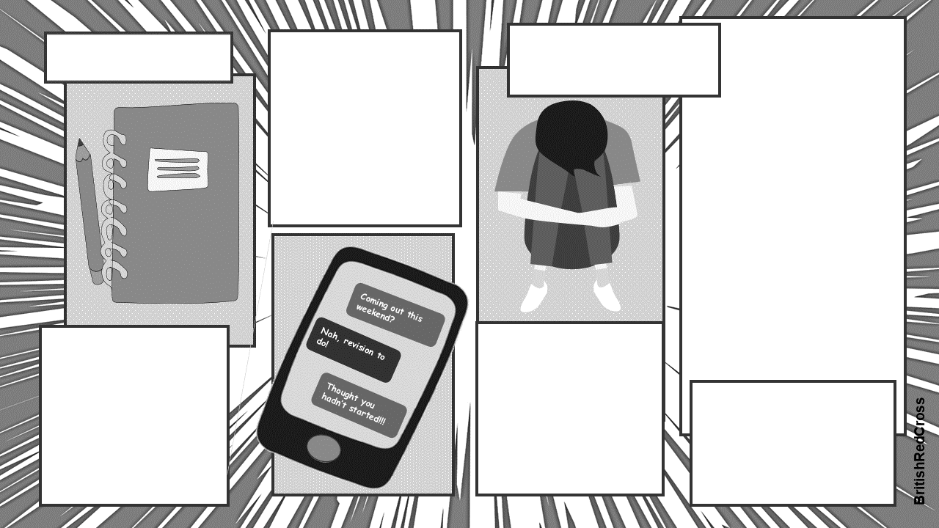
M
Max feels like there isn’t enough time to squeeze all of his revision in.
ax is finding it hard
to study for his exams.
As the weeks draw closer to Max’s exams, he becomes stressed and is starting to regret not revising sooner. It turns out, his friends had started to revise weeks back but just didn’t admit it.
He has workbooks and notes from class, but he keeps putting off his revision. His friends said they haven’t revised yet, so he doesn’t see the need to start just now.
He feels weighed down and like there is too much to do. This leads to more procrastination and no revision. His first exam is in 8 days, and he does not feel prepared.

