Slide 1

Lebanon: Families Fleeing Conflict
Notes:
What is happening in Lebanon?
Since the attacks in Israel in October 2023, and the escalation of the conflict that has led to unprecedented suffering in Gaza, the intensity of fighting in Israel and Lebanon has been escalating. In October 2024, the situation has got even worse. After a sudden increase in hostilities, many people have fled Southern Lebanon, as people try to escape the fighting. Many had been displaced from the area already.
[British Red Cross – October 2024]

Slide 2

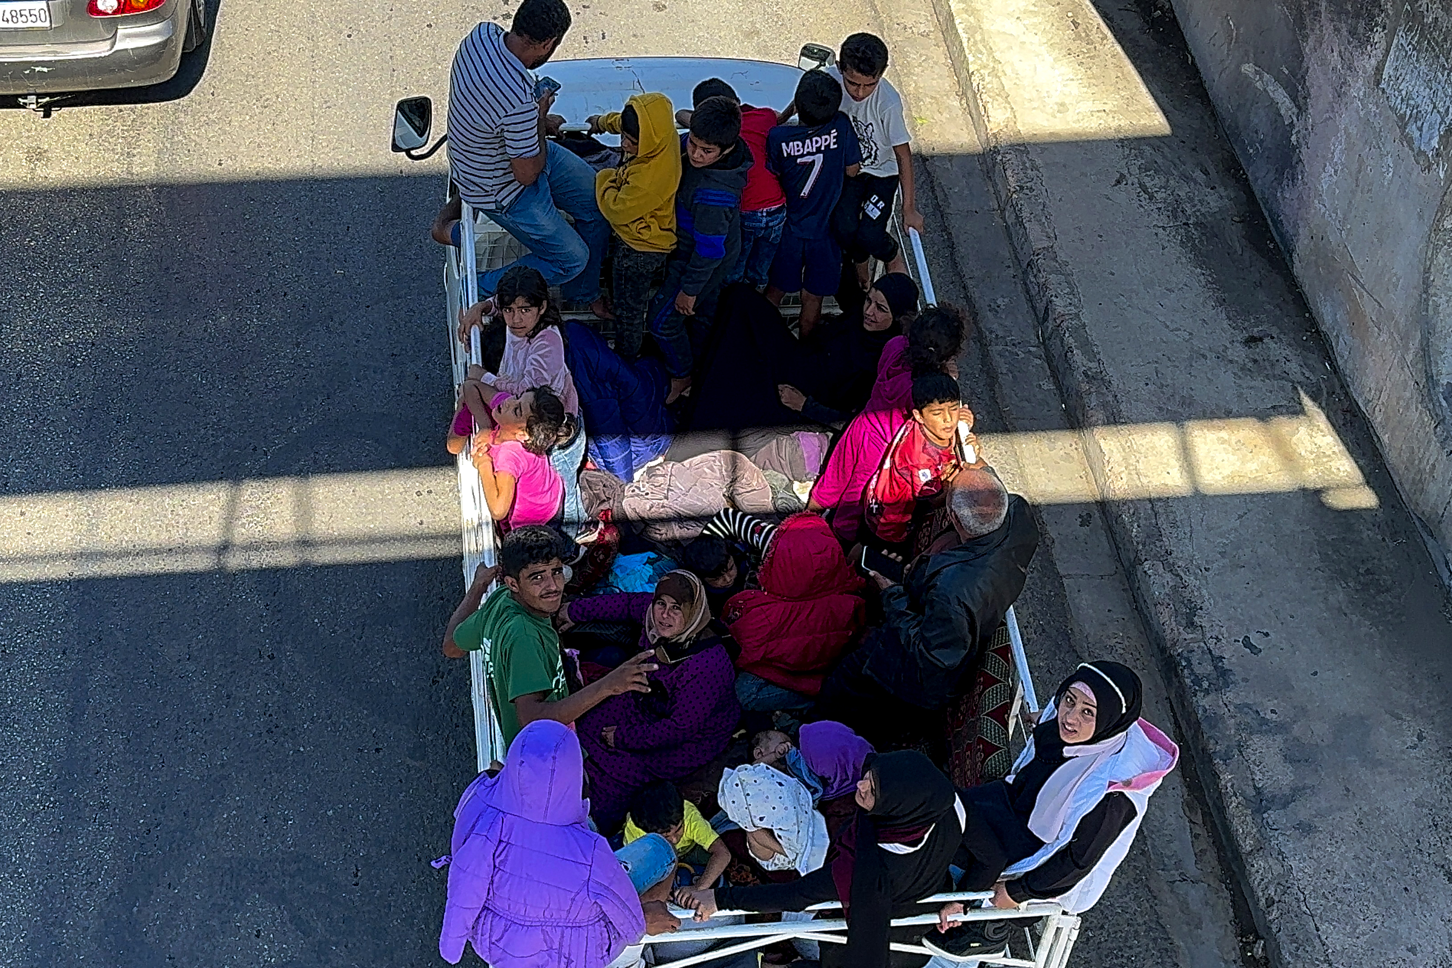

Photography: Andalou / Getty Images
See: What do you see in the picture? What’s happening?
Notes:
Photo description: Heavy traffic formed at the entrance of the city of Saida after residents of southern Lebanon, particularly from areas near the border, were forced to flee towards the north of the country due to the escalating conflict in September 2024.
Photo credit: Anadolu / Getty images

Slide 3
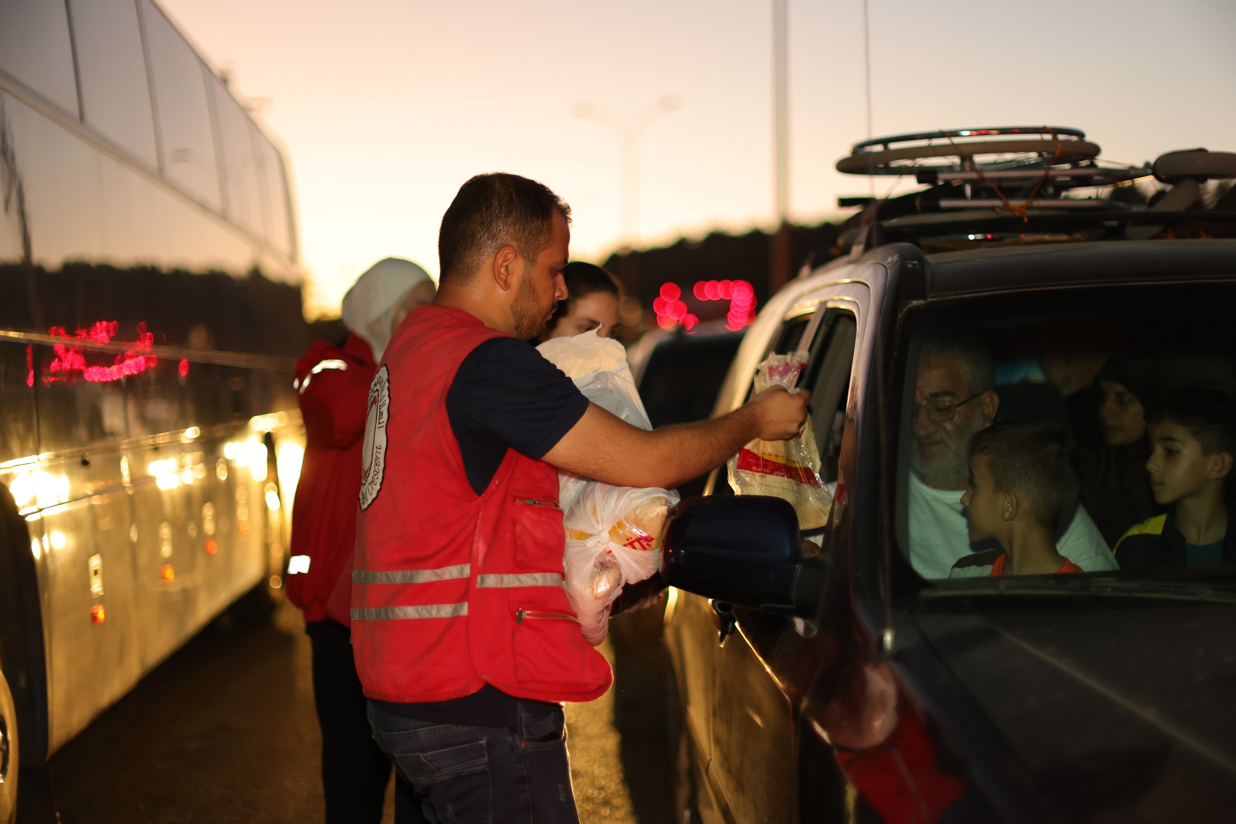
Photography: Syrian Arab Red Crescent
Think: What do you think these people are thinking about? What is important to them at this moment? Where is it they are going?
Notes:
Possible discussion points:
What they have left behind
Finding safety
Which of their belongings to take
What they have been through
Their friends and family members
Photo description: Amid escalating conflict in Gaza, Lebanon, and Syria, the Syrian Arab Red Crescent (SARC) has been on the frontlines, responding to the urgent needs of returnees and refugees entering Syria. The SARC has provided meals, water, and essential non-food items to help those fleeing conflict.
Photo credit: Syrian Arab Red Crescent

Slide 4
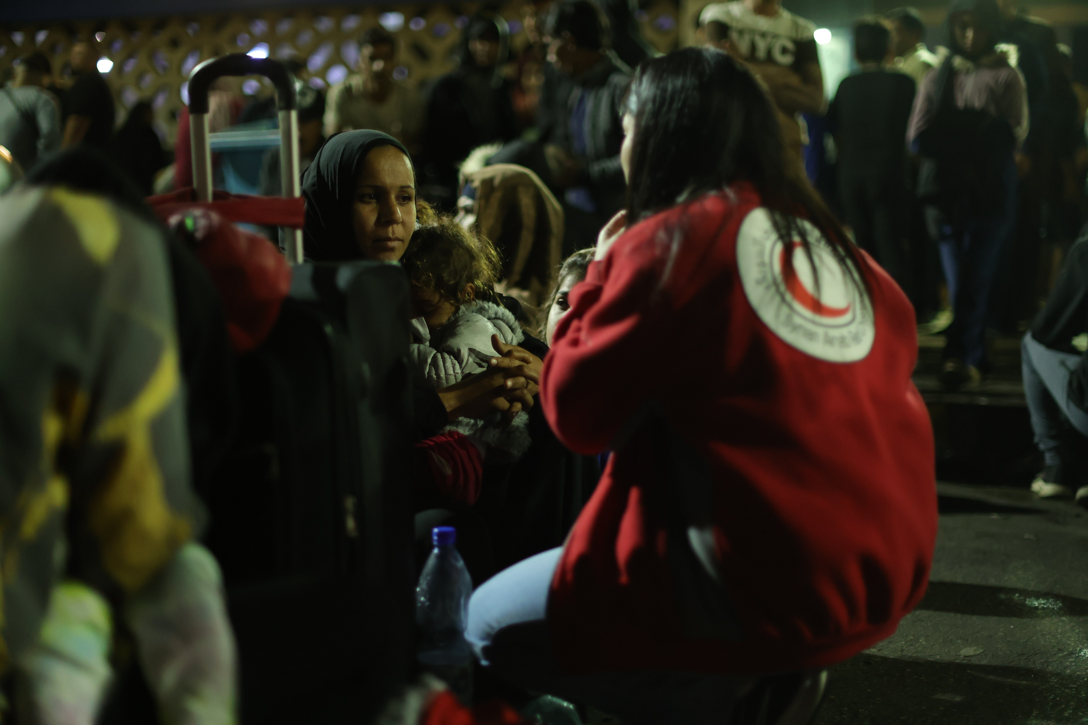
Photography: Syrian Arab Red Crescent
Many families are separated during conflict.
Feel: How do you think they feel? Why might they feel this way?
Notes:
Further questions for learners:
What do you think they might be asking this person about?
Did they have to leave family members behind?
How would you try to contact family members who had been left behind or lost in the journey?
Photo description: Amid escalating conflict in Gaza, Lebanon, and Syria, the Syrian Arab Red Crescent (SARC) has been on the frontlines, responding to the urgent needs of returnees and refugees entering Syria. The SARC has provided meals, water, and essential non-food items to help those fleeing conflict.
Photo credit: Syrian Arab Red Crescent

Slide 5


“Family separation during conflicts should be avoided at all costs, even if it means compromising on safety.”
Agree
Disagree
5
Notes:
Give learners the opportunity to share their answers. Once they’ve listened to each other’s arguments, give them a chance to review their position. If they wish to change sides, encourage them to do so.
Things for learners to consider:
difficulty finding contact during conflict (destroyed infrastructure for wifi/telephone, no address if moved away from home, disrupted postal service etc.)
priorities of humanitarian charities (providing shelter, places of safety, food, medical care)
disrupted government services (police, social care).
danger of conflict (military, combatants, presence of weapons)
needs of family (mobility, health, attachment to home)
accessing money

Slide 6

Reflect on your own:
What are your thoughts and feelings about
these images and the events you have talked
about?
6
Notes:
This is an extension task for personal reflection. Encourage learners to reflect on this activity, whether writing it down or just thinking.

Slide 7
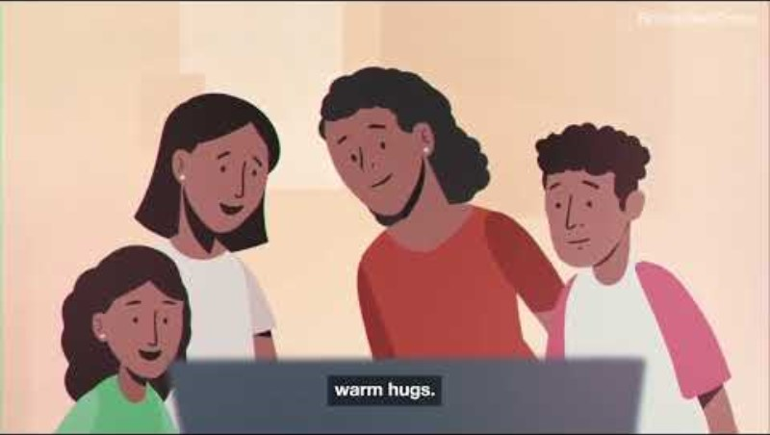
Watch this animation to find out how the Red Cross Red Crescent movement help reunite families fleeing conflict.
7
Notes:
Follow-up question for learners:
Reflect on Jan's story and the photographs of people fleeing the conflict in Lebanon you saw earlier. How did watching this animation make you feel?
Video credit: British Red Cross YouTube (https://youtu.be/OJDRn7UH3OI?feature=shared)

Slide 8
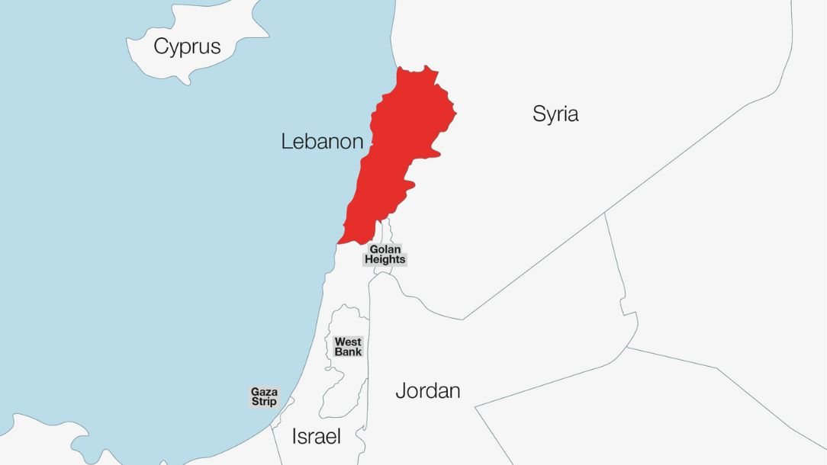
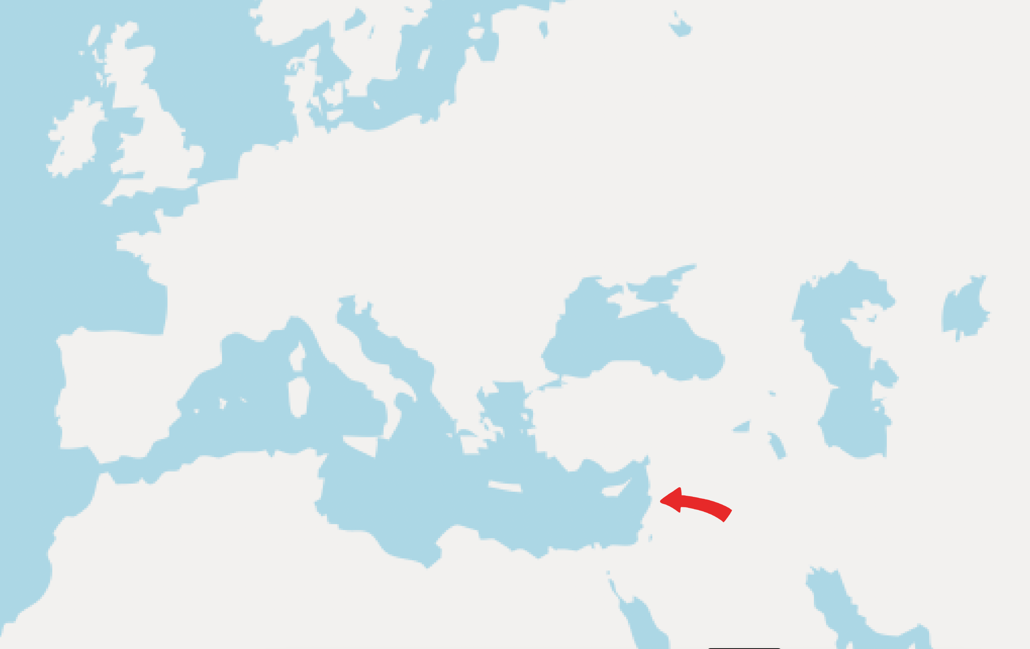
Where is Lebanon?
Notes:
Map credit: Lebanese Red Cross
Where is Lebanon?
Lebanon is located on the eastern shore of the Mediterranean Sea. Lebanon's southern border is shared with Israel, while Syria borders Lebanon to the east and north.

Slide 9



Learn more:
Learn more about the current situation in Lebanon on our website. Use our teaching resources to explore the topic further:
Rules of War (teaching resource).
If War Comes to You (interactive film).
Israel and the Occupied Palestinian Territory (Newsthink).
Brothers across borders (interactive film).
Share with others:
Share what you’ve learned with others. Show them the images, discuss the debate with them, or reflect together on how you feel about this event.
Do something:
Set up a fundraising event in your area or school for the British Red Cross’ Gaza Crisis Appeal. Funds raised will go towards supporting people who need it most, including in Lebanon and Gaza.
9
Notes:
Some ideas of what you and your learners can do next.

