Slide 1








How did you do?
The most important thing I learned today is…
I am going to share my learning from today by…
Plenary
In today’s lesson, I am happy with the way I…
Now I know how to…
The skills I used today were…
The part I enjoyed most about today’s lesson was…
Notes:
Ask learners to think of how they would complete two of these speech bubbles. Encourage them to look at the emojis for inspiration if they need. Learners may choose to select an emoji that best shows their reflections.
Give them a moment to think then ask them to share with the group or a partner.
Optionally, you might like to ask learners to write their responses.

Slide 2
Plenary
What do
the most?
you
remember
It could be
A practical way to prepare or cope
Think of something from our lesson that you will remember the most.
Something you feel you did well
A new skill
Notes:
You could ask learners to make a note of this (optionally, on a sticky-note) and then share with a partner or the group. Make a note of any misconceptions to address in future sessions.

Slide 3


Take a pause
You may have found today’s lesson emotionally challenging. Checking in with how we feel these emotions in our bodies can be helpful.
Plenary
Take a pause final body scan
Spend a minute reflecting on your learning and how it made your body feel.
Start at the tips of your toes and scan each part of your body up to the top of your head.
You may notice a part of you feels hot, jumpy, uncomfortable, cold, or anything else!
Remember to be kind and gentle to yourself.
Notes:
Explain to learners that it can be emotionally challenging to learn about weather emergencies. It can help us cope if we take a pause and notice how these emotions are making us feel. Encourage learners to use this exercise regularly, whenever they are feeling overwhelmed.

Slide 4
How did you do?
Instructions:
Reflect on your learning from today and the big questions you answered.
Draw a small target in your book. The aim of a target is to hit the middle.
Add a dot to show how you were feeling about this topic at the start of the lesson.
Add another dot to show how you feel about it now.
Questions:
Did you make progress towards the middle?
Why was this?
What could be the next steps in your learning journey?
Example:
Plenary
Start
End
Notes:
Allow learners a few minutes to draw their circles and add their reflections. Then, invite them to discuss the questions with a partner, or share with the whole group.

Slide 5
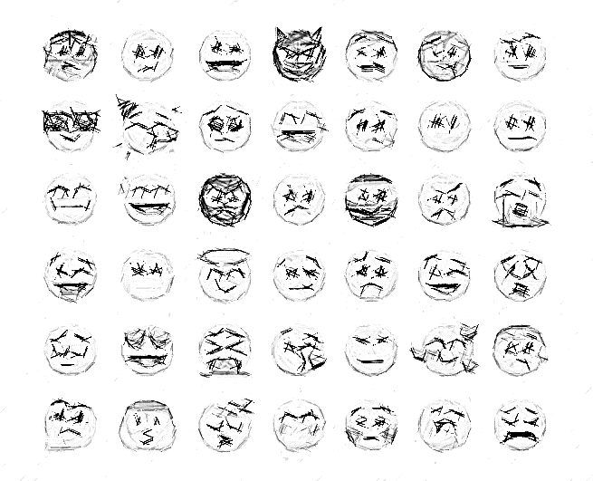
How was today’s lesson?
Reflect on how this lesson went for you.
Draw an emoji to share how you feel about this.
Say it
with
emojis ?
Plenary
I learned a lot about how I can cope, I’m going to think more about how I can share this to help others.
Notes:
Ask learners to quickly draw an emoji. Invite learners to share their emojis and ask them to explain. This could be to the group or partner.
Develop this plenary by asking learners if they can identify how this feels in their body.

Slide 6







Flooding
Heatwaves
Eco-anxiety
Read 3 characters’ flood stories and discuss how they could be affected.
Find out about the effects of heatwaves through completing a quiz.
Worksheet: heatwave facts to print
Read a character’s experience of eco-anxiety and use this to define what it is.
Look at local flood maps and the role of the emergency services to explore how flooding can affect us all.
Worksheet: note writing help
Examine a list of ways to cope and apply this to yourself and others.
Worksheet: coping with eco-anxiety
Learn how heatwaves affects our body and the first aid to help. Apply these to different scenarios.
Poster: heatwaves scenarios
Poster: heatwaves first aid
Create a video/script for social media of how to cope with eco-anxiety to share with friends and family.
Worksheet: eco-anxiety video script
Examine images of flooding and identify the dangers.
Create a decision flowchart to share with friends and family to help them prepare for a heatwave.
Worksheet: decision flowcharts
Play a scenario game to find out about bug out bags and why it is important to have one ready.
For use across all topics
Starters
Plenaries
Weather Together
award tracker
Bronze certificate
Silver certificate
Gold certificate
Play a ‘choose your own adventure’ game to learn how to respond to flood alerts and warnings.
Create resources to share with friends and family. This activity is designed to be repeated.
Rate these resources
Open another activity
Link
Link
Fill in this quick survey to help us improve Weather Together.
Click here to open the full web index.

