Slide 1


Humanitarianism in Action
Map of Syria
Slide 1

Slide 2
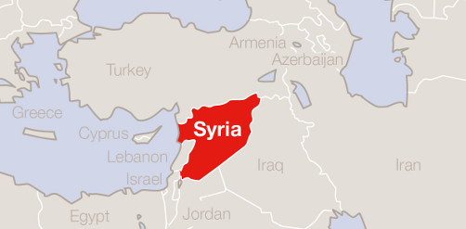
Map of Syria
This map is for illustrative purposes only and does not express a British Red Cross opinion.
© British Red Cross
Slide 2

Slide 3
Copyright notice
© British Red Cross 2015
All photographs fully protected by copyright. Schools and other educational organisations are free to use this PowerPoint for educational use. The licence does not extend beyond this use. This means that anyone wishing to put an image on a website, crop or edit it, or use it in any other way, must first contact the copyright holder and negotiate a licence for the use they require.
This resource and other free educational materials are available at redcross.org.uk/education
The British Red Cross Society is a charity registered in England and Wales (220949) and Scotland (SCO37738).
Slide 3

