Slide 1

Paw Patrol memory game.
Back to better
For full teaching resources visit our website
Notes:
Circles of control
Breathing with colour
Loss and ambiguous loss
Risk awareness
Shield
Preparedness
Healthy habits

Slide 2
How to play
Click PowerPoint view and show learners the next slides. Click “fast” “medium” or “slow” to flash up the cards at different speeds. Have learners try and remember the cards they see. They can try and remember the images of the social distancing rule on the card.
Click show all to reveal all the cards and see if they are correct. Play the game again on slide four with different cards.
At the end ask learners how many different rules they can remember.

Slide 3

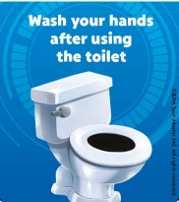
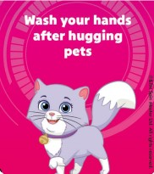
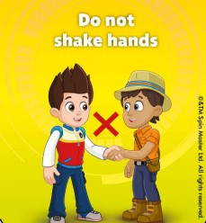
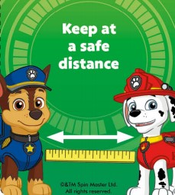
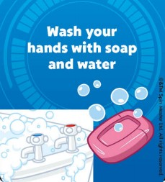
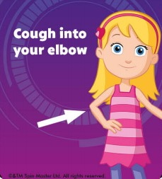
Fast
Medium
Slow
Show all
Hide all
Notes:
Right-click on an image and select change picture.
Select your picture. Click on insert.
Start your presentation.
Click on Fast, Medium or Slow to show the series of images.
Click Show All to see all the images.
Click Hide All to hide all the images.

Slide 4
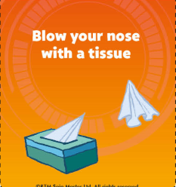
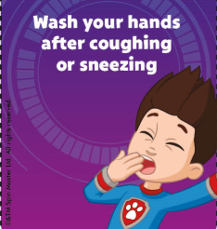
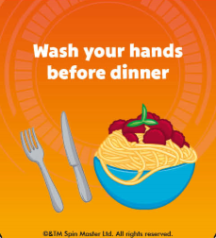
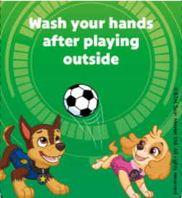
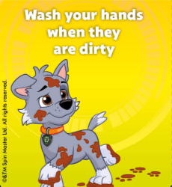

Fast
Medium
Slow
Show all
Hide all
Notes:
Right-click on an image and select change picture.
Select your picture. Click on insert.
Start your presentation.
Click on Fast, Medium or Slow to show the series of images.
Click Show All to see all the images.
Click Hide All to hide all the images.

