Slide 1





Instructions
Weather Together: heatwave safety
30 Minutes
Success criteria
Must identify ways to help in a heatwave emergency.
Should explain how to avoid becoming unwell in a heatwave.
Small group
Discussion
Invite learners to take a pause [3], then introduce the objective and the big question [4,5].
Ask learners to look at the image of a phone in the sun and discuss ideas [6]. Then, share the damage the sun can cause [7]. Support learners to make the connection that the sun can damage our bodies too [8].
Explain that learners will learn some heatwave first aid and introduce the task [9]. Invite learners to reflect on their first aid learning by answering the questions [10].
Explain that next learners will put their first aid into practice. Go through the instructions on the slide [11].
Gather learner’s attention and invite reflection [12].
Refer back to the big question to review progress [13].
Apply your learning to prepare for and cope with a heatwave
How to run the activity
What you need
Print heatwaves first aid posters, enough for one between two.
Print heatwaves first aid scenarios, enough for 1 per small group.
Optional: laptops/tablets
Invite learners to answer the question ‘how can heatwaves affect a phone?’ by conducting their own research. You could invite them to do the same to learn about heatwaves first aid.
Invite learners to create roleplays of the scenarios or think of their own scenarios to show the class how to apply the first aid information.
Ways to adapt
England: PSHE, Language and literacy, Citizenship
Scotland: Health and wellbeing, Literacy
Wales: Health and Wellbeing, Languages, Literacy and Communication
Northern Ireland: Communication, Thinking skills and personal capabilities,
Language and literacy.
Curriculum links
The British Red Cross Society © 2022 incorporated by Royal Charter 1908, is a charity registered in England and Wales (220949), Scotland (SC037738) and Isle of Man (0752)

Slide 2
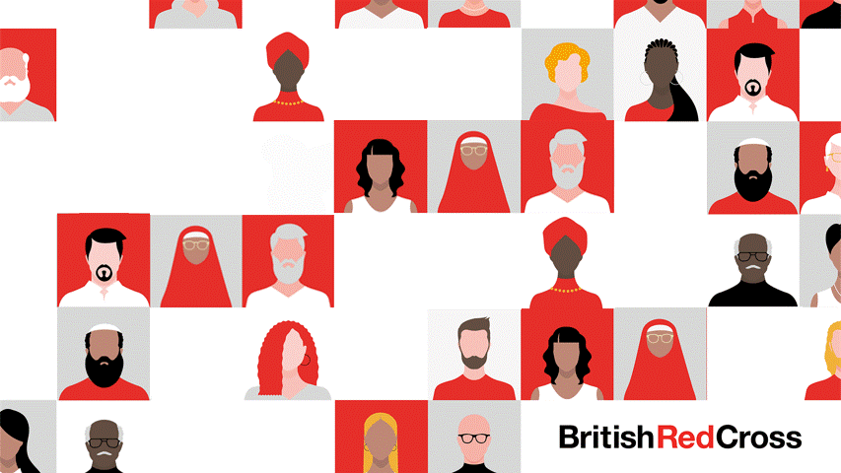
Screensaver
Notes:
This is a screen saver which you could use while settling the group.

Slide 3



Take a pause
Notice and name
Pause
Focussing your attention on different things can help quieten your thoughts.
Sit up straight with your feet flat on the ground and your hands resting in your lap.
Take a long, deep breath.
Look around you and name 3 small details you can see to yourself, in your head.
Then, listen and name 3 small sounds you can hear.
Finally, focus on your body and name one sensation you can feel.
Take a pause happy place
Notes:
You can explain that it can be distressing to listen to other’s experience of the challenges they’re facing, especially if we have similar experiences and challenges. A way of coping with this is to take a moment and focus on our breathing.
Remind learners this is a way of being kind to ourselves which is important. How our body feels matters.
Explain to learners that sometimes we find our minds full of thoughts that are difficult to calm. This exercise can help quieten the mind.
Prompt learners to move through the steps.
You could invite learners to share, if they choose, how they found this breathing activity. Reassure learners that everyone’s body is different so everyone will respond to this activity differently.

Slide 4

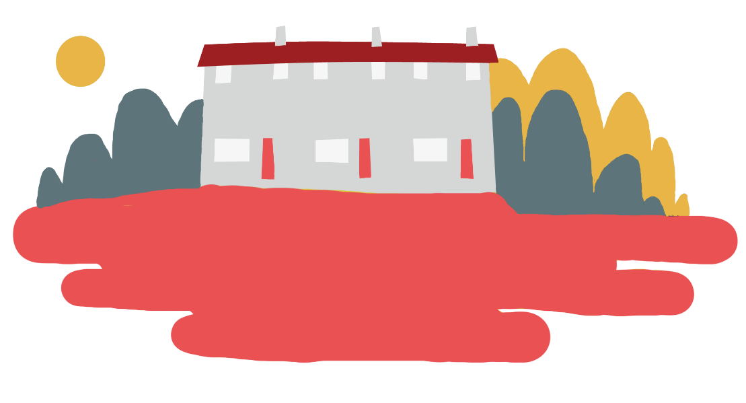

Objective
Heatwaves
Objective: Apply your learning to prepare for and cope with heatwaves.
To meet this objective, you’ll learn about heatwaves first aid and apply this knowledge through engaging in a scenario.

Slide 5
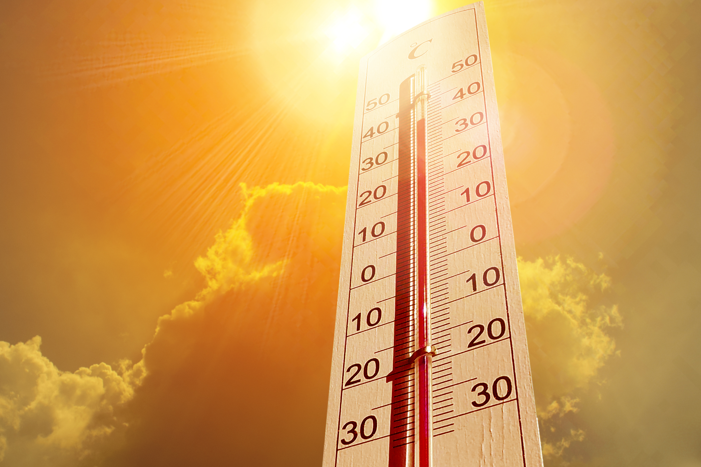

Big question
Big question
How can you prepare for and cope in a heatwave?
Notes:
Big questions are an assessment tool for educators and learners to demonstrate progress through an activity.
Share this slide with learners and give them a moment to reflect on the question.
Then, ask them to discuss with a partner before sharing their ideas with the group.
At this point in the activity, it is expected that learners may not have many ideas or know how to answer this question.
The question will be reviewed at the end of the activity. This is an opportunity for learners to see how much progress they’ve made and how many more ideas they now have.

Slide 6
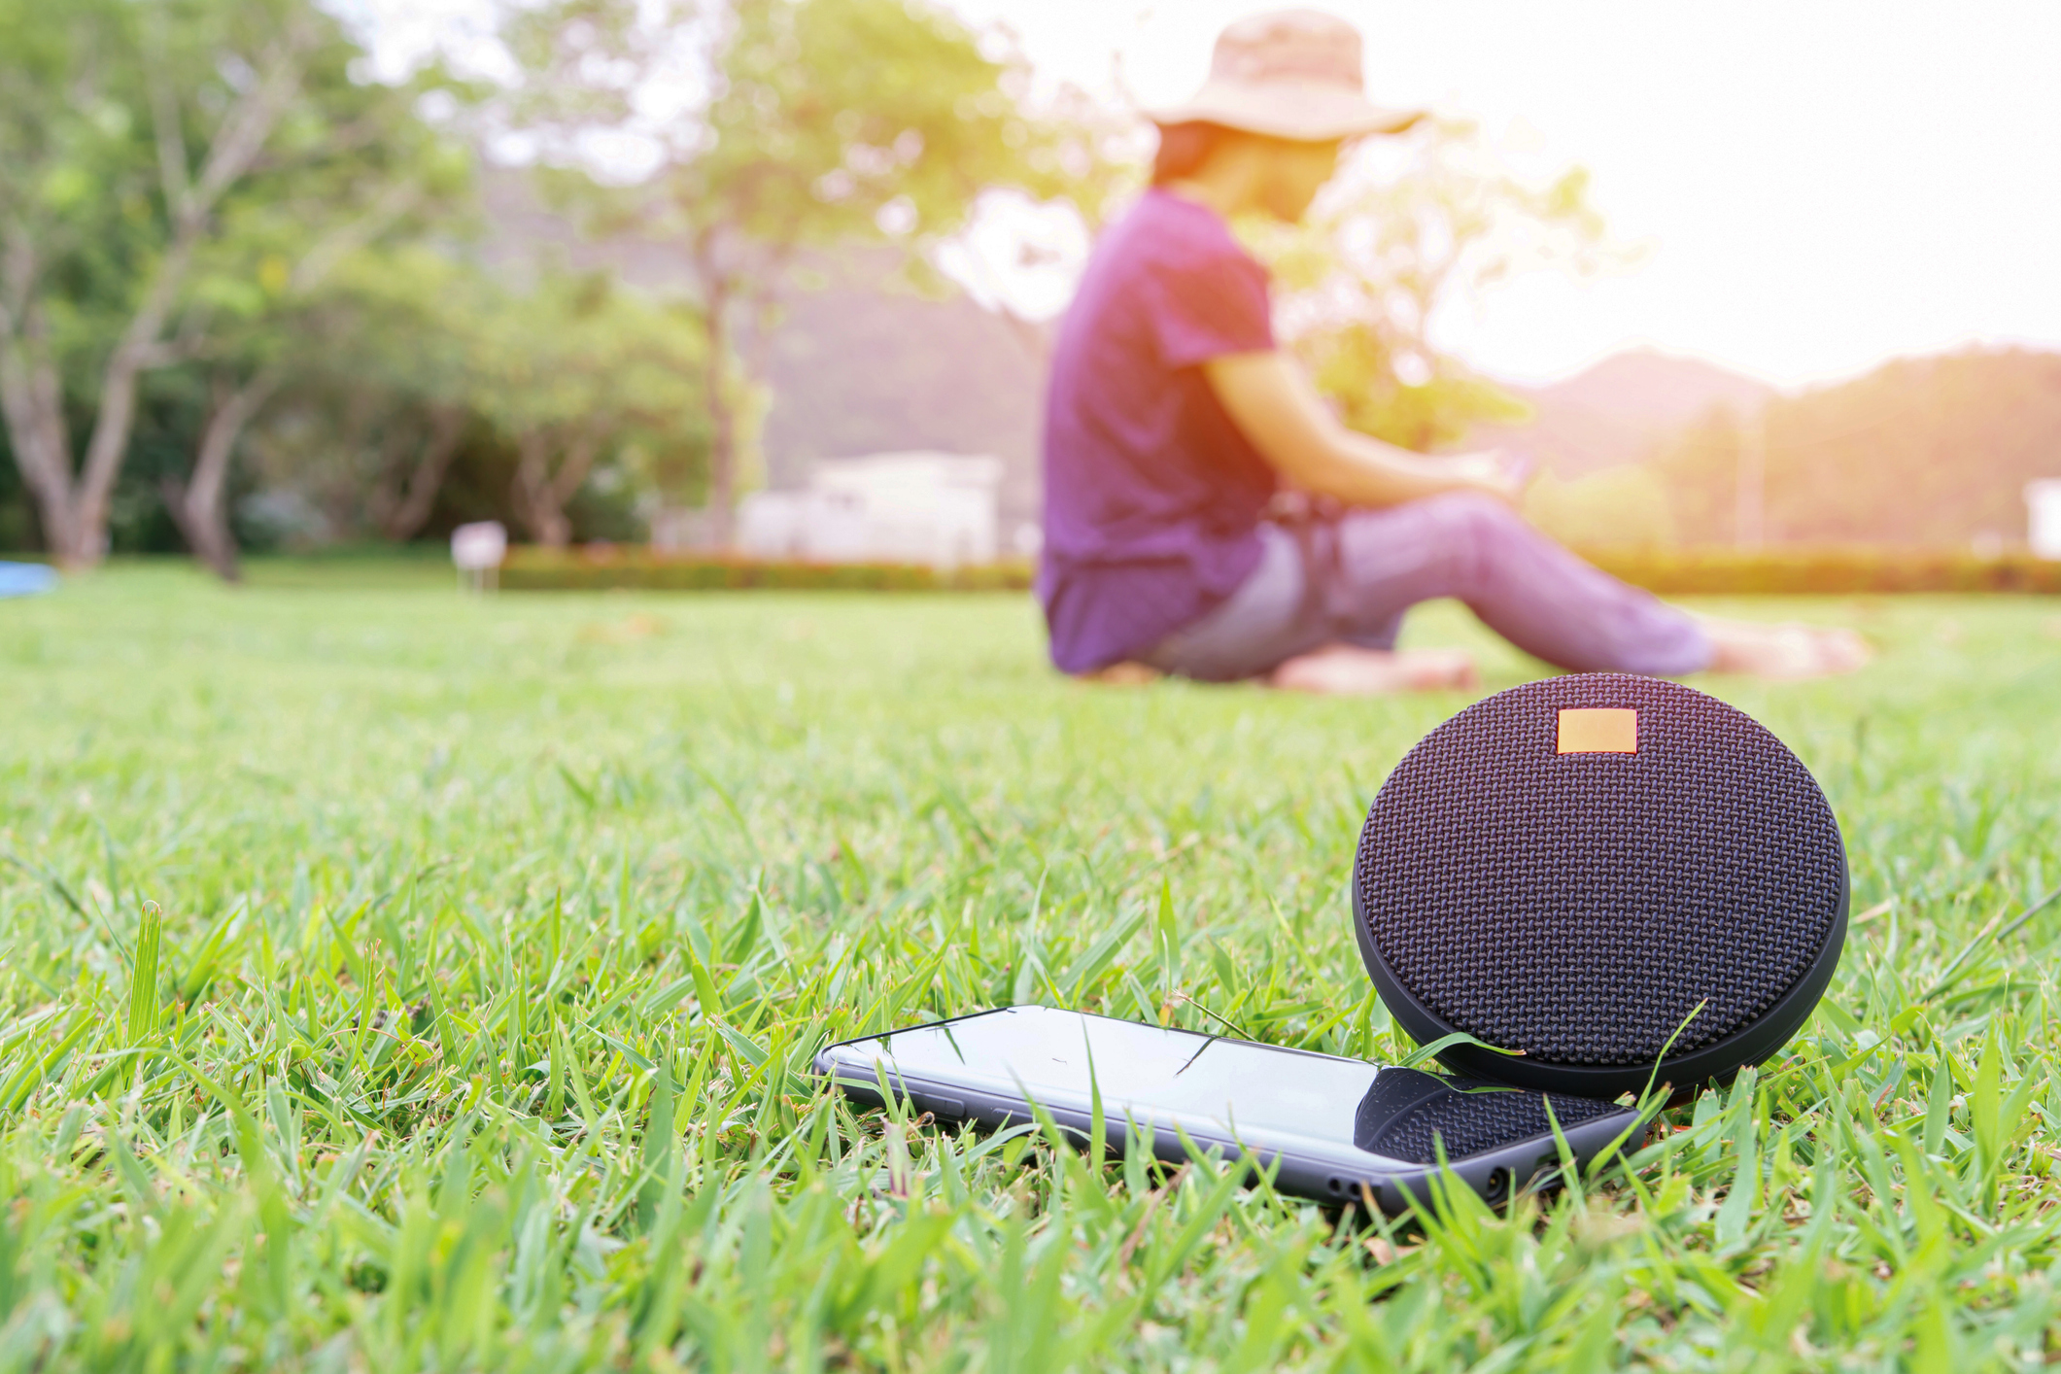
How can heatwaves affect a... phone?
Here’s some questions that might help you:
Have you ever left your phone in direct sunlight and found a problem?
First, identify what you can see in this image.
Have you ever noticed heat causing problems for your phone?
Have you ever left your phone in a hot car and noticed anything different about it?
Then, think about what could go wrong with this.
Notes:
This slide is to engage learners with the idea that sunlight and heat can cause many problems for all of us.
Ask learners to talk to a partner about what they can see in the image, then share together as a group.
Repeat this approach for thinking about what could go wrong.
Learners should start to consider the impact of sunlight on a phone (heat and direct sunlight are bad for phones and can break them).

Slide 7
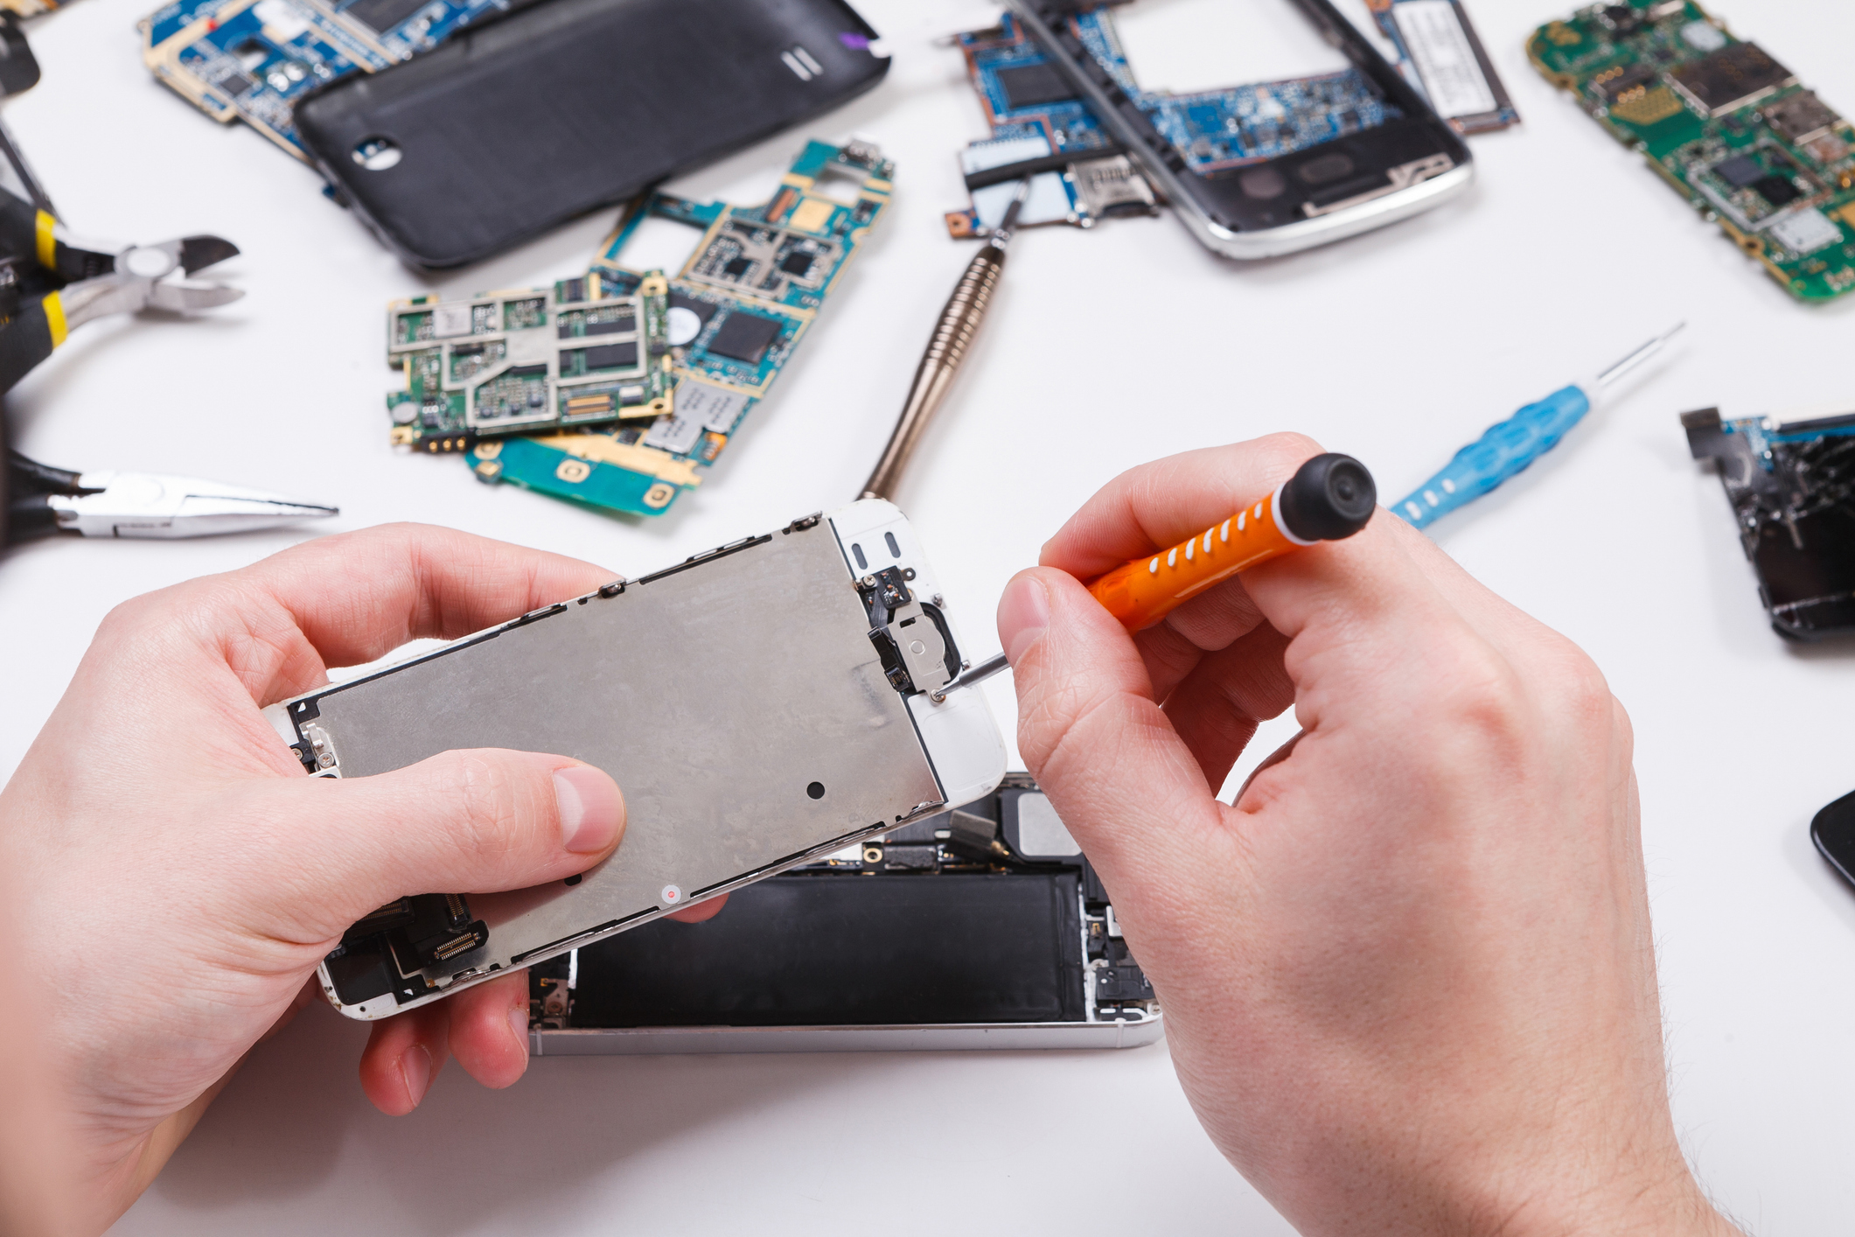
How can heatwaves affect a phone?
How can heatwaves affect a... phone?
Heatwaves can cause your phone to get too hot, especially if you leave it in direct sunlight.
This can damage the parts inside your phone.
The circuit boards can warp (bend or distort) and your battery can overheat.
Direct sunlight can damage the screen, causing it to crack or stop responding when you touch it.
You may notice your phone works much slower in a heatwave, even without being in sunlight.
Discuss
What problems might you have in a heatwave if you can’t use your phone?
Notes:
Share the consequences of light and heat for phones with learners.
Encourage learners to answer the question by thinking practically. If there was an emergency or serious situation, what would it mean for them if their phone was broken? If they had gone out with friends and needed to arrange a lift or look up bus times, what would it mean if their phone was broken?

Slide 8
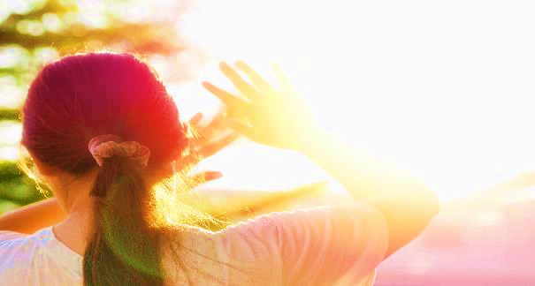
How can heatwaves affect your body?
How can heatwaves affect your... body?
Just like your phone, your body can be damaged by heatwaves and sunlight too.
In the next part of this activity, you’ll find out how heatwaves can affect your body and what you can do to stay safe.
Notes:
Help learners make the connection between phones and the next part of the activity that focuses on the impact of heatwaves on people.

Slide 9

How can heatwaves affect your body?
During a heatwave, people could experience:
dehydration
sunburn
heat exhaustion
heatstroke.
(Select the links to view the first aid advice.)
Your task:
It is important to know what these are and be able to spot the signs so that you can stay safe in a heatwave.
In pairs, carefully read and discuss the first aid information. Ask your teacher any questions you have.
Team up with another pair and test each other on the information.
E.g. what is it called when…
E.g. what is a symptom of…
E.g. how can you help with…
Notes:
Explain that these are all negative affects of heatwaves on people that can be very serious.
Review the task with learners and guide them to the heatwaves first aid information (printed slides).
Model some of the questions learners might ask of each other – direct learners to the question starters on the slide.
If you have time, repeat and rotate the task until all learners have had time to investigate all the first aid advice.

Slide 10
How to stay safe in a heatwave?
Safety
Now that you’ve learned how a heatwave can affect our bodies, think about how you could prevent this, and help others prevent this too.
How can you stay safe in a heatwave?
Discuss with a partner.
Refer back to the heatwave first aid information.
Notes:
Invite learners to reflect on their learning so far, by discussing the question on the slide.
To reflect on this question, learners will need to consider the steps they would need to take to avoid needing first aid. Encourage them to review their print-out and reflect on this.
Learners should conclude that first aid prevention should include: covering up and wearing suncream, staying out of direct sunshine, staying in cool environments, not doing anything too physical when it is most hot, drinking plenty of water and watching out for signs of sun damage in themselves and those around them.
If time, you could have learners create a poster or list of ways to stay safe.

Slide 11

How to stay safe in a heatwave?
Scenarios
Now, try to apply what you’ve learned so you’re prepared for a heatwave and know how to cope.
What are they experiencing?
What should they do?
How could this be prevented next time?
1. In your group, read and discuss your scenario.
2. Answer the questions on your scenario card.
3. Be ready to share your ideas with the whole group.
Notes:
Divide learners into small groups and give them a copy of one of the slides 16-19.
Ask learners to carefully read the scenario and apply the first aid information they learned.
Then, prompt them to answer the questions on the scenario.
If any groups struggle, provide them with copies of the first aid information.
You could also ask a learner who is confident on a particular first aid skill to join a group to help with the discussions.

Slide 12
How to stay safe in a heatwave?
How to stay safe in a heatwave?
Share learning
Next, share your ideas with the group.
For your scenario, briefly explain the situation.
Then, share your answers.
What were they experiencing?
What should they do?
How could this be prevented next time?
Notes:
Remind learners of the importance of active listening.
You could switch this around and ask each group to become the teachers.
They present the scenario to the group and then invite them to share what they think are the answers to the questions.

Slide 13
Big question
Big question
How can you prepare and cope with a heatwave?
Notes:
Give learners a few moments to reflect on this question before inviting them to discuss with a partner. Then, encourage feedback as a group.​
Referring to the big question should enable you and your learners to see how much they have learned from the activity. Answers to this question should be more detailed and varied at this point.​

Slide 14

Thank you
End
Thank you

Slide 15
Resources and support

Slide 16
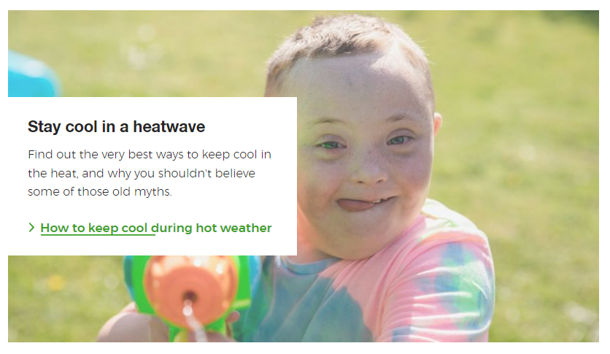
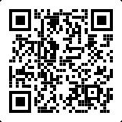
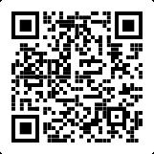
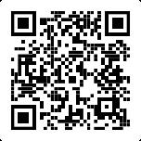
Where to find more information
Learn how to stay cool in hot weather.
Visit the British Red Cross website to read the Feeling the Heat report.
Resorces
https://www.redcross.org.uk/stories/health-and-social-care/first-aid/beat-the-hot-weather-top-tips-for-staying-cool
Visit the British Red Cross website to learn more about how to prepare for and cope with heatwaves.
https://www.redcross.org.uk/get-help/prepare-for-emergencies/heatwaves-uk
https://www.redcross.org.uk/about-us/what-we-do/we-speak-up-for-change/feeling-the-heat-a-british-red-cross-briefing-on-heatwaves-in-the-uk

Slide 17
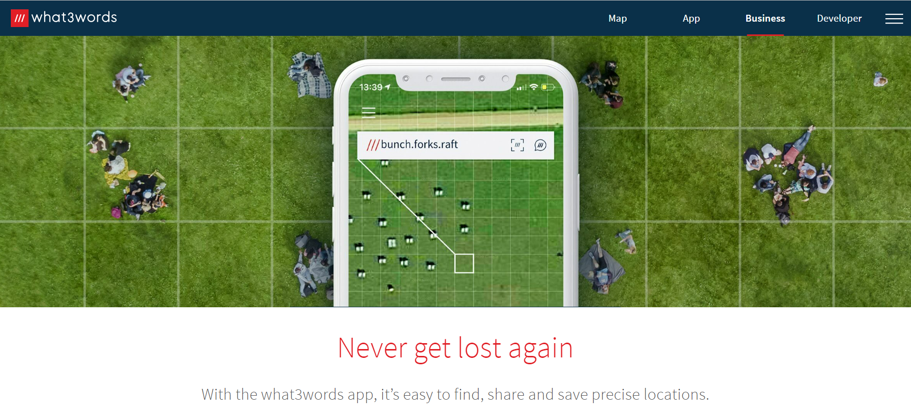
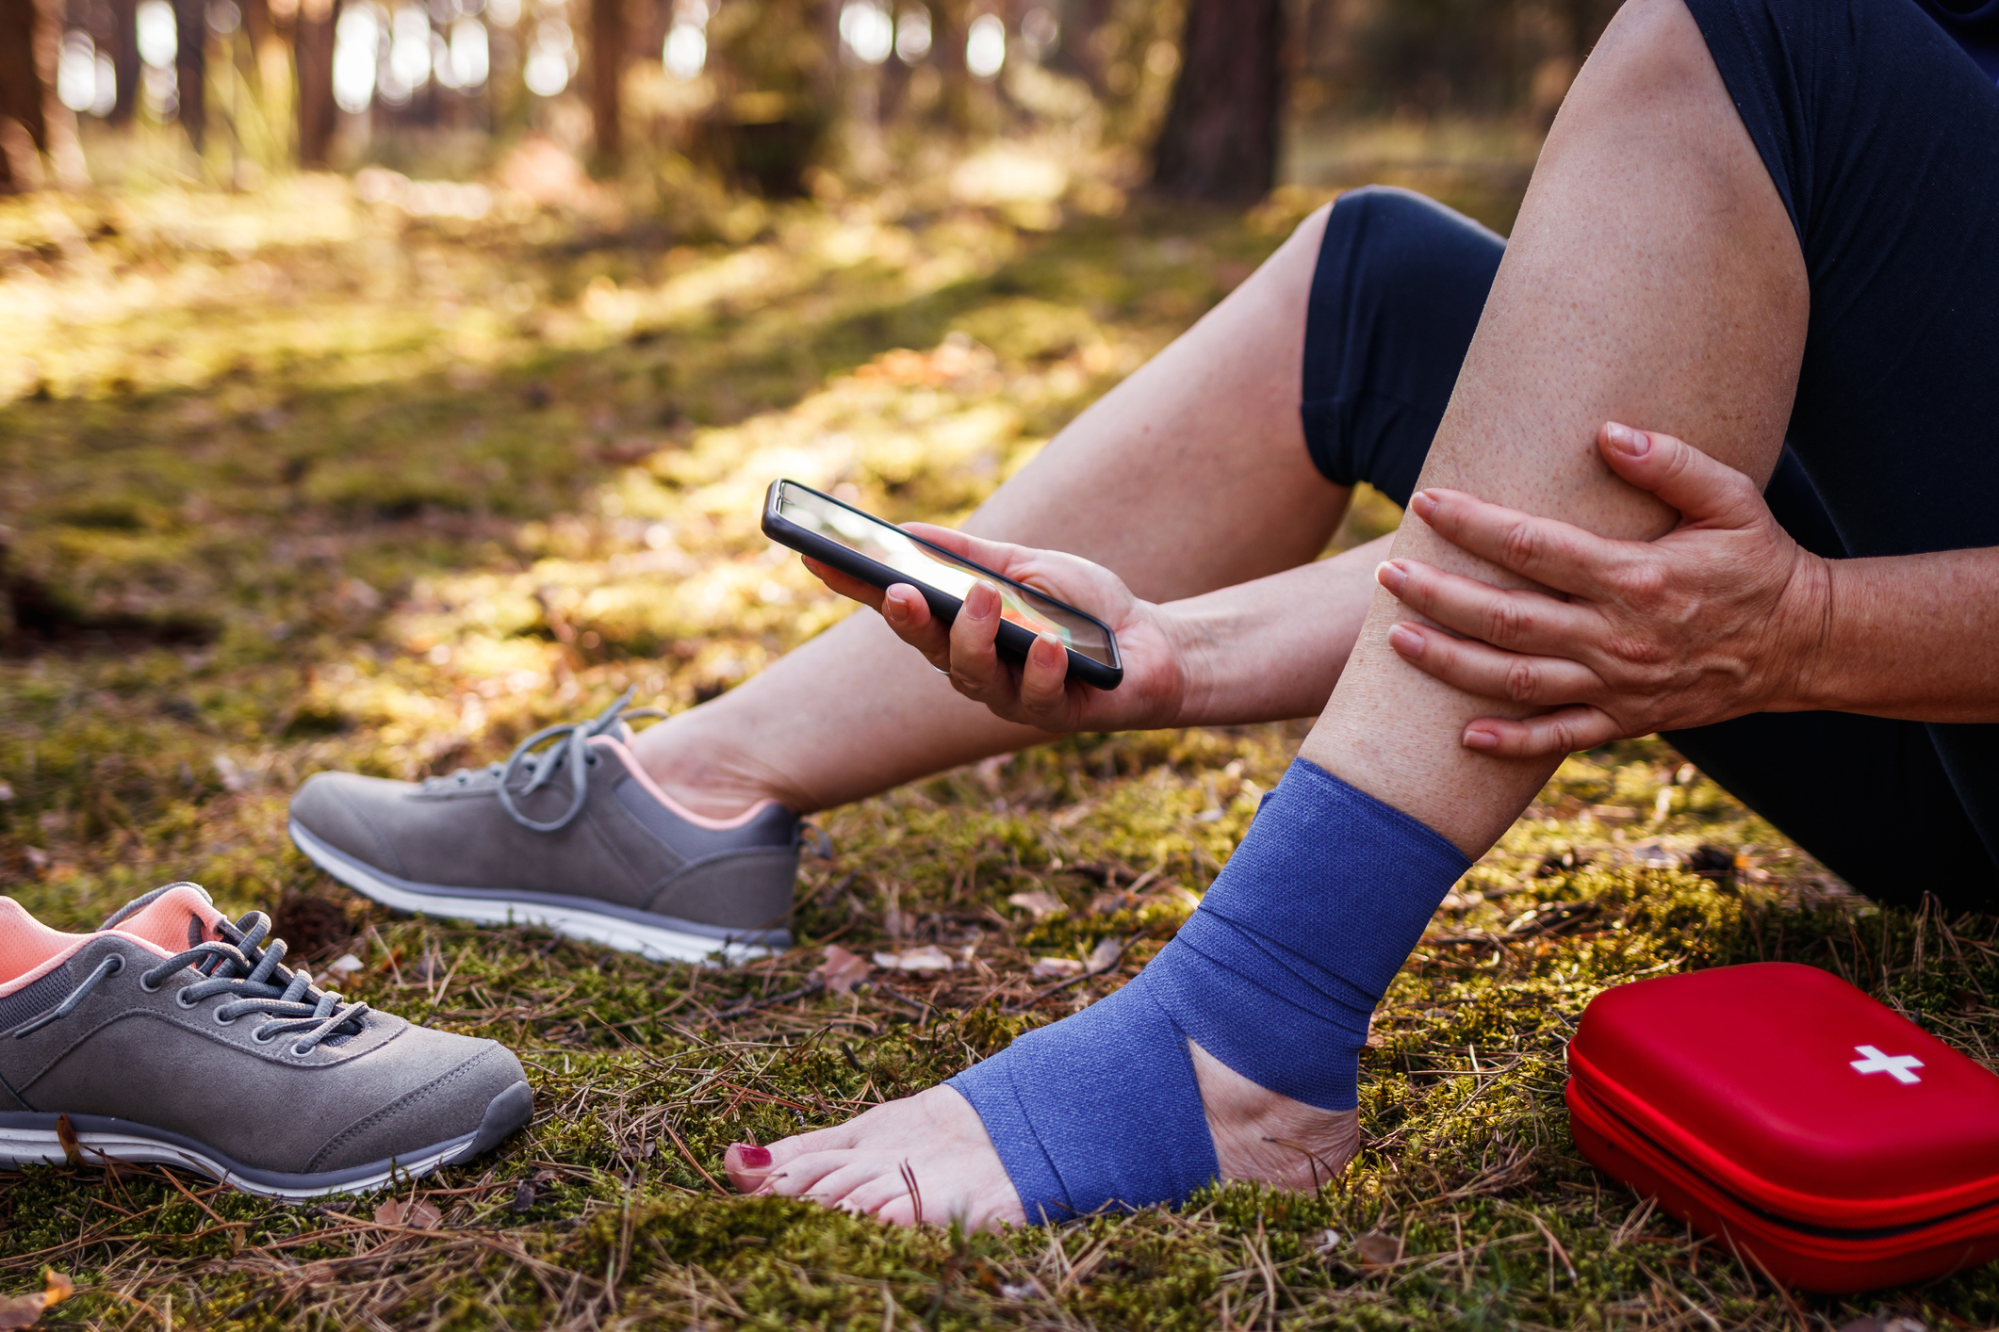
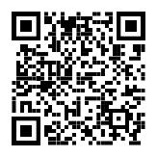
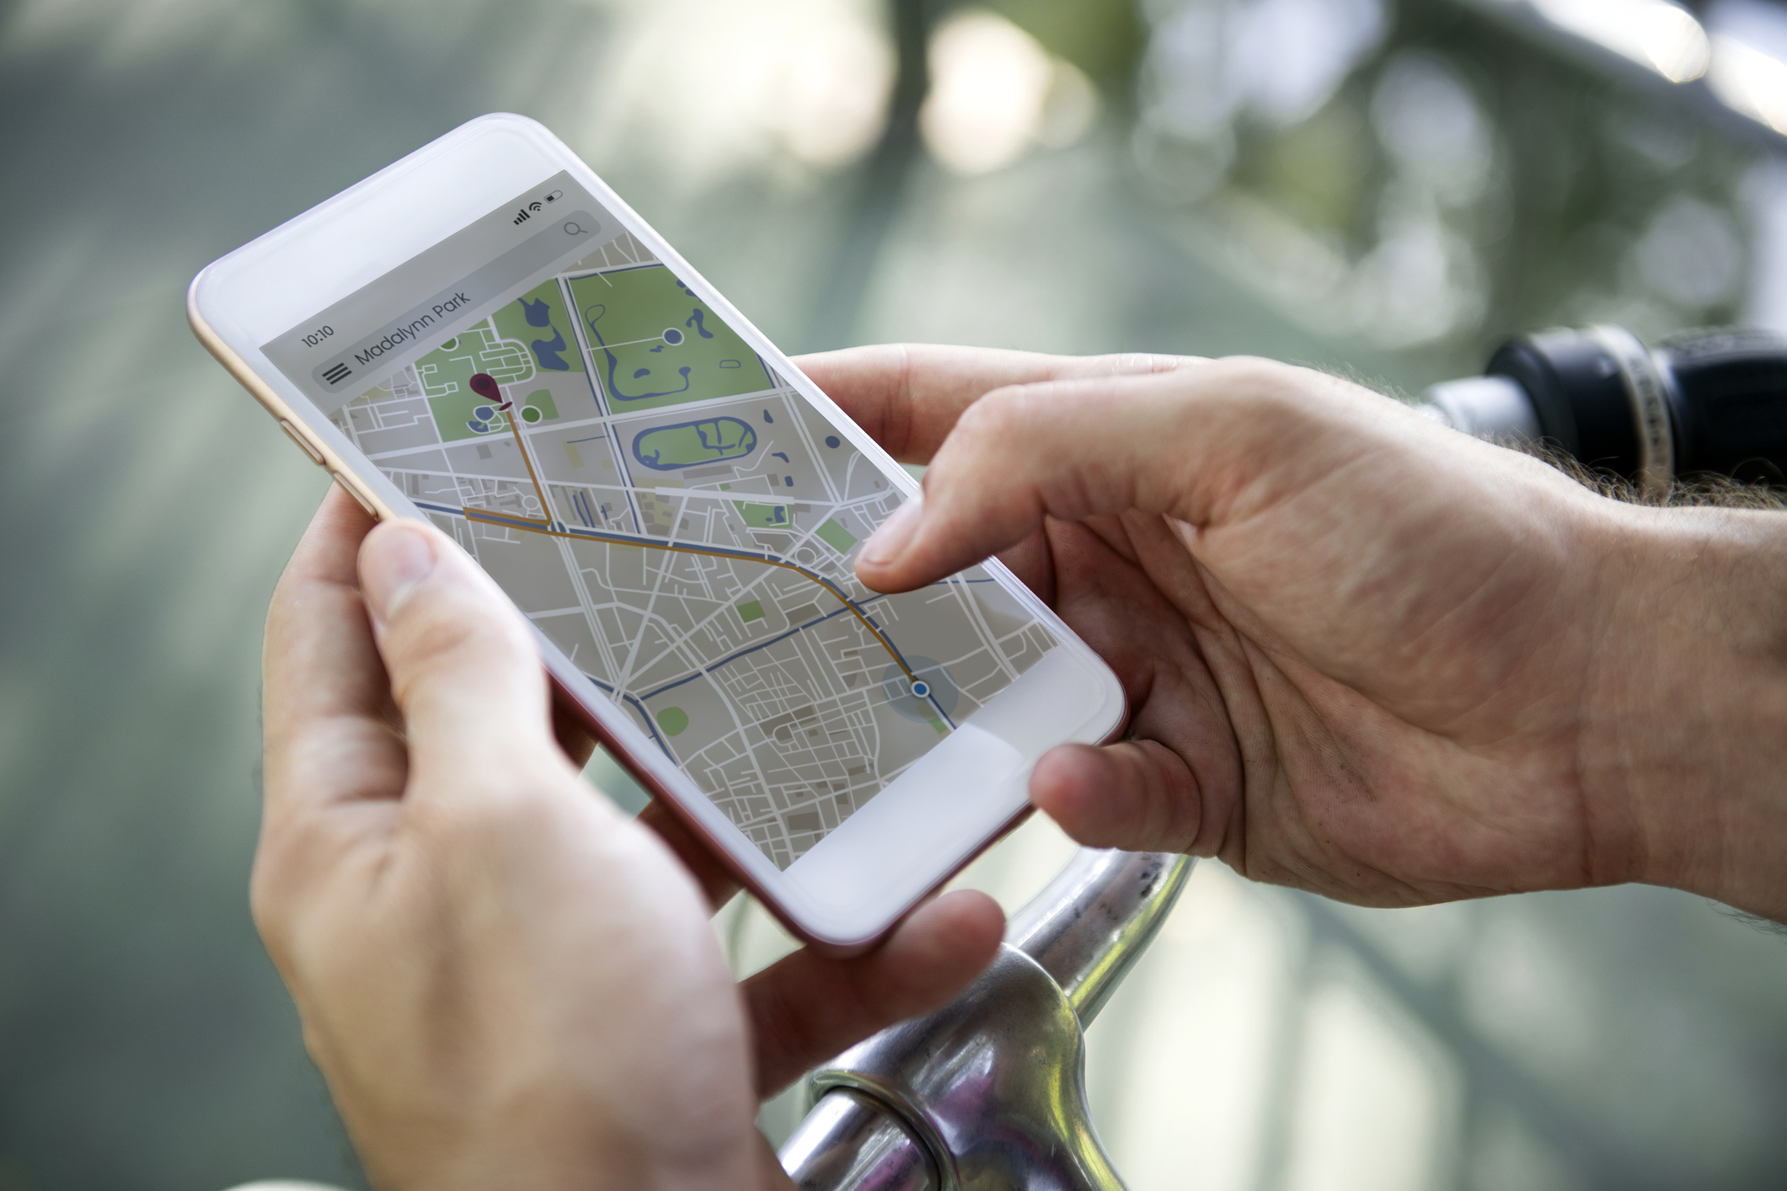
How to tell the emergency services where you are
2. Some smartphones have a built-in feature to call the emergency services and share your location. Find out how to use this on your phone.
3. You could also use a maps app to pinpoint and share your location. Learn how to do this so you’re ready for an emergency.
Resources
1. You could get the what.three.words app
what3words.com/products/what3words-app

Slide 18
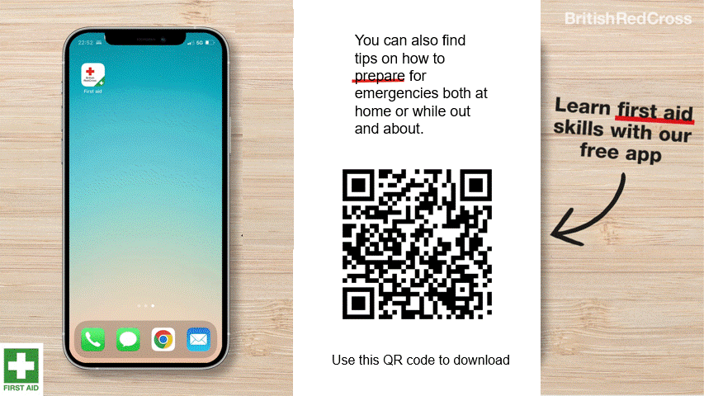
First aid app information
First aid app

Slide 19






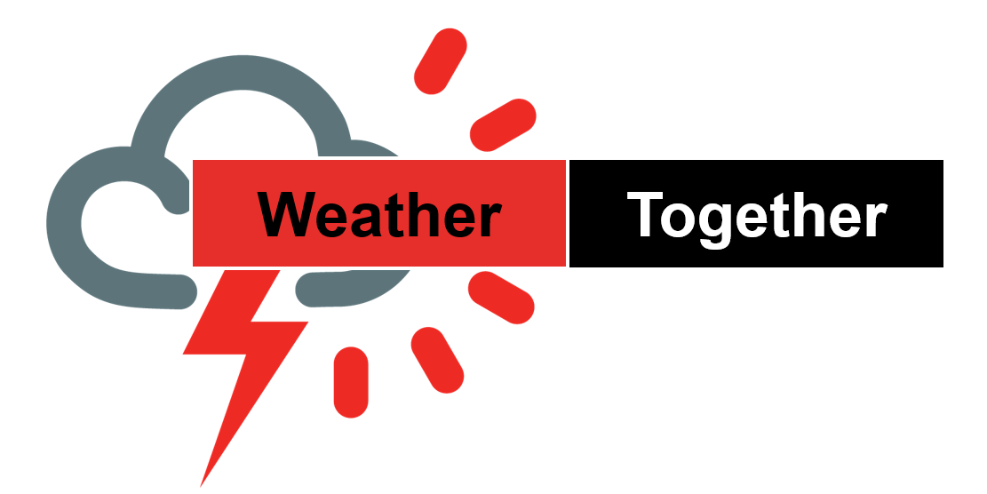
Flooding
Heatwaves
Eco-anxiety
Read 3 characters’ flood stories and discuss how they could be affected.
Find out about the effects of heatwaves through completing a quiz.
Worksheet: heatwave facts to print
Read a character’s experience of eco-anxiety and use this to define what it is.
Look at local flood maps and the role of the emergency services to explore how flooding can affect us all.
Worksheet: note writing help
Examine a list of ways to cope and apply this to yourself and others.
Worksheet: coping with eco-anxiety
Learn how heatwaves affects our body and the first aid to help. Apply these to different scenarios.
Poster: heatwaves scenarios
Poster: heatwaves first aid
Create a video/script for social media of how to cope with eco-anxiety to share with friends and family.
Worksheet: eco-anxiety video script
Examine images of flooding and identify the dangers.
Create a decision flowchart to share with friends and family to help them prepare for a heatwave.
Worksheet: decision flowcharts
Play a scenario game to find out about bug out bags and why it is important to have one ready.
For use across all topics
Starters
Plenaries
Weather Together
award tracker
Bronze certificate
Silver certificate
Gold certificate
Play a ‘choose your own adventure’ game to learn how to respond to flood alerts and warnings.
Create resources to share with friends and family. This activity is designed to be repeated.
Rate these resources
Open another activity
Link
Link
Fill in this quick survey to help us improve Weather Together.
Click here to open the full web index.

