Slide 1
East Africa facing hunger
Volcano in Hawaii
Full lesson plan from redcross.org.uk/education
Full lesson plan from redcross.org.uk/education
Notes:
1

Slide 2
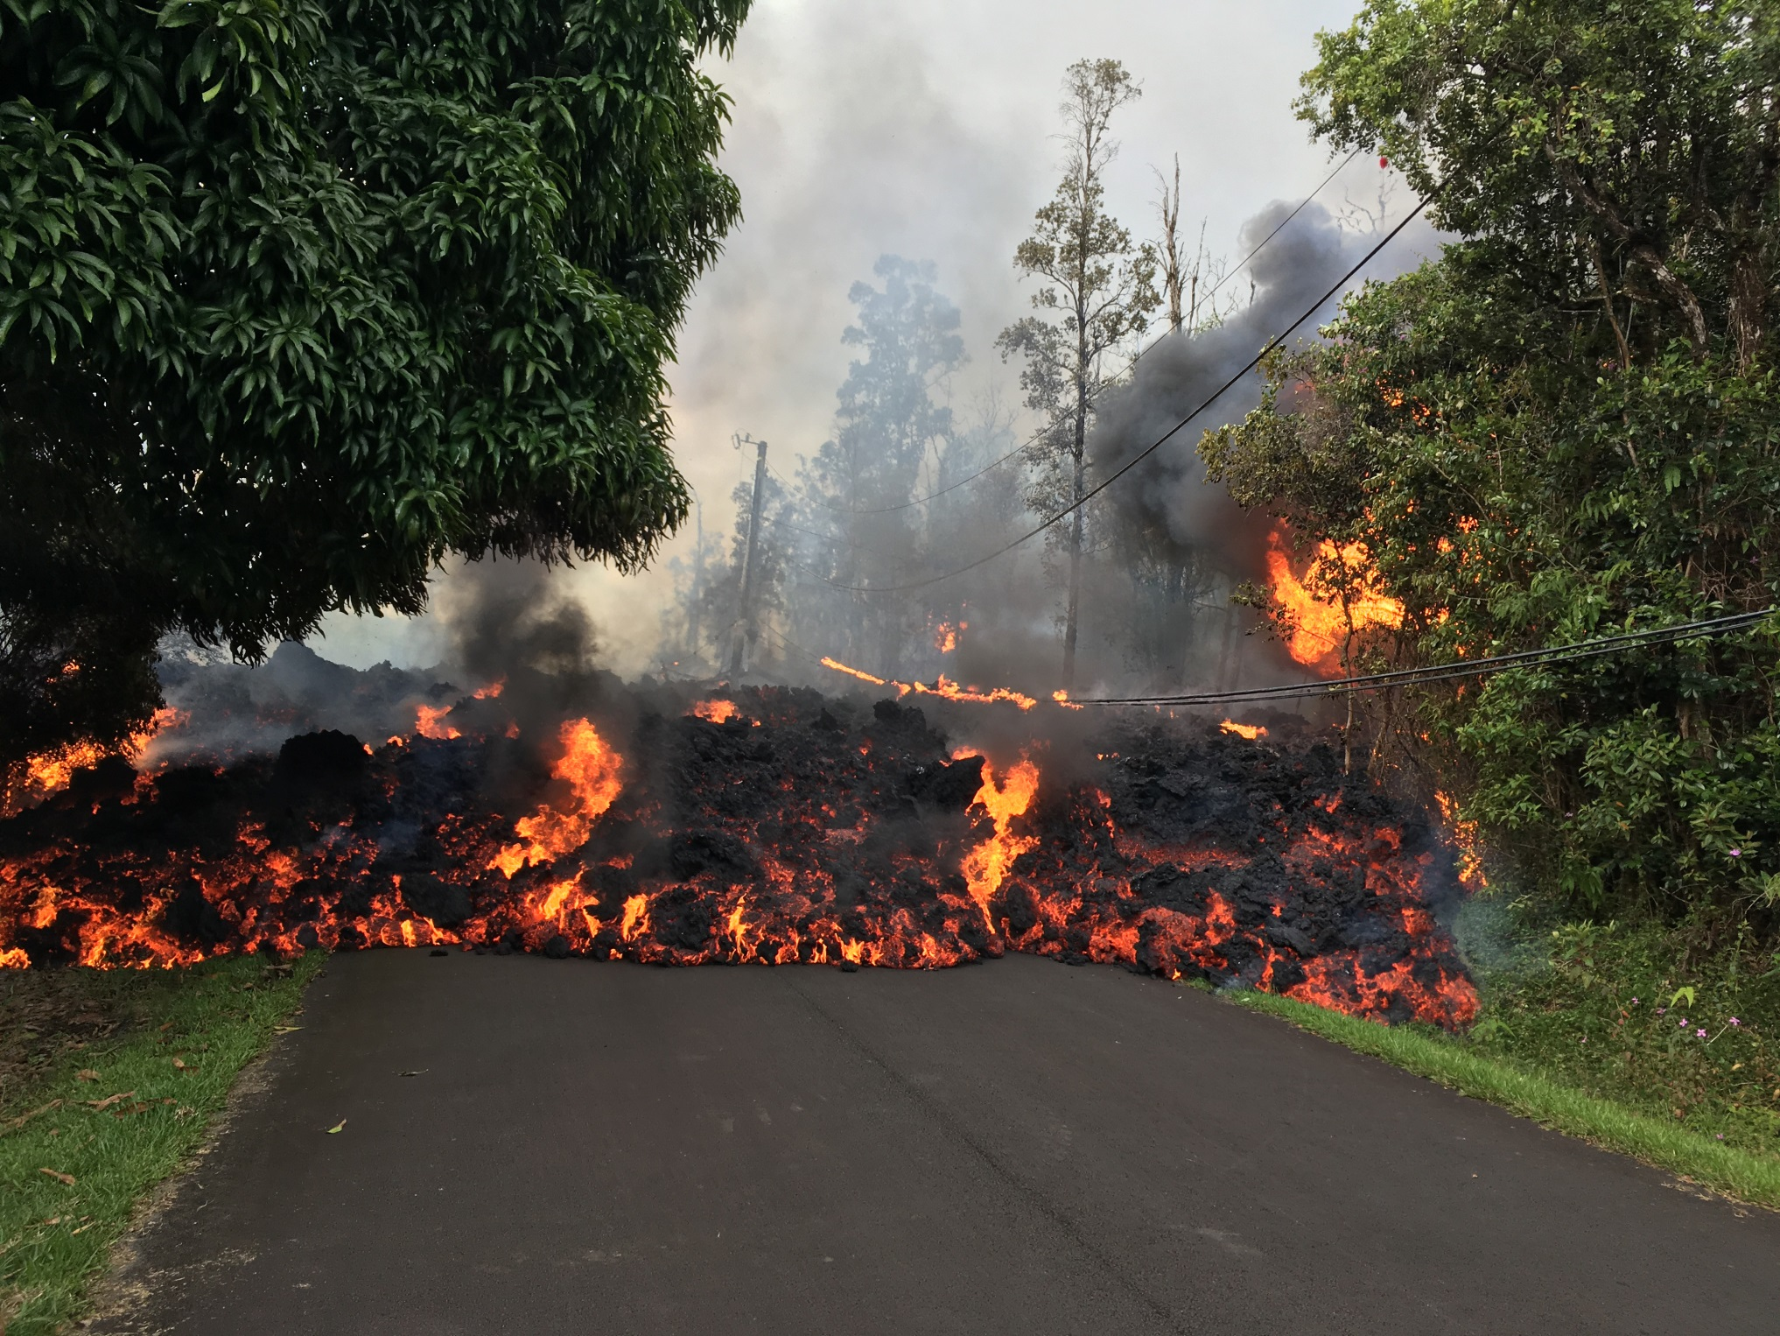

Slide 3
Hawaii Fire Department reports that air quality is condition RED around [cracks] in the southeast area of Lanipuna Gardens and surrounding farm[s] on Pohoiki Road.
Condition RED means immediate danger to health … such as choking and inability to breathe. Sulphur Dioxide (SO2) gas … is especially dangerous for the elderly, children/babies and people with [breathing] problems.
Highway 132 is closed at Pohoiki Road intersection and a checkpoint is located on Highway 130 by Pahoa High School. Only local traffic is allowed beyond all roadblocks.
As a [safety] measure, residents of Lower Puna are advised to be on the alert in the event of possible gas emissions and volcanic eruption. Because there may be little to no advance notice to evacuate, you should be prepared to evacuate at short notice. Take this time to prepare.
If you evacuate voluntarily, the Pahoa Community Center and Kea’au Community Center are open. Food will be provided and the shelters are pet-friendly. … We want everyone in the Lower Puna area to be ready, and to remain safe.

Slide 4
Hawaii Fire Department reports that air quality is condition RED around fissures in the southeast area of Lanipuna Gardens and surrounding farm lots on Pohoiki Road. Condition RED means immediate danger to health, so take action to limit further exposure. Severe conditions may exist such as choking and inability to breathe. Sulphur Dioxide (SO2) gas from fissures is especially dangerous for the elderly, children/babies and people with respiratory problems.
The Hawaii Department of Transportation (HDOT) announced that Highway 130 is open beyond Malama Street for local residents only. The Hawaii Police Department reports no large trailers or heavy equipment will be allowed over the metal plates.
Highway 132 is closed at Pohoiki Road intersection and a checkpoint is located on Highway 130 by Pahoa High School. Only local traffic allowed beyond all roadblocks.
As a precautionary measure, residents of Lower Puna are advised to be on the alert in the event of possible gas emissions and volcanic eruption. Because there may be little to no advance notice to evacuate, you should be prepared to evacuate at short notice. Take this time to prepare.
If you evacuate voluntarily, the Pahoa Community Center and Kea’au Community Center are open. Food will be provided and the shelters are pet-friendly. This is a precautionary message. We want everyone in the Lower Puna area to be ready, and to remain safe.

Slide 5
Photo credits and captions
Slide 2: Lava flow covers the road following the eruption of the Kilauea volcano, Hawaii, in May 2018 © U.S. Geological Survey.
Slides 3/4: The civil defence message issued by the Hawaii Fire Department onTuesday 15 May at 6 p.m. Slide 3 shows a graded version. Slide 4 shows the original message.
Important legal note
This photograph is fully protected by copyright. Schools and other educational organisations are free to use it for educational use. The licence does not extend beyond this use. This means that anyone wishing to put the image on a website, crop or edit it, or use it in any other way, must first contact the copyright holder and negotiate a licence for the use they require.
This resource and other free educational materials are available at redcross.org.uk/education
The British Red Cross Society is a charity registered in England and Wales (220949) and Scotland (SCO37738).
Notes:
1

