Slide 1





Newsthink.
Refugee Week 2023
© British Red Cross 2022. All images © British Red Cross 2022 unless otherwise stated.
This resource and other free educational materials are available at www.redcross.org.uk/education
The British Red Cross Society is a charity registered in England and Wales (220949) and Scotland (SCO37738).

Slide 2

Learning objectives:
Learn about a humanitarian awareness event.
Apply your learning and empathy to understand why the event takes place.
Share your learning by discussing a debate topic, showing your active listening skills.
Refugee Week 2023
Newsthink
Notes:
Share the learning objectives.
If time, learners may wish to share information, knowledge or thoughts they have on the topic.

Slide 3
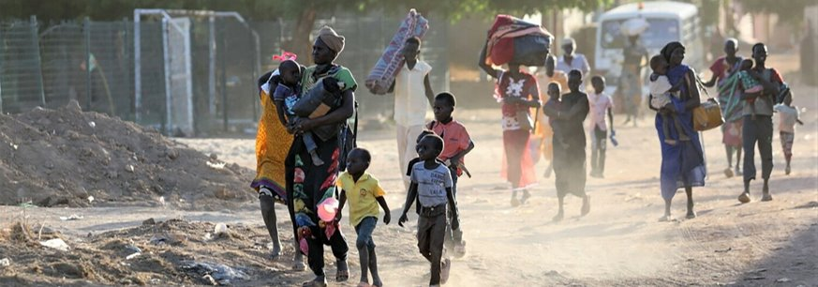

Refugee Week 2023
See: What can you see in this picture?
What might be happening and where might this be?
Newsthink
Notes:
Support learners by explaining:
This image shows Sudanese people fleeing their neighbourhoods amid fighting between the army and paramilitaries in Khartoum, Sudan’s capital.
Internally Displaced Persons (IDPs) are people who have fled their homes and are on the move in their country, seeking safety. Refugees are people who have fled their country and crossed an international border to seek refuge.
Reasons for fleeing a place include war, violence, conflict and persecution. Persecution means being treated unfairly or cruelly because of characteristics including ethnicity, religion, sexual orientation or political beliefs.
Conflict in Sudan is currently causing hundreds of thousands of people to leave their homes in search of safety.
The British Red Cross is the UK’s largest independent provider of services for refugees and asylum seekers. Services that refugees and asylum seekers might need include translation of information into their language, medical support, shelter, clothing and food.
Ask learners:
What emotions does this image evoke in you?
What other examples can you think of where we have heard recently in the news, regarding people leaving their homes and fleeing their country?

Slide 4
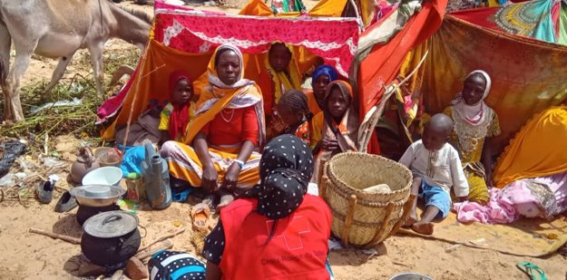
Refugee Week 2023
Think: Why do you think the people in this photo are here?
What do you think they need?
Who do you think the person with their back to us might be?
Newsthink
Notes:
Support learners by explaining:
This is a camp in Chad – a country that borders Sudan. The people here have fled their homes due to the flare-up of violence, which is currently widespread throughout Sudan. Sudan and neighbouring countries have suffered years of violence, instability, and economic hardship, so recent fighting has worsened this humanitarian crisis. Around 30,000 people arrived in the Ouaddai region of Chad, from Sudan, within a 48h period.
Hundreds of lives have been lost so far and thousands of people have been injured and are in need of urgent care. Civilians are unable to access food or water because shops remain closed, and safety is not assured. Basic services like the provision of electricity and internet services have been disrupted. This is why many have left the area seeking refuge.
The person in the photo with their back to us is a member of the Tchad Red Cross volunteer team. They are among the first to provide support and protection.
Ask learners:
What do you think the camp might be like?
What sort of support and resources do you think the Red Cross volunteers might provide?

Slide 5
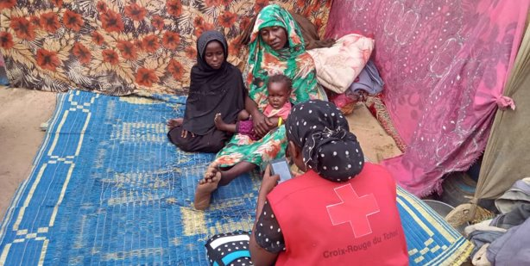
Refugee Week 2023
Feel: How might families who have fled their homes feel?
How does this image make you feel?
Newsthink
Notes:
Support learners to consider the situation.
Many people have fled the conflict in Sudan and sought refuge in neighbouring Chad. The volunteers at the camps aim to provide those who have fled (mostly women and children) with basic provisions, such as shelter, food and water (especially water, considering the extremely high temperatures in Chad). Some people are also in need of medical attention.
Many aid supplies sent by the United Nations to Sudan have been warehoused because of the violence, and widespread looting has made it unsafe to deliver them in many places. Aid supplies have made it through to these camps, though there isn’t always enough to go around.
The camps are not permanent solutions but offer a safe place to stay during emergencies.
Some camps in Chad have been set up in areas where water shortage was already an issue.
Ask learners:
How might it feel to leave your home?
How might it feel to arrive at a refugee camp?
How might Chadian people feel about the refugee camps?

Slide 6

Refugee Week 2023
See: What can you see in this picture? ​
Think: What do you think might be happening? Where might this be? ​
Feel: How does this image make you feel?
Newsthink
Notes:
Support learners by explaining:
This is a photo of a country’s citizens gathered at a demonstration. They want to express their views about refugees.
Refugees apply for asylum when they reach a safe country. If a person is granted asylum, it means the country they have arrived in will protect them and support them. In 2022, 89,398 people sought asylum in the UK.
Some refugees experience support when they arrive in a new country, while others are not made to feel so welcome. Different governments in different countries have different laws in place and help refugees and asylum seekers in different ways.
Refugee Week is an annual humanitarian awareness event, which takes place in the UK on 19-25 June 2023. This year’s theme is ‘compassion’.
The aim of Refugee Week is to share experiences and stories, learn more about others’ experiences, and consider how we can show support and compassion for refugees. It is also a time to celebrate the contributions, creativity and resilience of refugees and people seeking sanctuary (a safe place).
Ask learners:
What emotions does this image evoke in you?
What does compassion mean? Why do you think the chosen theme for this year is compassion?
How important might it be to a refugee to receive a welcoming atmosphere and a friendly face when they arrive in a strange country, after what may have been a very difficult journey?
What might refugees take with them when they flee a country, and what might they have to leave behind?
What might refugees be thinking when they arrive in a new country?
Image: Netavisen_Sameksistens_dk on pixabay.com

Slide 7


“People fleeing dangerous environments should be treated with compassion.”
Refugee Week 2023
Agree
Disagree
Newsthink
Notes:
Read the statement together and ask the group whether they agree or disagree. Encourage learners to think about the reasons behind their view.
Give learners the opportunity to share their answers. Once they’ve listened to each other’s arguments, give them a chance to review their position. If they wish to change sides, encourage them to do so.
Under International Humanitarian Law (IHL), it is unlawful to purposefully target civilians or anyone no longer involved in the fighting. If they do so, it could be seen as a “war crime”.
For a full session plan on IHL see our resource on the Rules of War: https://www.redcross.org.uk/get-involved/teaching-resources/rules-of-war

Slide 8

“All refugees and asylum seekers should be given protection, support and resources for their immediate needs.”
Refugee Week 2023
Agree
Disagree
Learn about refugees fleeing Ukraine
Learn about refugees fleeing Afghanistan
Newsthink
Notes:
Read the statement together and ask the group whether they agree or disagree. Encourage learners to think about the reasons behind their view.
Give learners the opportunity to share their answers. Once they’ve listened to each other’s arguments, give them a chance to review their position. If they wish to change sides, encourage them to do so.
Terms:
Asylum seeker: Someone who flees their homeland and arrives in another country. ​They make an application of asylum to stay in the new country.
Refugee: Someone who has proven to the authorities that they would be at risk if they returned home.
If time, refer to the Ukraine resource by following the link, to provide learners with more context of refugees fleeing their country.
Now show them the Newsthink image about the Afghanistan crisis – it has a similar situation and the same question. Do learners have the same answer for these people? If so, why? Do all people deserve to be safe? What does that mean?
Look at our guidance for teaching conflict impartially for a factsheet on what the law says about people’s rights to safety during conflict.

Slide 9
“We can all help to make refugees and asylum seekers feel welcome.”
Refugee Week 2023
Agree
Disagree
Newsthink
Notes:
Read the statement together and ask the group whether they agree or disagree. Encourage learners to think about the reasons behind their view.
Give learners the opportunity to share their answers. Once they’ve listened to each other’s arguments, give them a chance to review their position. If they wish to change sides, encourage them to do so.
Support discussion around what ‘being made to feel welcome’ means to different people with different needs.

Slide 10

Refugee Week 2023
Reflect on your own:
What are your thoughts and feelings about these images and the topic we’ve talked about?
Newsthink
Notes:
This is an extension task for personal reflection. Encourage learners to reflect on this activity, whether writing it down or just thinking about the topic discussed relating to the image.

Slide 11



Learn more:​
Learn more about Refugees and migration.​
​
Share with others:​
Share what you’ve learned about refugees, asylum seekers and Refugee Week with others. Watch a news article linked to refugees and discuss this with someone.​
​
Do something:​
You can help people seeking sanctuary by arranging a fundraiser in support of the British Red Cross campaign Every Refugee Matters. Check out our fundraising and events page for all upcoming events.
Refugee Week 2023
Newsthink
Notes:
Some ideas of what you and your learners can do next. Use other teaching resources to explore the topic in more detail. Encourage learners to share their learning with peers or family. Want to do something to help? Consider arranging a fundraiser to show your support for refugees by joining our Every Refugee Matters campaign:
https://www.redcross.org.uk/get-involved/every-refugee-matters

