Slide 1

Choice and making decisions.
Back to better
September 2020
For full teaching resources visit our website

Slide 2




Slide 3


Slide 4


Slide 5
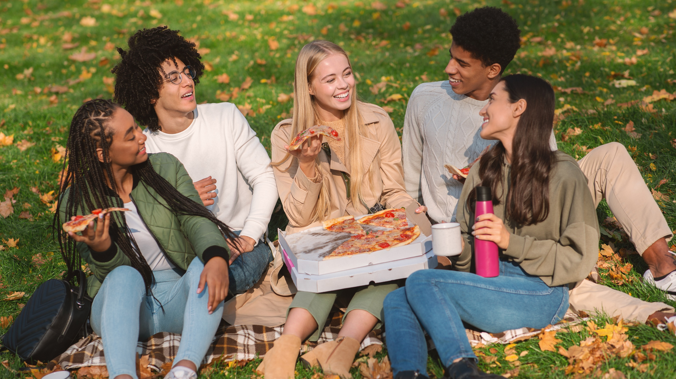

Slide 6
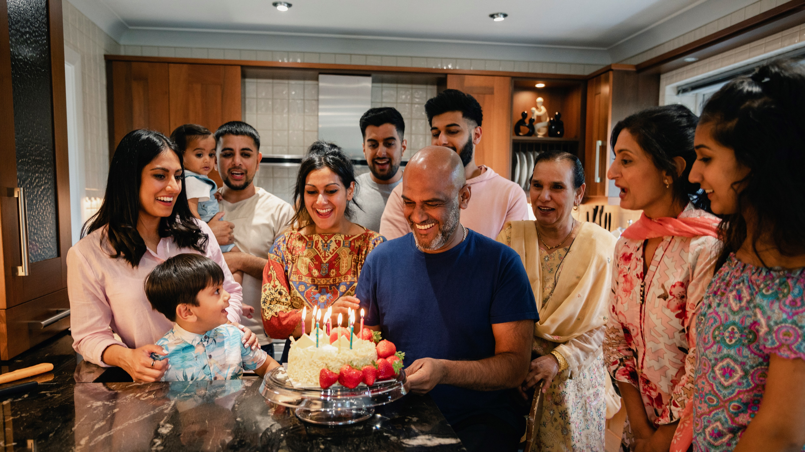

Slide 7


Slide 8


