Slide 1
East Africa facing hunger
Forces of Nature: Resilience
Full lesson plan from redcross.org.uk/education
Full lesson plan from redcross.org.uk/education
Notes:
1

Slide 2
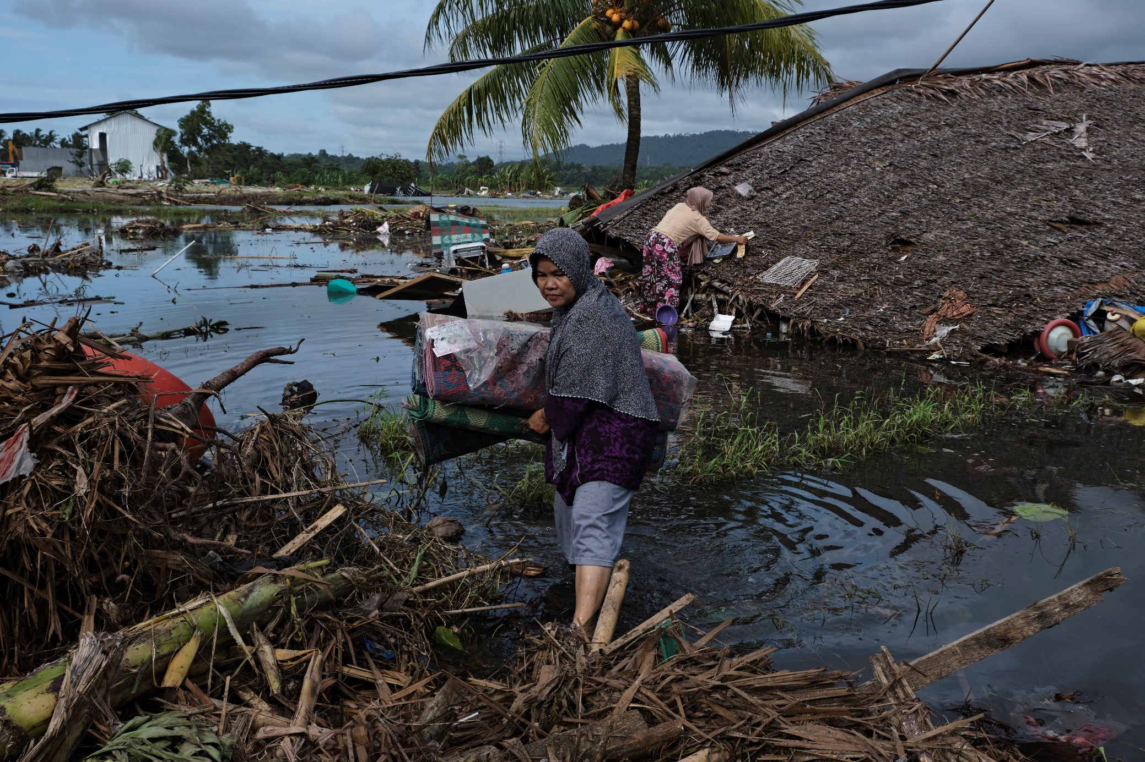

Slide 3
Resilience:
“Having the ability, skills, behaviours and coping strategies to support yourself and others during times of change or a sudden shift in circumstances, such as a crisis caused by a disaster or emergency.”

Slide 4
Photo credits
Slide 2: A woman salvages materials from her restaurant which was washed 30 metres across a road by the tsunami in Banten, Indonesia, on 28 December ©Ed Wray/Getty Images.
This resource and other free educational materials are available at redcross.org.uk/education
The British Red Cross Society is a charity registered in England and Wales (220949) and Scotland (SCO37738).
Notes:
1

