Slide 1

Head injury.
First aid champions
Learn how to help someone who has a head injury

Slide 2





First aid skills
Head injury – learn activity
Sequencing activity
Put the images on the next slide in order of how to help someone who has a head injury.
  Can you show the correct order of what to do when someone needs first aid help?
  You can look at the ‘how to help’ someone who has a head injury card to help you.

Slide 3
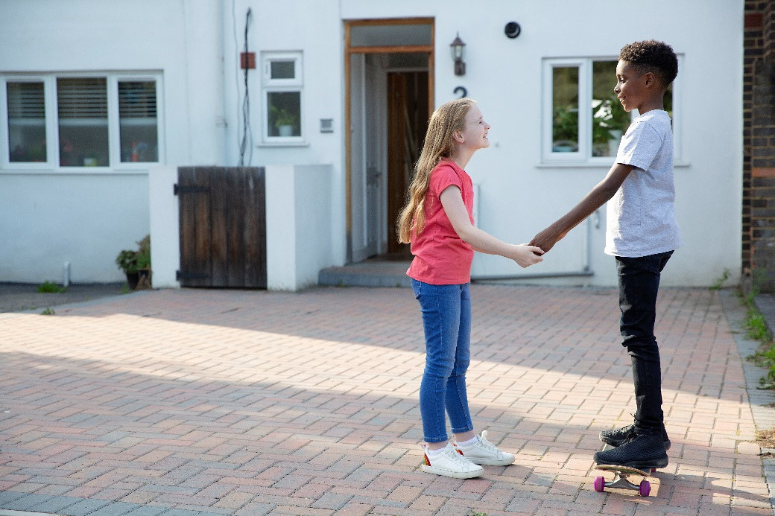
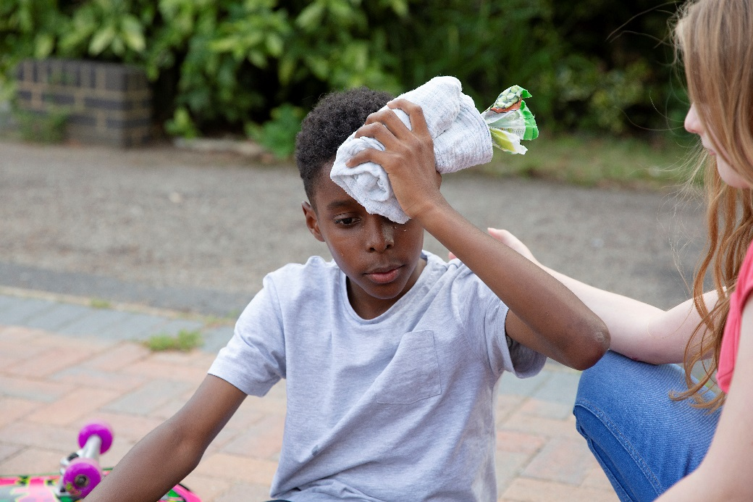
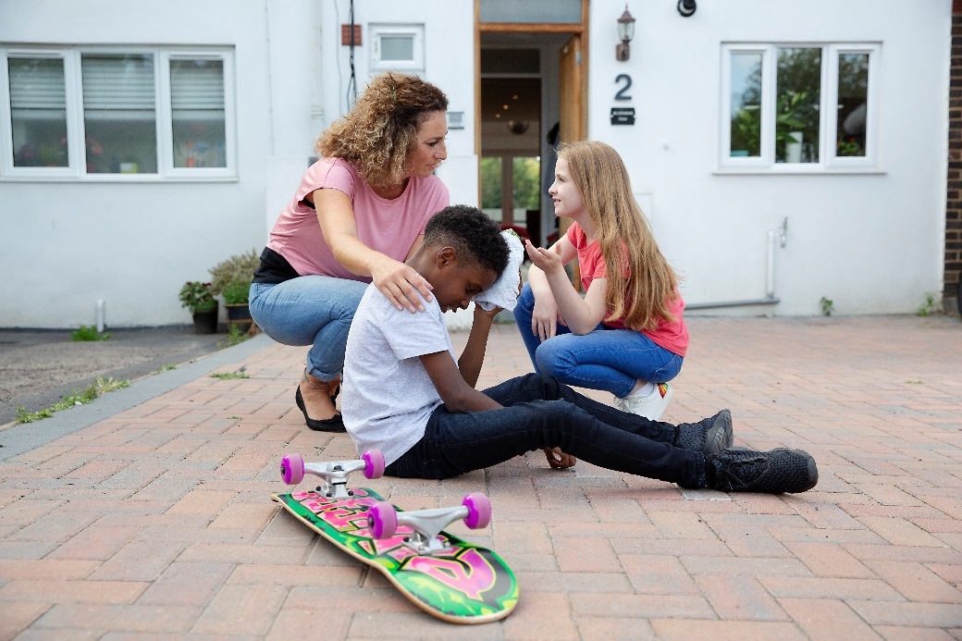
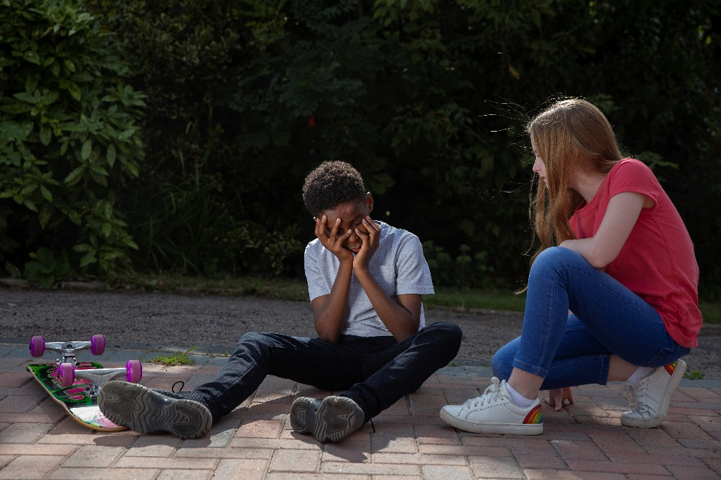
First aid skills
Head injury – learn activity
Put the numbers on the images in the order you think would be best to help someone who has a head injury

Slide 4
First aid skills
Head injury – learn activity
Now see if you got the steps to help in the right order
How to help someone who has a head injury
Help them to rest.
Hold something cold on where they have bumped their head (like a bag of frozen peas wrapped in a tea towel).
Tell an adult.

Slide 5
How to help someone who has a head injury card
Remind yourself of the steps to take to help someone who has a head injury

