Slide 1



Newsthink.
Ukraine

Slide 2

Newsthink.
Ukraine
Learning objectives:
Examine and discuss an image related to a current humanitarian news event
Analyse and identify how people are impacted by this event
Discuss and debate a statement relating to a core value by explaining whether you agree or disagree

Slide 3
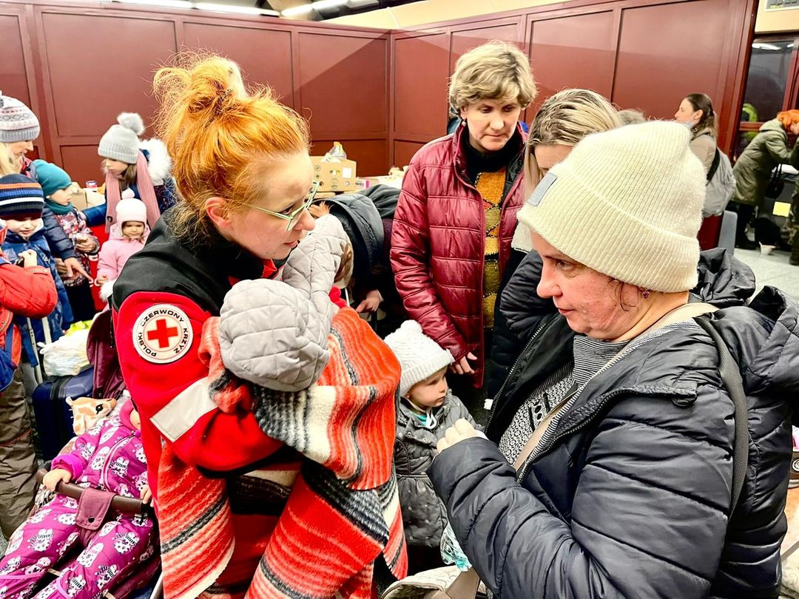

Newsthink.
Ukraine
See: What do you see in the picture? What’s happening?
Notes:
Support leaners by explaining:
This a picture of a Polish Red Cross worker supporting someone newly arrived from Ukraine. On Sunday, February 27, more than 420 people were looked after by Polish Red Cross volunteers. 44 of them received medical assistance. Since Thursday (Feb 24) almost 300,000 people have come to Poland.
The Polish Red Cross have supplied the Ukrainian Red Cross with tents and other much needed items including diapers, sanitary napkins, food, blankets and material for bandages for the wounded.
Polish Red Cross staff and volunteers have been working across the country to support those arriving from Ukraine. More and more trains are arriving from Ukraine at Przemyśl railway station every day. People are also arriving in Hungary, Slovakia and other surrounding countries.
More than 500,000 people have left the country according to the United Nations High Commissioner for Refugees, and many more thousands are displaced from their homes within Ukraine.

Slide 4
Newsthink.
Ukraine
Think: What do you think these people are thinking about? What is important to them at this moment?
Notes:
Support learners by asking them to consider the situation.
What might someone be thinking if they suddenly had to leave their home? What might they try and take with them? Where might they try flee to?
Encourage learners to think about whether each person in the picture has the same concerns? What might the children think is important? What about the women? The woman working for the Polish Red Cross?

Slide 5
Newsthink.
Ukraine
Feel: How do you think they feel? Why might they feel this way?
Notes:
Support learners by asking them to consider the situation.
Are they all feeling the same? What might each person in the photo be feeling?

Slide 6


Newsthink.
Ukraine
“Civilians should never be targeted.”
Agree
Disagree
Notes:
Give learners the opportunity to share their answers. Once they’ve listened to each other’s arguments, give them a chance to review their position. If they wish to change sides, encourage them to do so.
Under International Humanitarian Law (IHL), it is unlawful to purposefully target civilians or anyone no longer involved in the fighting. If they do so, it could be seen as a “war crime”.
For a full session plan on IHL see our resource on the Rules of War: https://www.redcross.org.uk/get-involved/teaching-resources/rules-of-war

Slide 7
Newsthink.
Ukraine
“All people deserve to be safe.”
Agree
Disagree
Notes:
Give learners the opportunity to share their answers. Once they’ve listened to each other’s arguments, give them a chance to review their position. If they wish to change sides, encourage them to do so.
Now show them the Newsthink image about the Afghanistan crisis – it has a similar situation and the same question. Do learners have the same answer for these people? If so, why? Do all people deserve to be safe? What does that mean?
Look at our guidance for teaching conflict impartially for a factsheet on what the law says about people’s rights to safety during conflict.

Slide 8

Newsthink.
Ukraine
Reflect on your own:
What are your thoughts and feelings about this image and the events you talked about?
Notes:
This is an extension task for personal reflection. Encourage learners to reflect on this activity, whether writing it down or just thinking.

Slide 9



Newsthink.
Ukraine
Learn more:
Learn more about conflict and its consequences with our Rules of War resource.
Share with others:
Share what you’ve learned with others. Show them the image, discuss the debate with them, or reflect together on how you feel about this event.
Do something:
Tackle the spread of any misinformation in your school by teaching others to check their sources.
Notes:
Some ideas of what you and your learners can do next

