Slide 1
Amazon wildfires
Full lesson plan from redcross.org.uk/education
Notes:
1

Slide 2
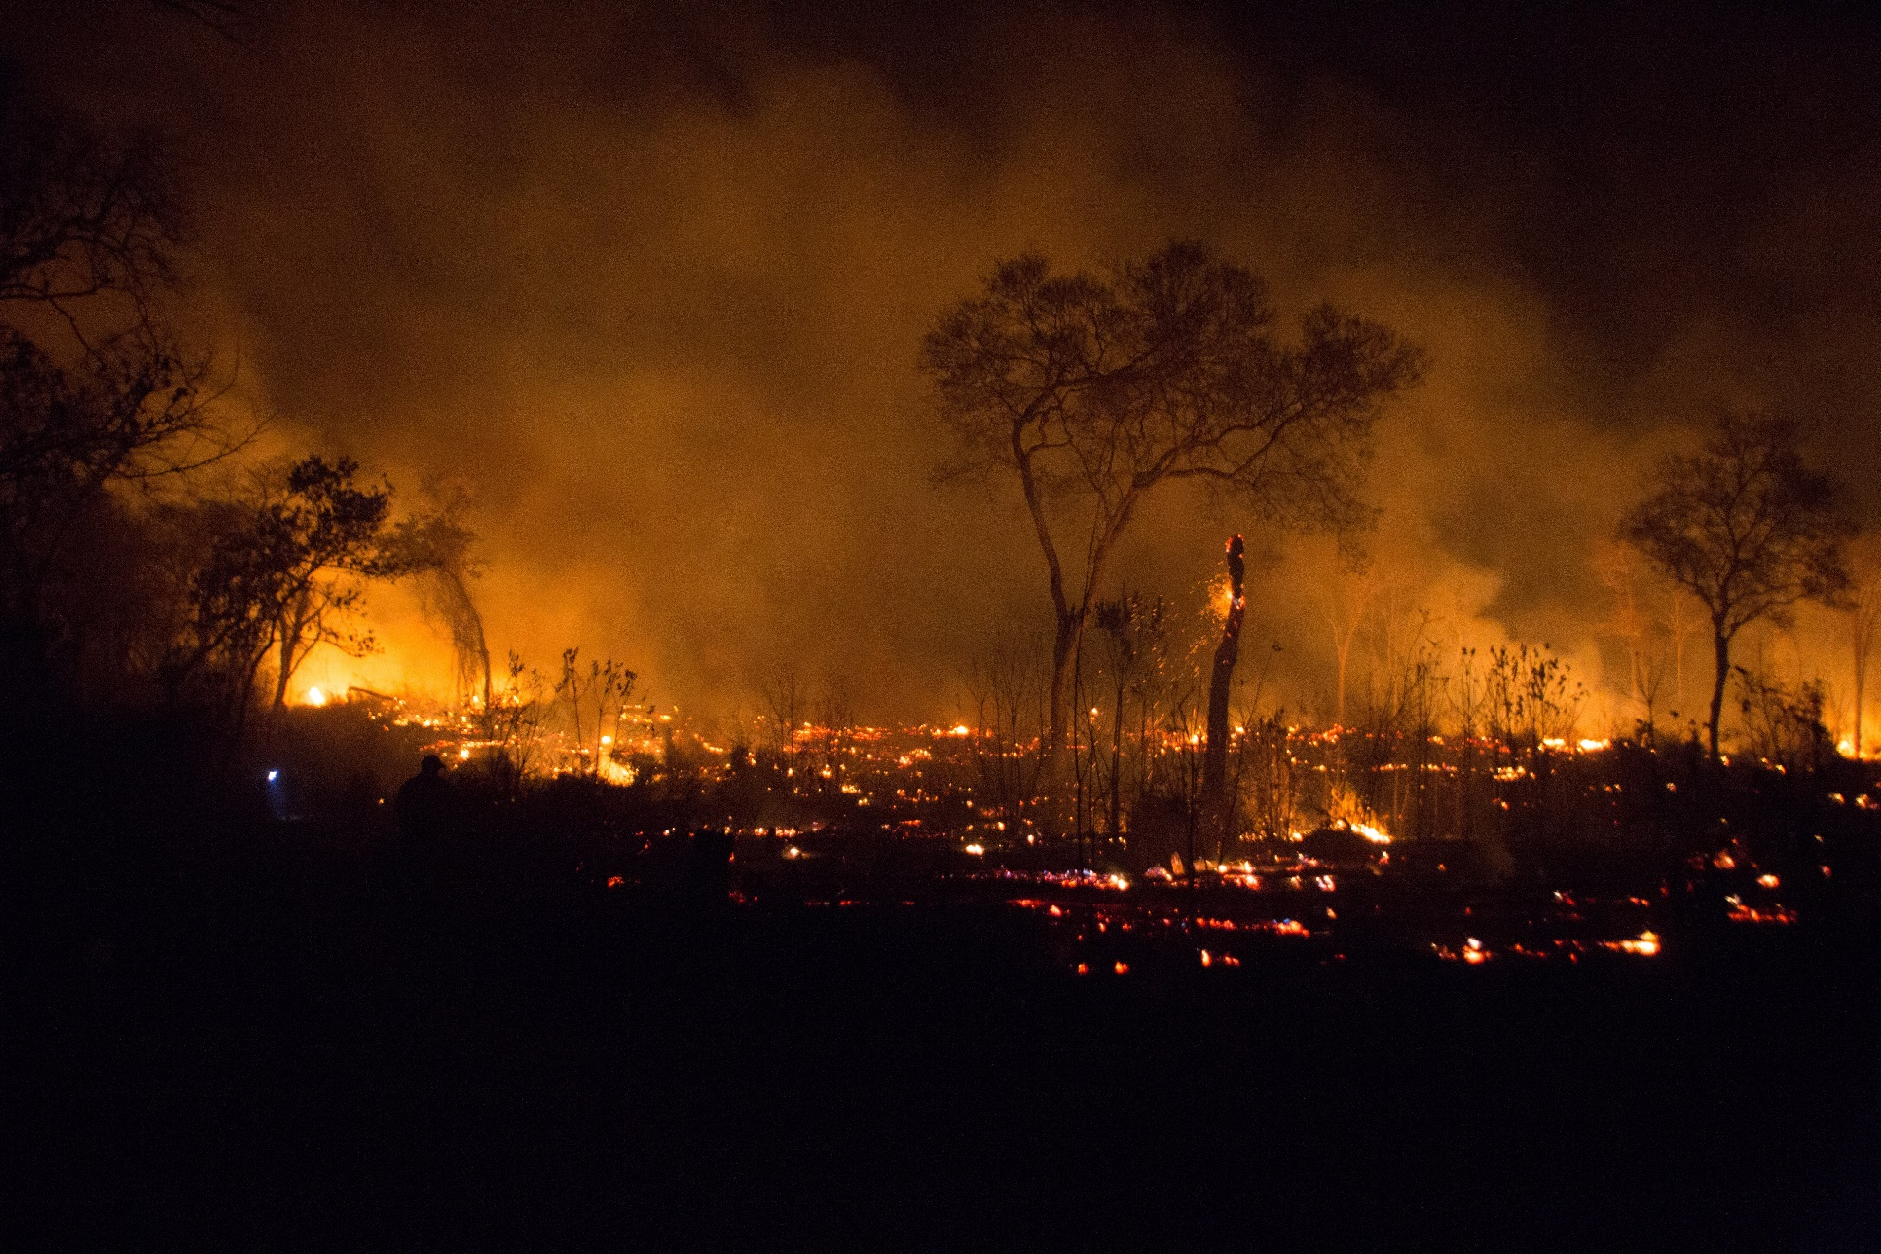

Slide 3
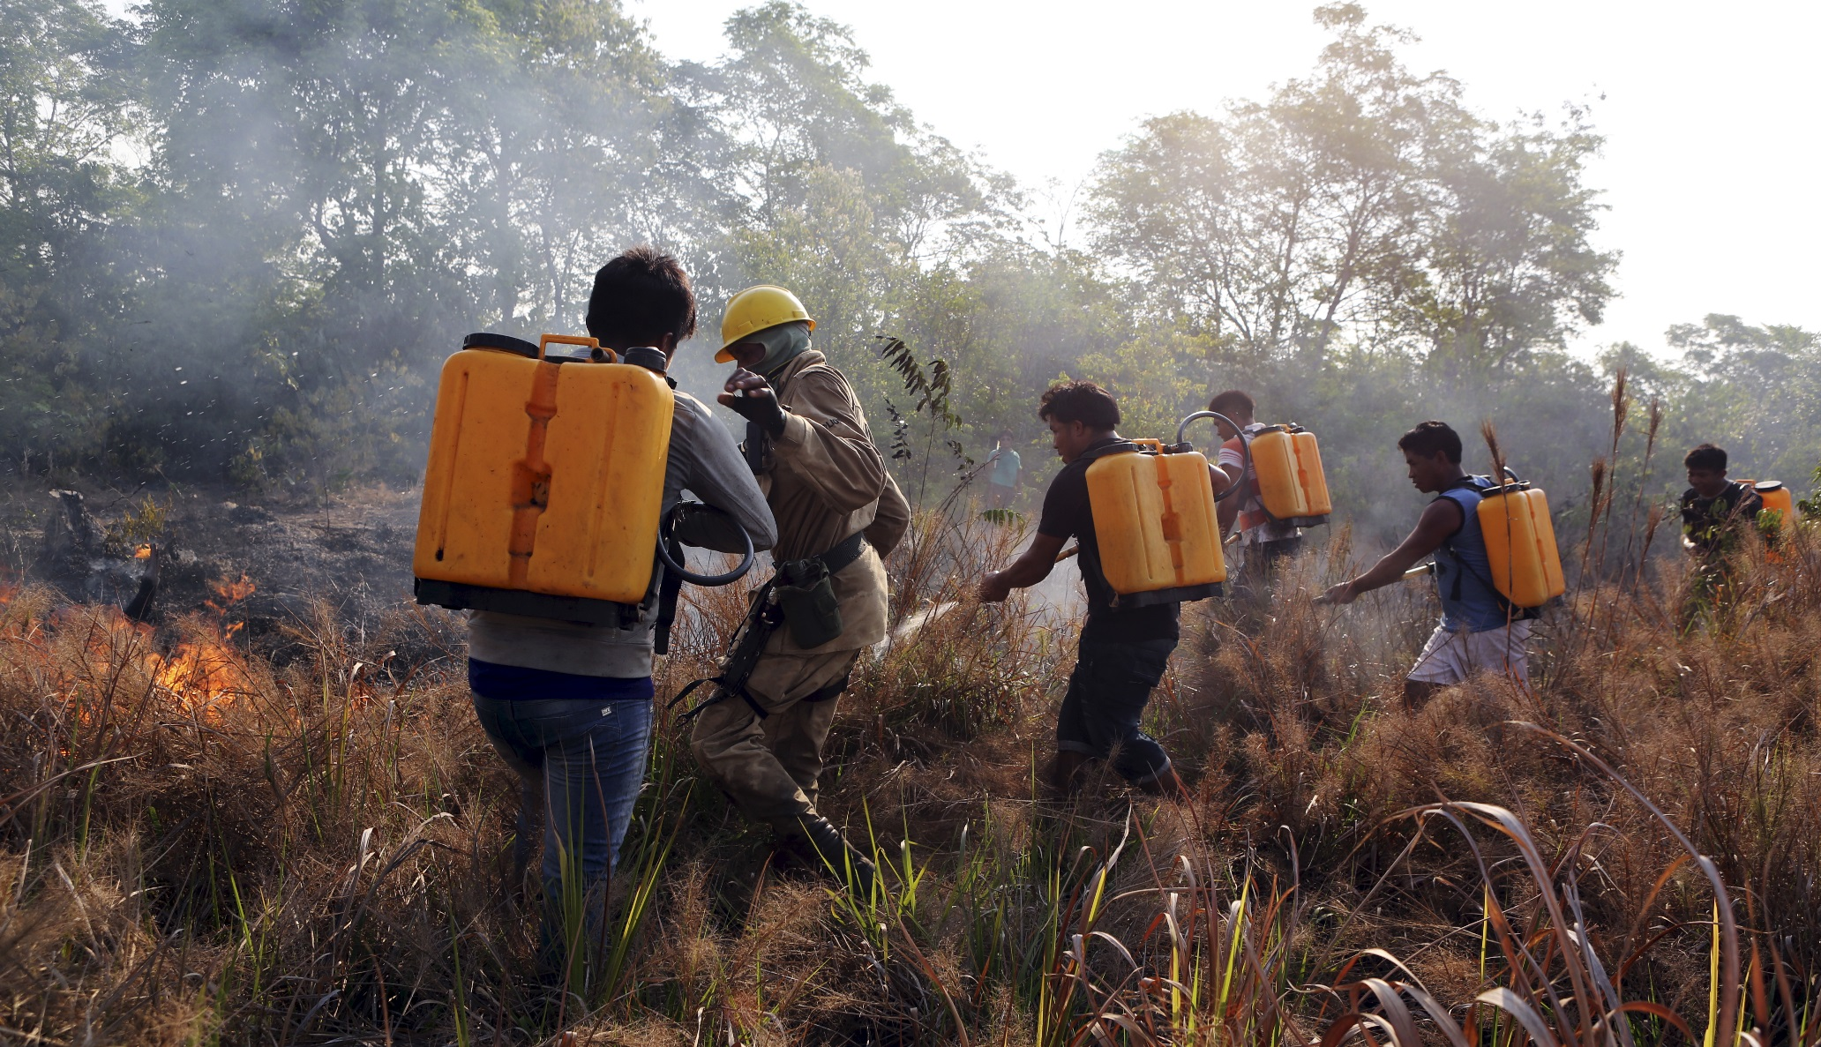

Slide 4

Photo credits and captions
Slide 2
Flames and smoke raise from the Chiquitania Forest fires. The emergency forces in eastern Bolivia continue to contain the devastating Amazon rainforest fire.
Credit: © Jorge Silva/Reuters.
Photo 2 (Round 2)
Caption: Indigenous people train with firefighters so they can fight fires on their lands.
© Paulo Whitaker/Reuters.
Notes:
1

