Slide 1
The Red Cross emblem
Full lesson plan from redcross.org.uk/education
Notes:
1

Slide 2


Slide 3
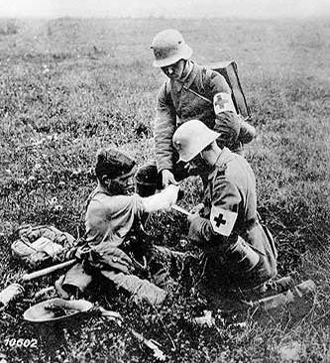
German military doctors,
World War I

Slide 4
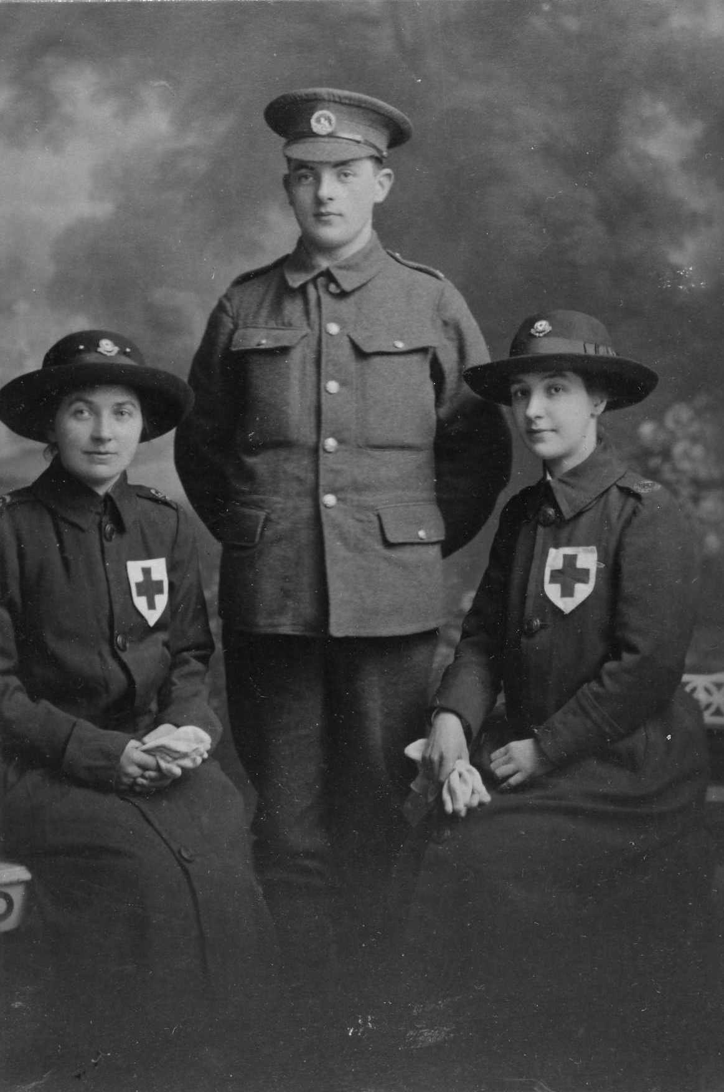
VAD volunteers, World War I

Slide 5
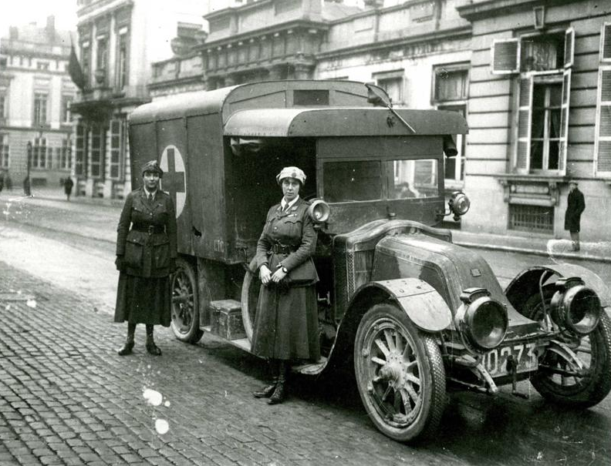
A Red Cross ambulance with two ambulance drivers (World War I)

Slide 6
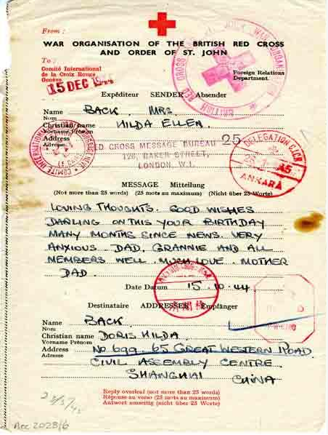
A Red Cross message to a prisoner of war (1944)

Slide 7
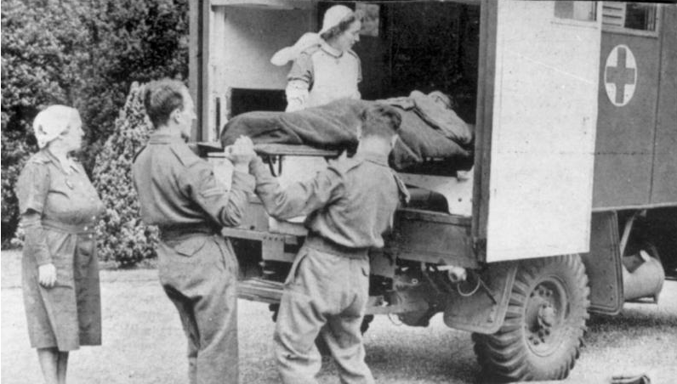
British Red Cross members help D-Day casualties (1944)

Slide 8

ICRC helicopter lands in South Sudan

Slide 9
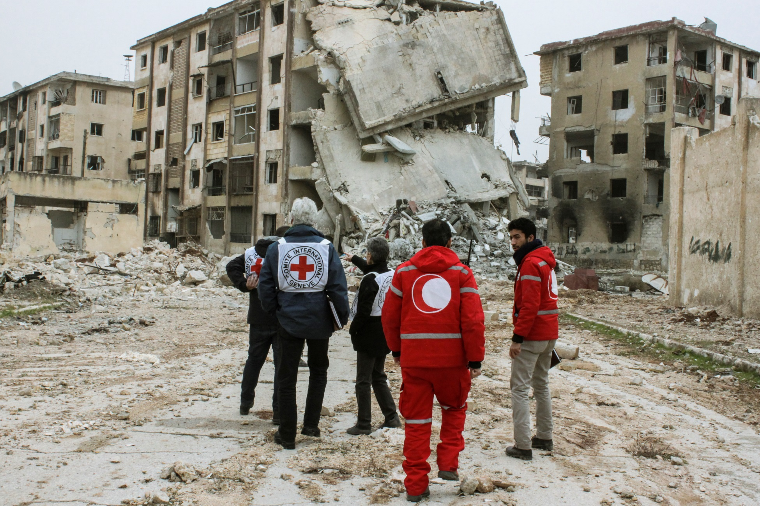
ICRC and Syrian and Arab Red Crescent assess living conditions in Aleppo, Syria

Slide 10
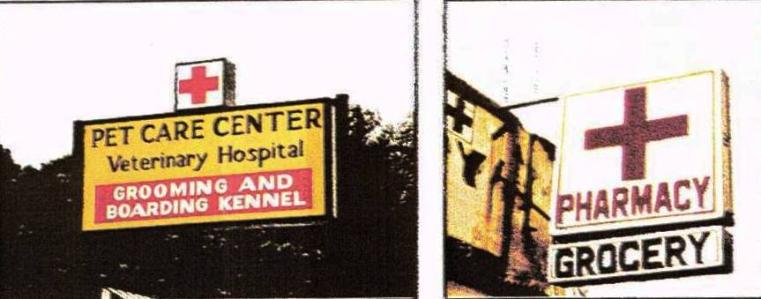
Misuse of the emblem

Slide 11
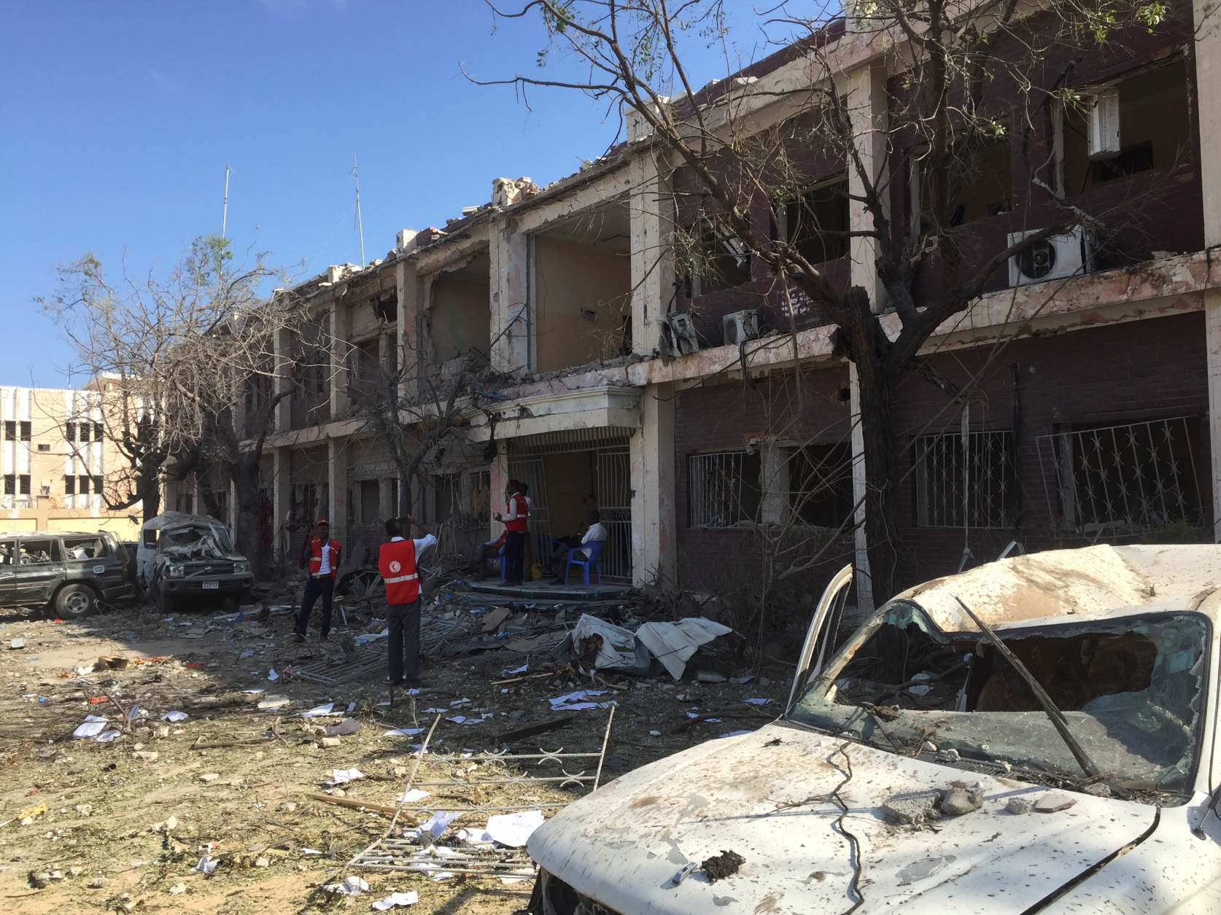
Explosion at Somalia Red Crescent offices, 2017

Slide 12
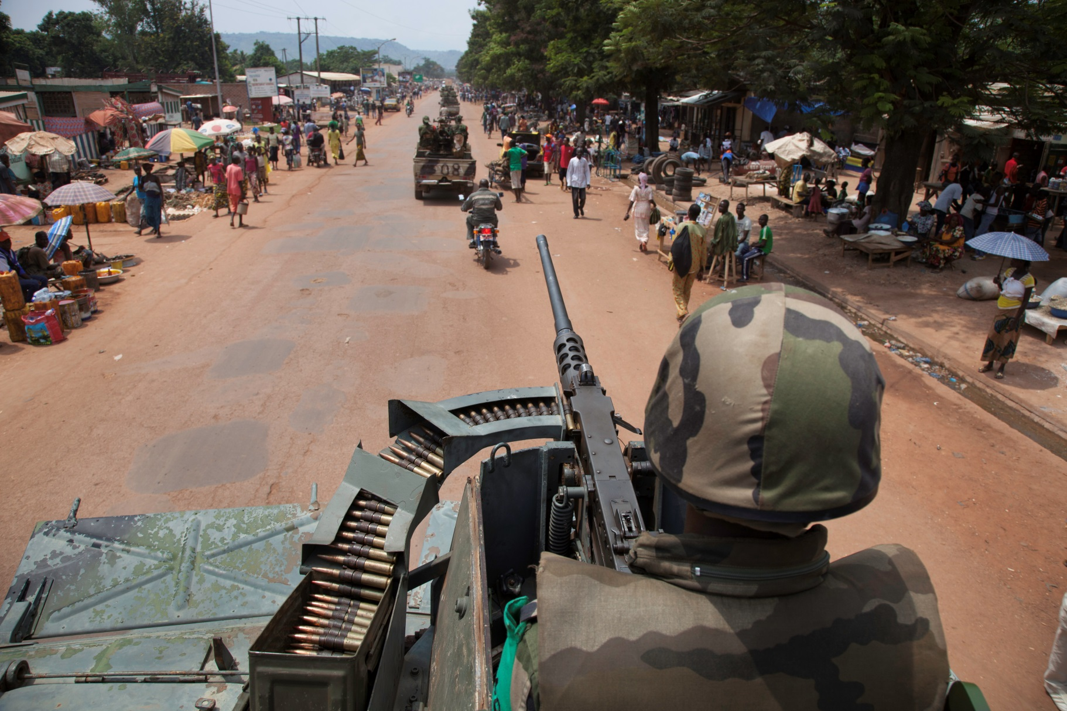
Combatants must never display a Red Cross, a Red Crescent or a Red Crystal emblem

Slide 13


The red cross, the red crescent and the red crystal emblems
Notes:
2

Slide 14
Photo credits and captions
All images © British Red Cross unless otherwise stated.
Slide 8: ICRC helicopter lands in South Sudan © Albert Gonzalez Farran/ICRC
Slide 9: ICRC and Syrian and Arab Red Crescent assess living conditions in Aleppo, Syria © Sevim Turkmani/SARC
Slide 11: Explosion at Somalia Red Crescent offices, 2017 © Daniel Gérard O'Malley/ICRC
Slide 12: Soldiers on patrol in the Democratic Republic of Congo © Boris Heger/ICRC
Notes:
1

