Slide 1
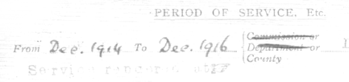





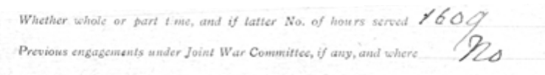
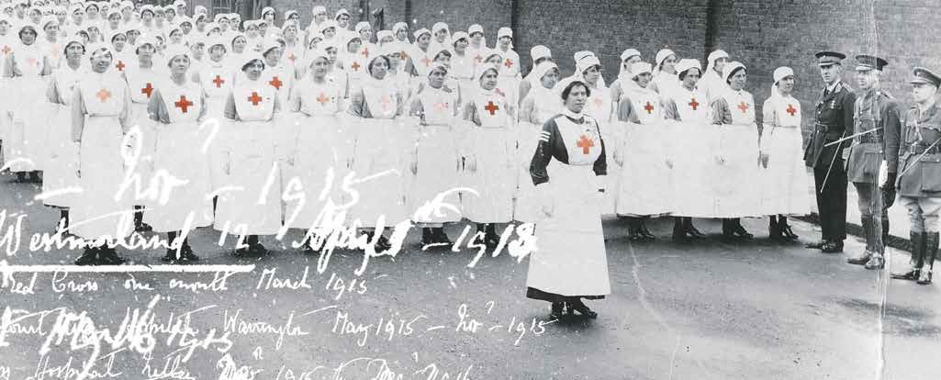
First World War volunteers
Supporting PowerPoint

Slide 2
Introduction

Slide 3
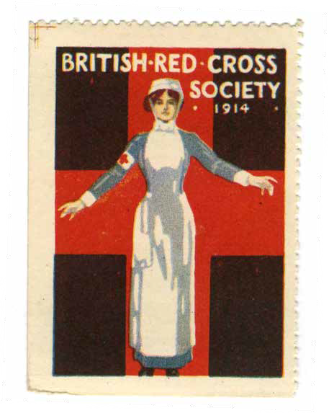
The First World War
Started: August 1914
Ended: 11 November 1918
Around 10 million soldiers and 7 million civilians were killed in the war.
20 million people were wounded.
Who helped during WWI?

Slide 4
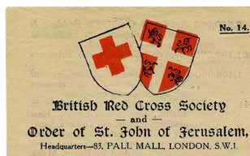
Joint War Committee
At the start of WWI, the British Red Cross joined together with the Order of St John to create the Joint War Committee (JWC).
Together, they:
Raised money.
Coordinated activities.
Worked closely with the Government.
At the heart of these activities were Voluntary Aid Detachments (VADs).
What were VADs?

Slide 5
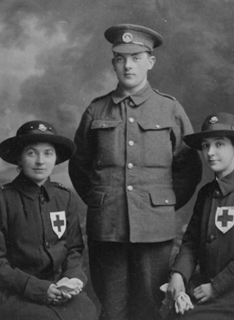
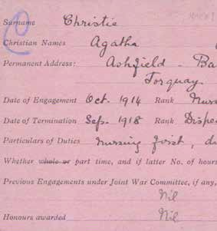
Voluntary Aid Detachments
VADs were single-sex units of volunteers. A male unit had around 40 volunteers. A female unit had 20 volunteers and 3 staff.
VAD became the nickname for a unit, but a single volunteer was also known as a VAD.
By the end of the war in 1918 there were over 90,000 volunteers across Britain, Europe and the Middle East.
What do you think volunteers did to help?

Slide 6
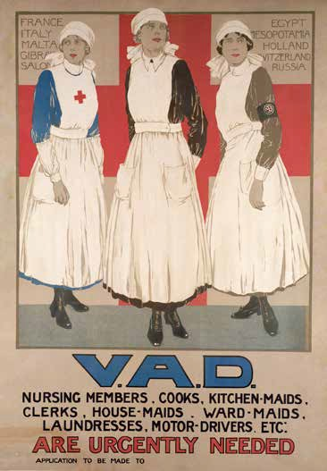
Volunteer roles
Volunteers performed a range of roles during the war:
Auxiliary nurse (support nurse)
Hospital cook
Driver
Finding missing and wounded soldiers
Transporting supplies to hospitals and prison camps
Carrying stretchers and wounded away from frontline (male VADs)
Air raid duty
What were the challenges of this work?

Slide 7
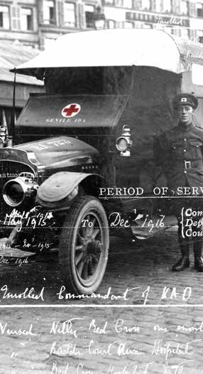
Helping in a crisis
VADs often had to work in difficult and sometimes dangerous situations.
They saw the effects of war first hand, as they dealt with injuries, shell shock, burying the dead, and telling families about their loved ones.
VADs were even asked to be responsible for air raid duty, as the Red Cross emblem was thought to make people behave calmly.
What were the benefits of this work?

Slide 8
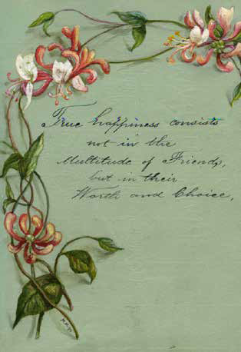
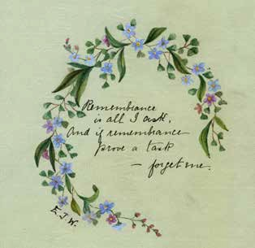
Hope and joy
Despite the hardship and horror of war, being a VAD also provided many people with new opportunities.
Letters, memory albums and photographs show us that many VADs had happy times working with others and being able to help or care for others.
Many women had greater freedom
and responsibility by being VADs.
How did this affect their lives after the war?

Slide 9
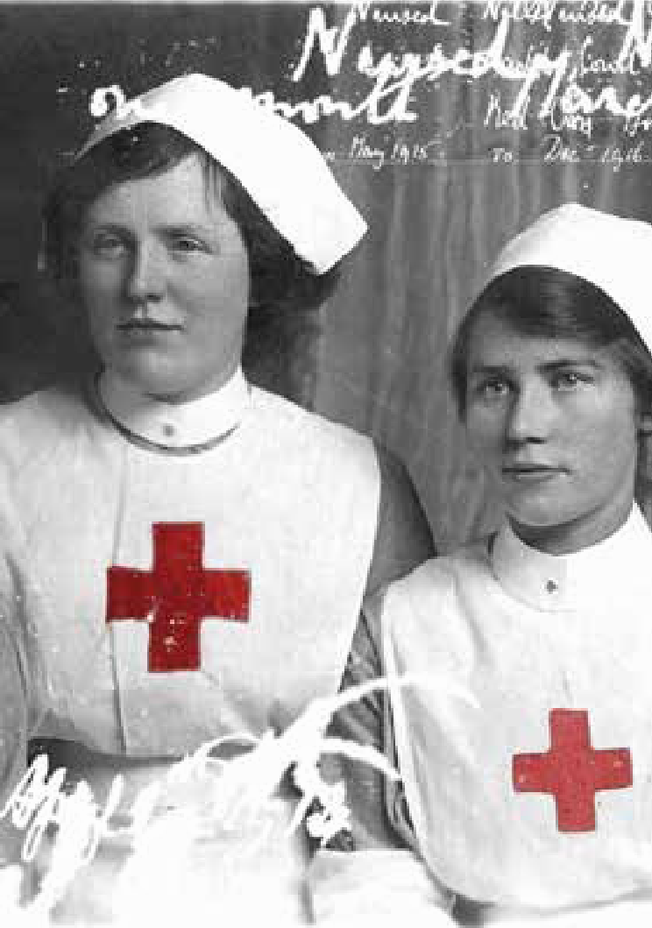
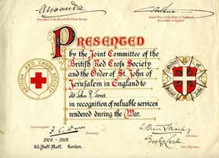
Work experience
Many VADs gained useful experience
out of their wartime volunteering.
The British Red Cross and the Order of
St John provided training and professional exams. They also rewarded service and achievement with honours and “stripes“
for volunteers to sew on their uniform.
After the war, more women had paid jobs and this was partly due to the role they had played as VADs.
Who did VADs provide help to?

Slide 10
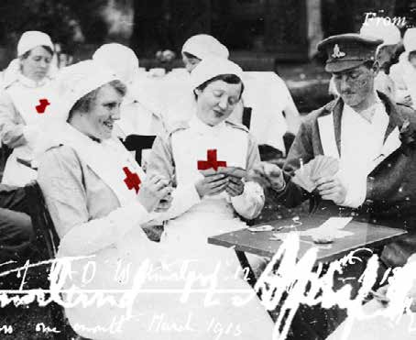
Humane treatment
The most important thing VADs did in WWI was to treat all people humanely, no matter what side they were on.
Being humane means providing care, showing empathy, and avoiding cruelty.
Providing care for the sick and wounded and helping to clothe and feed prisoners of war are examples of humane treatment. Today, humane actions like this form part of International Humanitarian Law (IHL).

Slide 11
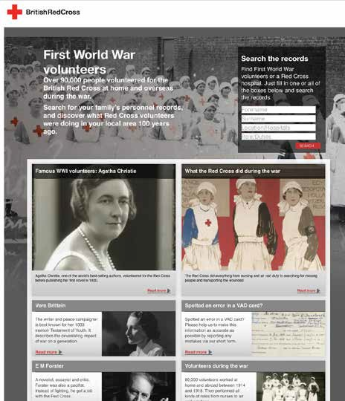
Remembering those who gave
The British Red Cross has created a website with information about individual VADs and about the important contributions they made during the First World War.
You can search the website to see what VADs did near you, or perhaps find information about relatives or family friends who may have worked as VADs.

Slide 12
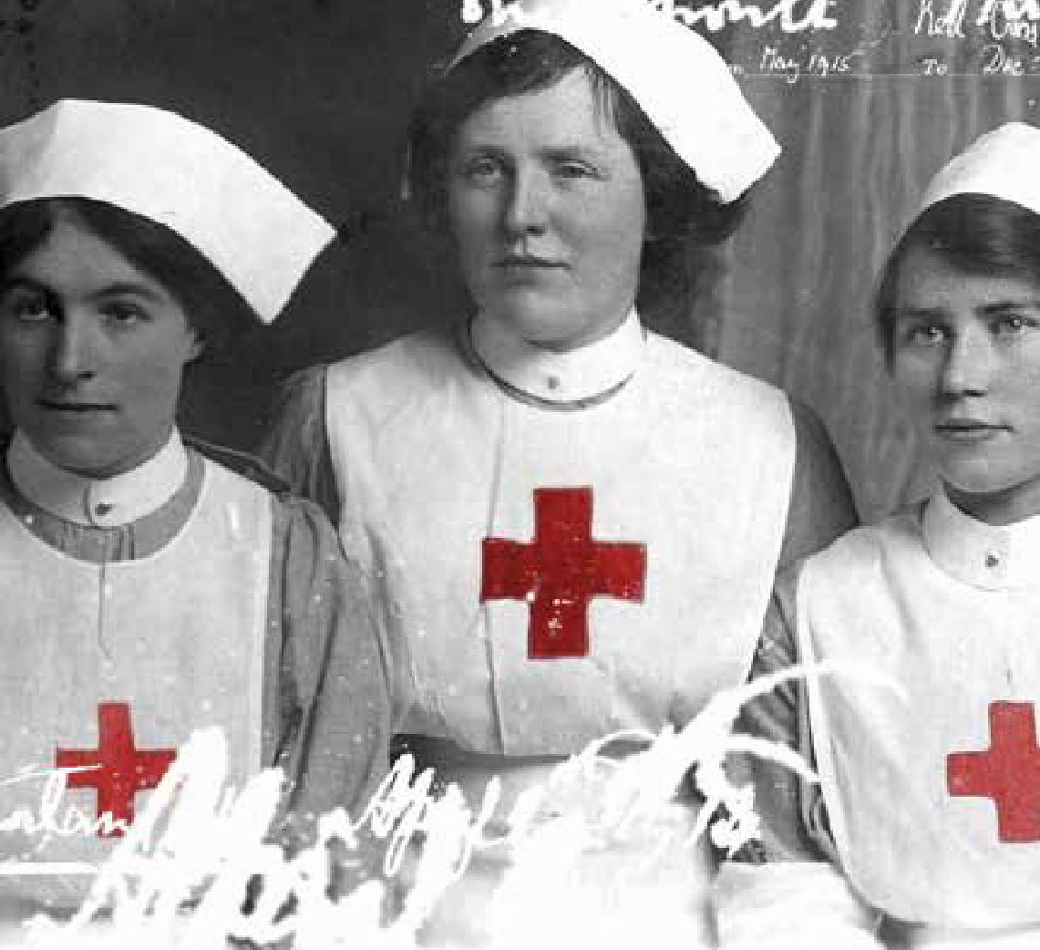
Module one: The power of volunteering
Module one

Slide 13
1.1 Volunteering in a
Voluntary Aid Detachment (VAD)
 | Volunteer 1 | Volunteer 2
Name
Gender
Age
Location/s
Duties
Other information (How many hours did they work? When were they a volunteer? etc.)
What questions do you have about the volunteers you investigated? What do you imagine it was like to be them and to work in a VAD?
How might they have felt? What kinds of feelings might they have had?
Module one

Slide 14
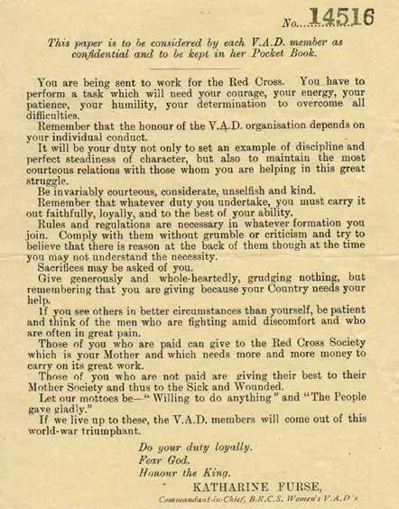
1.2 Code of practice
Module one

Slide 15
1.5 Motivations for volunteering
Support my country
Help those who are in need
Try something different
I’d want someone to help me
I like to be in control
Use my skills to help others
Develop new skills
Feel that I’m doing something
It sounds like an adventure
Support those affected by war
Because people will think I’m good
Provide friendship and support
Because I can
Protect my family
Module one

Slide 16
2.1 Auxiliary hospitals
Auxiliary hospital = a temporary hospital that provides extra support during wartime.
How many auxiliary hospitals were set up by the British Red Cross during the First World War?
How did the services and care provided by auxiliary hospitals differ to the military hospitals?
Who provided the care in auxiliary hospitals?
What did the patients like about auxiliary hospitals?
How was an auxiliary hospital organised and managed?
How were auxiliary hospitals funded?
Module one

Slide 17
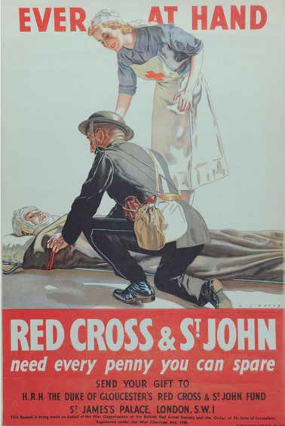
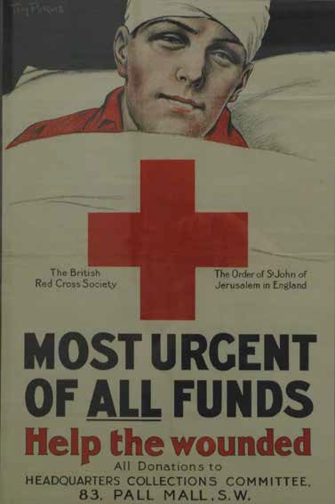
2.1 Posters
Module one

Slide 18
2.3 Volunteering in auxiliary hospitals near you
What do you think life would have been like for the volunteer at that time?
Why do you think they volunteered?
As a group, think about what daily life might have been like for a volunteer:
What might they have done?
What might they have experienced?
What could have been challenging?
What might they have enjoyed?
Module one

Slide 19
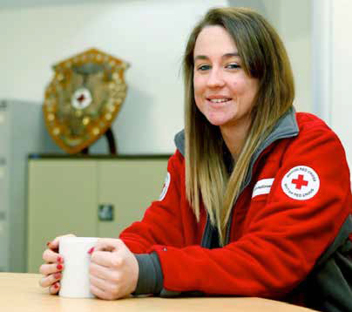
2.4 Auxiliary hospitals today
My name is Victoria and I’m a British Red Cross young responder. I’ve worked in many rest centres over the years, providing emotional support for people in crisis.
Having a good rest centre ready to help people and meet their needs is really important. It helps so much in the initial response.
A rest centre has to be planned. Good planning within the council makes a good rest centre.
Some of the things worth thinking about include: knowing where it should be set up, what to have ready, making sure the site has disabled access, accessible toilets, easy parking and access for emergency vehicles. Ensuring the right teams of people are there is important too.
We’ve set up rest centres differently, but one we set up during recent flooding worked really well…
Module one

Slide 20
2.4 Auxiliary hospitals today
As you come in, there is a reception area where everyone is signed-in and signed-out.
After you’ve been signed-in, we have tea, coffee, food, and refreshments.
The Red Cross is there with clothing and practical support including pharmacy and first aid support.
Cubicles have been built with tables and chairs inside, where people can talk with someone in private, rather than in front of others.
There is a pet’s area and a children’s area where we have set up a film – to keep the
children occupied.
- We included a quiet space where people can go and relax, and not feel they have to be around big groups of others if they don’t want to be.
- We also closed off the bottom end of the hall and set up beds behind a partition – the lights are off and it is a quiet area.
Module one

Slide 21
2.4 Auxiliary hospitals today
Easily accessible?
Car parking area?
Level access to the entrance or an entrance for disabled people?
A large room/hall for a holding area?
A room for private interviewing?
Basic kitchen facilities?
Food
(taking into account dietary/medical/ allergy/cultural factors)?
Washing/toilet facilities (including facilities accessible to disabled people)?
Telephone room?
General administration office?
Pets area?
First aid/medical advice area?
Staff rest room
(away from all public areas)?
Help for people who might not speak English?
Prayer room?
Crèche/play area?
Communal recreation area?
People who can provide emotional and practical support?
Information and advice tables with people able to provide practical assistance and answer questions?
Module one

Slide 22
3.1 Women in the VADs
Can you find any famous women who became volunteers? What made them famous? What was their role?
What were some of the roles that women did as volunteers?
Can you find out about the uniform that women volunteers wore? Can you sketch a picture of this using a description or perhaps from a photograph?
What were the caps that women had to wear called? Can you find out anything more about the person they were named after?
If you wanted to be a woman volunteer in a VAD, what did you have to do (training etc.)?
How were women organised as volunteers in VADs?
What new opportunities did volunteering provide for women?
How might it have felt for women to have a role in the VAD?
Module one

Slide 23
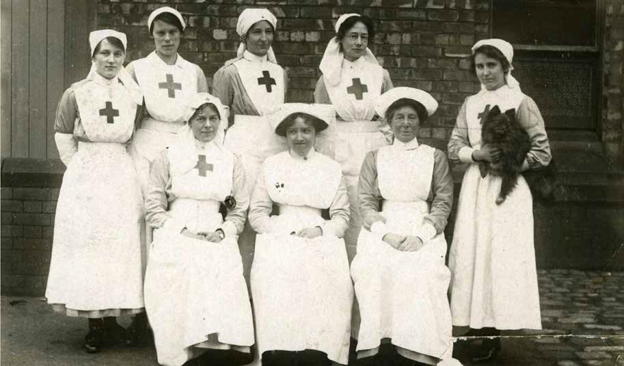
3.1 Women in the VADs

Slide 24
3.2 In her shoes
Ishobel Ross was a Scottish teacher who signed up with the British Red Cross to volunteer in a VAD.
Later she travelled 1,800 miles to Serbia to work in a hospital kitchen for the Scottish Women’s Hospital.
The hospital was run and managed by women.
Accommodation was basic, with people sleeping in canvas tents.
The hospital looked after soldiers who were fighting on both sides in the war and was neutral in the care it offered.
She saw soldiers wearing different uniforms passing through the town – Serbian, Russian, Italian and more.
She heard bombardments (attacks with bombs) and saw flashes on the hill at night.
Module one

Slide 25
3.2 In her shoes
How she might have felt before she left/ during her journey/when she arrived.
What she might have had to learn in her new role.
What the challenges and the positives might have been.
What kinds of things might have helped her to cope with these challenges.
What the benefits of this work might have been.
Module one

Slide 26
3.3 Equality and fairness
What kinds of jobs did women do before WWI?
What happened when men went to fight during the war?
What were the benefits of this?
What were some of the challenges that women faced?
What happened after the war?
What tensions did women face after the war?
And what were the challenges?
Module one

Slide 27
3.4 Changing roles
Clerk (note taking,
letter writing etc.)
Driver
Cook
Farmer
Bus conductor
Dispenser (giving out medicine)
Commandant (in charge of a hospital)
Nurse
Teacher
House maid
Module one

Slide 28
3.5 Coping with challenges
“Responsibility does not only lie with the leaders of our countries (…). It lies with each of us individually.”
The Dalai Lama
“Peace is a daily, weekly, a monthly process gradually changing opinions, slowly eroding old barriers, quietly building new structures.”
J. F. Kennedy
“When the whole world is silent, even one voice becomes powerful.”
Malala Yousafzai
“There is no great force for change, for peace, for justice and democracy, for inclusive economic growth than
a world of empowered women”.
Phumzile Mlambo-Ngcuka
Module one

Slide 29
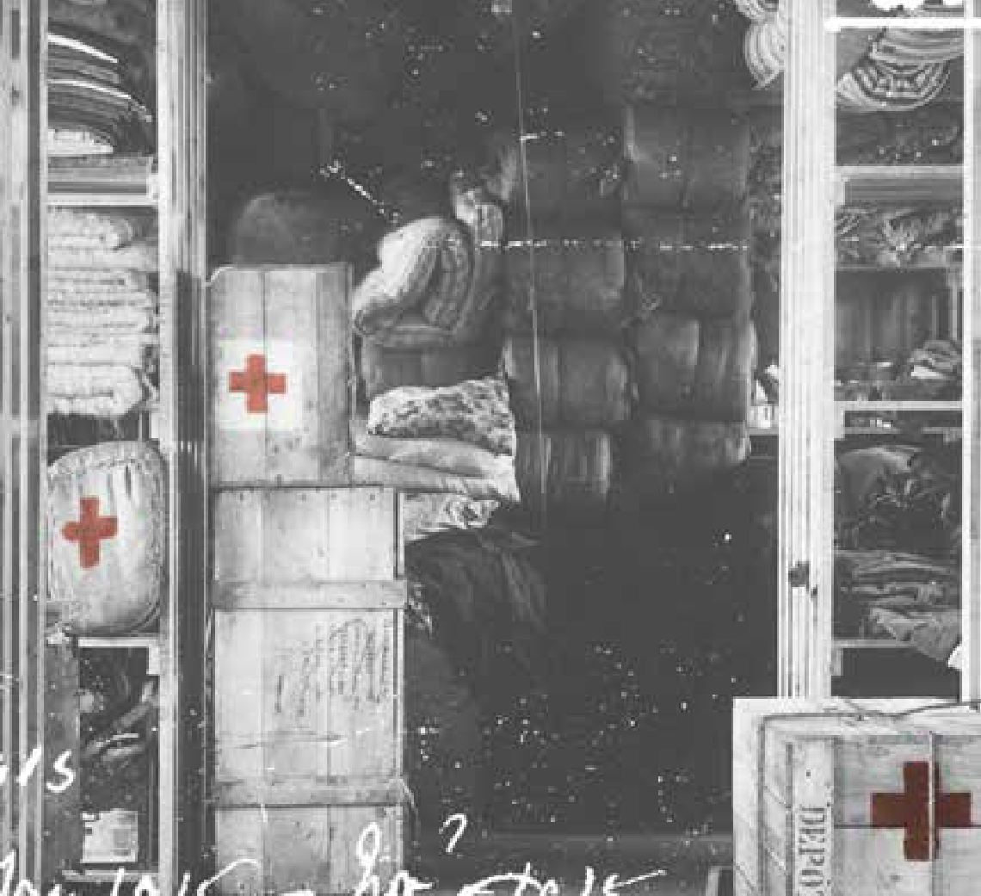
Module two: Protections in war
Module two

Slide 30
1.1 Why do we have rules?
Caring for the sick and wounded:
People caring for the sick and wounded should be protected (as they are not engaged in combat).
The Red Cross is legally recognised as an emblem displayed by humanitarian workers caring for the sick and wounded. Those wearing it should be protected, as they are clearly marked as medical personnel.
Hospitals and other buildings treating the sick and wounded are not allowed to be attacked.
All people (including humanitarian workers and army medical staff) caring for the sick and wounded should do so impartially – they should care for them no matter who they are fighting for.
Module two

Slide 31
1.2 Feeding prisoners of war
What was in a typical emergency food parcel for prisoners of war?
How long did an emergency food parcel last?
How many food parcels were the Red Cross allowed to keep at any one time in German prisoner of war camps?
Were all food parcels the same?
What else might prisoners find in their parcels and why was that important?
Module two

Slide 32
1.5 Treating prisoners humanely
The principle of Humanity expresses what the International Red Cross and Red Crescent Movement places beyond anything else:
the need to act in order to “prevent and alleviating human suffering wherever it may be found”.
Moreover, the Movement exists to promote mutual understanding, friendship, co-operation and lasting peace amongst all peoples.
redcross.org.uk/about-us/what-we-stand-for
Module two

Slide 33
1.5 Treating prisoners humanely
“…If a small parcel of personal requisites weighing not more than three or four lbs., and bearing a distinctive mark could be sent, say, once a month by the relations of prisoners through an authorised Association, this would go
a long way to allay the dissatisfaction then existing among relatives without any serious risk of assisting the enemy.
The following articles might be included:
Pipes, sponge, pencils, tooth powder, pomade, cap badge, badges of rank, numerals and shoulder titles, shaving brush, safety razor, bootlaces (mohair), pipe lights, medal ribbons, brass polish, housewife (sewing kit), handkerchiefs (one a quarter), shaving soap (one stick a quarter),
health salts, insecticide powder, braces and belts (provided they are made of webbing and include no rubber or leather), combs, hair brushes, toothbrushes, buttons, chess, draughts, dominoes, dubbin, hobnails, sweets or chocolate (8 oz only), one pair mittens every quarter,
one muffler every quarter, one pair of socks instead of mittens or muffler.”
Module two

Slide 34
1.5 Basic rules of IHL
 | Prohibitions | Obligations
Protecting the most vulnerable persons civilians wounded and sick detainees health-care workers | It is forbidden to: target civilians and civilian objects (houses, schools, places of worship, cultural or historic monuments, etc.); murder and torture; commit acts of sexual violence; forcibly displace and starve civilians; attack hospitals, ambulances and health-care workers; use human shields; destroy stocks of food, farming areas, and the water supply; recruit or use children under the age of 15 in armed conflict; misuse the red cross / red crescent / red crystal emblem; interfere with the delivery of humanitarian relief; damage the environment. | Captured civilians and enemy combatants: must be given adequate food, water, clothing, shelter and medical care; must be allowed to have contact with their families; Children and women must be detained separately from men, to the extent feasible. Enemy combatants who are wounded, sick, shipwrecked, or surrendering: must be searched for, collected and cared for; must not receive preferential treatment, except on medical grounds. A surrendering enemy must not be wounded or killed. The specific protection, health and assistance needs of women affected by armed conflict must be respected. Everyone is entitled to a fair trial.
Limiting the way in which war is conducted weapons use of force | It is forbidden to: use weapons that cause unnecessary suffering (such as poison, blinding laser weapons or antipersonnel landmines); use weapons that cannot distinguish between civilians and military targets (such as landmines); take hostages; pretend to be a civilian while fighting; order or threaten that there shall be no survivors. | Those who are fighting must make an effort to figure out who is a combatant and who is not in the fight. Attacks must be limited to military objectives. During an attack, every precaution must be taken to minimize the potential harm to civilians and civilian objects.
Module two

Slide 35
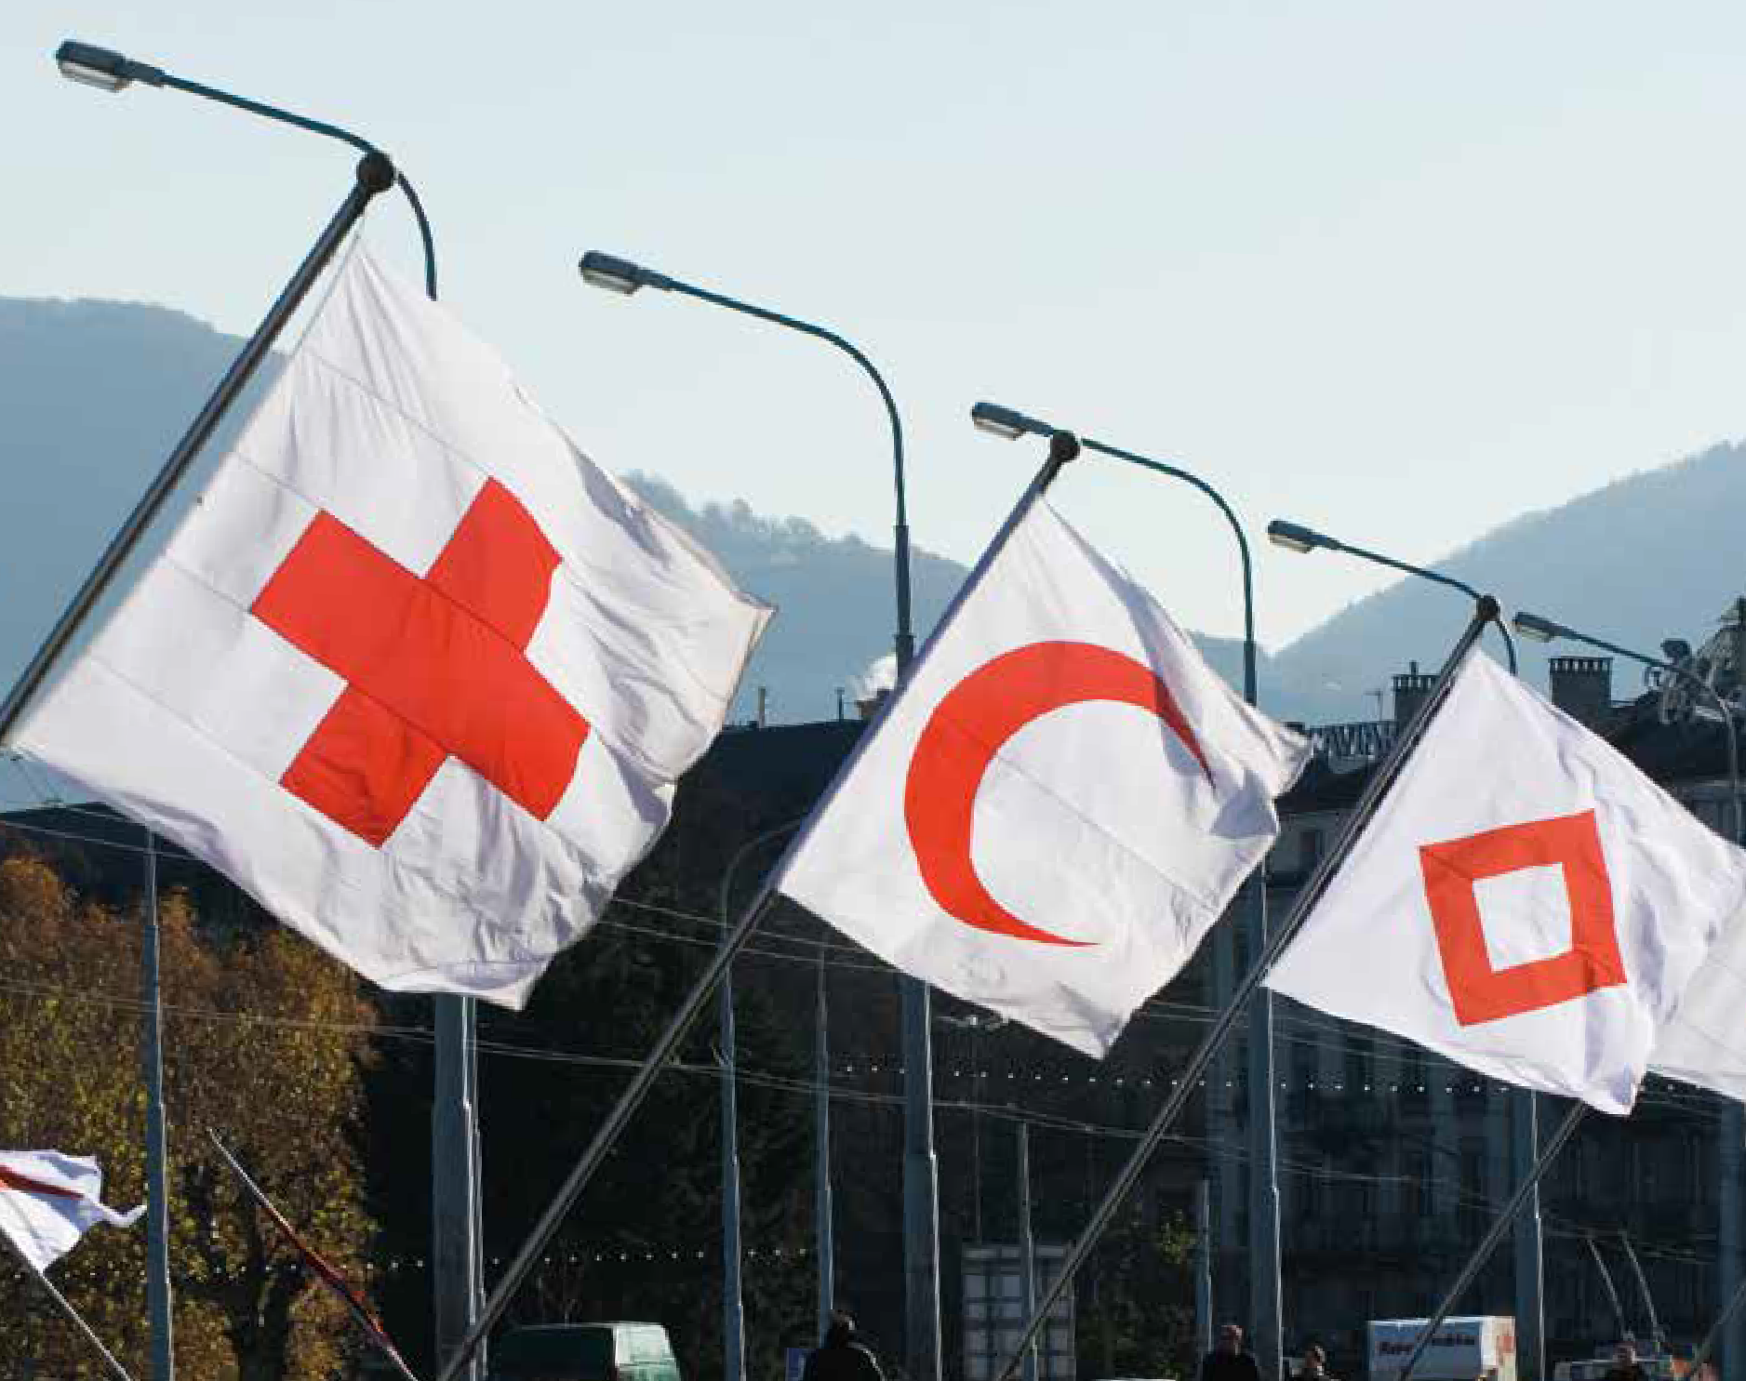
2.1 The Story of an Idea
Module two

Slide 36
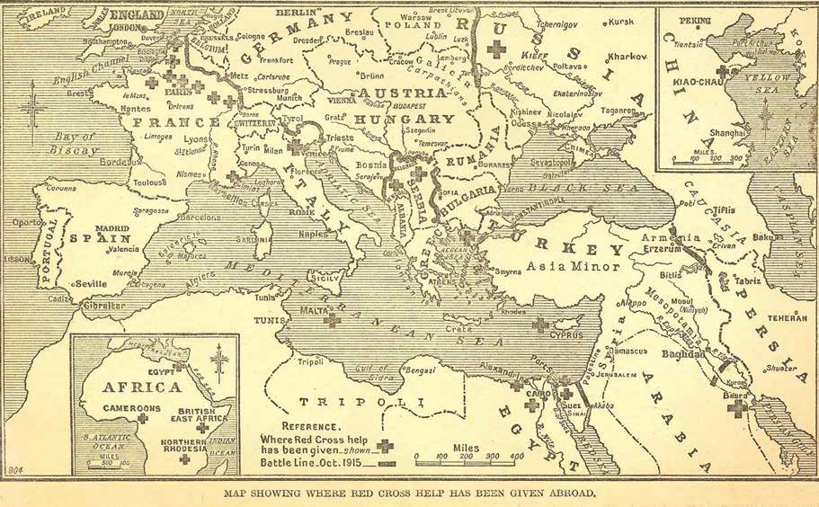
2.2 Helping in modern-day conflict
Module two

Slide 37
2.3 Protecting the helpers
Medical personnel | Civilians
Soldiers | Volunteers
Module two

Slide 38
2.4 Reflecting
How did POWs cope with their situations?
How did the Red Cross start?
What principles is it based on?
What protections are there in place for those affected by conflict?
(If you have watched the “Story of an Idea” video), how might Henry Dunant have felt when
he decided to help the wounded soldiers?
What moved him to help?
Module two

Slide 39
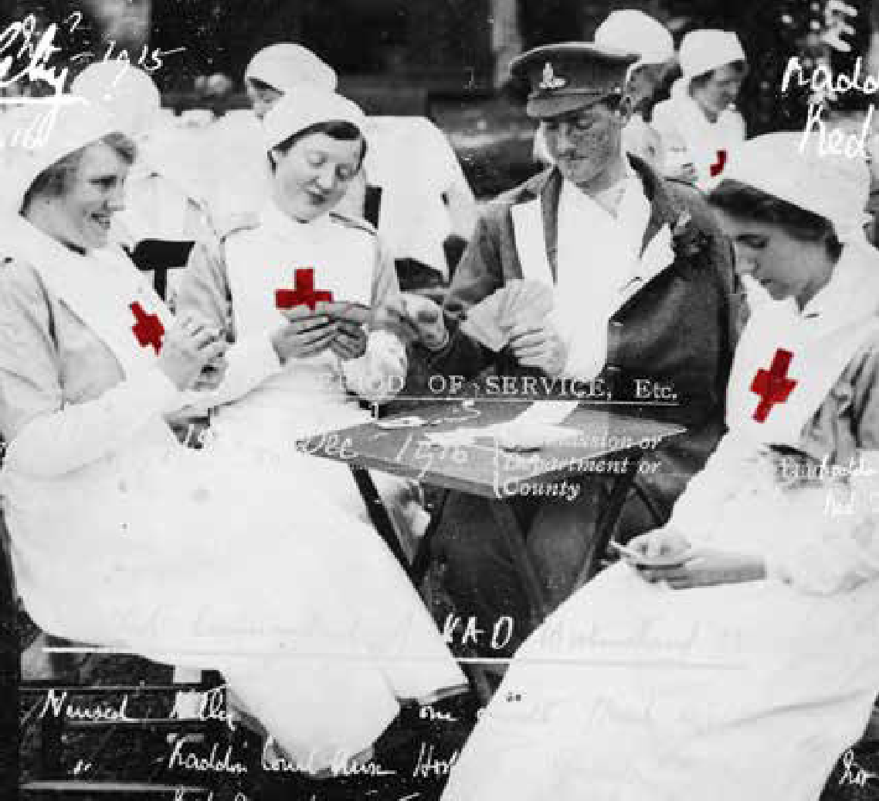
Module three:
Humanity in action
Module three

Slide 40
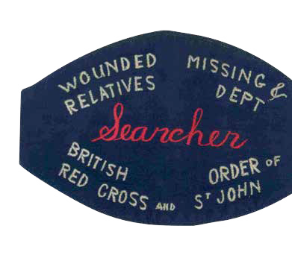
1.1 Seeing a need and using an opportunity
Searchers’ roles included:
searching for wounded in hospitals where soldiers were taken for treatment.
tracing graves.
returning letters from the battlefields to people who had written them.
writing letters to relatives to tell them about the fate of their loved ones.
finding out which soldiers were prisoners of war and passing this information on to their families.
Module three

Slide 41
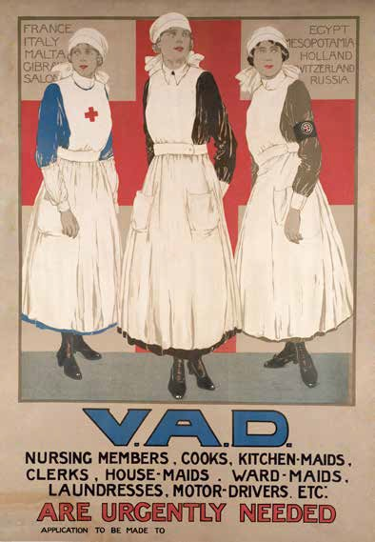
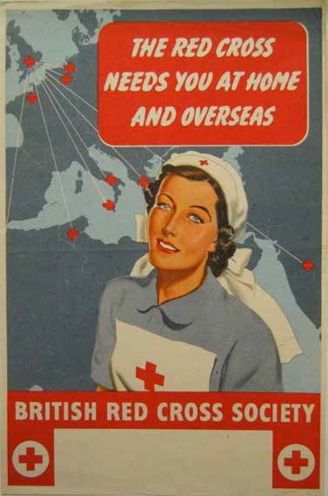
1.2 The right volunteer
Module three

Slide 42
1.3 Showing humanity
“It was soon decided that official forms and methods should be discarded when writing to relatives waiting for information about ‘the missing’.
This was so that each enquirer felt that a personal interest was taken in his or her case.”
Module three

Slide 43
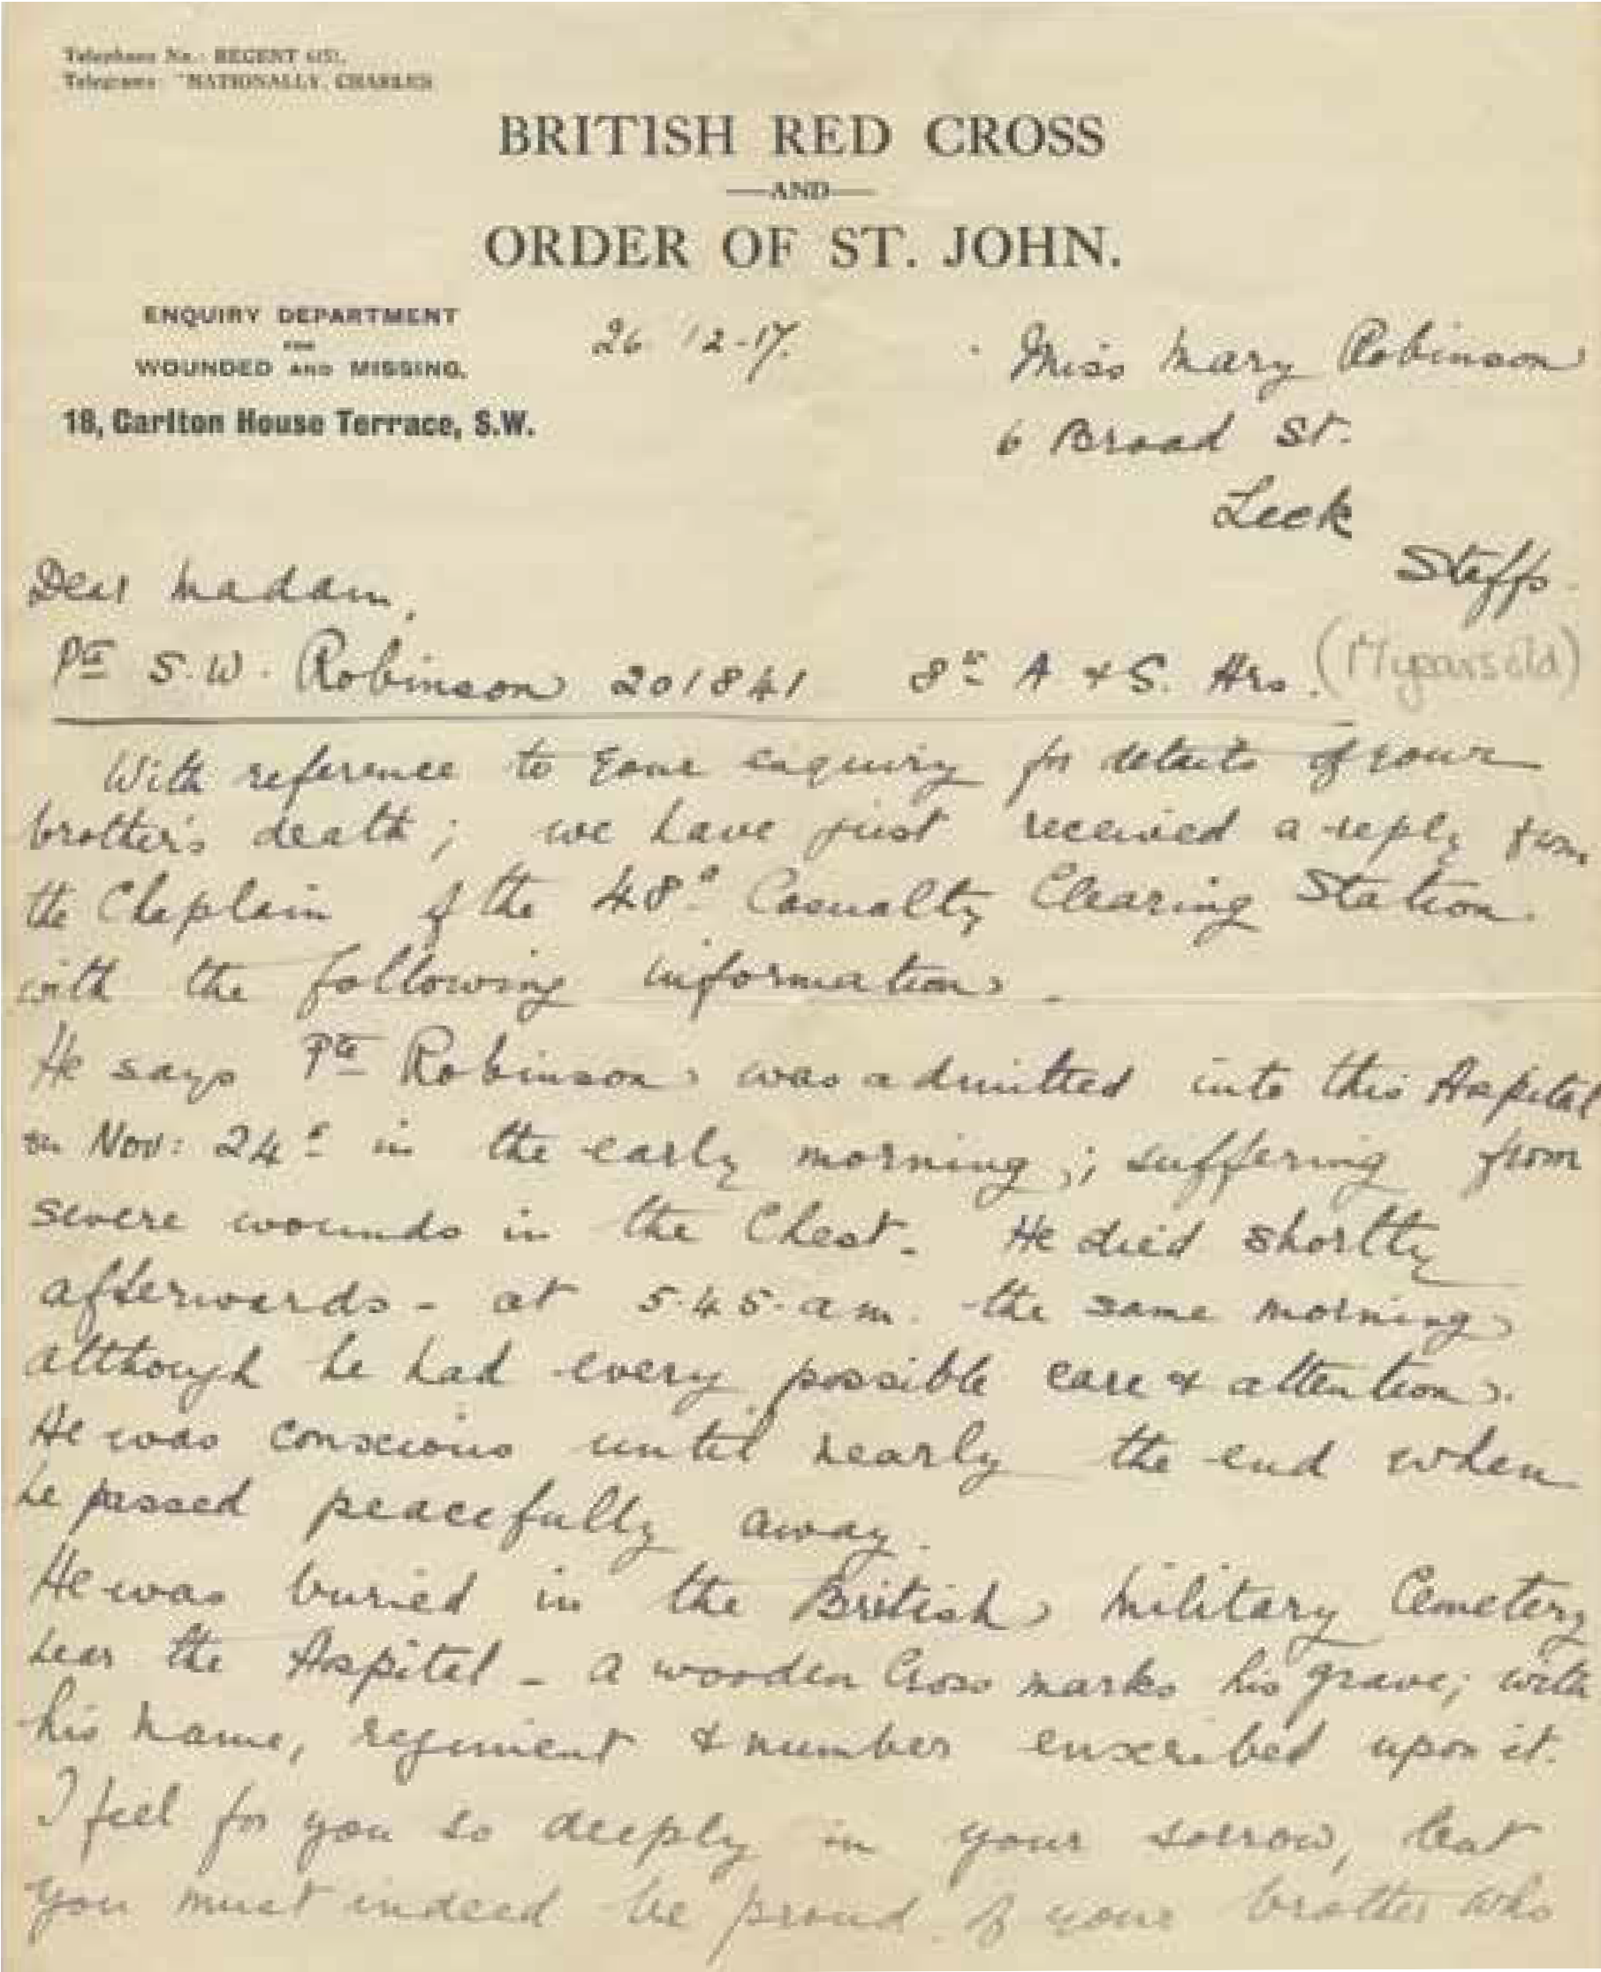
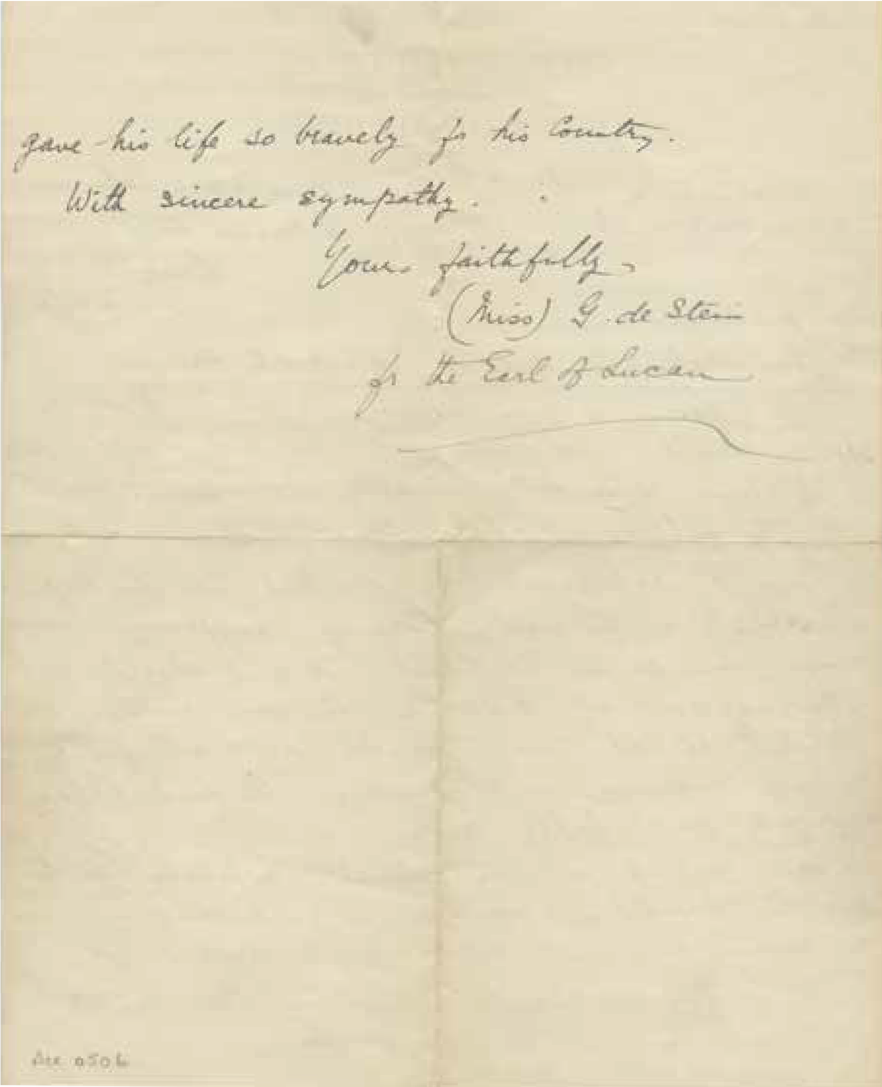
1.4 A letter to Miss Mary Robinson
Module three

Slide 44
2.1 The VAD refugee service
A refugee is:
“A person who owing to a well-founded fear of being persecuted for reasons of race, religion, nationality, membership of a particular social group or political opinion, has left their home country.
As a result, they are unable or unwilling to seek
protection from, or return to, their home country.”
(United Nations Convention Relating to the Status of Refugees)
Module three

Slide 45
2.1 The VAD refugee service
Gertrude Ashberry Florence Acheson Thomas Baird
Gwyneth Mabel Ashurst Kate Eugenie Allwright Susan Bucknill
Marion Alexander Alfred Samuel Balm John Agar
Vega Baldensperger Nellie Cliftoy Barnard Henry Anderson
Name | Where did they volunteer? (country, region, town, city etc) | What was their role? | How might this have helped refugees?
Gertrude Ashberry
Thomas Baird
Module three

Slide 46
2.2 Mapping support for refugees
France
Belgium
Serbia
Salonika (the city of Thessaloniki which had just become part of Greece)
Mesopotamia (now mostly Iraq)
Persia (now mostly Iran)
Switzerland
Egypt
Palestine (now in Israel and Palestine)
Module three

Slide 47
2.2 Mapping support for refugees
Module three

Slide 48
2.2 Mapping support for refugees
Looking at your map, discuss where was most support needed for refugees.
What sort of help was most in demand from the information you have researched?
Which refugees had to travel the greatest distances?
How do you think it would have felt to arrive in a British Red Cross refugee centre?
How do you think the refugees might have been feeling when they arrived?
How might the volunteers who supported refugees have felt?
What learning can you take from this to understand how people from refugee backgrounds might feel today?
Module three

Slide 49
2.3 Modern-day refugees
Which region/s of the world are most refugees currently in?
Where do most of the refugees go?
Do refugees spread evenly in surrounding or nearby countries?
Which countries/regions have the most refugees at the moment?
Module three

Slide 50
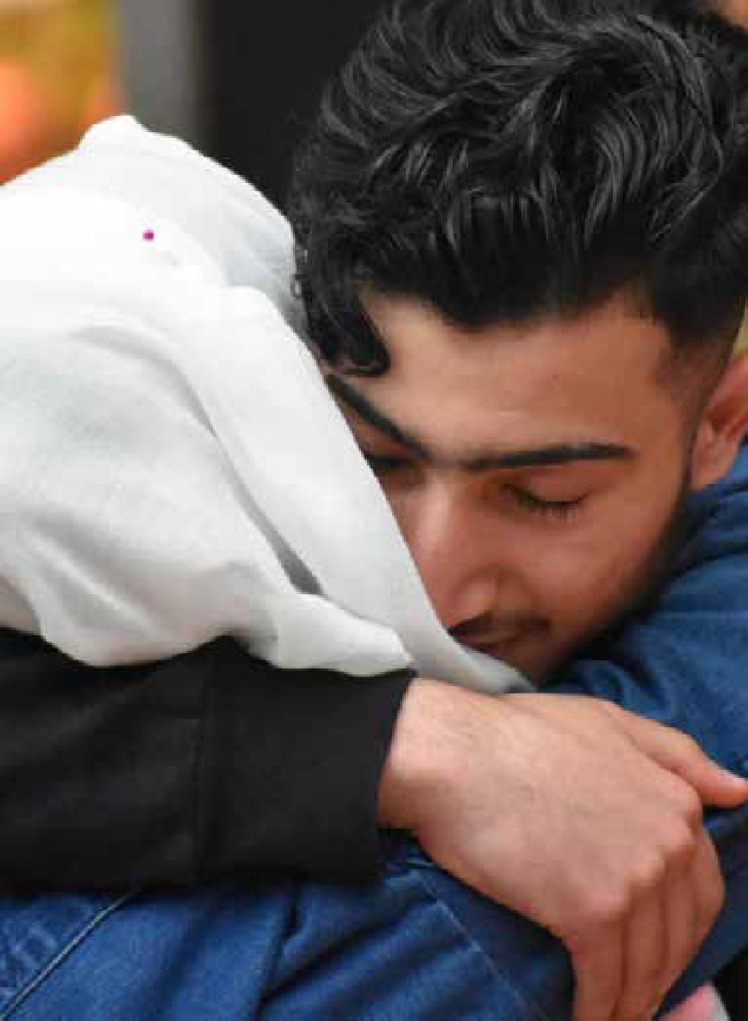
2.4 Welcoming refugees
What do learners think has been difficult about the family’s experience?
What kinds of emotions do they think might have been involved when they were separated?
And now that they are reunited?
How might their lives now be different now?
What kind of support might they need?
Module three

Slide 51
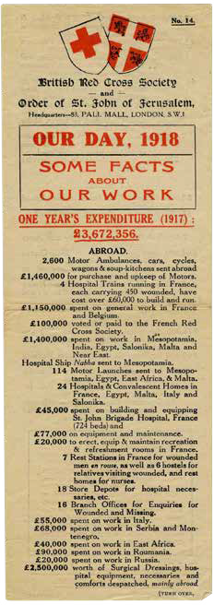
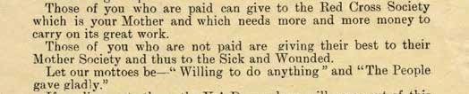
3.1 The costs of support
Module three

Slide 52
3.1 The costs of support
What other things of interest can you find in the leaflet? Are there any things that surprised you?
If you read this leaflet during WWI, which items on the list would you most want to give money for?
e.g. rest stations, hospitals, clothing, parcels of
food to prisoners of war, facial injury hospitals etc.
- Why do you think this leaflet does not ask for money directly? Do you think it is still effective in persuading readers to support the work of the British Red Cross?
Module three

Slide 53
3.2 Gladly giving and carefully funding
Try and identify five different methods of raising funds.
Think about what was the most unusual method of raising funds.
Consider which method of fundraising you think is most successful and why.
Module three

Slide 54
3.2 Gladly giving and carefully funding
You’ve received 4 million pounds from the Times newspaper fund.
The Lord Mayor’s City of London Fund has raised money through the trade associations and presented you with a cheque for £750,000.
Christie’s auction house has given you £84,383 from the sale of 41 pearl necklaces. The necklaces were made from 3,500 individual pearls sent in by members of the public to help raise money for the British Red Cross.
You have received £68,000 from an annual collection by many religious organisations.
Module three

Slide 55
3.2 Gladly giving and carefully funding
Thinking about the amount of money you have to spend, what would you prioritise and why?
What influenced your decision?
How do you hope the funds will help people affected?
Module three

Slide 56
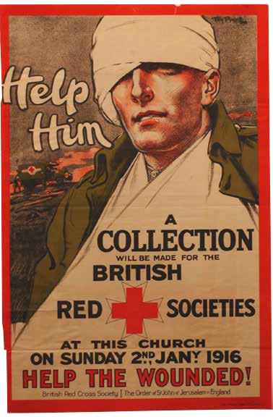
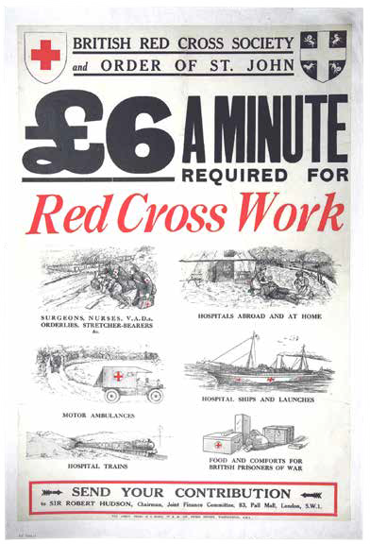
3.3 Appealing to a common humanity
Module three

Slide 57
Copyright notice
© British Red Cross 2018
All photographs fully protected by copyright. Schools and other educational organisations are free to use this PowerPoint for educational use. The licence does not extend beyond this use. This means that anyone wishing to put an image on a website, crop or edit it, or use it in any other way, must first contact the copyright holder and negotiate a licence for the use they require.
This resource and other free educational materials are available at redcross.org.uk/education.
The British Red Cross Society, incorporated by Royal Charter 1908, is a charity registered in England and Wales (220949), Scotland (SC037738) and Isle of Man (0752).

