Slide 1
Refugees: Identity
Full lesson plan from redcross.org.uk/education
Notes:
1

Slide 2
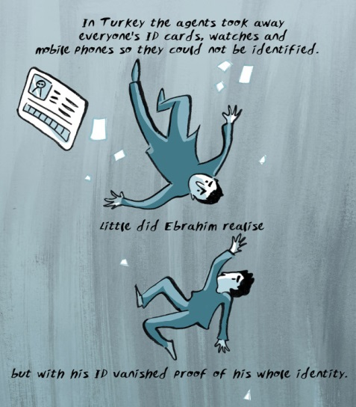
Lost identity

Slide 3
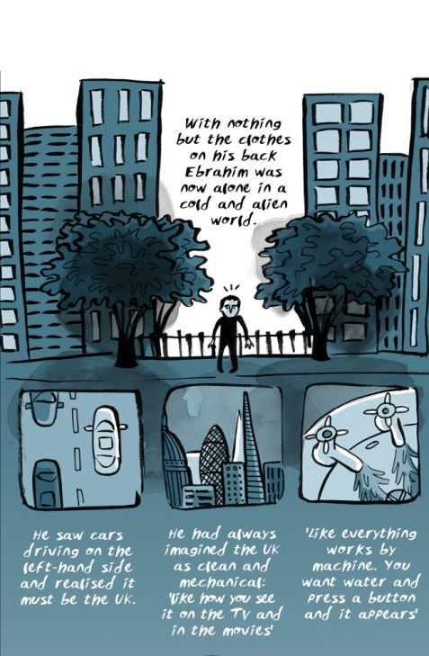
Arrival in the UK

Slide 4
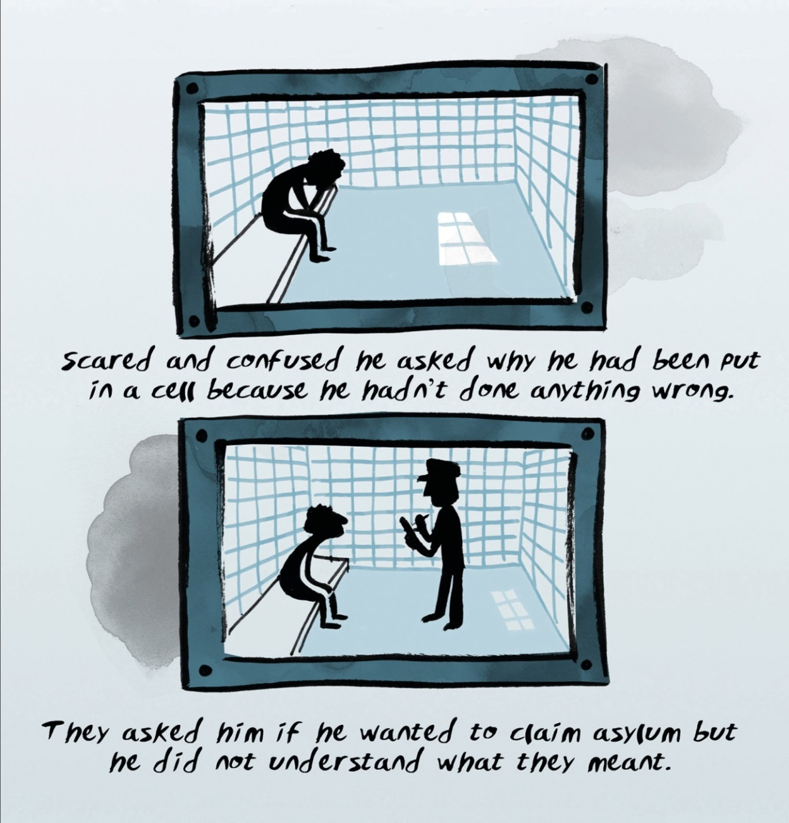
Scared and confused

Slide 5
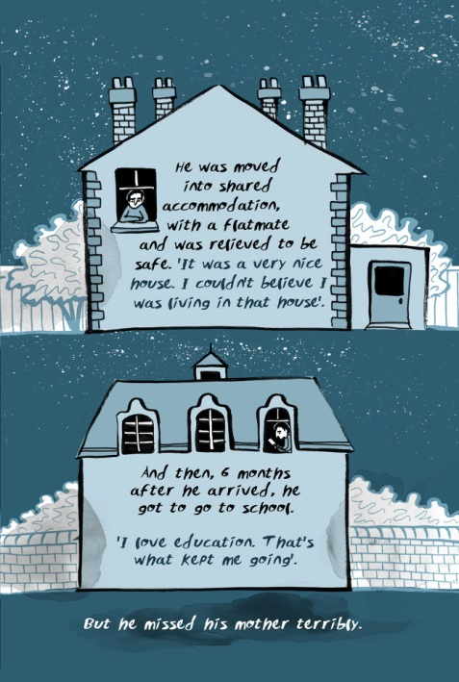
Everyday life

Slide 6
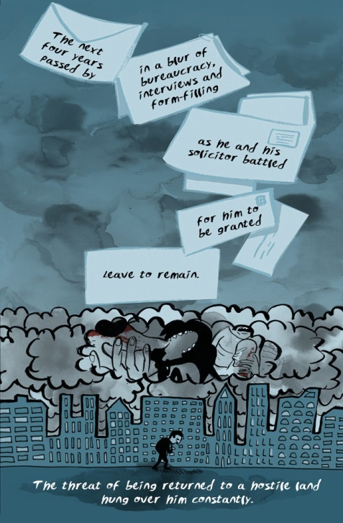
Emotional support

Slide 7
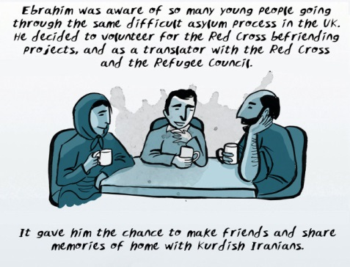
Friendship

Slide 8
Image credit and caption
Images taken from Over Under Sideways Down
© British Red Cross
Important legal note
This image is fully protected by copyright. Schools and other educational organisations are free to use it for educational use. The licence does not extend beyond this use. This means that anyone wishing to put the image on a website, crop or edit it, or use it in any other way, must first contact the copyright holder and negotiate a licence for the use they require.
This resource and other free educational materials are available at redcross.org.uk/education
The British Red Cross Society is a charity registered in England and Wales (220949) and Scotland (SCO37738).
Notes:
1

