Slide 1





Newsthink.
Heatwaves
© British Red Cross 2023. All images © British Red Cross 2023 unless otherwise stated.
This resource and other free educational materials are available at www.redcross.org.uk/education
The British Red Cross Society is a charity registered in England and Wales (220949) and Scotland (SCO37738).

Slide 2

Learning objectives:
Learn about the definitions and dangers of heatwaves.
Apply your understanding of how extreme heat events can impact people’s lives, particularly vulnerable communities.
Share your thoughts and ideas on which aspects of a heatwave’s effects are most significant.
Heatwaves
Newsthink
Notes:
Share the learning objectives.
If time, learners may wish to share information, knowledge or thoughts they have on the topic.
If you would like to extend the learning about heatwaves, download our free Weather Together toolkit: teaching resources to use with 10 – 16 year olds covering heatwaves, flooding and eco-anxiety.

Slide 3

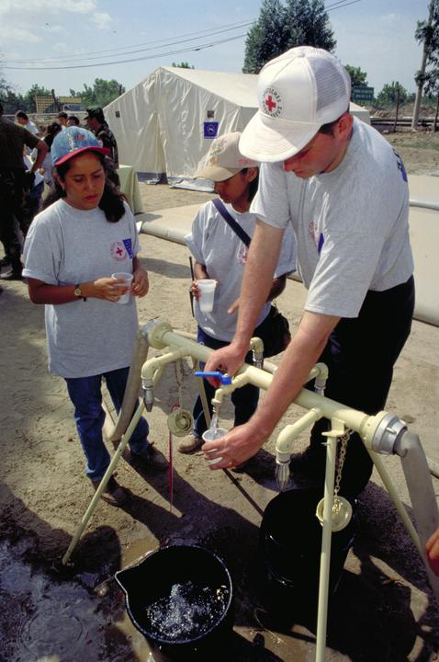

Think: How might cities like London be affected by heatwaves?
How might people's health be affected by heatwaves?
Which people are most at risk during a heatwave?
Heatwaves
Newsthink
Notes:
Support learners by explaining:
Cities can get up to 10°C hotter than the countryside, causing roads to melt and rail tracks to buckle. But it is not only transport that can be disrupted. Phone networks and energy generation can also be affected by extreme heat.
Extreme heat is deadly and kills more people than any other weather event. Heatwaves can directly lead to a number of medical conditions:
Heatstroke This is where the body gets too hot and can’t cool itself. It causes hot and dry skin, headaches, dizziness, and confusion. The body temperature rises to over 40 °C. As the body gets hotter, the person becomes unresponsive.
Dehydration This is where the body uses more water than is taken in. It causes dry mouth, headaches, dizziness or confusion, less or dark urine, and cramps or tightness in some muscles.
Sunburn This is where skin damage is caused by too much time in direct sunlight. It causes ​​skin to feel hot and painful and appear redder than usual. It might become blistered and can take up to 5 hours to appear after the damage has happened.
Heat exhaustion This is where too much water and salt is lost from the body. It causes dizziness, confusion, headache, nausea (feeling sick), fast breathing, sweating and skin is cool, paler skin than usual and cramps.
Elderly people, small children and pregnant women are particularly susceptible to extreme heat. As are people with underlying medical conditions. People who are exposed to high temperatures such as those who work outside or the homeless are also at greater risk.
Advice on first aid to help people suffering with heatstroke and heat exhaustion can be found on the British Red Cross website on the page about heatwaves: https://www.redcross.org.uk/get-help/prepare-for-emergencies/heatwaves-uk
Make learners aware of the British Red Cross free first aid app, which provide simple first aid skills to use during emergencies. https://www.redcross.org.uk/first-aid/save-a-life

Slide 4
See: What can you see in these pictures?
What might the people be doing?
Heatwaves
Newsthink
Notes:
Support learners by explaining:
The picture on the left is London during a heatwave. A heatwave is defined as a period of unusually hot weather that persists for at least three consecutive days. In the UK, heatwaves are becoming hotter, longer, more frequent and more dangerous. All of the top 10 warmest years on record have occurred since 2002. The hottest day on record in the UK was 19th July 2022 when temperatures reached 40.3°C.
The picture on the right shows volunteers establishing an emergency water supply in Peru. In times of extreme weather, water is extremely important. Unfortunately, heatwaves often coincide with times when there is a shortage of water. Heatwaves are most common in arid areas. Some countries have been identified as being the most at risk of heatwaves, including Afghanistan, Papua New Guinea, Guatemala, Honduras and Nicaragua.
Climate change is contributing to extreme weather conditions, including heatwaves and flooding. You can explore these issues further with the British Red Cross Weather Together teaching resources: a toolkit to teach 10-16-year-olds how to prepare for and cope with extreme weather events, including resources on flood risk, how to prepare for the next heatwave, and eco-anxiety.

Slide 5
Feel: How might people be emotionally affected during a heatwave?
How might those suffering in a heatwave be helped and by whom?
How could communities prepare for and cope with heatwaves?
Heatwaves
Newsthink
Notes:
Support learners by explaining that:
People can feel extremely stressed during heat waves. They are often worried about their own health and the well-being of loved ones. Disruption to transport and phone networks means they might not be able to check up on vulnerable relatives which can lead to increased levels of anxiety.
The British Red Cross helps people in the UK and around the world prepare for, deal with and recover from the impact of climate change. For example, teaching agricultural techniques to mothers in Zimbabwe and farming techniques to those in drought-hit areas.
The free Weather Together teaching resources from the British Red Cross cover how to prepare for the next heatwave.

Slide 6

Newsthink
If a heatwave were to happen next week, which of the following would concern you most?
Give each a score out of 10, with 10 being the most concerning and 1 being the least.
Heatwaves
Your physical and mental health /10
Your loved ones' physical and mental health /10
Disruption to the phone and transport networks /10
A shortage of water /10
Notes:
Support learners by explaining:
This is purely opinion-based and that there is no right or wrong answer. The intention of the exercise is for them to process and prioritise the impacts of a heatwave from a personal point of view.
Share learners’ responses to allow them to consider others’ perspectives and the reasons behind others’ opinions.

Slide 7

Newsthink
Heatwaves
Based on the scores you have given, create a five-point plan on how you would prepare for an upcoming heatwave.
Notes:
Support learners by explaining:
The five-point plan should show awareness of how to avoid becoming ill during a heatwave. Remind learners about the medical risks and what is needed to help those who are ill. Remind them to reflect on their personal circumstances and those of their loved ones - which might be quite different from other people.
You may wish to refer to the advice on preparing for very hot weather or extreme heat in the UK, on the British Red Cross website.
The free Weather Together teaching resources from the British Red Cross also cover how to prepare for the next heatwave.

Slide 8
Newsthink
Why might other people’s plans be different from yours?
Do you think the increased risk posed by more frequent and hotter heatwaves is the same all over the world?
Are some parts of the world more at risk than others? Why might this be?
Heatwaves
Notes:
Support learners by explaining:
Some areas of the world are significantly hotter than the UK. Many of these areas are less economically developed and do not have the same level of infrastructure - particularly when it comes to water.
The Red Cross uses research to inform the work they do. The latest report from the International Panel on Climate Change (IPCC) states that climate change is already impacting the lives of billions, particularly the world’s poorest, who have contributed the least to it.
The IPCC report warns that between 3.3 and 3.6 billion people live in areas that are highly vulnerable to the impacts of climate change. The latest science also confirms, with very high confidence, that climate impacts and risks increase vulnerabilities and socio-economic inequalities. In addition, the report highlights that climate-related weather extremes are increasingly driving displacement.
Explain to learners that as well as responding to emergencies and disasters caused by climate change, the Red Cross also empower communities to combat the effects of climate change. For example, teaching agricultural techniques to mothers in Zimbabwe and farming techniques to those in drought-hit areas.

Slide 9

Newsthink
“The impact on people’s physical health is the most significant and worrying aspect of heatwaves.”
Heatwaves
Agree
Disagree
Notes:
Read the statement together and ask the group whether they agree or disagree. Encourage learners to think about the reasons behind their view.
Give learners the opportunity to share their answers. Once they’ve listened to each other’s arguments, give them a chance to review their position. If they wish to change sides, encourage them to do so.

Slide 10
Newsthink
“The impact of heatwaves will be felt equally in all parts of the world.”
Heatwaves
Agree
Disagree
Notes:
Read the statement together and ask the group whether they agree or disagree. Encourage learners to think about the reasons behind their view.
Give learners the opportunity to share their answers. Once they’ve listened to each other’s arguments, give them a chance to review their position. If they wish to change sides, encourage them to do so.

Slide 11

Reflect on your own:
What are your thoughts and feelings about these images and the topic we’ve talked about?
Heatwaves
Newsthink
Notes:
This is an extension task for personal reflection. Encourage learners to reflect on the learning and discussions that have taken place in the lesson, whether writing it down or just thinking about the topic discussed.

Slide 12

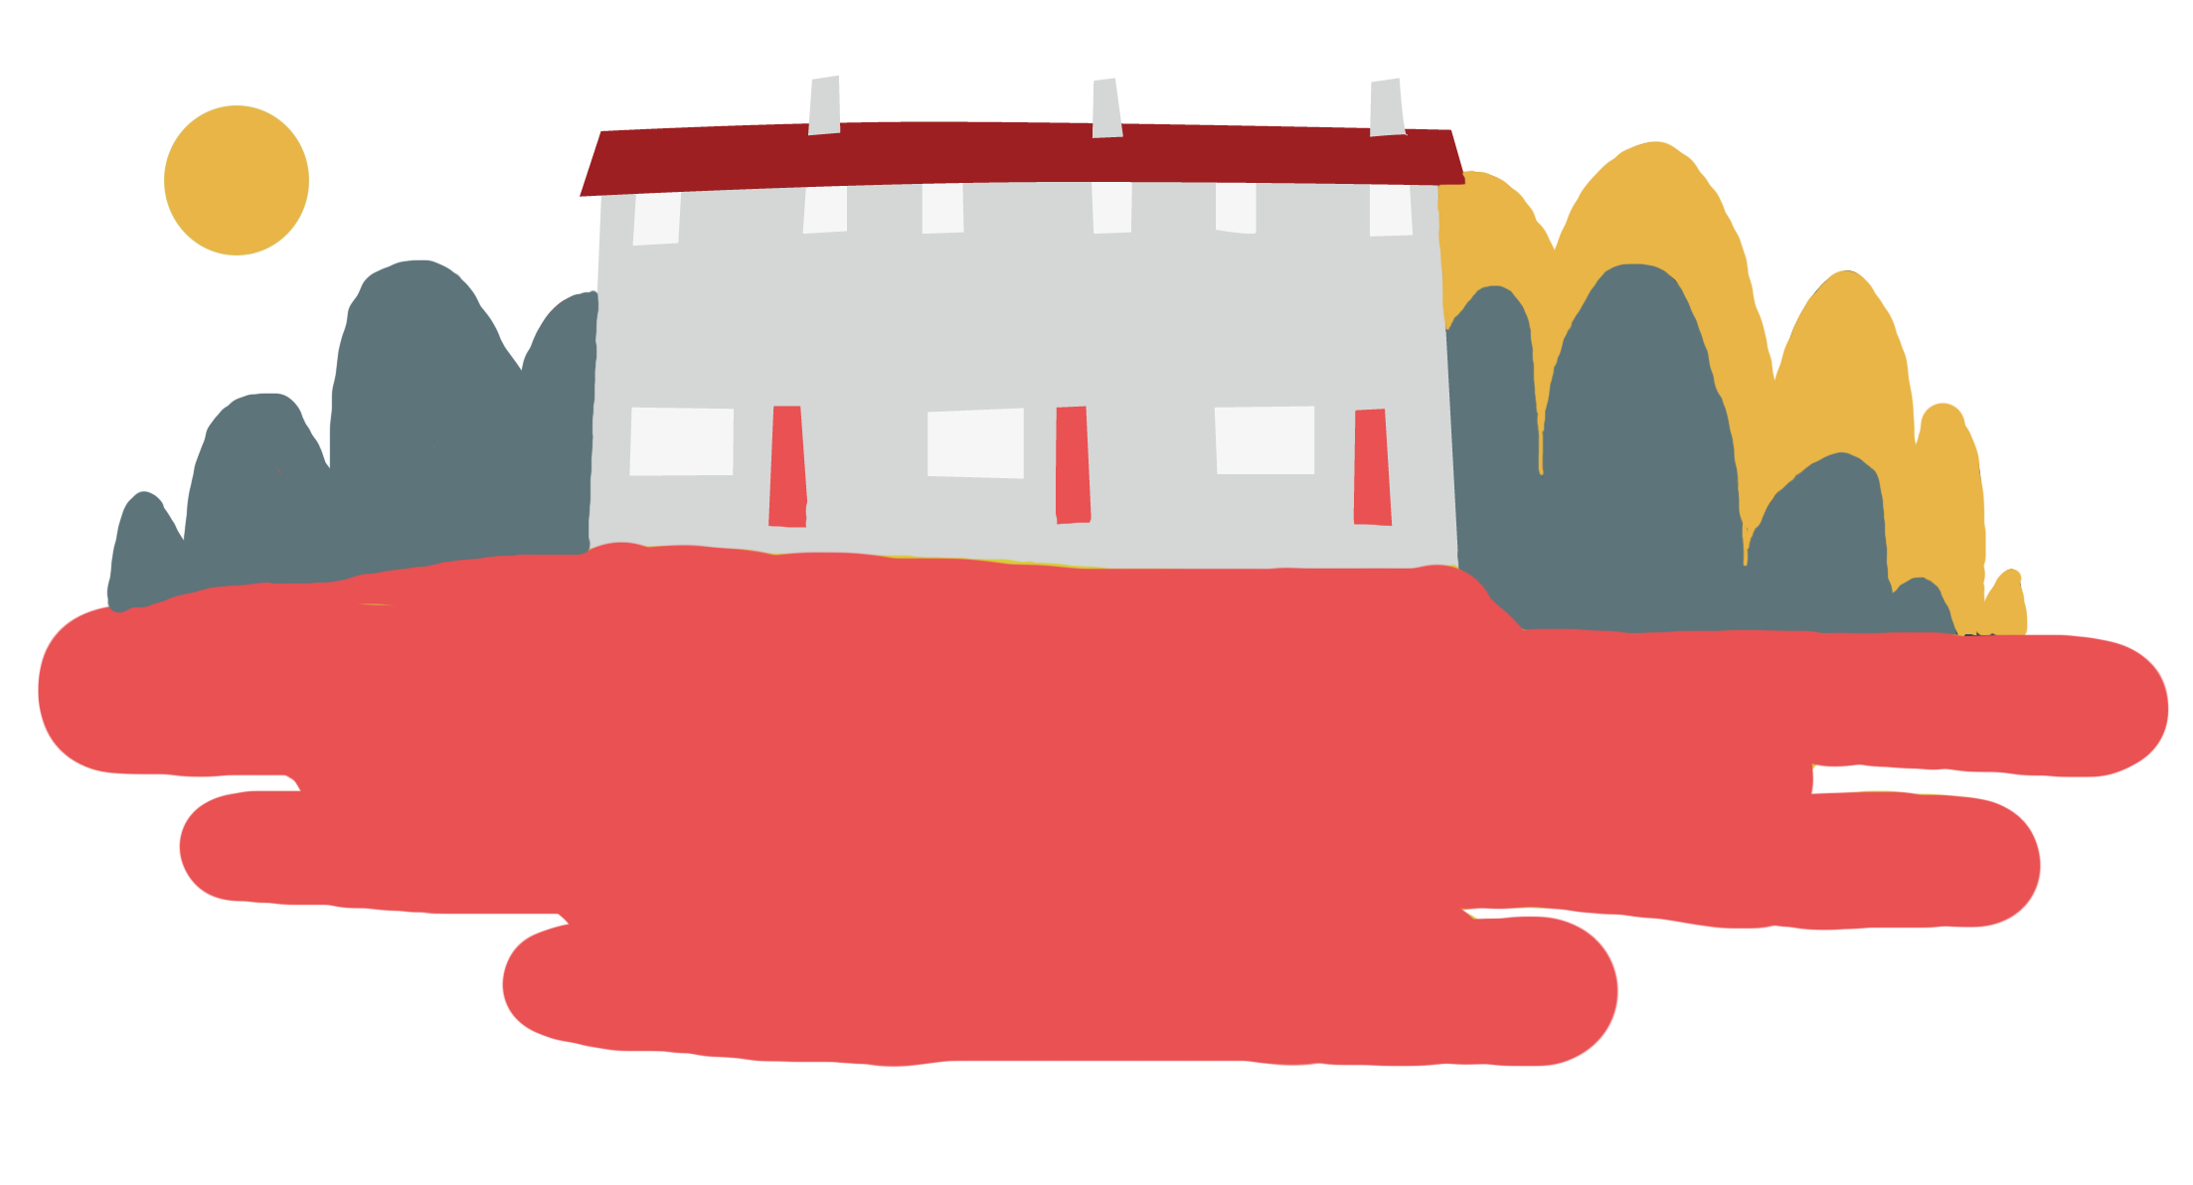

Objective
Heatwaves
Is heat dangerous?
Learn more about heatwaves and take the quiz with our Weather Together lesson resource.

Slide 13



Learn more:​
Learn more about how the British Red Cross are helping vulnerable people plan and survive heatwaves.
​
Share with others:​
Share your thoughts on the impact that extreme heat events have on some of the most vulnerable members of society with your peers and family members.
​
Do something:​
See how you can help the British Red Cross to help others through fundraising and volunteering.
Heatwaves
Newsthink
Notes:
Expand learners’ knowledge of heatwaves then take the learning further and look at another form of extreme weather – flooding – with the Weather Together (https://www.redcross.org.uk/get-involved/teaching-resources/weather-together-resources) teaching resources. Weather Together is a toolkit to teach 10-16-year-olds how to prepare for and cope with extreme weather events, including resources on flood risk, how to prepare for the next heatwave, and eco-anxiety.
If learners are keen to get involved with helping communities affected by climate change (including heatwaves), consider organising a fundraising event at school.

