Slide 1

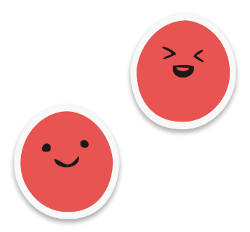

Kindness is powerful

Slide 2
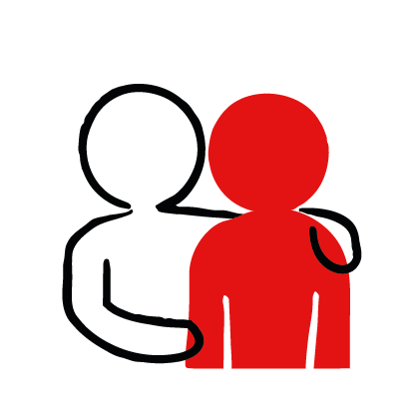

What does being kind mean to you
Notes:
Ask your learners to think about this question. Give them time to think or discuss in pairs and then ask for answers.
You could encourage people to write down their answers on a sticky note and have them put it anonymously on the board if done in a classroom.

Slide 3
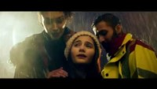
Notes:
Show learners this video about how powerful kindness can be. Ask them to think about the power of kindness in the video. What acts of kindness can they see? How does the kindness make the people feel?
Ask them to think about the last time someone was kind to them, or they were kind to someone. What kind act was done? How did it make you feel? If learners feel comfortable, they can share their stories with the group.

Slide 4
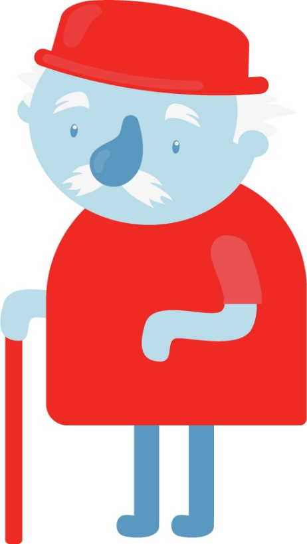
A story of kindness
Mr Phillpotts was feeling lonely.
He lived alone and didn’t see or talk to many people.
His only friend’s were his pets. He had a goat, some chickens and a cat called Sally.
Notes:
Pick from the three stories and read it to your learners. Ask them to think about the power of kindness in the stories.
You can add details and descriptions to the stories if you want to, or use this opportunity to tell another story you know which demonstrates the power of kindness. We recommend stories like:
https://www.youtube.com/watch?v=kAo4-2UzgPo
-

Slide 5
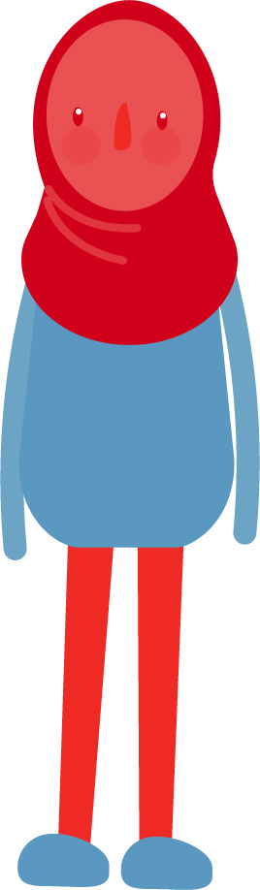
A story of kindness
One day, Ari moved in next door.
She was new to town and didn’t have many friends either.
Ari’s family saw My Phillpotts often, and would wave hello to him.
She loved animals, and every morning she saw him feeding his goat and chickens.
She wished she could help him.

Slide 6

A story of kindness
Her parents told Ari to ask Mr Phillpotts if she could help him look after his animals before school sometimes.
So she did.
Mr Phillpotts thought that was a great idea.
Both of them felt a little less lonely now.

Slide 7
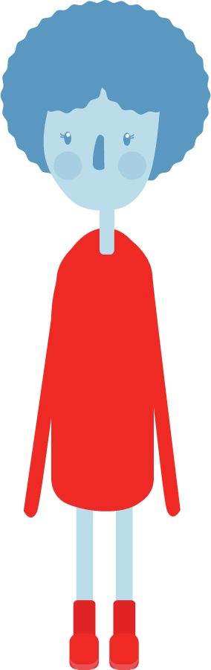
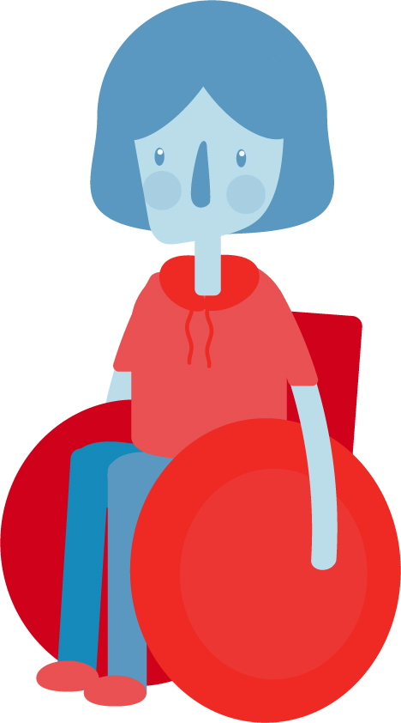
A story of kindness
Riley and Elis were good friends.
One day at school, they fell out.
Riley was playing with Elis’ toy and accidentally lost it over the fence.
Riley was sorry but Elis was upset and shouted at Riley, calling her “stupid”.

Slide 8
A story of kindness
Riley felt so sorry that she went to find the toy she lost after school and found it in the park next door.
Elis was so sorry that she yelled at her friend and made her feel bad when it was just an accident.
The next day, they both apologized. Riley gave Elis back her toy and they carried on playing, carefully!

Slide 9
A story of kindness
Ari was new at school.
She didn’t have any friends and was quite shy.
She didn’t know what to do to make friends.

Slide 10
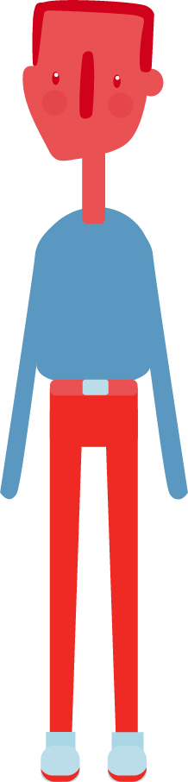
A story of kindness
Darby had lots of friends at school.
He sat next to Ari in class, but didn’t really speak to her.
He got the idea that she was a bit sad. She always sat alone at lunch time.

Slide 11
How could Darby and Ari be kind to each other

Slide 12
A story of kindness
One day Darby asked Ari if she wanted to come and have lunch with him and his friends.
She said yes, even though she was still quite shy.
She thanked him.
They became good friends, since they both really liked sports, and often had lunch together from then on.

Slide 13
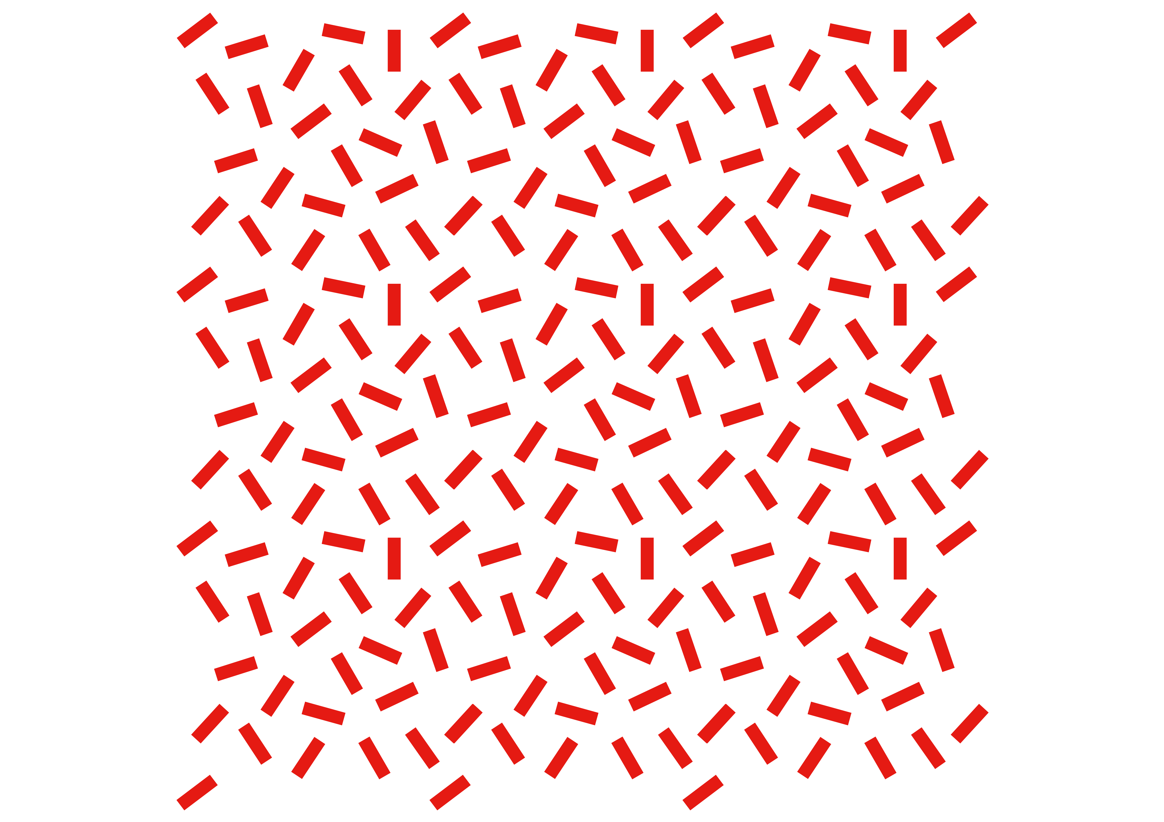
What power did kindness
have in the story?
Notes:
Ask learners to reflect on the story and what they learned about being kind to others and the impact kindness can have.

Slide 14
How could you be kind to someone today
Notes:
Ask learners to think about one way they could be kind to someone today. They could set themselves a ‘Kindness intention’ for that day or week.

Slide 15
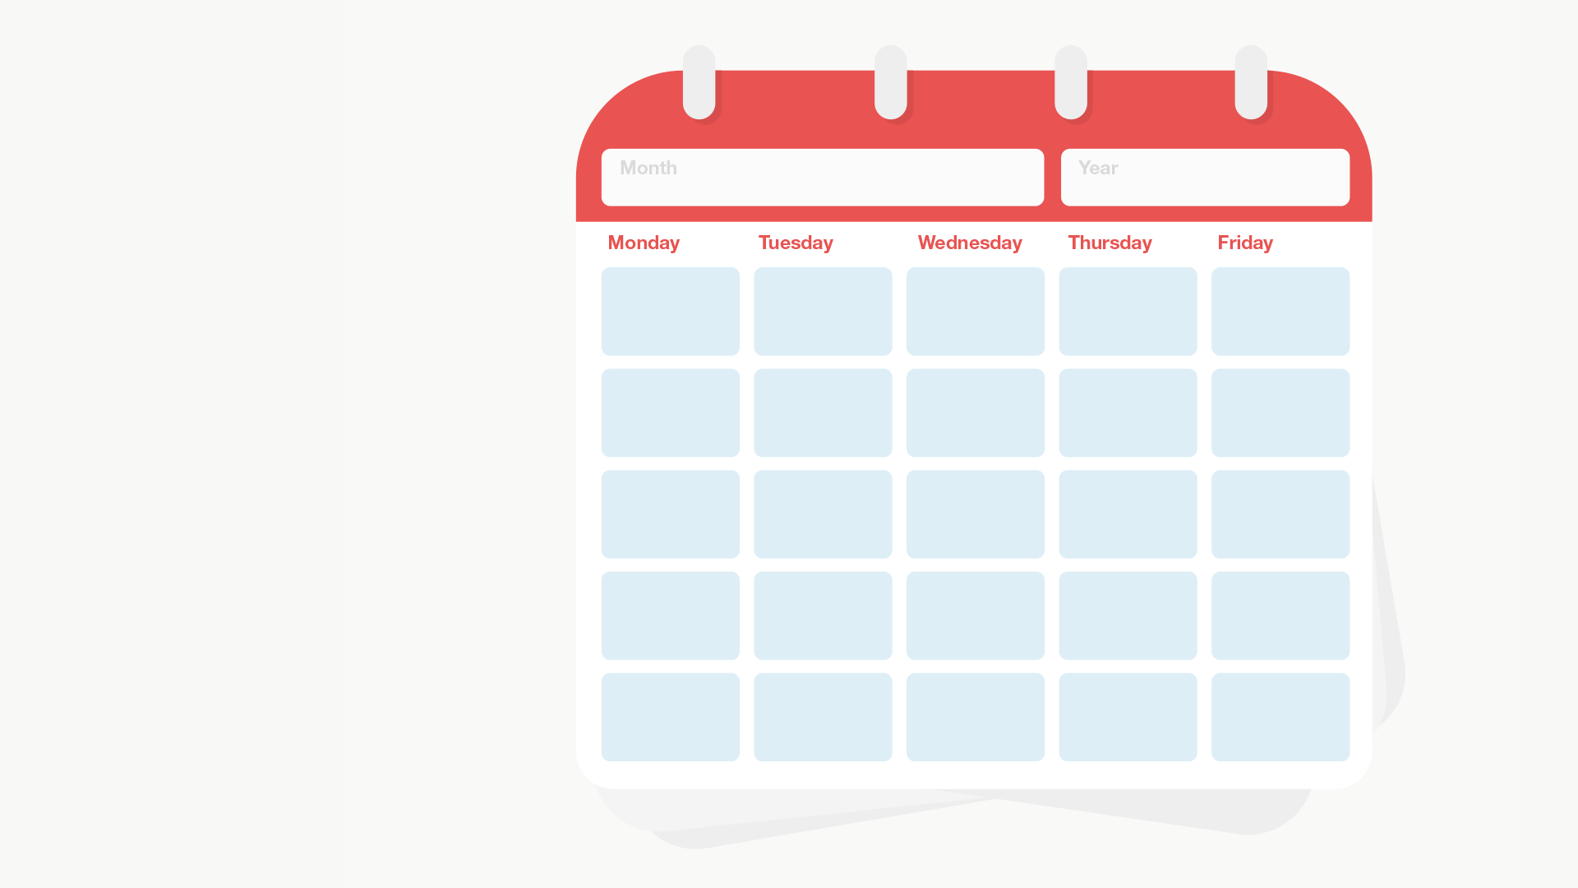




Use the Spring kindness calendar to challenge yourself to do one kind act a day
Notes:
Use the Kindness calendar with learners to continue thinking about how we can be kind to someone everyday. Encourage learners to think of one way they can kind to someone in their life everyday for the next month. It could be the same kind thing everyday like “I will say thank you to everyone who helps me everyday” or it can a different thing each day. Can they try and do more than one thing a day? Could they add a new kind act each week?
Keep track of their progress on the individual kindness calendar or set a group intention and track it together on the giant calendar. Think about how you can reward your learners for being kind for the whole month – could you host a kindness awards ceremony and give them each a certificate? Could you give them extra break time or have a kindness party, where they dance to some music? It’s important to model kind behaviour, but also to reward it.

Slide 16

Your kindness
is powerful

