Slide 1
Refugee Week 2016
Full lesson plan from redcross.org.uk/education
Notes:
1

Slide 2
Facts – what do you know or want to know about the person and their story?
Feelings – what emotions are evident? How do you think they might be feeling?
Present – how are they living now? What would you like to ask them?
Future – what might you ask them about their hopes for the future?

Slide 3
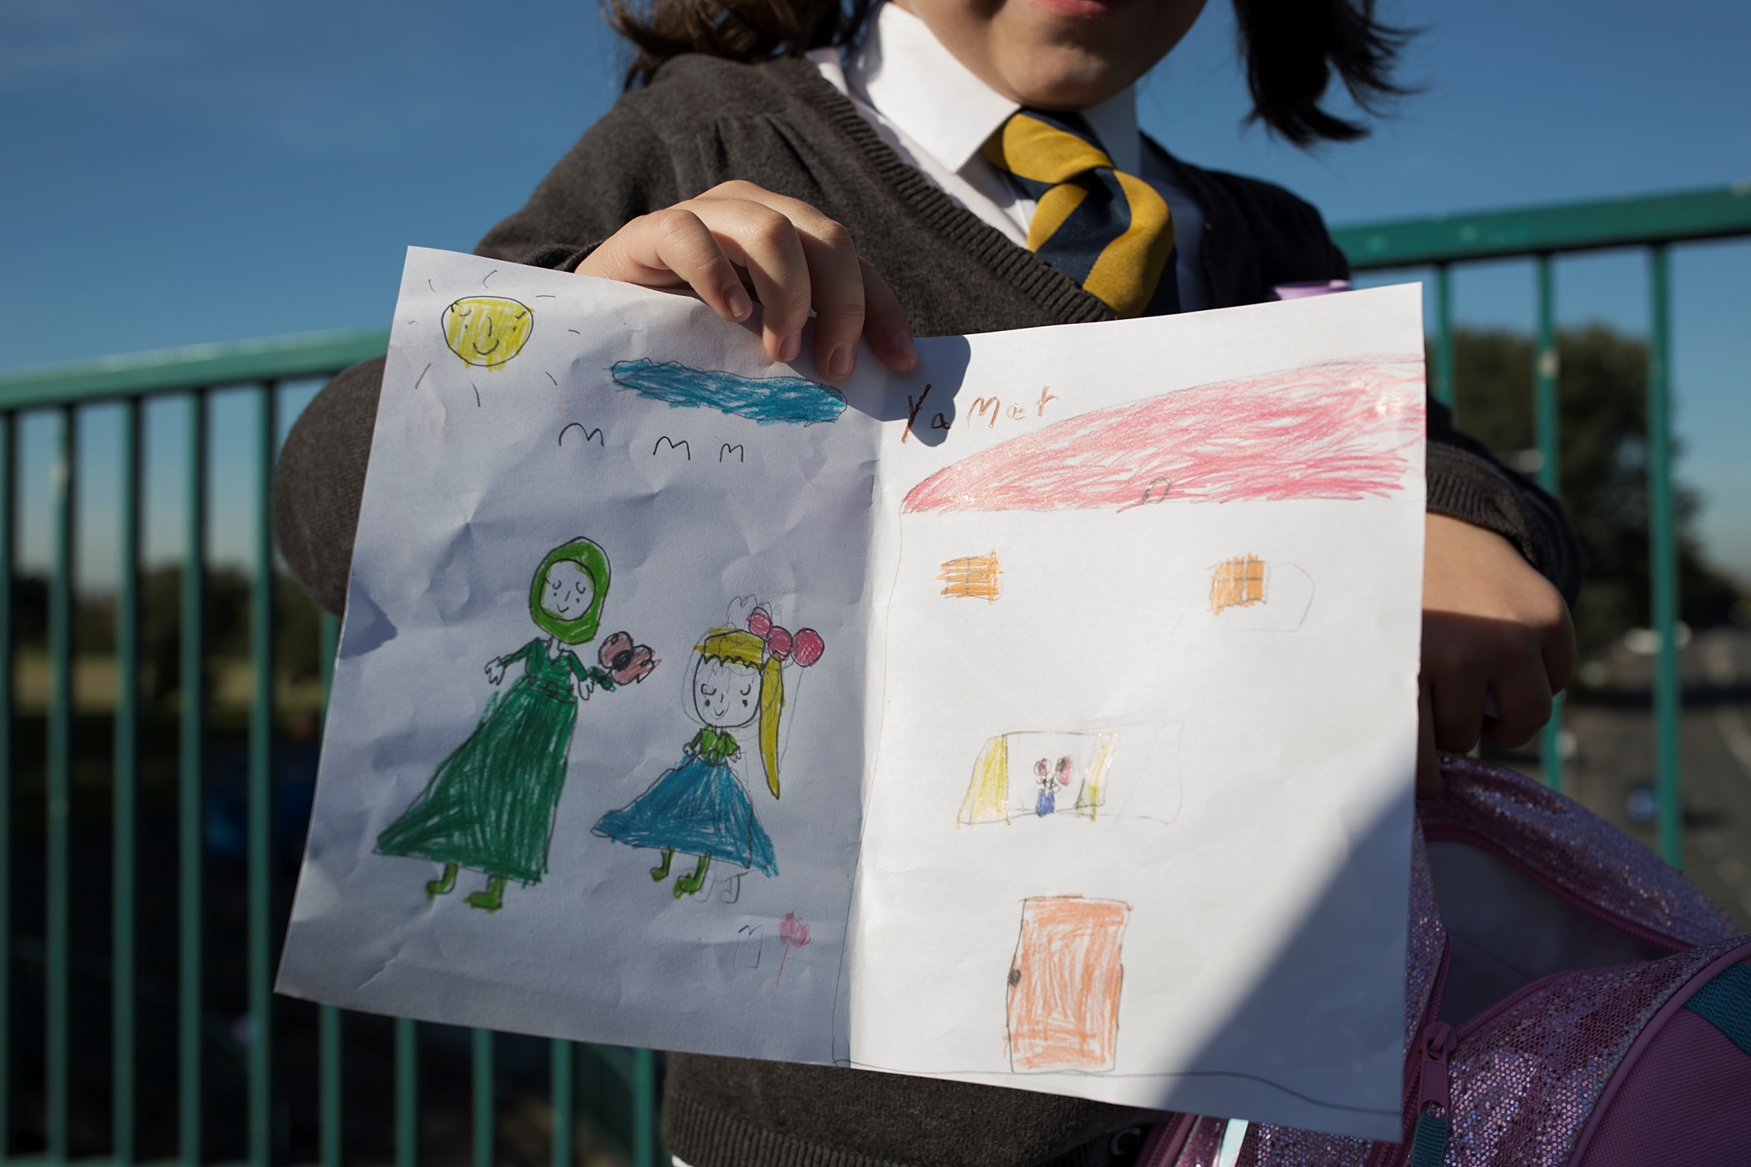
This is Yamat showing a picture of her home in Syria. She is a refugee living in Glasgow, Scotland.
,

Slide 4
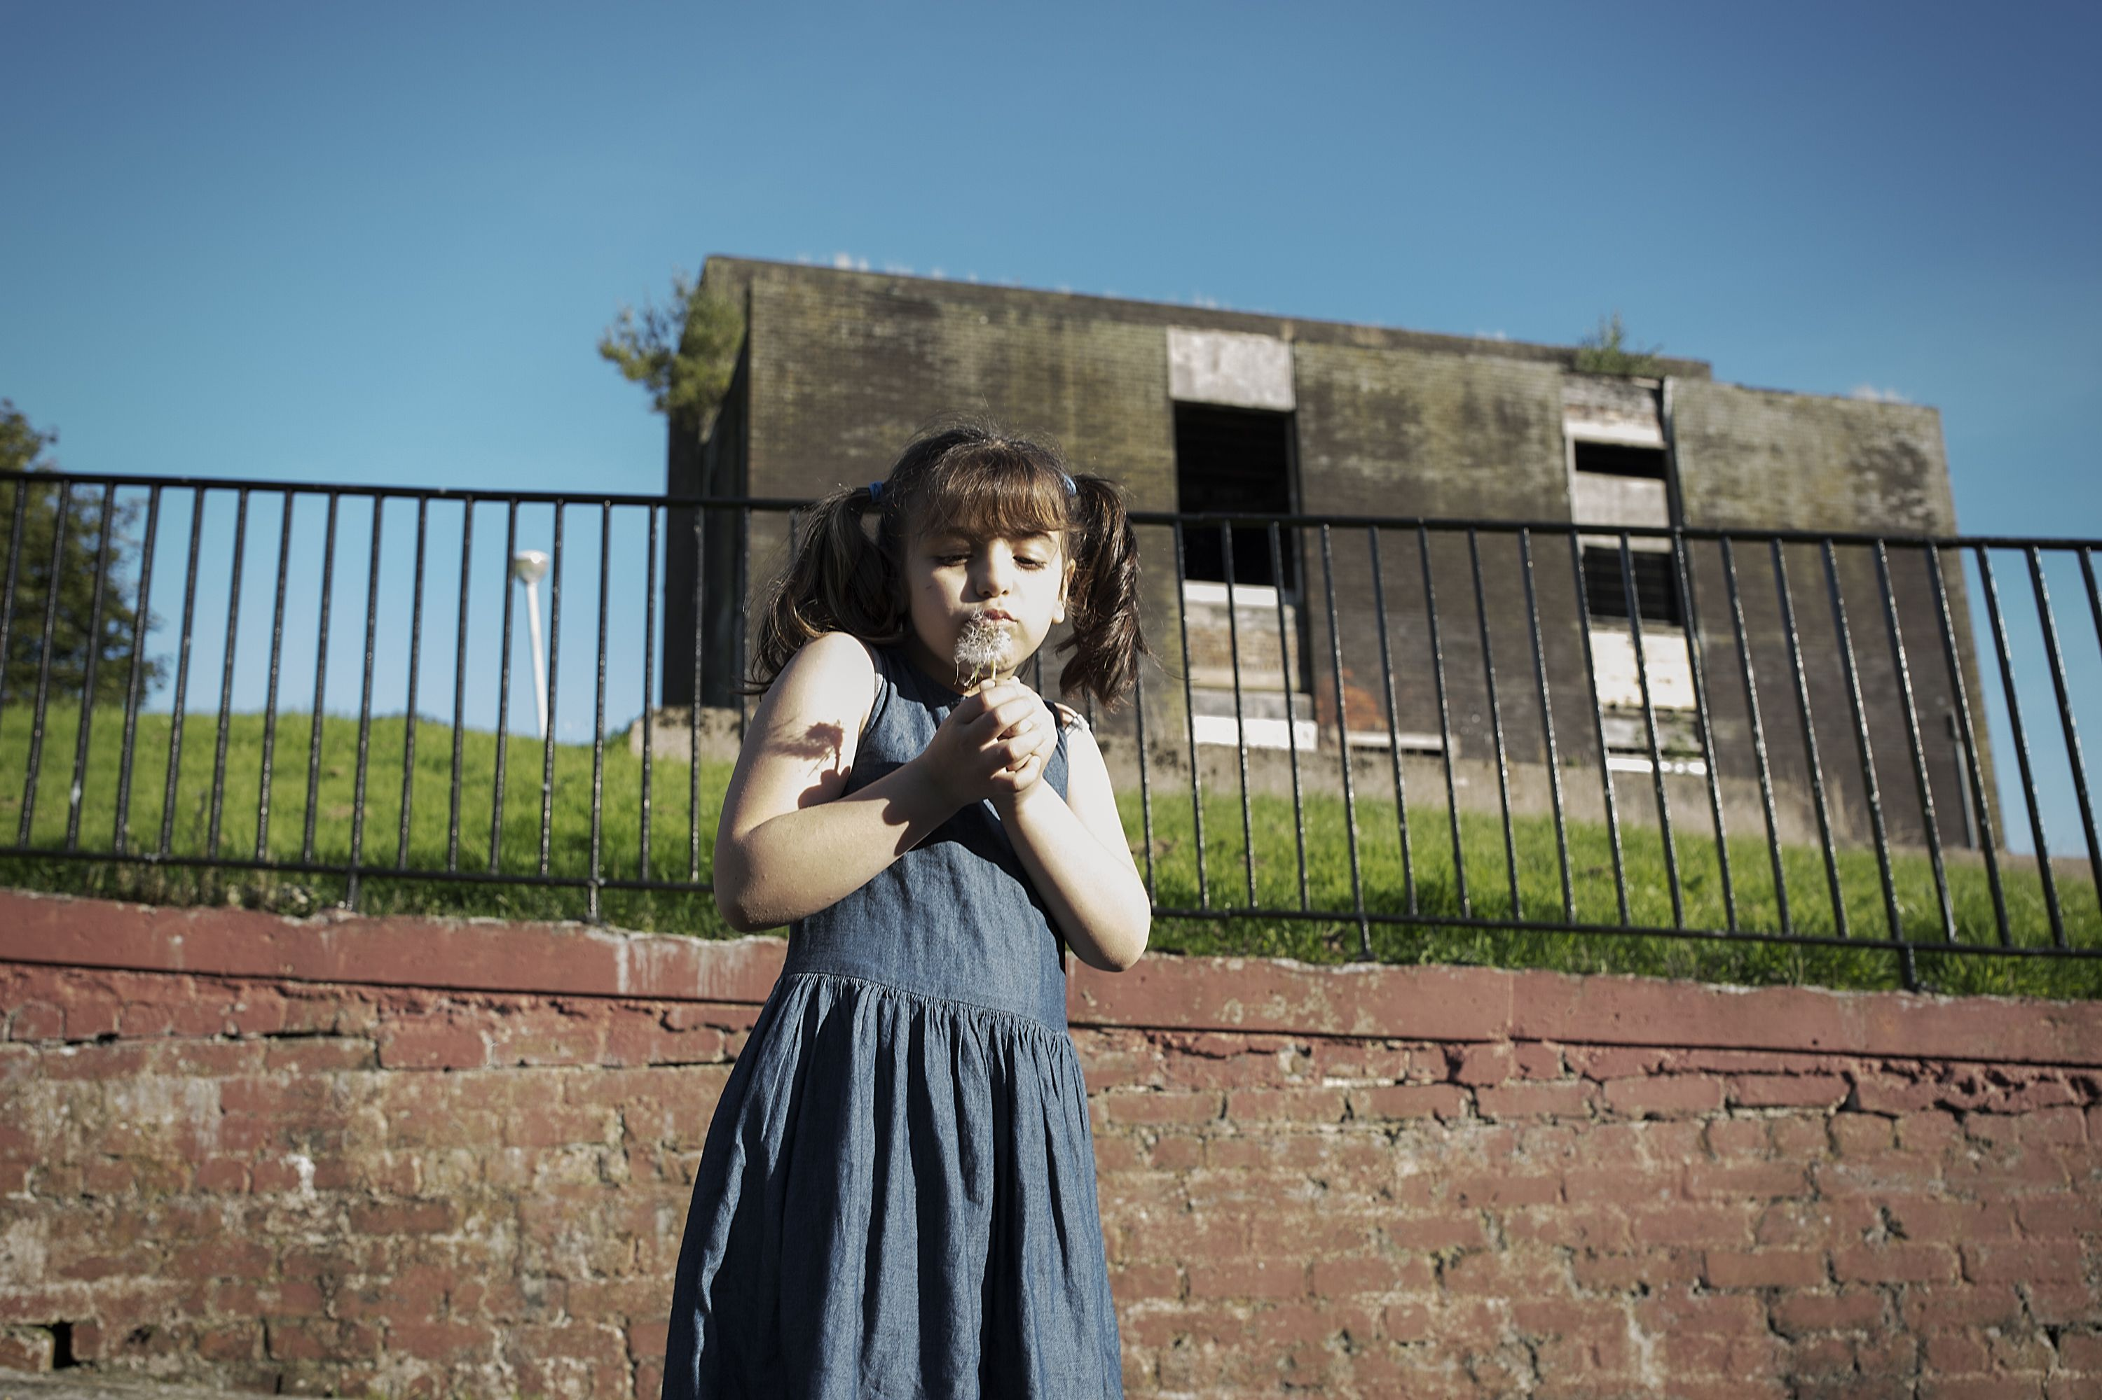
Photo shows 8 year old Yamat in Glasgow.

Slide 5
Photo credits
Photos
© Conor Ashleigh/British Red Cross 2015
Important legal note
These photographs are fully protected by copyright. Schools and other educational organisations are free to use them for educational use. The licence does not extend beyond this use. This means that anyone wishing to put the images on a website, crop or edit it, or use it in any other way, must first contact the copyright holder and negotiate a licence for the use they require.
This resource and other free educational materials are available at redcross.org.uk/education
The British Red Cross Society is a charity registered in England and Wales (220949) and Scotland (SCO37738).
Notes:
1

