Slide 1


Coronavirus: Covid-19 outbreak
Full lesson plan from redcross.org.uk/education

Slide 2
Definitions activity: what is coronavirus?

Slide 3
Coronavirus
A large family of viruses
Covid-19
Getting unnecessarily large amounts of a product
Misinformation
Staying indoors, avoiding contact with other people
Separating people known or believed to be infected with a disease from the public
Pandemic
Panic Buying
False stories that are presented as being true
Quarantine
A new strain of coronavirus
Social Distancing
Staying away from gatherings and not standing close to other people
Self-isolation
A new disease that spreads around the world beyond expectations

Slide 4
Coronavirus
A large family of viruses
Covid-19
A new strain of coronavirus
Misinformation
False stories that are presented as being true
Pandemic
A new disease that spreads around the world beyond expectations
Panic Buying
Getting unnecessarily large amounts of a product
Quarantine
Staying indoors, avoiding contact with other people
Social Distancing
Staying away from gatherings and not standing close to other people
Self-isolation
Separating people known or believed to be infected with a disease from the public

Slide 5
Poster activity

Slide 6
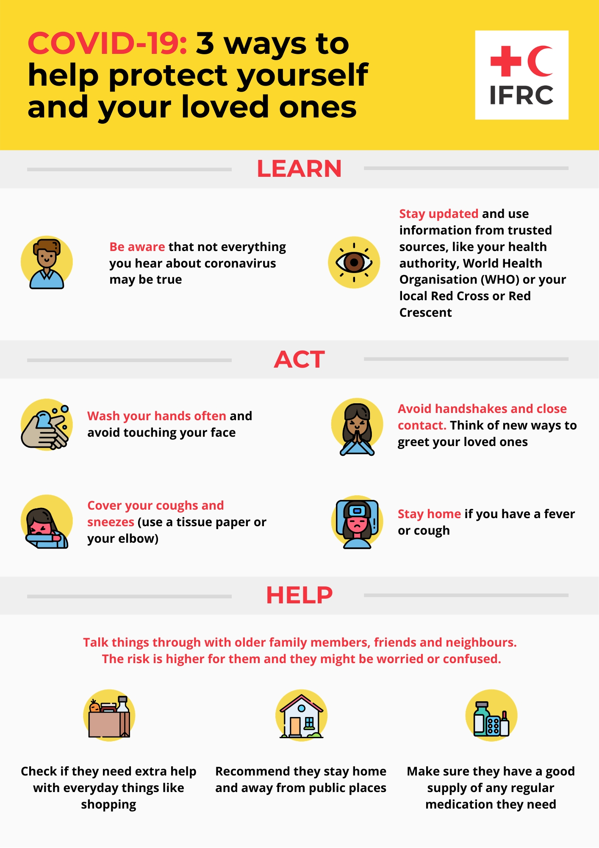

Slide 7
Quiz activity: how can you spot misinformation?

Slide 8
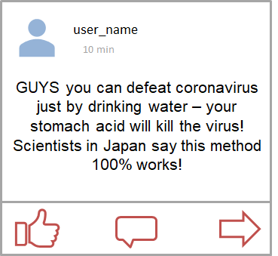
1. Trust or not?

Slide 9
1. Think again
Using the ‘fake expert’ to convince you what they’re saying is true is a common tactic.
There is no source or evidence to back up this claim.

Slide 10
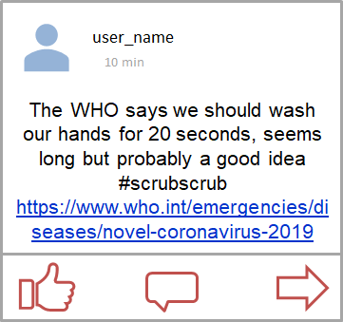
2. Trust or not?

Slide 11
2. Trust
Washing your hands with soap and water for 20 seconds is the scientifically proven way to kill the most germs.
Their claim is supported by a link to a trusted source so you can check yourself.

Slide 12
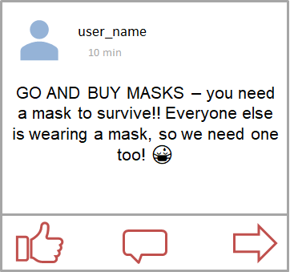
3. Trust or not?

Slide 13
3. Think again
This encourages people to be afraid and plays on their negative emotions. This is a common tactic.
Panic buying anything is harmful to others and often unnecessary.

Slide 14
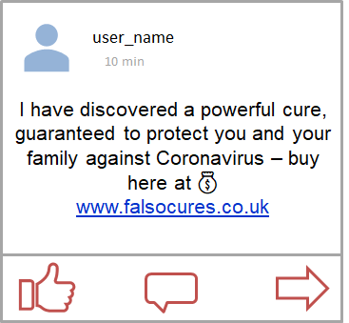
4. Trust or not?

Slide 15
4. Think again
Making money is a common reason people spread disinformation. People selling things will always try and convince you that you need them.
Be careful when following unknown links.

Slide 16
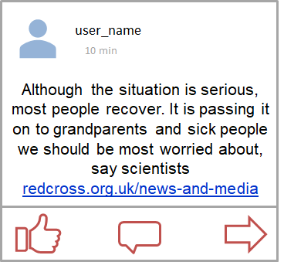
5. Trust or not?

Slide 17
5. Trust
You can click the source to check for yourself.
It is backed up by a trusted news source.

Slide 18
Kindness and resilience

Slide 19
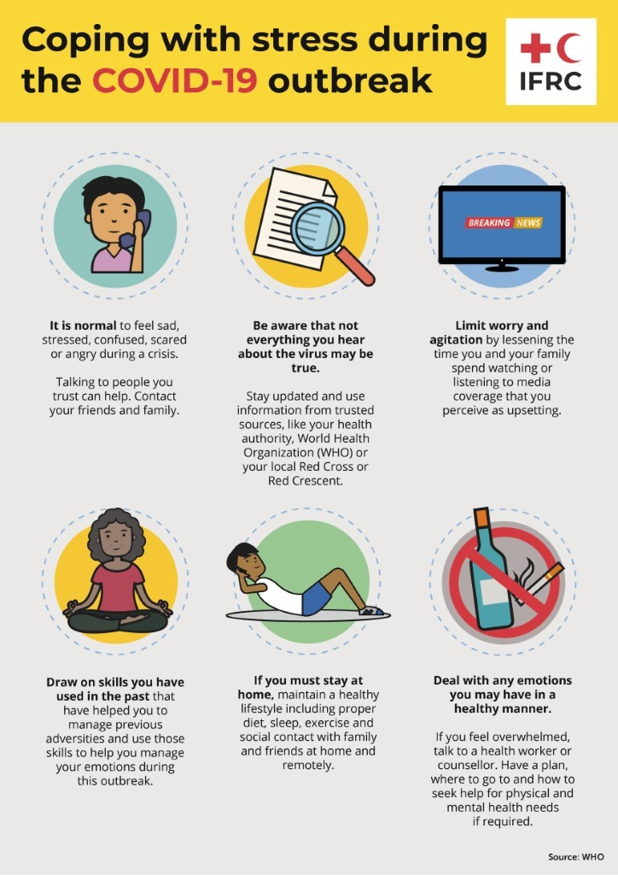

Slide 20

© Naeem Khan/British Red Cross

