Slide 1
East Africa facing hunger
Surviving camp in monsoon rains
Full lesson plan from redcross.org.uk/education
Full lesson plan from redcross.org.uk/education
Notes:
1

Slide 2
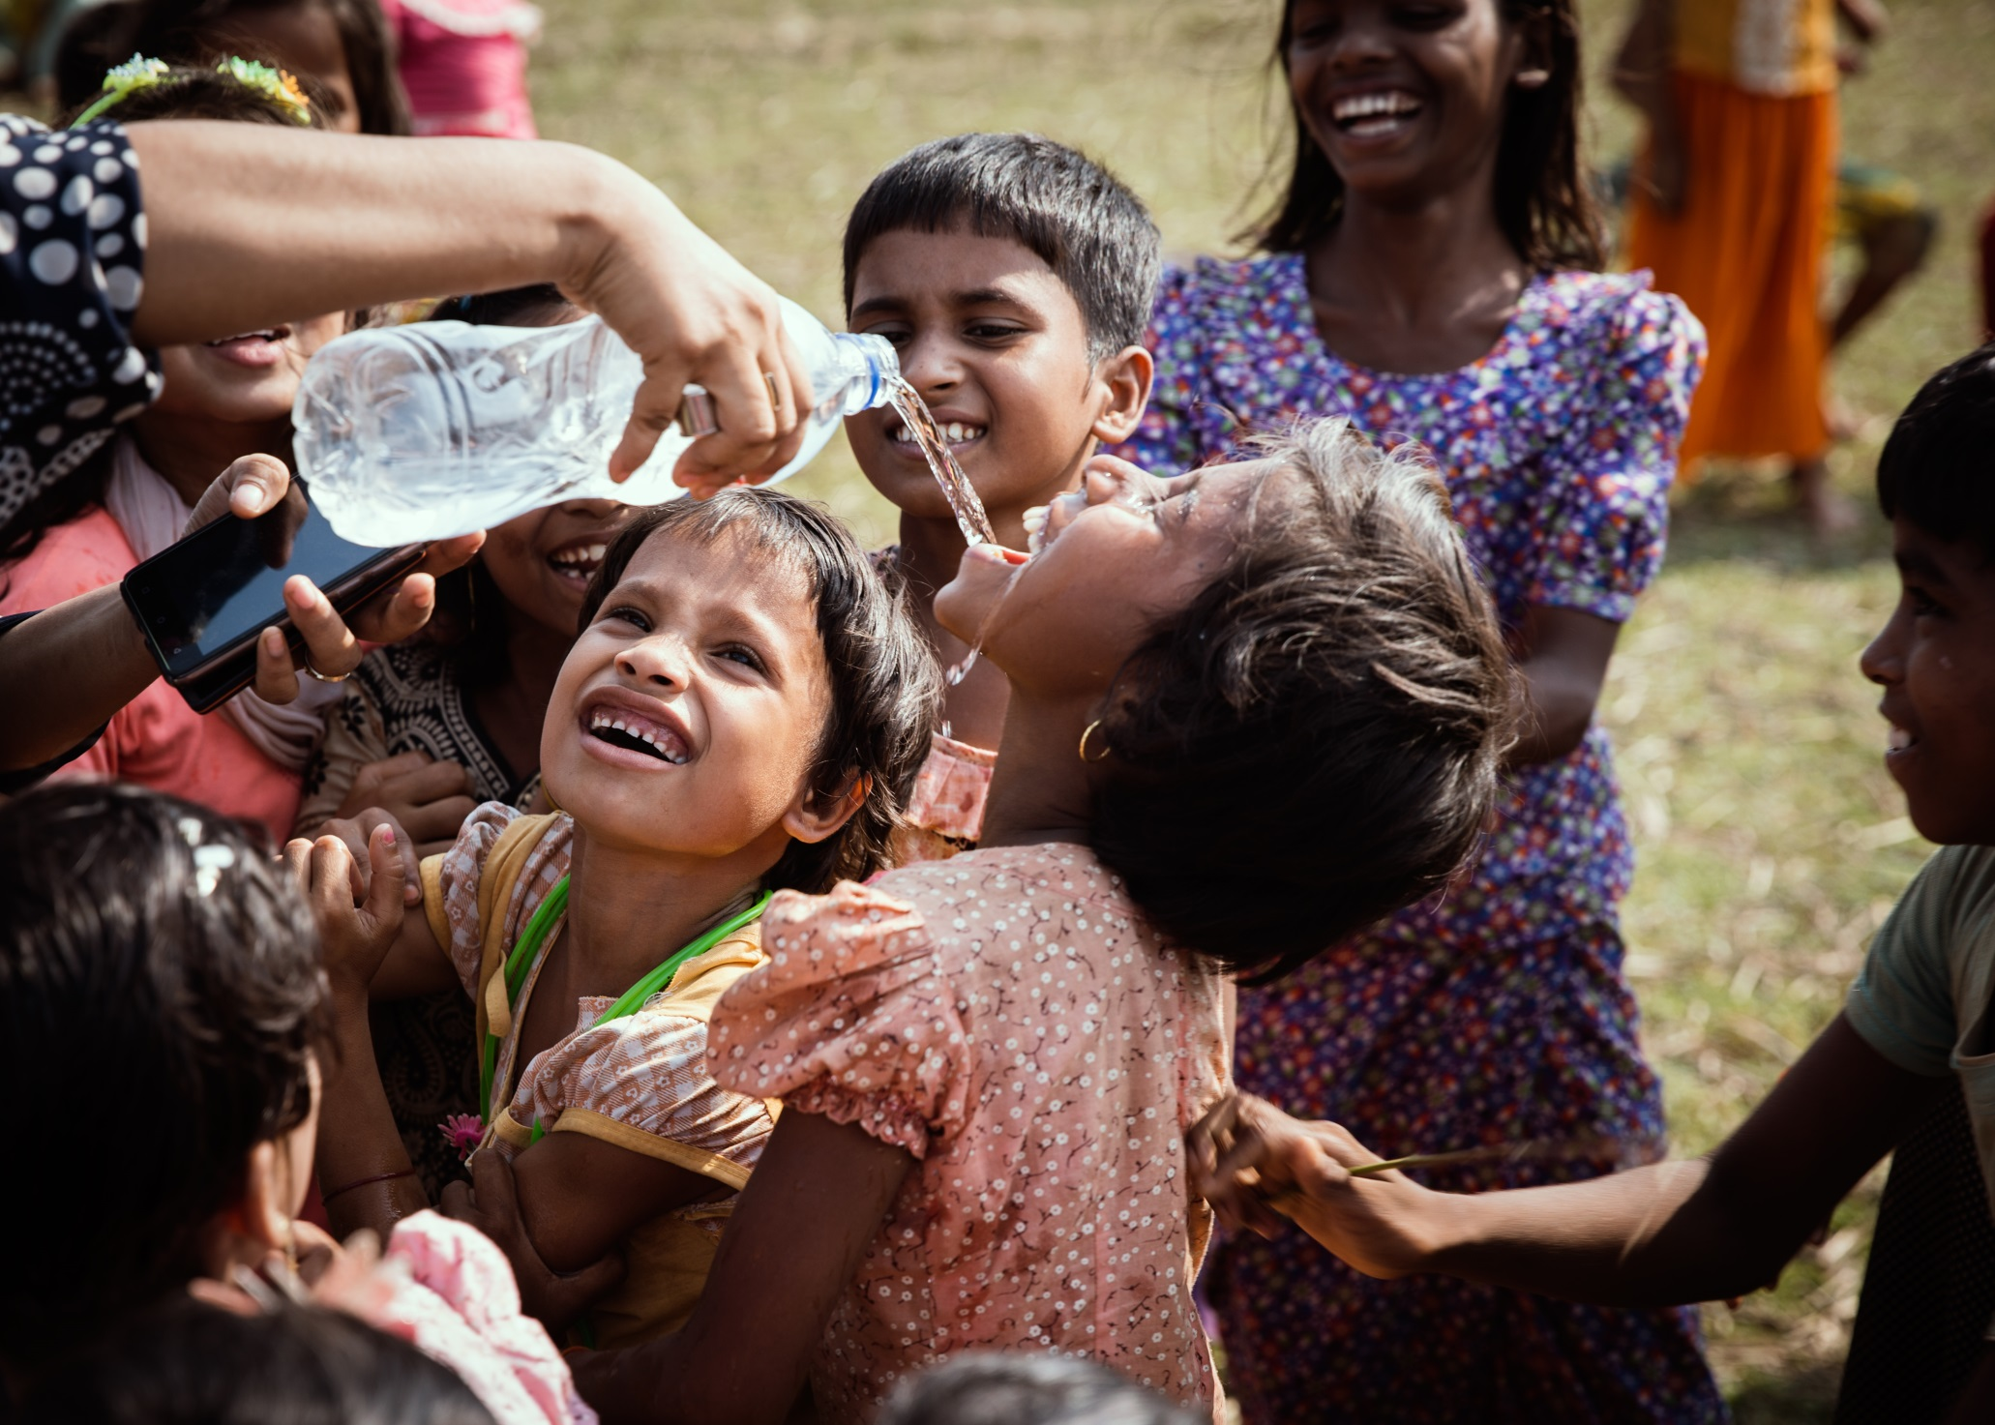

Slide 3
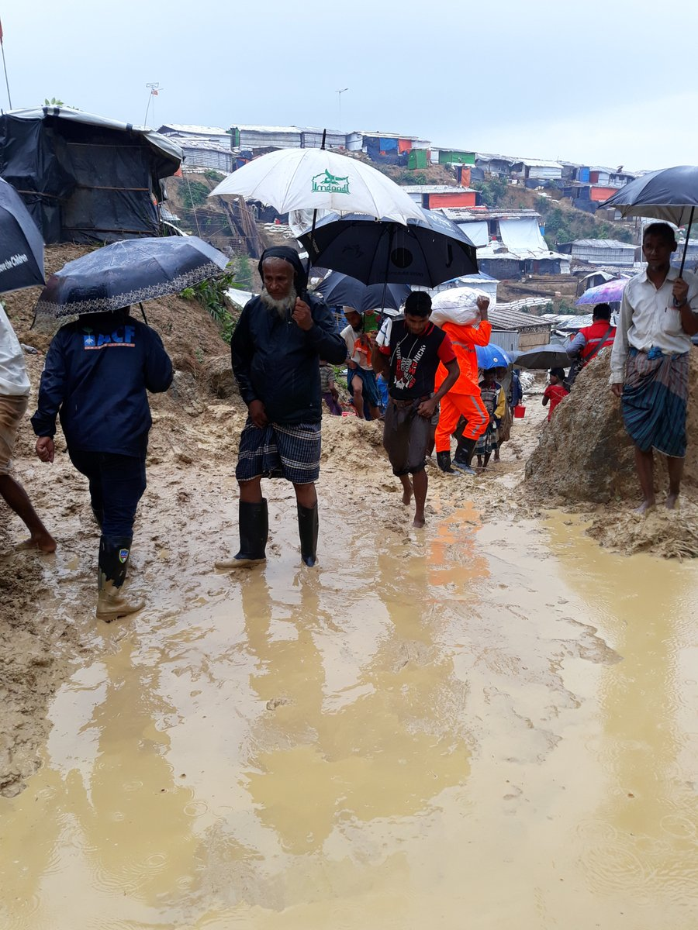

Slide 4
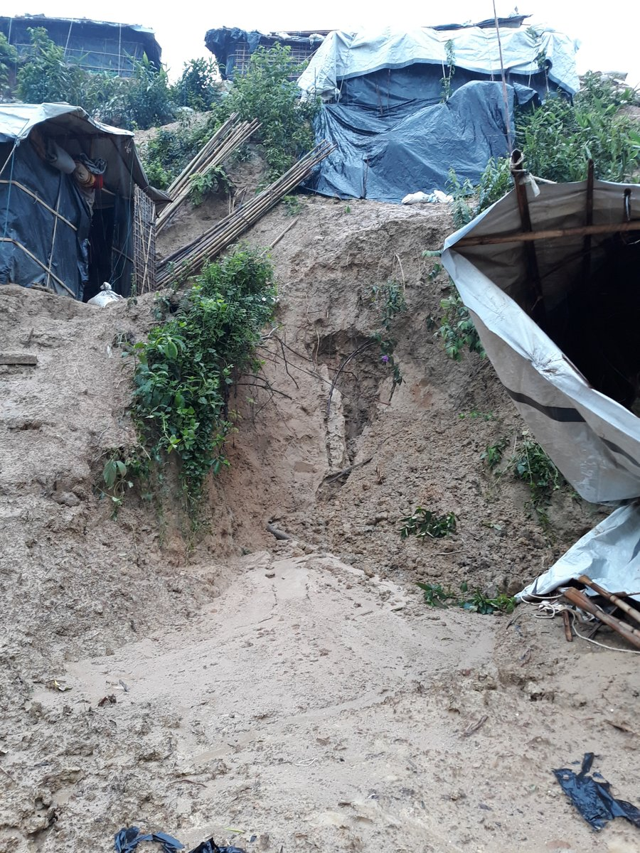

Slide 5
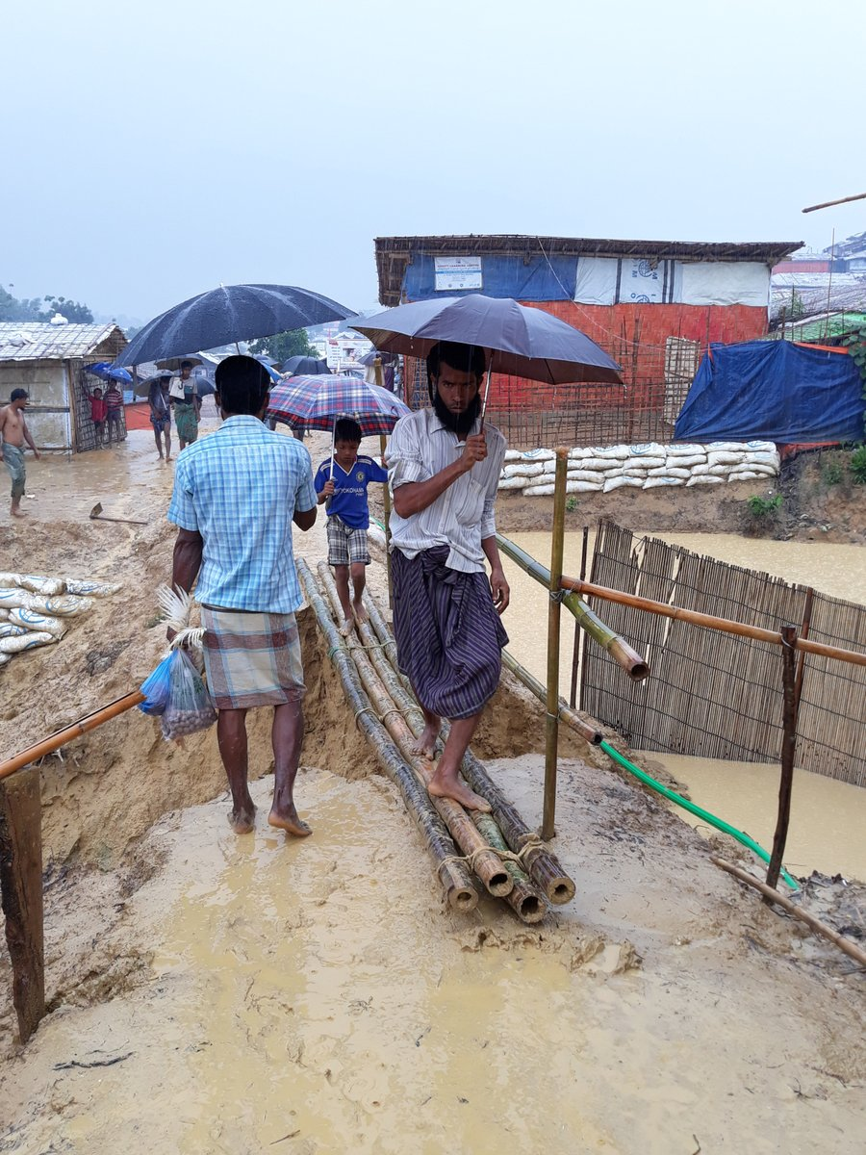

Slide 6
“It’s a really daunting task. There are moments when I feel real despair, but there are moments when I feel real hope – because of this indomitable human spirit of togetherness.”

Slide 7
Photo credits and sources
Slide 2: © Marcus Valance/SOPA Images/LightRocket via Getty Images
Slides 3–5: © Julia Brothwell / British Red Cross
Slide 6: Quote by Dr Jemilah Mahmood, IFRC
This resource and other free educational materials are available at redcross.org.uk/education
The British Red Cross Society is a charity registered in England and Wales (220949) and Scotland (SCO37738).
Notes:
1

