Slide 1
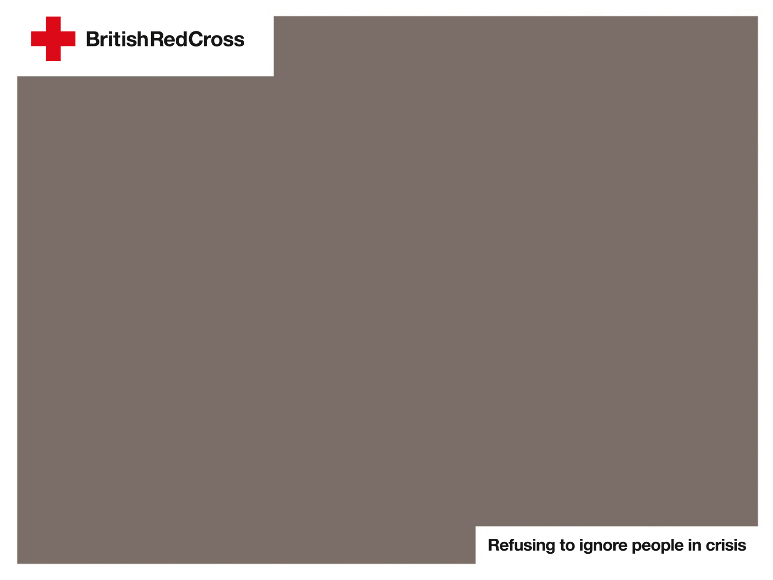
Where do emergencies happen?
Notes:
Explain to the children that they will need to identify whether the emergency shown on each slide can happen in the UK, outside of the UK, or both. After looking at the slide, they will need to hold up the relevant sign.
Answers
In UK:
floods
heatwaves
storms
snowstorms and winter cold weather.
Outside of the UK:
earthquakes
floods
storms
volcanic eruptions
hurricanes
tornadoes
tsunamis
snowstorms and winter cold weather
heatwaves.

Slide 2

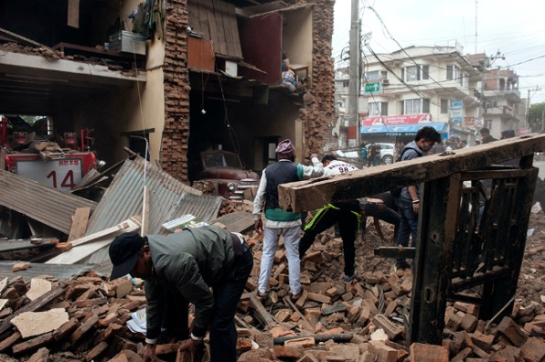
Earthquakes
Source: British Red Cross
Notes:
Image: Nepal Earthquake, 25 April 2015
Where do earthquakes happen?
Both in and outside of the UK – but only very small ones happen in the UK and they are rarely felt.

Slide 3
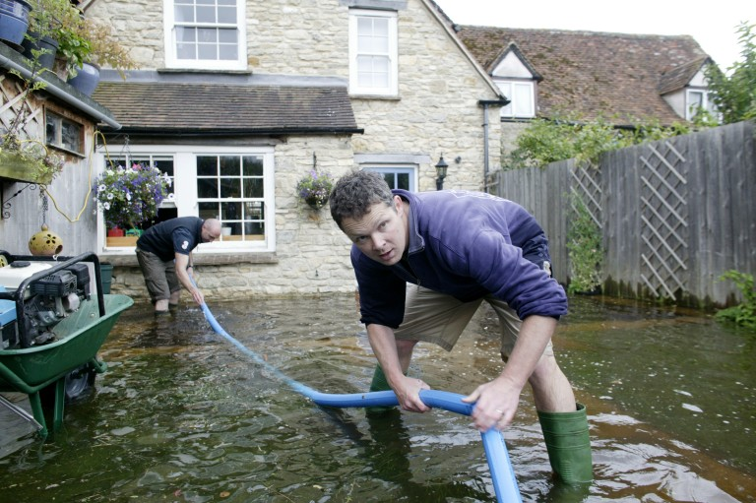
Floods
Source: British Red Cross
Notes:
Image: Flooding in the UK
Where do floods happen?
Both in and outside of the UK.

Slide 4
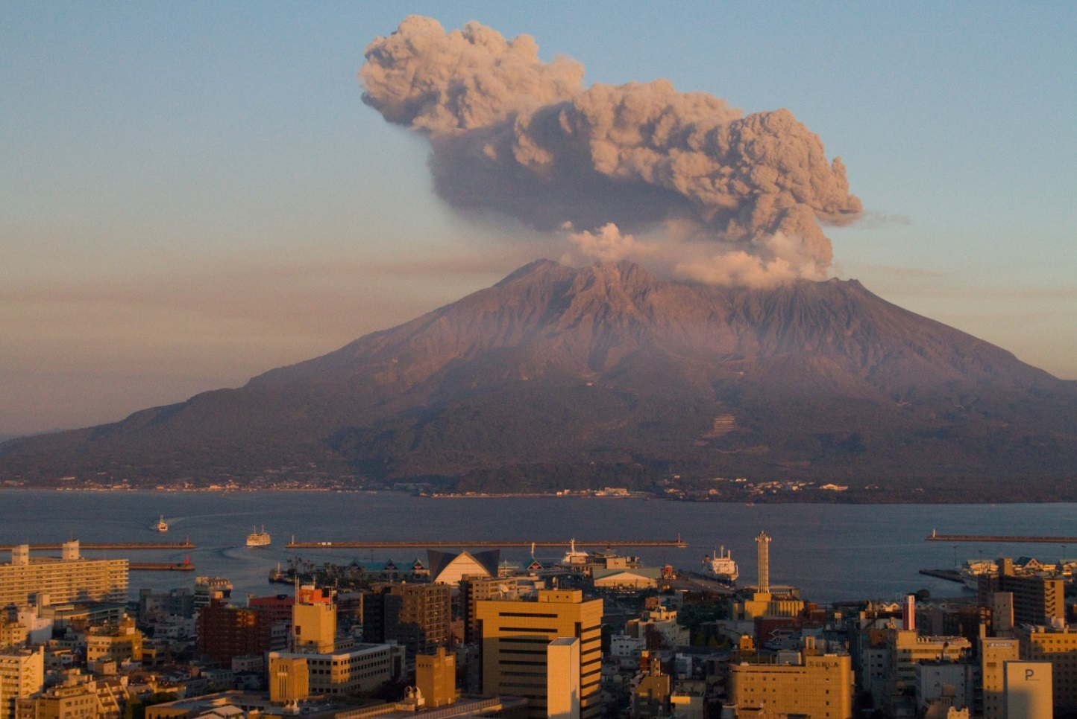
Volcanic eruptions
Source: © Photo by Kimon Berlin - CC BY-SA 2.0
Notes:
Image: Sakurajima Volcano, Japan, erupting in 2009
Where do volcanic eruptions happen?
Outside of the UK, in countries like Italy, USA, Japan, Indonesia, the Philippines and others.

Slide 5
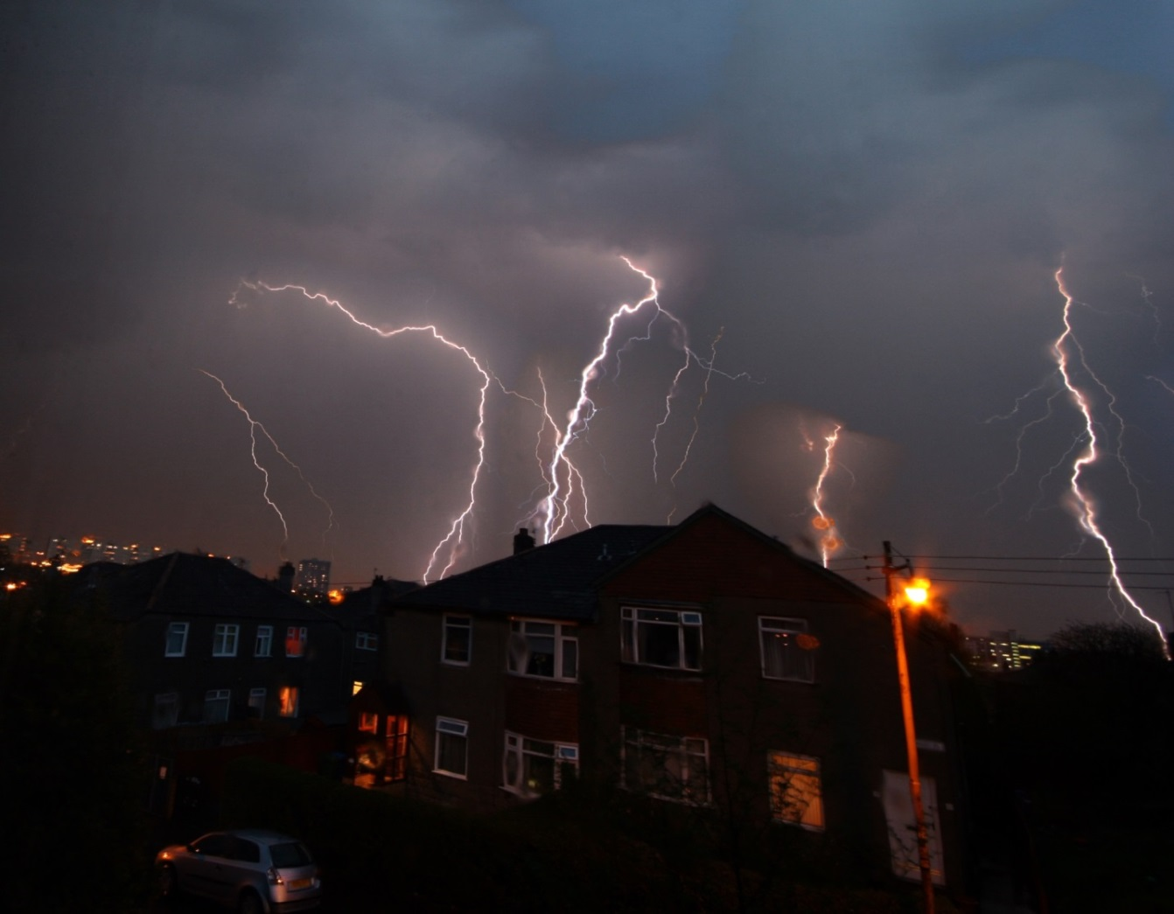
Storms
Source: © Photo by Martin McCarthy/iStock
Notes:
Image: Thunderstorm in the UK
Where do thunderstorms happen?
Both in and outside of the UK.

Slide 6
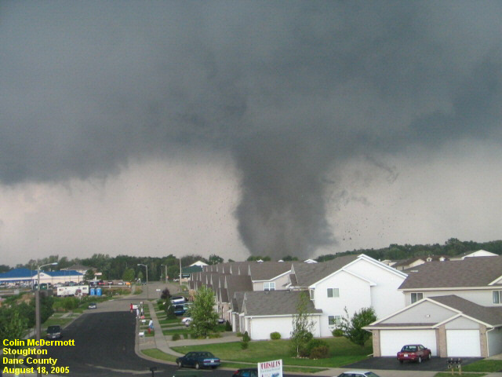
Major tornadoes
Source: NOAA
Notes:
Image: Stoughton Wisconsin Tornado, 18 August 2005
Where do large tornadoes happen?
Outside of the UK.

Slide 7
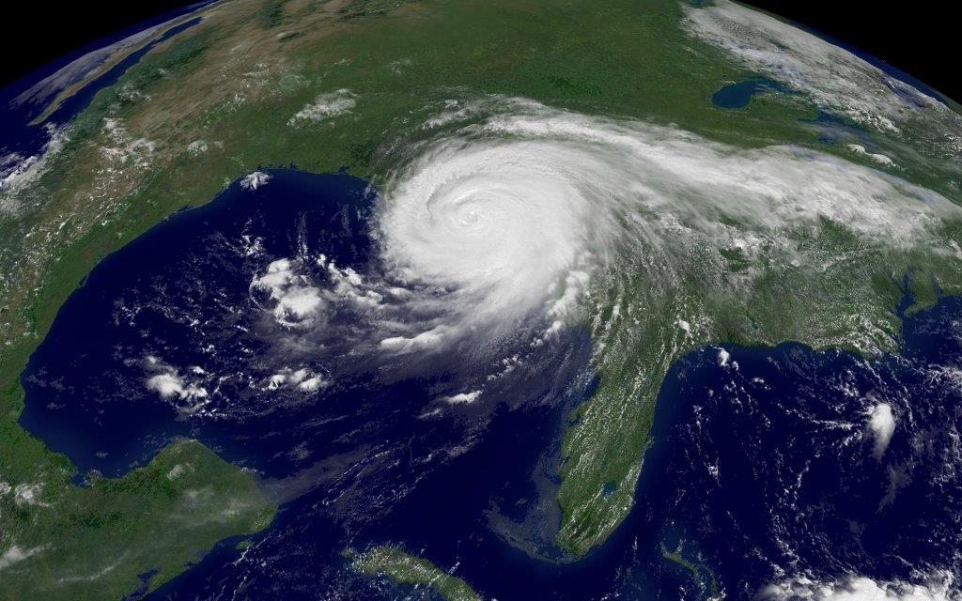
Major hurricanes
Source: IFRC
Notes:
Image: Hurricane Katrina in the USA in 2005
Where do large hurricanes happen?
Outside of the UK.

Slide 8
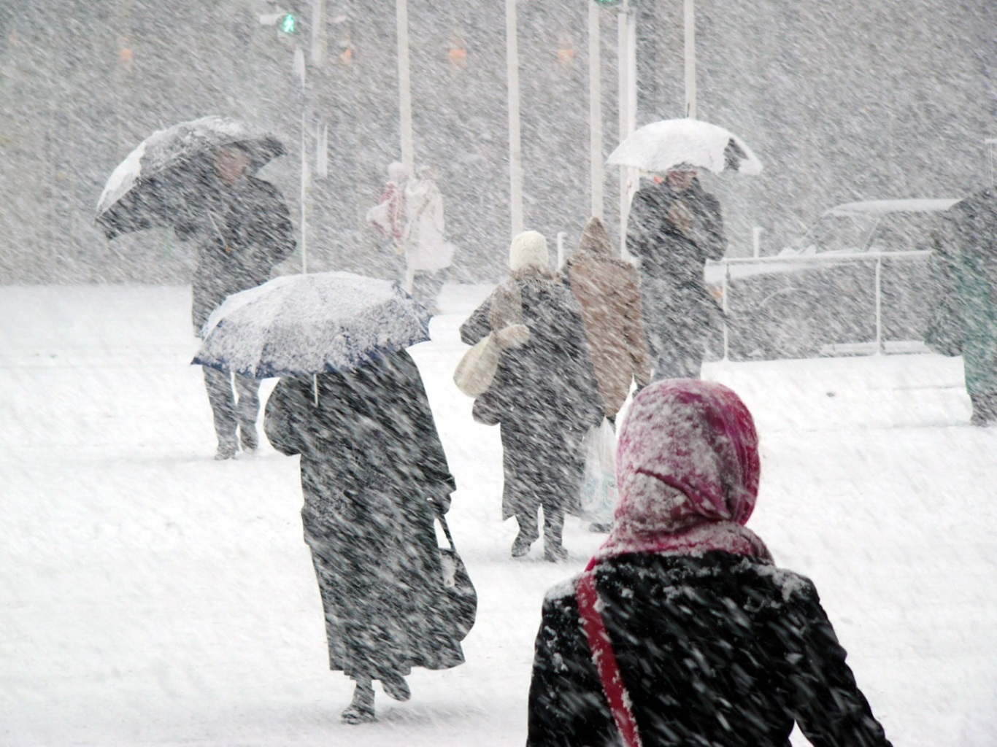
Snowstorms and winter cold weather
Source: © Photo by Dainis Derics/iStock
Notes:
Image: Winter storms and cold weather in the UK
Where do snow storms and winter cold weather happen?
Both in and outside of the UK.

Slide 9
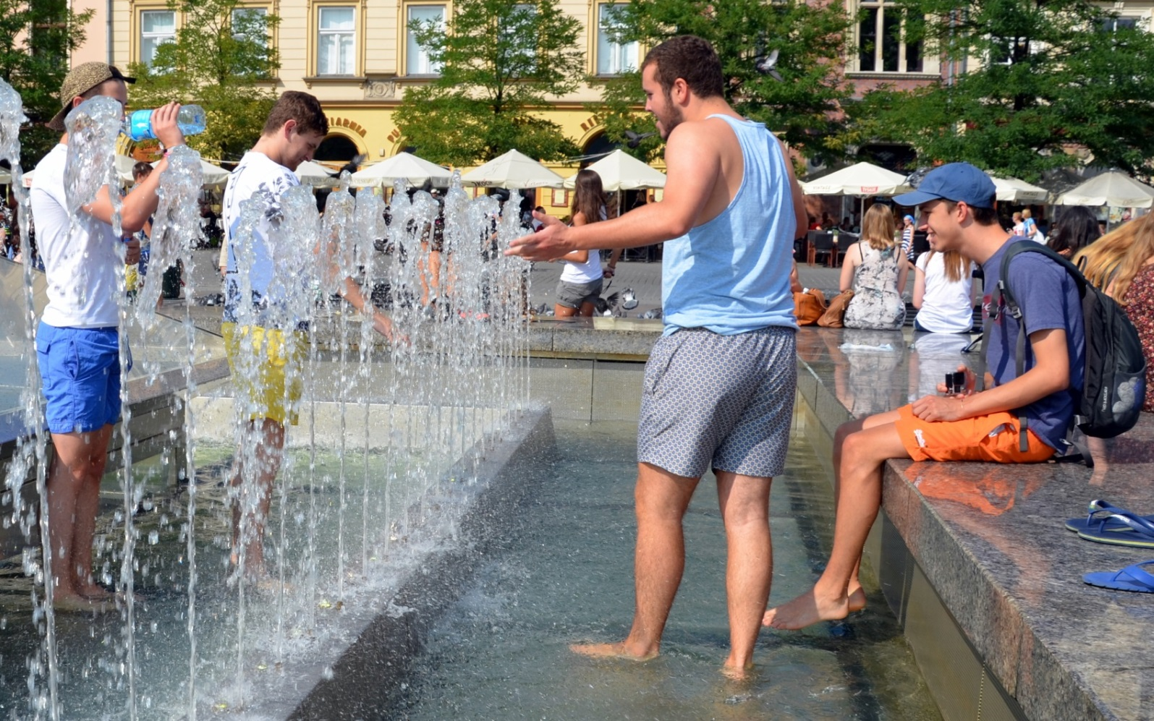
Heatwaves
Source: Photo by Silar, CC BY-SA 4.0
Notes:
Image: Heatwave in Kraków, in Poland in 2015
Where do heatwaves happen?
Both in and outside of the UK.

Slide 10
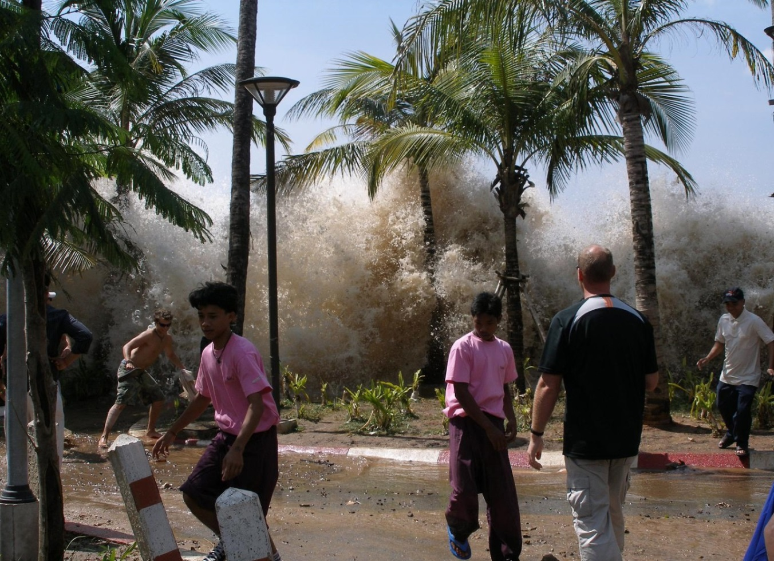
Tsunamis
Source: © Photo by David Rydevik, Wikimedia Commons
Notes:
Image: 2004 Boxing Day Tsunami in Thailand
Where do tsunamis happen?
Outside of the UK.

