Slide 1
East Africa facing hunger
Bystander or lifesaver?
Full lesson plan from redcross.org.uk/education
Full lesson plan from redcross.org.uk/education
Notes:
1

Slide 2
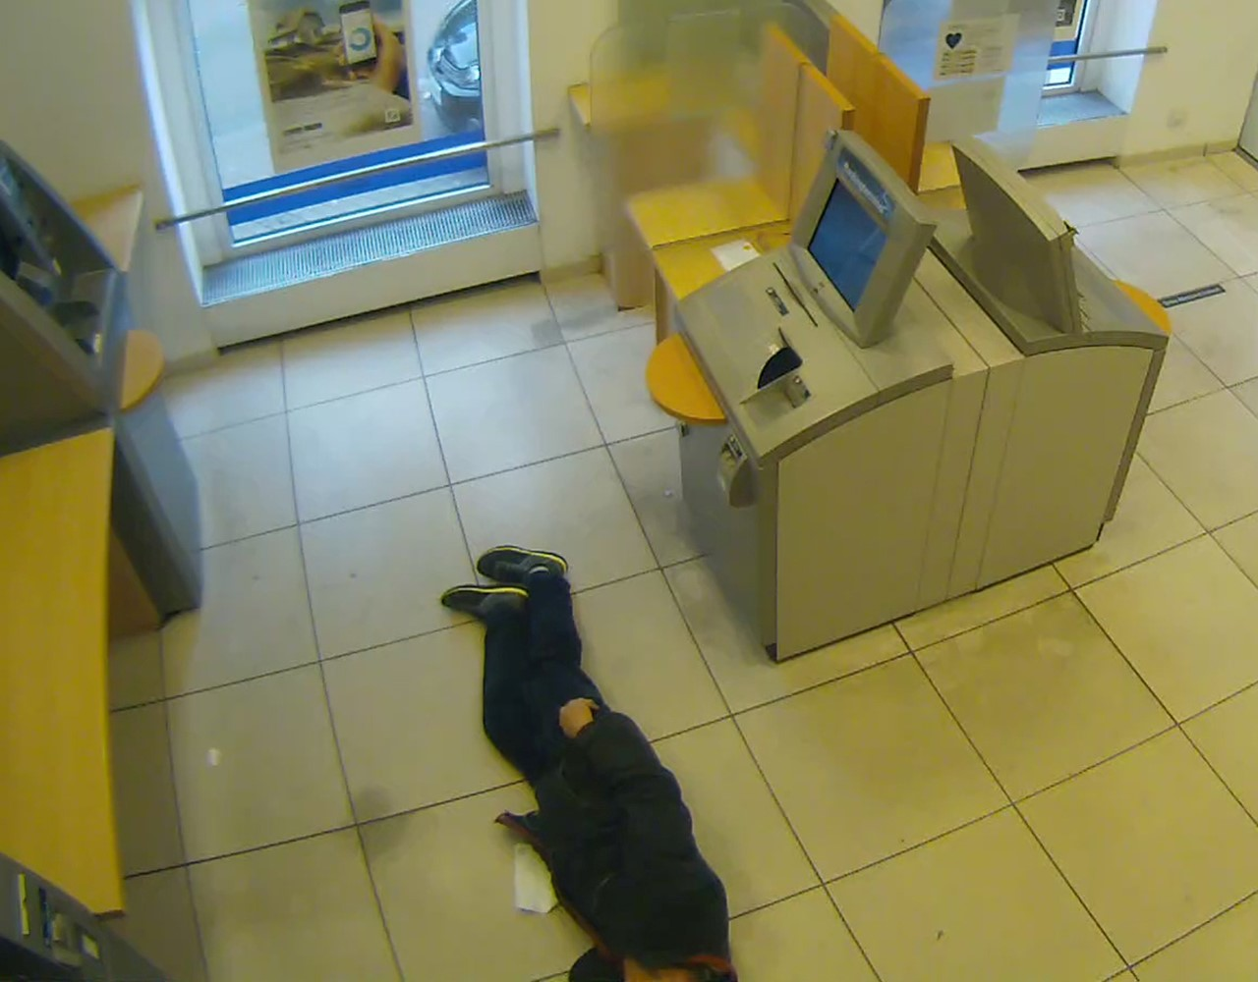
Notes:
In the village of Badanrero, a Kenyan Red Cross nutritionist measures the circumference of the children’s arms, their height and their weight. Many children are small for their age and underweight. They are given a two-week supply of Plumpy’Nut , a peanut-based paste designed to increase their weight.

Slide 3
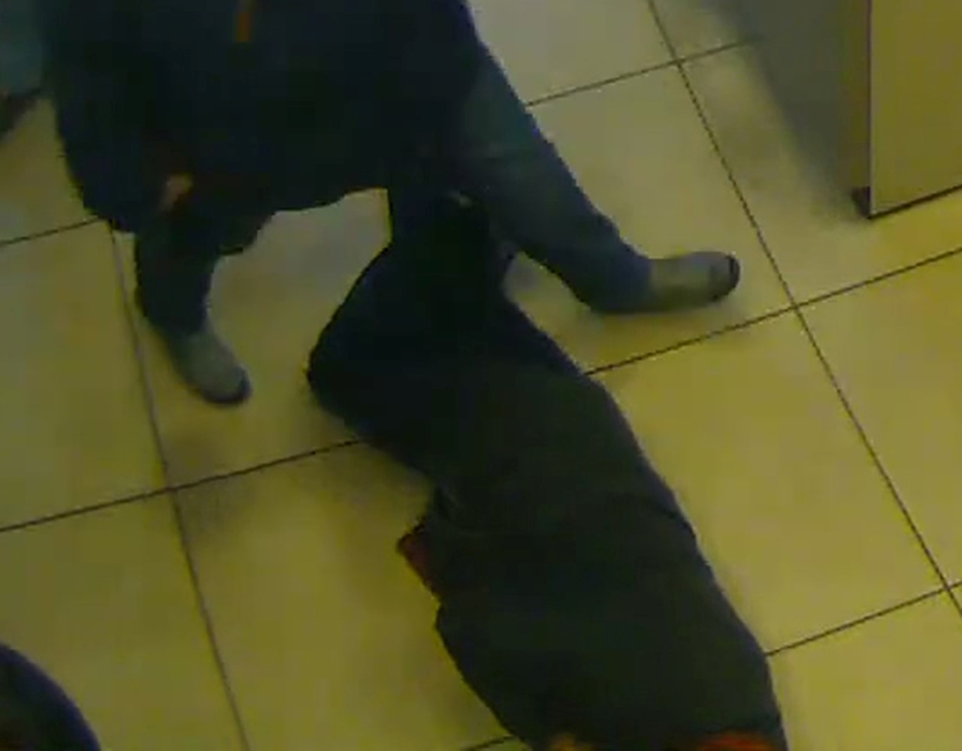

Slide 4
Photo credits and captions
Caption: Hinschauen statt Wegsehen! - Mann verstirbt nach internistischem Notfall - Mitmenschen helfen nicht sofort
Photo: CCTV image © Polizei Nordrhein-Westfalen
Important legal note
This photograph is fully protected by copyright. Schools and other educational organisations are free to use it for educational use. The licence does not extend beyond this use. This means that anyone wishing to put the image on a website, crop or edit it, or use it in any other way, must first contact the copyright holder and negotiate a licence for the use they require.
This resource and other free educational materials are available at redcross.org.uk/education
The British Red Cross Society is a charity registered in England and Wales (220949) and Scotland (SCO37738).
Notes:
1

