Slide 1

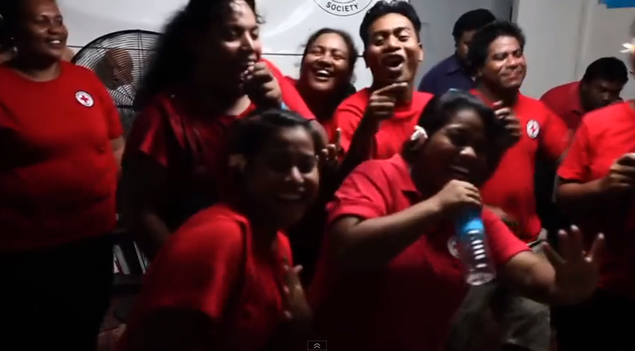
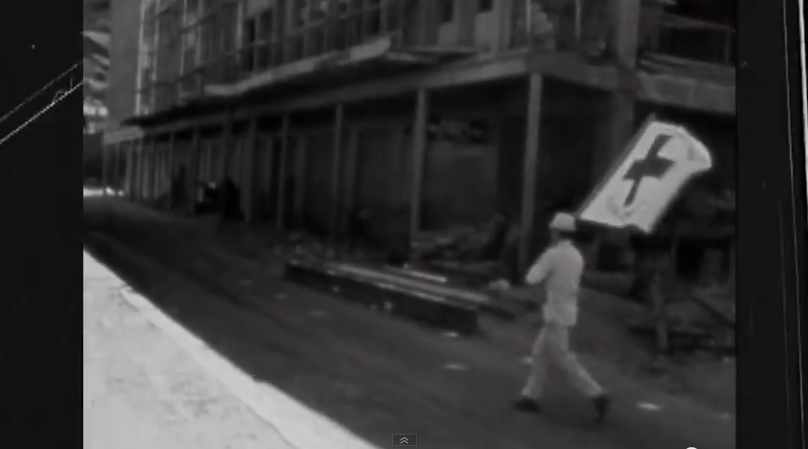

Exploring the power of humanity
© IFRC
Humanitarianism in action
© IFRC
Slide 1

Slide 2
What is humanity?
Humanity is the state or quality of being human.
Humanity is the collective name for all human beings.
Humanity is the quality of being humane.
Slide 2

Slide 3
An introduction
The International Red Cross and Red Crescent Movement has been around for more than 150 years, engaged in humanitarian work.
Through this assembly and a short film, we will think about what being ‘humanitarian’ means, and what ‘humanitarian’ work is.
Slide 3

Slide 4
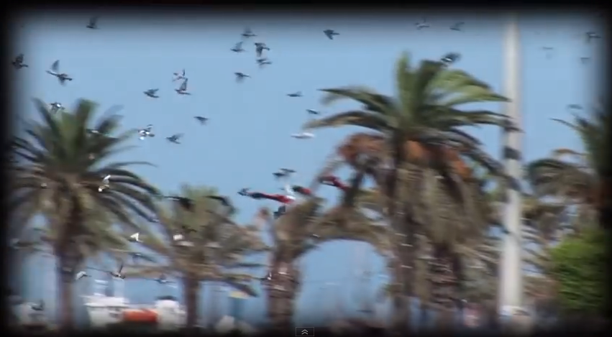
The film: The power of humanity
Watch the film.
Consider these questions:
what do you notice in the film?
how does it make you feel?
what makes you feel like that?
© IFRC
Slide 4

Slide 5
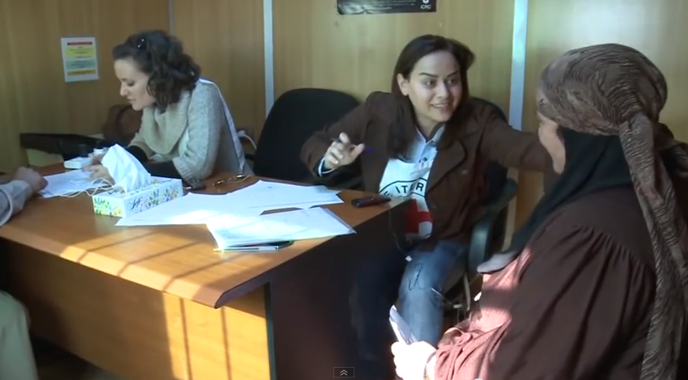

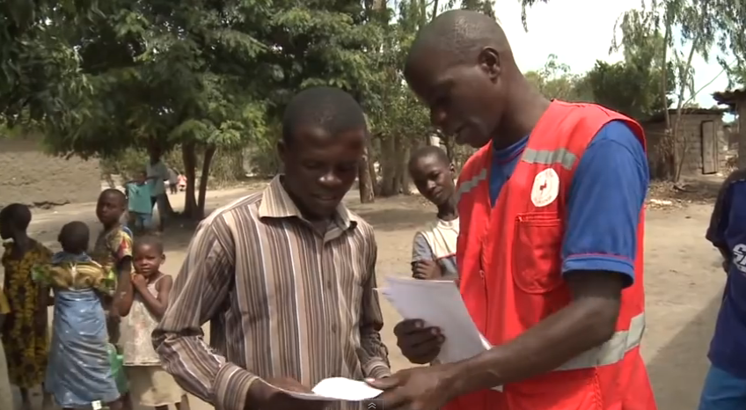
Exploring ‘The power of humanity’
Talk to a partner about someone or something that stood out to you in the film.
What was happening?
Why did it stand out?
What feelings did you have?
Why do you think you might have had those feelings?
Can you link this back to the word humanity?
© IFRC
Slide 5

Slide 6
Looking deep: humanitarian actions and attitudes
Watch the film a second time. This time focus on…
…what actions are taking place to help people in crisis?
…what attitudes/behaviours are being displayed towards those needing help?
Slide 6

Slide 7
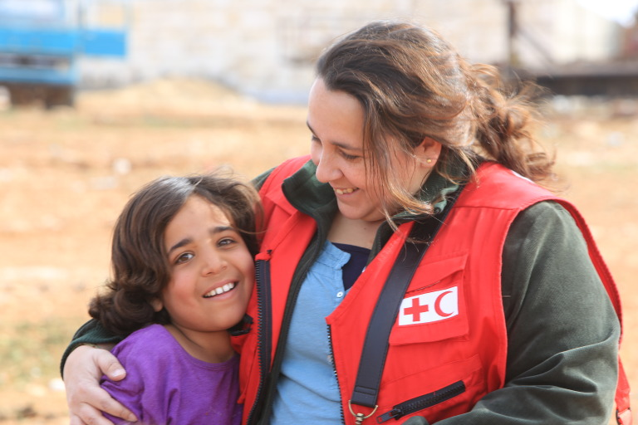

Over 150 years of Humanitarianism in Action
The Movement began with one person’s humanitarian attitude and action after coming across a battle where those involved in the conflict were wounded and dying on the battlefield without help. Henri Dunant, a Geneva merchant/businessman from Switzerland, decided to step in and set up a make shift hospital in a nearby church with the help of local villagers. He treated those on both sides of the conflict equally, attending to the most urgent cases of distress first and recording last goodbyes to send to loved ones.
The Red Cross and Red Crescent Movement has grown steadily ever since, and is now the largest humanitarian network in the world, helping people in crisis no matter who they are or where they are from. There are over 100 million members worldwide.
© Ibrahim Malla/BRC
© IIFRC
Slide 7

Slide 8
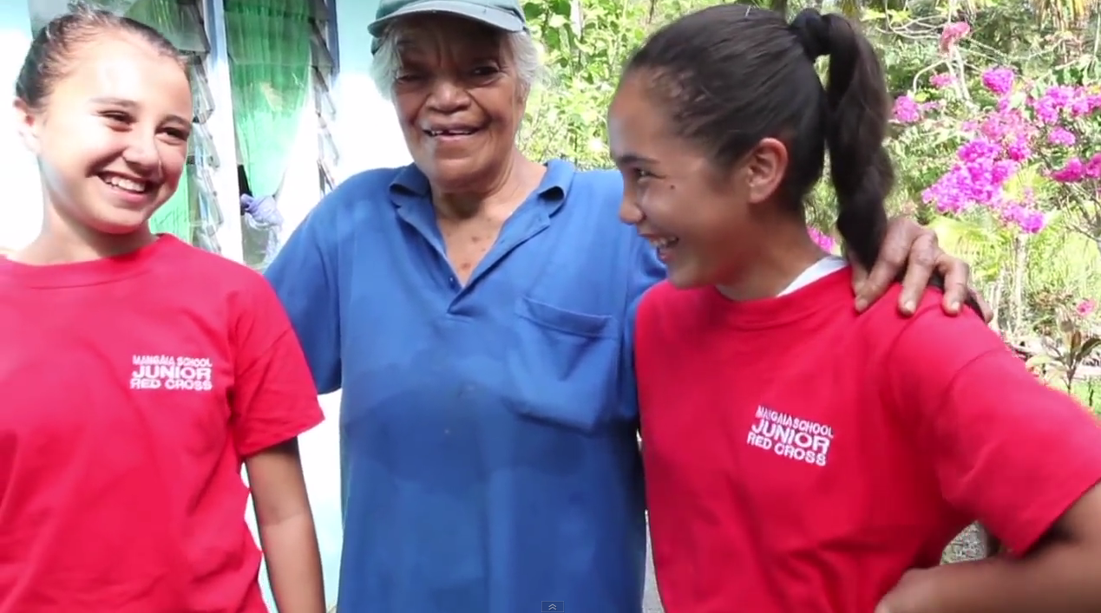
The Power of Humanitarianism
© IFRC
Slide 8

Slide 9
Reflecting on humanitarianism
Although the film shows humanitarianism in action in many different and sometimes challenging situations, both here and around the world, humanitarianism is all around us.
It begins right here in the way we interact with each other, and with those who may need help around us.
Thinking about your own power as part of humanity, consider one humanitarian action or humanitarian attitude that you could focus on today and use in your interactions with others.
Slide 9

Slide 10
Copyright notice
© British Red Cross 2015
All photographs fully protected by copyright. Schools and other educational organisations are free to use this PowerPoint for educational use. The licence does not extend beyond this use. This means that anyone wishing to put an image on a website, crop or edit it, or use it in any other way, must first contact the copyright holder and negotiate a licence for the use they require.
This resource and other free educational materials are available at redcross.org.uk/education
The British Red Cross Society is a charity registered in England and Wales (220949) and Scotland (SCO37738).
Slide 9

