Slide 1
Shared humanity
Full lesson plan from redcross.org.uk/education
Notes:
1
Ask children to look at each of the images and try and think of things that they might have in common with the children in the image (a shared humanity).
They can write their ideas inside the person outline on their paper.
If they identify things that are different (diversity in humanity) then they can place these around the outside of the person shape.
You can prompt them to think about shared humanity in the following ways:
relationships (we all have a mother, we are all part of the human race – humanity etc)
feelings and emotions (we can all be happy, sad, cross, sorry, we can all show love etc)
basic needs (we all need food, we all need water, we all need the right amount of warmth etc)
actions (we can all show affection, we can all be kind, we can all help someone else etc).

Slide 2
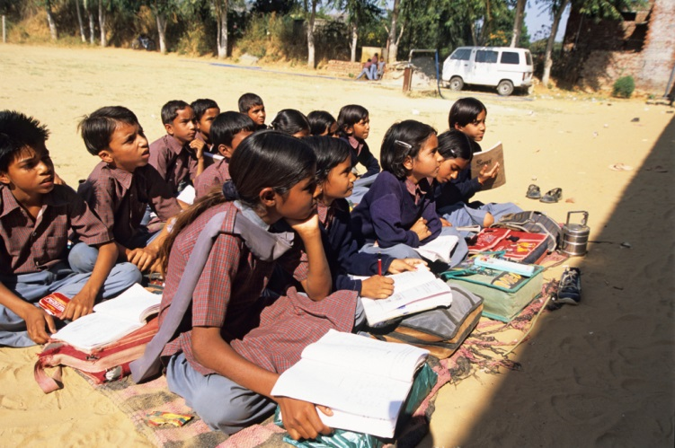
Notes:
Children studying outside at a rural school near Jaipur in Rajasthan, India
© Listening Eye Images/Rob Bowden

Slide 3
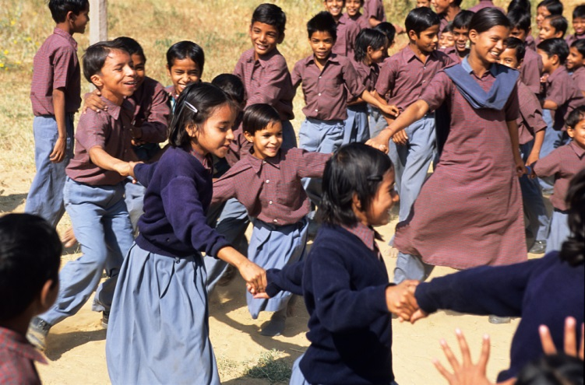
Notes:
Children playing at a rural school near Jaipur in Rajasthan, India
© Listening Eye Images/Rob Bowden

Slide 4
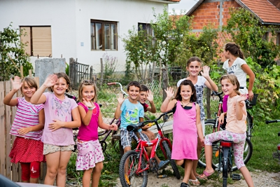
Notes:
Children outside together in communities affected by severe floods, Bosnia and Herzegovina 2014
© Stephen Ryan / IFRC

Slide 5
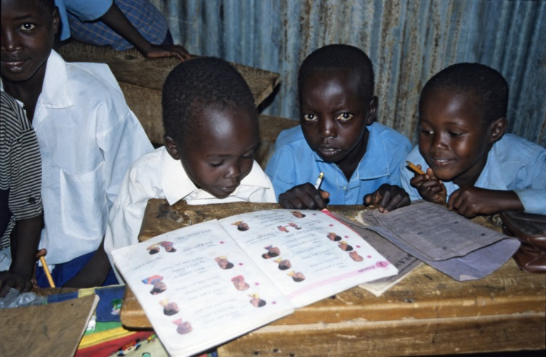
Notes:
Children in primary school in West Pokot, Kenya
© Listening Eye Images/Rob Bowden

Slide 6
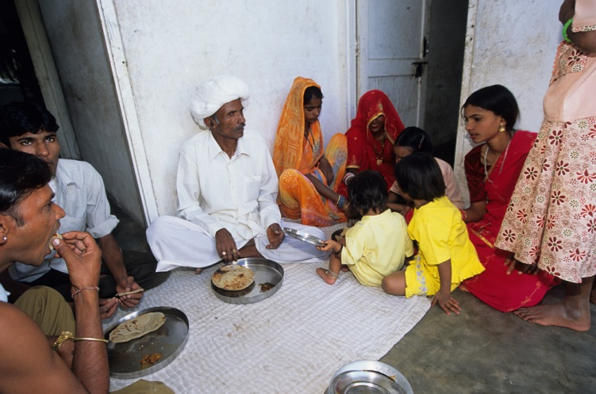
Notes:
A family sit together for lunch in Rajasthan, India
© Listening Eye Images/Rob Bowden

Slide 7
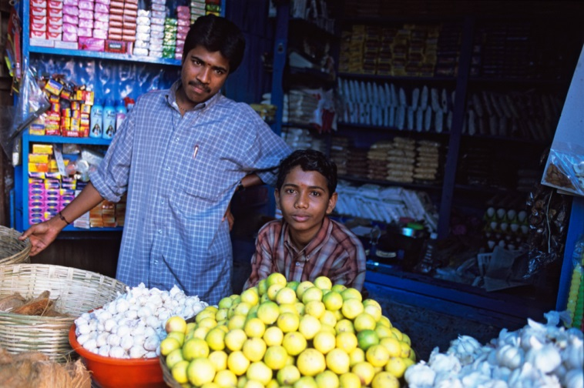
Notes:
Father and son in their roadside store in Munnar, Kerala, India
© Listening Eye Images/Rob Bowden

Slide 8
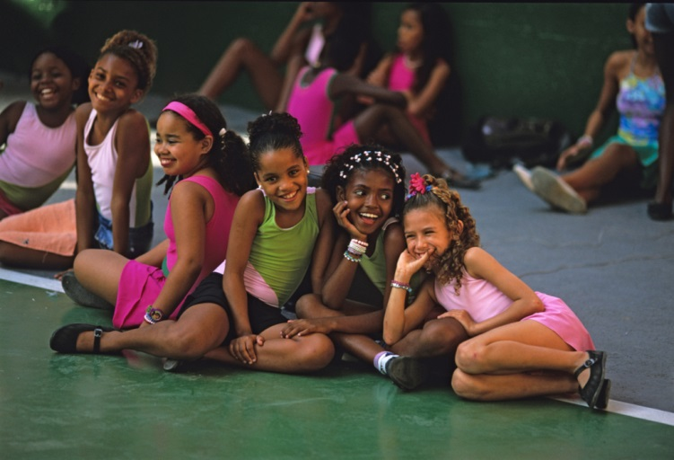
Notes:
A group of girls rest during a samba class after school in Rio de Janeiro, Brazil
© Listening Eye Images/Edward Parker

Slide 9
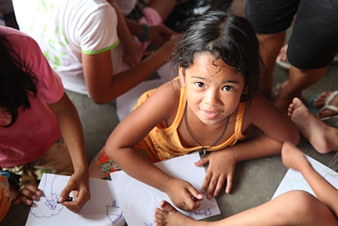
Notes:
Zaira, 7, draws pictures at a Red Cross Evacuation centre after floods struck her village, Philippines, 2013
© IFRC

Slide 10
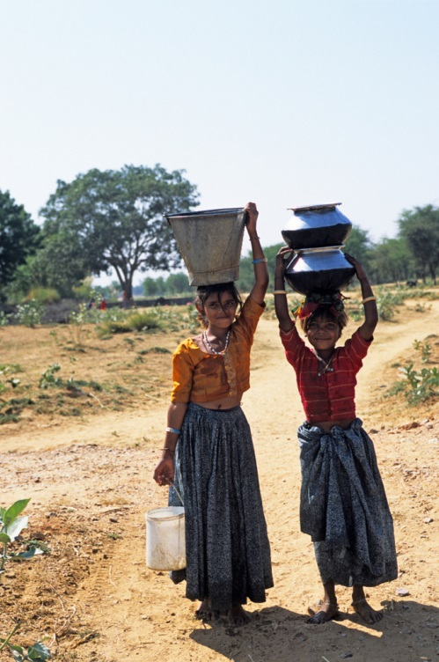
Notes:
Young girls collecting water for their family, Rajasthan, India
© Listening Eye Images/Rob Bowden

Slide 11
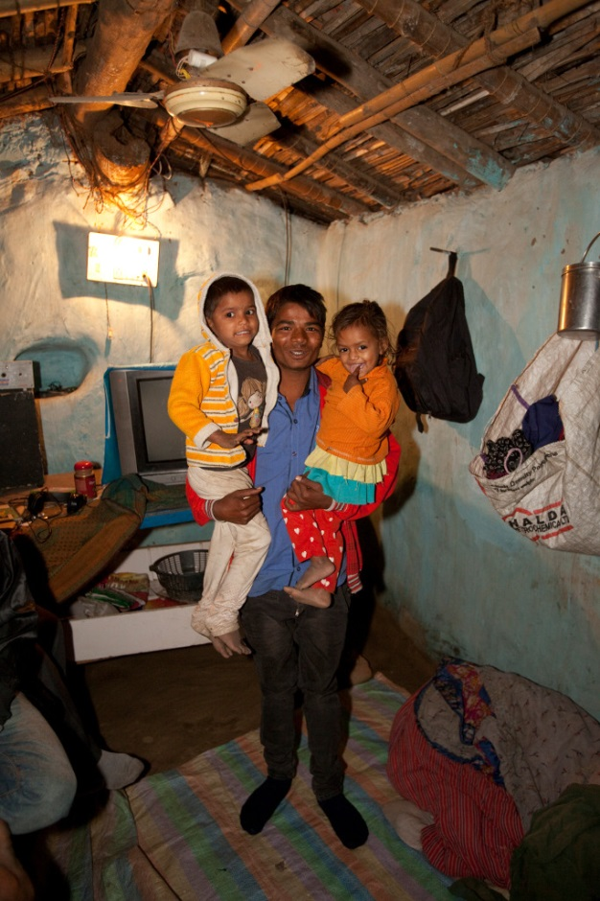
Notes:
A father with his two children inside their simple one room home in Bodhgar, India
© Listening Eye Images/Edward Parker

Slide 12
Copyright information
Important legal note
These photographs are fully protected by copyright. Schools and other educational organisations are free to use them for educational use. The licence does not extend beyond this use. This means that anyone wishing to put the images on a website, crop or edit it, or use it in any other way, must first contact the copyright holder and negotiate a licence for the use they require.
This resource and other free educational materials are available at redcross.org.uk/education
The British Red Cross Society is a charity registered in England and Wales (220949) and Scotland (SCO37738).
Notes:
1

