Slide 1
Black History
Month: Humanitarians

Slide 2
What does a humanitarian look like?

Slide 3
Unconscious bias
Unconscious bias is the idea that, without really knowing it, we view people differently. We make assumptions about people based on stereotypes, things we learn and experience and what we see and hear, and this changes how we treat them. It means we favour certain kinds of people and not favour others based on our own ideas.

Slide 4
Humanitarian stories
What makes these people humanitarians?
What kind acts did they do?
What makes them resilient?

Slide 5
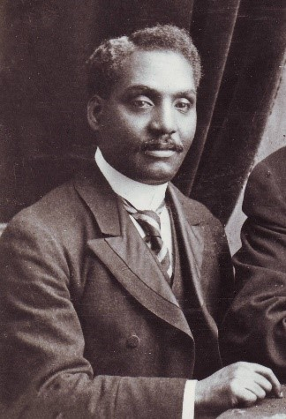
John Alcindor
Born in Trinidad, Dr John Alcindor was a physician and activist for racial equality, who helped others during the first world war despite facing prejudice and discrimination. Although he had a medical degree from Edinburgh University and having worked in several London hospitals for many years, he was rejected by the Royal Army Medical Corps during the war because of his origin.
Dr Alcindor persisted with his desire to help those in need by joining the British Red Cross as a volunteer and treated countless wounded soldiers at London railway stations as they returned from the battlefields. He was later awarded a Red Cross medal for his life-saving work.
He also conducted research and published articles on cancer, influenza and tuberculosis and worked to prevent syphilis and tuberculosis in Great Britain. His research set the groundwork for the correlation between poverty, low quality food and unbalanced diets in poor health.

Slide 6
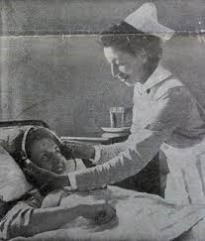
Princess Tsehai
Princess Tsehai was the daughter of Haile Selassie of Ethiopia, born in Addis Ababa. She joined her father in exile in London and trained as a state registered nurse in 1939 at Great Ormond Street for Sick Children. After the restoration of her father in 1941, she returned to Ethiopia to work in Dessie Hospital. Sadly, Princess Tsehai in 1942 died from complications during childbirth; her baby also did not survive. Emperor Haile Selassie founded the Princess Tsehai Memorial Hospital in her memory which was also funded by British admirers that were very moved by her death. The hospital was also created to serve as a nursing school.

Slide 7
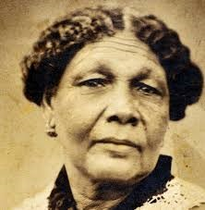
Mary Seacole
Born and raised in Jamaica, Mary came to England in 1854 after the start of the Crimean War to join the British War Office to go and help wounded soldiers in Ukraine. She was flatly refused despite her valuable education in Caribbean and African medicine.
Instead, she decided to raise money for herself to travel to Balaclava, Ukraine and set up the British Hotel, where she could tend to the injured soldiers. She also visited the battlefield to treat the wounded and became known as 'Mother Seacole'.
She returned to England after the war penniless and in ill health. The newspapers discovered her story, and in 1857 Queen Victoria's nephew hosted a benefit in her name, attracting thousands of people and raised plenty of funds for her.
Mary later published her memoir, 'The Wonderful Adventures of Mrs Seacole in Many Lands'.

Slide 8

Identify some Black British humanitarians you admire.
What makes them a humanitarian?

