Slide 1



Newsthink.
Flash Floods - Spain

Slide 2
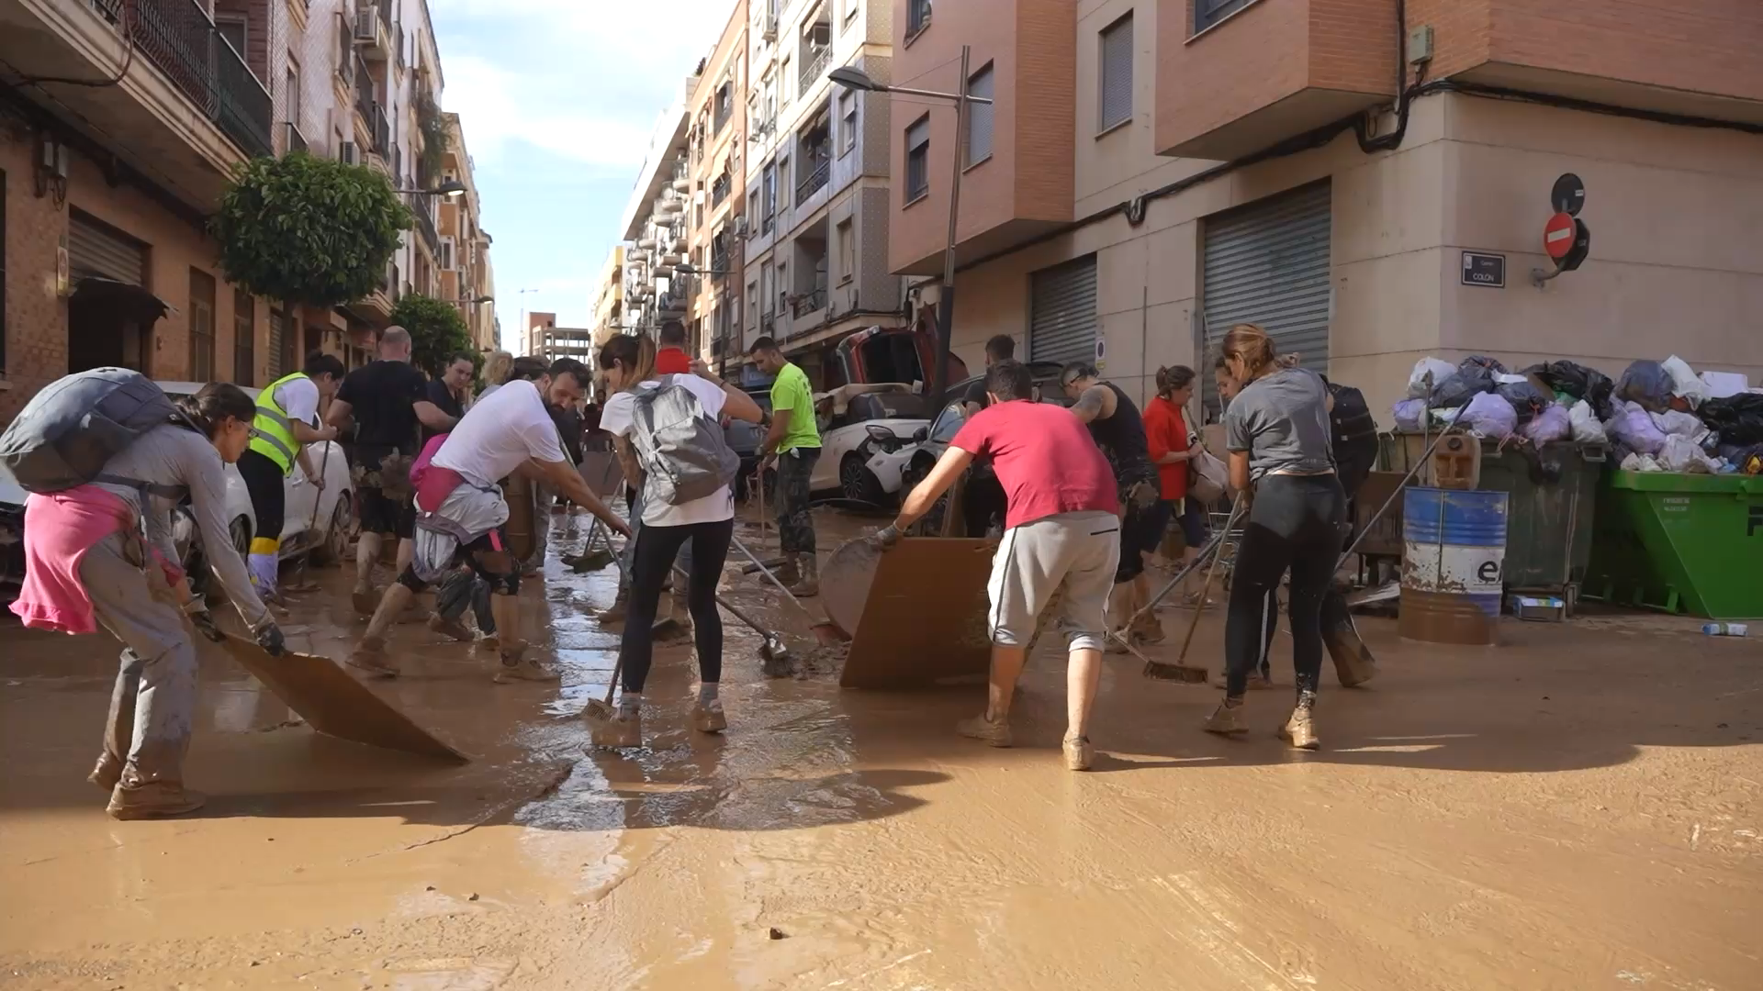
Newsthink.
Spain Flash Floods
Photographer: Europa Press-Footage News
Notes:
Watch this video on the situation in Spain. Answer the questions as a group with the following slides.
Video Description: this video depicts the people of Sedaví coming together, in the aftermath of flooding, to clean and feed their community from destruction and damage
Video Location: Sedaví, Valencia, Spain
Video Date: 2nd November 2024

Slide 3
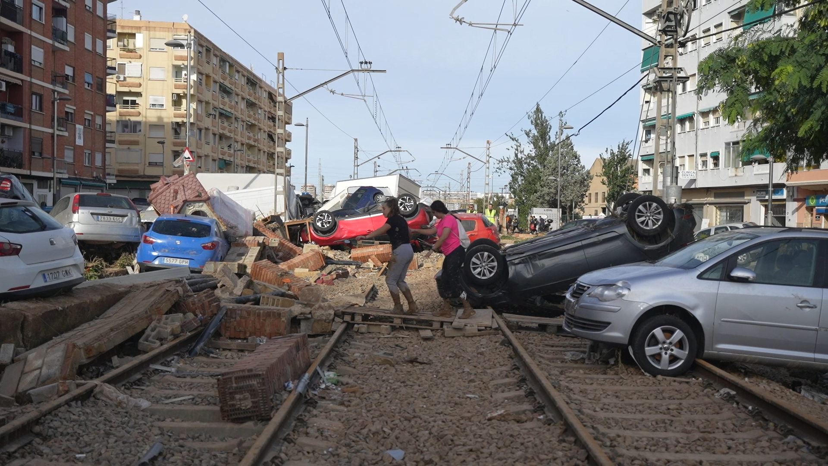

Newsthink.
Spain Flash Floods
Photographer: Europa Press-Footage News
See: What do you see in the picture? What’s happening?
Notes:
Possible answers:
Destruction from the floods
Cars upturned
People climbing out of the rubble
Train tracks – public transport disrupted
A man helping wearing high-vis

Slide 4
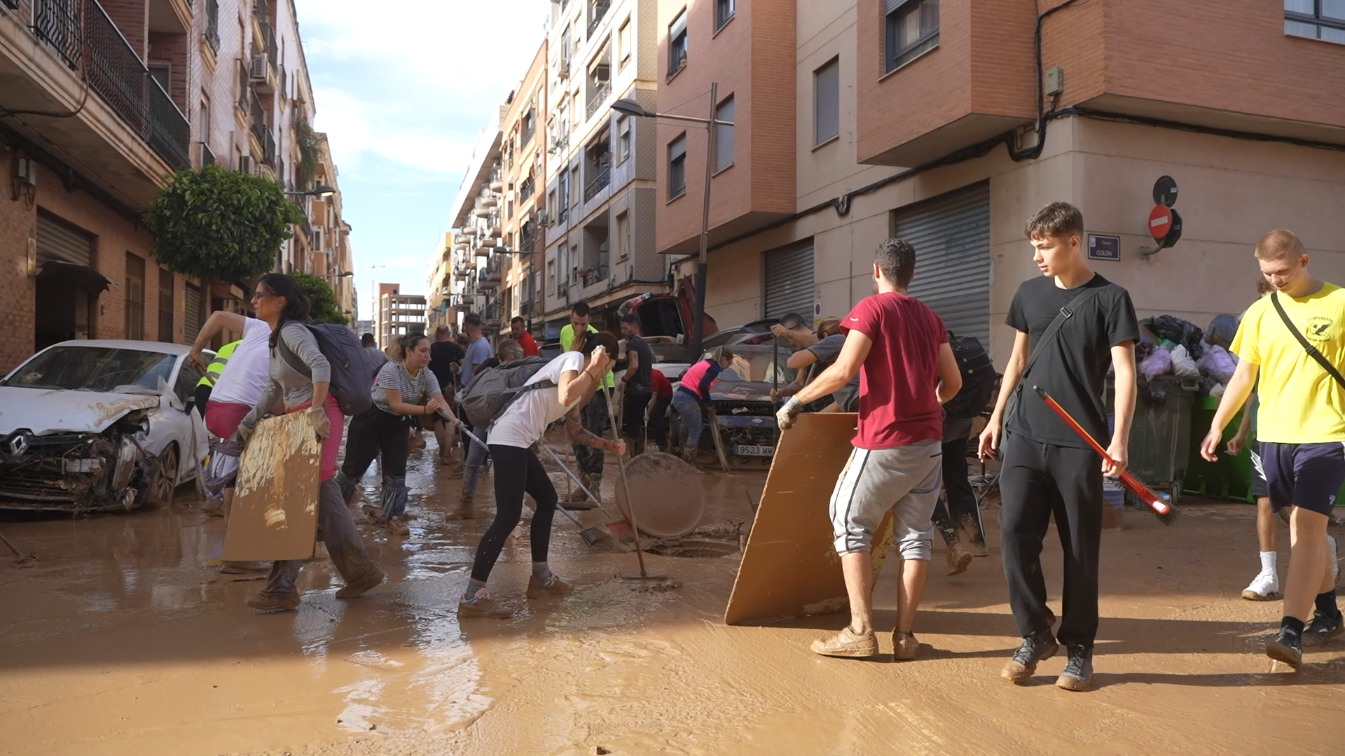
Newsthink.
Spain Flash Floods
Photographer: Europa Press-Footage News
Think: What do you think these people are thinking about? What is important to them at this moment?
Notes:
Possible answers:
Getting life back to normal
Clearing roads and cars
Lasting damage and the cost of repairs
Going to work and school
Visiting family and friend
Sanitation issues
Pets

Slide 5
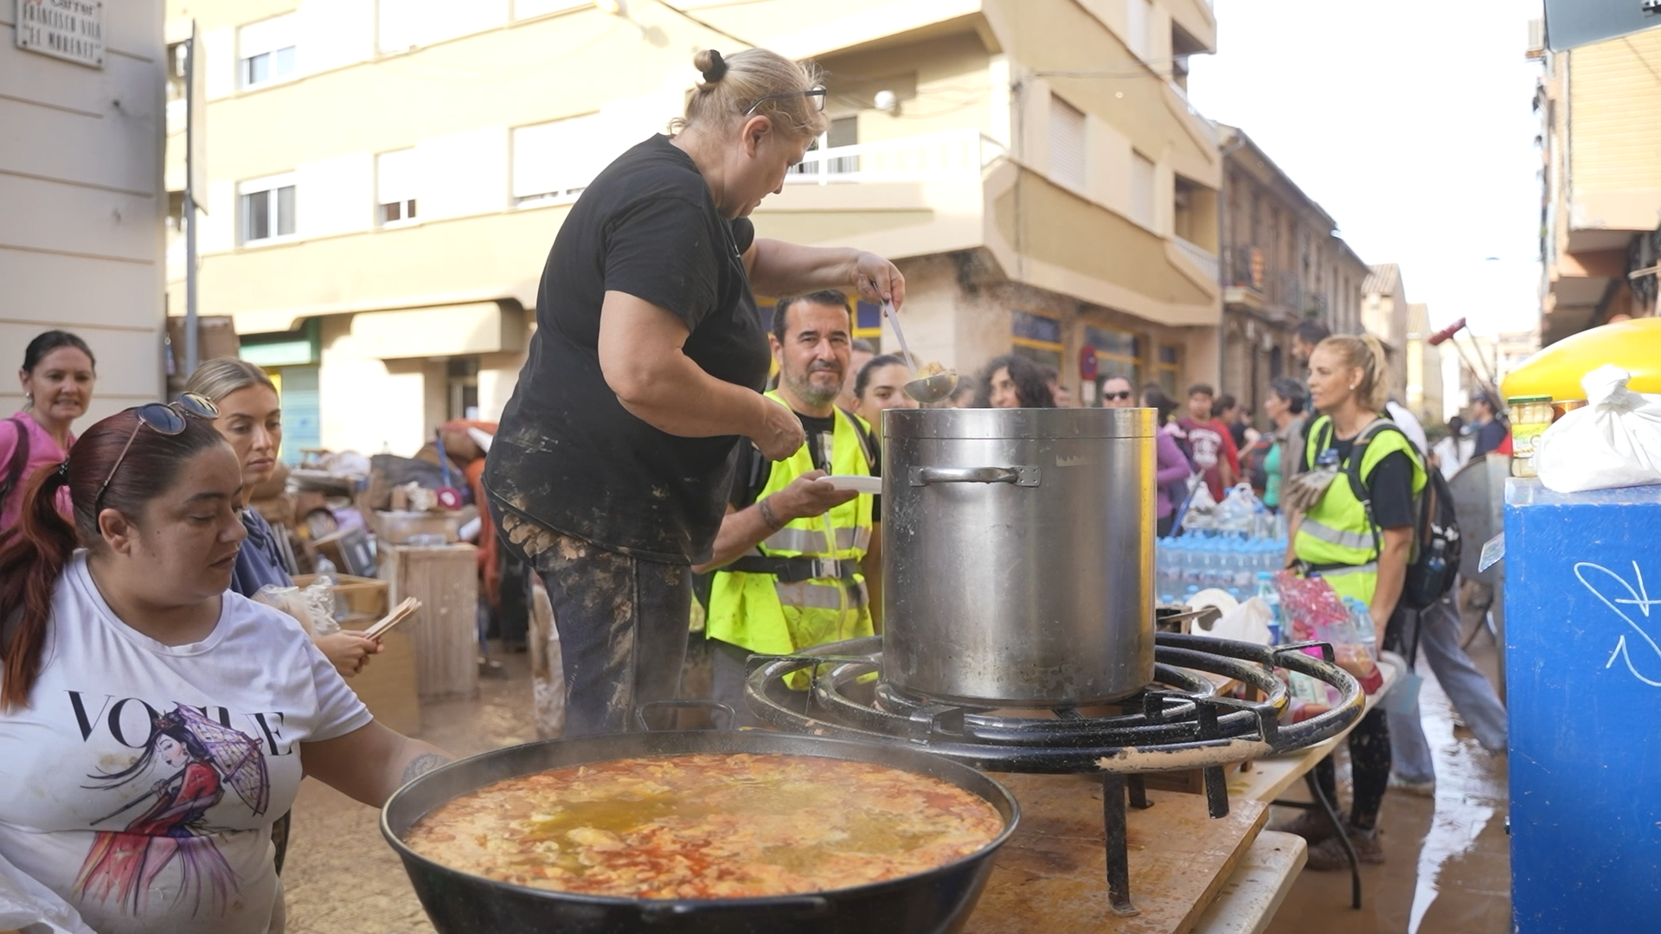
Newsthink.
Spain Flash Floods
Feel: How do you think they feel? Why might they feel this way?
Notes:
Possible answers:
Sad – the destruction of their homes
Anxious – worried about friends and family members
Hopeful - the impact of communities and volunteers helping each other

Slide 6


Newsthink.
Spain Flash Floods
“Can the impact of flash floods on individuals and communities be prevented?"
Agree
Disagree
Notes:
Give learners the opportunity to share their answers. Once they’ve listened to each other’s arguments, give them a chance to review their position. If they wish to change sides, encourage them to do so.
Teacher suggestion to discuss in the debate:
Climate change
Early warning systems
Flood defence infrastructure
The geography of your area (whether it is prone to flooding or high-density population)

Slide 7

Newsthink.
Spain Flash Floods
Reflect on your own:
What are your thoughts and feelings about the video and the impacts of flooding on people?
Notes:
This is an extension task for personal reflection. Encourage learners to reflect on this activity, whether writing it down or just thinking.

Slide 8
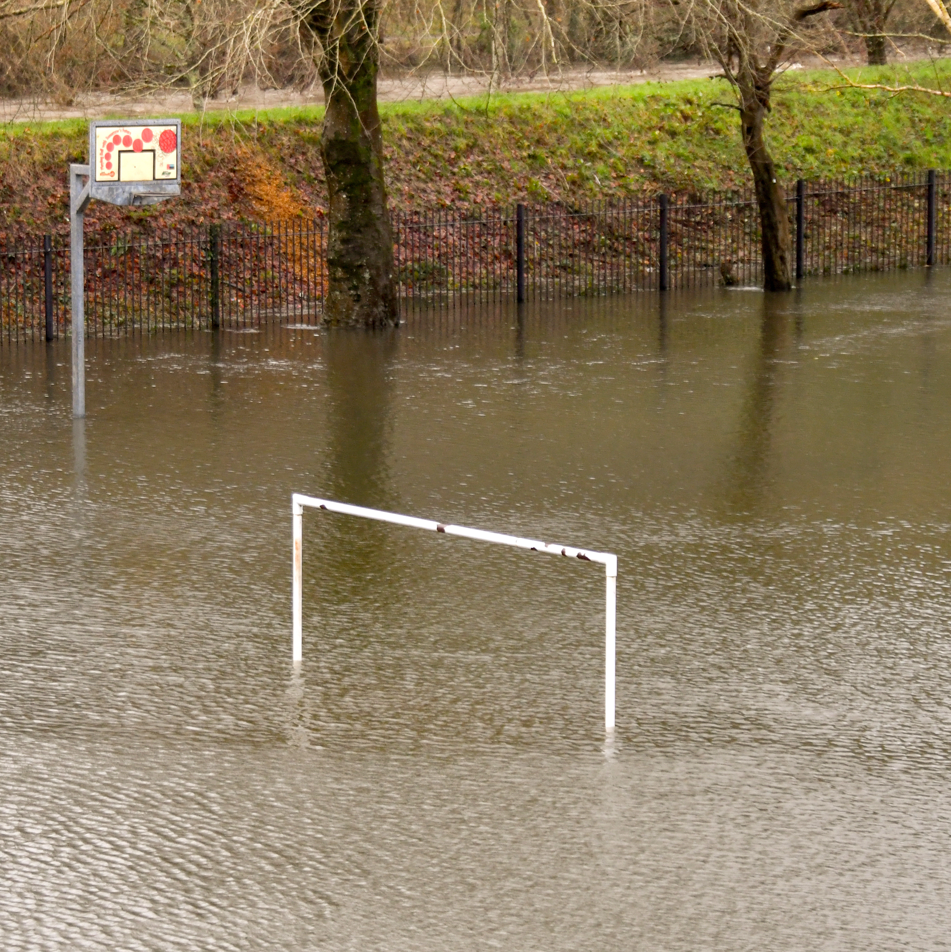
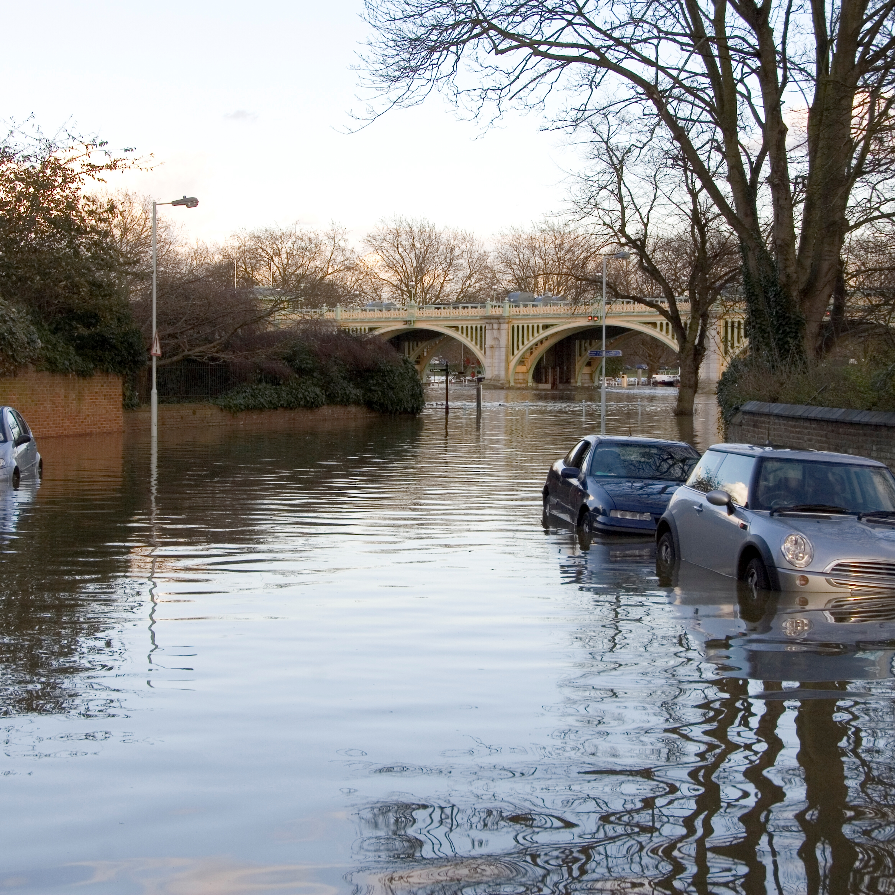
What are flash floods?
Flash flooding happens when rain falls so fast, such as during a storm, that the underlying ground cannot drain it away fast enough.
Why are they so dangerous?
The water is strong and fast moving.
There are increased health risks (such as, contaminated water).
They can trigger other natural disasters (such as, mudslides).
Newsthink.
Spain Flash Floods
Notes:
Flash Flood Definition Source: What causes flash floods? - Met Office
For more information on flooding: Flooding UK: Prepare for floods | British Red Cross

Slide 9
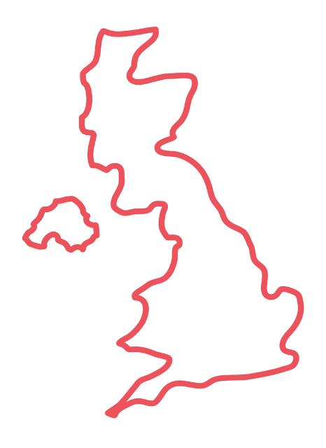





Newsthink.
Spain Flash Floods
Scotland
What are the flood risks for your area?
Scan to view government flood information.
Northern Ireland
England
Wales
Notes:
Click on the ‘i’ symbol to take you directly to the flood information for each government.

Slide 10



Newsthink.
Spain Flash Floods
Learn more:
Use our Weather Together toolkit to explore how to prepare for and cope with extreme weather events. Learn about the topics of:
Flooding
Heatwaves
Eco anxiety
Share with others:
Talk to your family and friends about the floods in Spain. Ask them if they have any experiences of flooding themselves.
Do something:
Use the British Red Cross website to find out about how to prepare for and what to do if a flood happens in your area.
Notes:
Some ideas of what you and your learners can do next

