Slide 1
Plenary
Notes:
At the end of your lesson, pick one plenary that matches the resource type you used (Learn / Apply / Share) and choose 1 prompt on the slide that matches the topic (flooding/heatwaves/eco-anxiety).
Click on the topic prompts for the lesson(s) you did not teach. Those prompts will disappear, leaving only the relevant question visible for your learners. This modular approach gives you flexibility to tailor plenaries to your learners.
Then move to the grey box activity, this is the development stage where learners do something with what they’ve learned, such as reflecting, creating or applying skills. This sequence ensures discussion first, then deeper engagement through action.
Purpose: Use a plenary after teaching to close the loop in a way that matches the kind of learning your young people have just completed (learn resource, apply resource or share resource)
Delivery tips
Keep it brief (1 on‑slide activity, quick pair‑share, 1–2 voices to the room).
Always use the topic prompt printed on the slide (Flooding / Heatwaves / Eco‑anxiety).
Optional: capture outcomes on a Learning & Action wall (reflections+ action targets) to show progression across the unit.
Brief description of the British Red Cross holistic framework for teaching climate preparedness:​ The British Red Cross holistic framework for climate preparedness education supports the whole learner through four components:​
Knowledge and awareness: Builds understanding of climate risks, impacts, and safety measures through accurate information and critical thinking.​
Active learning: Engages learners in hands-on activities such as roleplay and scenario-based tasks to apply knowledge in practical ways.​
Social and emotional resilience: Helps learners manage feelings about climate change and emergencies through reflection, grounding techniques, and emotional literacy.​
Agency and empowerment: Encourages learners to take meaningful action, share knowledge, and feel confident in their ability to prepare and support others.​
This framework ensures climate education is not only about facts but also about skills, wellbeing, and empowerment for real-world resilience.​
Activation of holistic framework in plenary slides:
Knowledge & Awareness The learn plenary (Fact reflection) asks learners to name one new insight and one assumption they’ve changed. This consolidates accurate understanding and surfaces misconceptions to revisit.
Active Learning The Apply plenary (Skills snapshot) has learners state a concrete step/decision they practised and where it transfers beyond the classroom. This strengthens procedural knowledge and readiness.
Social & emotional resilience The feelings check‑in and the Climate emotions wheel normalise climate emotions, link them to triggers, and introduce a simple regulation/strategy choice so learners can steady themselves.
Agency & empowerment The share plenary (Action target) turns learning into a specific, near‑term step and identifies who it will be shared with—building efficacy and a route to community benefit.

Slide 2
What did you learn today?
Plenary
Flooding:
“What new risks or impacts did you discover?”
Fact reflection
Write down one thing you didn’t know before today’s activity.
Write down one myth or preconception you had that’s now changed.
Share your reflection with a partner or post it on the wall.
Heatwaves:
“What fact surprised you most?”
Eco-anxiety: “What helped you understand this feeling better?”
Notes:
Use this plenary only if you taught a Learn resource.
Click on the topic prompts for the lesson(s) you did not teach. Those prompts will disappear, leaving only the relevant question visible for your learners.
Then move to the grey box activity, this is the development stage where learners do something with what they’ve learned. This sequence ensures discussion first, then deeper engagement through action.
Toolkit: Use with Weather Together ‘Learn’ resources.
Flooding – Investigating your risks
Flooding – dangers of flooding
Flooding – How it affects everyone
Heatwaves – Facts
Eco-anxiety – What it is
Purpose: Use this slide to help learners consolidate new knowledge and challenge misconceptions. Encourage learners to reflect on how today’s learning changed their understanding of climate risks or emotional impacts.
Activity Instructions:
Ask the topic prompt on the slide – quick think‑pair‑share.
Instruct learners to complete the fact reflection steps on the slide:
2. Write one thing you didn’t know before today’s activity.
3. Write one myth/assumption you had that’s now changed.
4. Share your reflection with a partner or post it on the wall.
Holistic framework alignment:
Knowledge & Awareness : learners consolidate new facts and explicitly correct misconceptions by stating “what changed” in their understanding.

Slide 3
What did you do today?
Plenary
Flooding:
“What decisions did you make in the scenario?”
Skill snapshot
Draw or write about one practical skill you practised today (e.g. packing a bug-out bag, applying first aid, calming techniques).
Describe how this skill could help you or someone else in a real emergency.
Share your snapshot with a partner or small group.
Heatwaves:
“What first aid skill did you practise?”
Eco-anxiety: “What calming activity did you try?”
Notes:
Use this plenary only if you taught a Apply resource.
Click on the topic prompts for the lesson(s) you did not teach. Those prompts will disappear, leaving only the relevant question visible for your learners.
Then move to the grey box activity, this is the development stage where learners do something with what they’ve learned. This sequence ensures discussion first, then deeper engagement through action.
Toolkit: Use this slide with all Weather Together ‘Apply’ resources.
Flooding- Game of BOB
Heatwaves – Safety
Flooding – Prepare your home
Eco-anxiety – How to cope
Purpose:
Use this slide to prompt reflection on experiential/active learning. Encourage learners to connect their actions to real-world preparedness and community resilience.
Activity instructions:
Ask the topic prompt on the slide – quick think‑pair‑share.
Instruct learners- either together or in groups- to do the ‘skills snapshot’ activity.
Holistic framework alignment:
Active Learning : learners articulate and transfer a practised skill/decision to an authentic context, reinforcing procedural understanding.

Slide 4
What actions could you take?
Plenary
Flooding:
“What could you do to help your family prepare?”
Climate action stairs
Draw steps, then write down:
Step 1: one thing I’ll do (specific)
Step 2: When and where (day/time/place)
Step 3: Who I’ll share my action with
Heatwaves:
“What message could you share with others?”
Who I’ll share it with.
Eco-anxiety: “How could you support a friend or raise awareness?”
When/where I’ll do it.
One thing I’ll do.
Notes:
Use this plenary only if you taught a Share resource.
Click on the topic prompts for the lesson(s) you did not teach. Those prompts will disappear, leaving only the relevant question visible for your learners.
Then move to the grey box activity, this is the development stage where learners do something with what they’ve learned. This sequence ensures discussion first, then deeper engagement through action.
Toolkit: Use this slides for all Weather Together ‘Share’ resources.
Flooding – Sharing ways to prepare
Heatwaves – Help others cope
Eco-anxiety – Helping others
Purpose: Use this slide to help learners connect learning to action. Encourage them to think about how they can share their knowledge, support others and make change in their community.
Activity instructions:
Ask the topic prompt on the slide (Flooding / Heatwaves / Eco-anxiety) – quick think-pair-share.
Learners complete the Action stairs: write one specific action, add when & where, and who they’ll tell/share with.
Optional: 30-second buddy check for barrier + workaround.
Invite one or two pledges to the group; keep actions realistic and safe.
Holistic framework alignment:
Agency & Empowerment: learners set a specific, near‑term step, anchor it in time/place, and identify a sharing route, building confidence and community impact.

Slide 5
How did you feel today?
Plenary
Flooding:
“How did the character stories make you feel?”
Body scan
Draw an icon/symbol that represents how you felt during today’s activity.
Write or say what caused that feeling.
Identify where in your body you felt it (e.g. tight chest, butterflies in stomach).
Share with a partner or journal privately.
Heatwaves:
“How did learning about heat risks affect you?”
Eco-anxiety: “What emotions came up during the discussion?”
Notes:
Use this plenary with any resource to support emotional literacy.
Click on the topic prompts for the lesson(s) you did not teach. Those prompts will disappear, leaving only the relevant question visible for your learners.
Then move to the grey box activity, this is the development stage where learners do something with what they’ve learned. This sequence ensures discussion first, then deeper engagement through action.
Toolkit: Use this slide with all Weather Together resources.
Flooding – Sharing ways to prepare
Heatwaves – Help others cope
Eco-anxiety – Helping others
Purpose:
Use this slide to support emotional literacy and trauma-informed practice. Encourage learners to notice and name their emotions and reflect on how they managed them.
Activity instructions:
Ask the topic prompt on the slide, then invite a ‘body scan’ check‑in – brief think‑pair‑share (sharing optional).
Instruct learners to complete the ‘body scan’ step (name the feeling; where they noticed it), then resume.
Holistic framework alignment:
Social & emotional resilience: learners notice and name feelings linked to the activity, practising a simple regulation check‑in.

Slide 6
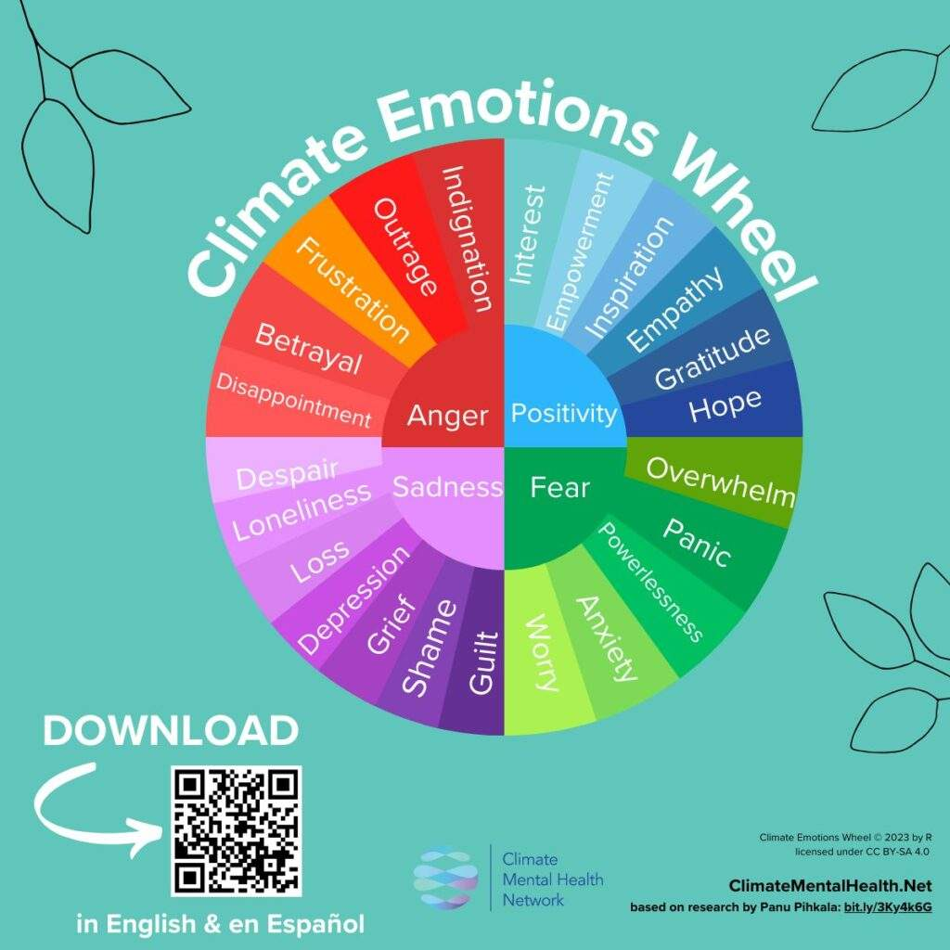
Climate emotions wheel
Plenary
Identify: Choose an emotion from the wheel that best describes how you feel after today’s lesson.
Articulate: Write or draw what caused that emotion.
Discuss: Share with a partner or group.
Coping strategy: What helped you cope or what could help next time.
Reflect: How could this emotion motivate action?
Notes:
Use this plenary with any resource to support emotional literacy.
Toolkit: Use this slide with any Weather Together resources.
Purpose:
Use this slide to help learners process emotional responses to climate topics. Encourage them to move from emotion to insight and action, building resilience and constructive hope.
Activity instructions:
Ask learners to follow the five steps shown on the slide:
Identify an emotion from the wheel that best describes how they feel after today’s lesson.
Articulate what caused that emotion (write or draw).
Discuss by sharing with a partner or group.
Coping strategy: note what helped them cope or what could help next time.
Reflect on how this emotion could motivate positive action.
Holistic framework alignment:
Social & emotional resilience: learners connect emotion → trigger → coping strategy in a simple, repeatable routine.
Agency & empowerment (when a next step is chosen): selecting a constructive action from the wheel converts feeling into doable behaviour.

Slide 7

End
Thank you

