Slide 1
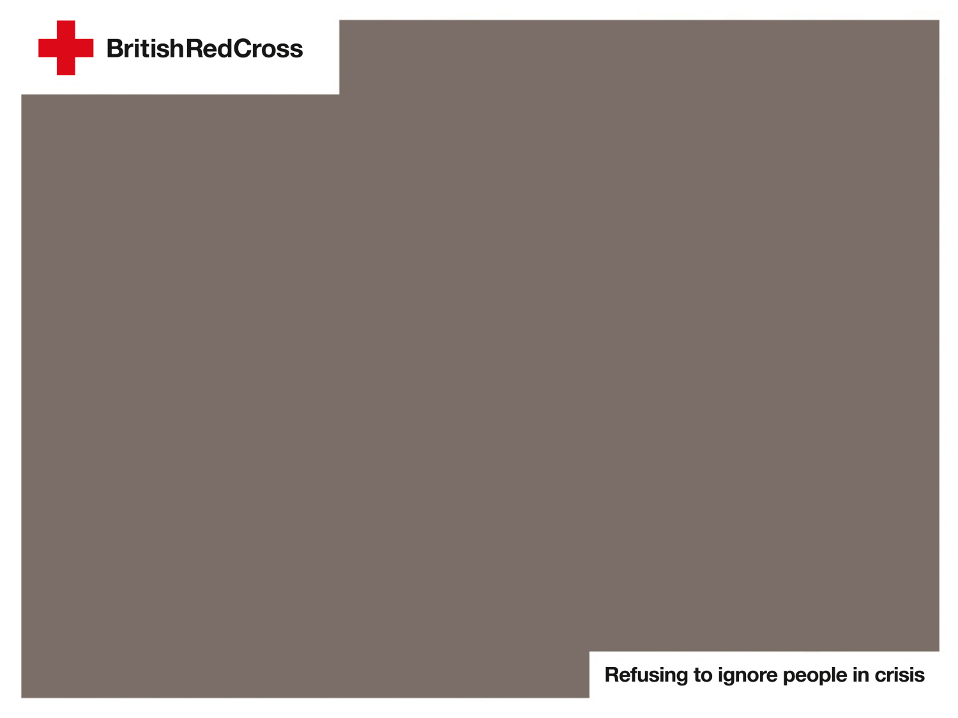
How does flooding happen?

Slide 2

You live near a river. It has rained a few times in the last couple of weeks.
Notes:
Stage 1

Slide 3
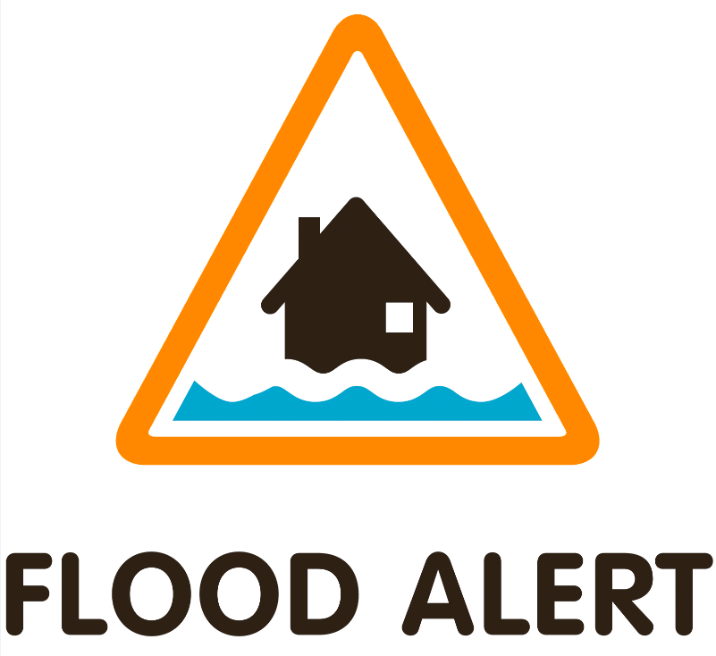
You hear a FLOOD ALERT on the television for your town.
Notes:
Stage 2
Flood alert icon source: Environment Agency

Slide 4
It starts and continues to rain for a couple of days.
Notes:
Stage 3

Slide 5
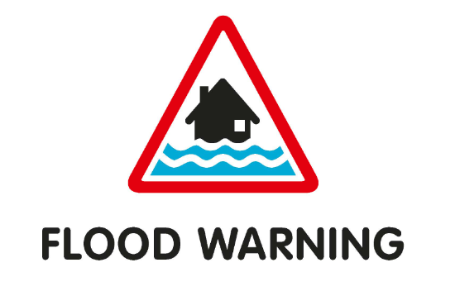
You hear a FLOOD WARNING on the television for your town.
Notes:
Stage 4
Flood warning icon source: Environment Agency

Slide 6
Your town starts flooding very quickly.
Notes:
Stage 5

Slide 7
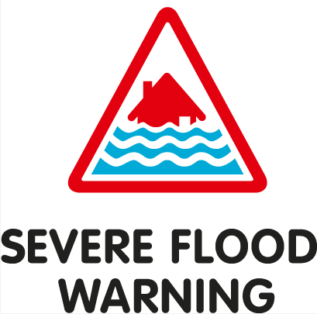
You hear a SEVERE FLOOD WARNING on the radio for your town.
Notes:
Stage 6
Severe flood warning icon source: Environment Agency

Slide 8
It stops raining. The flood outside your house slowly disappears.
Notes:
Stage 7

Slide 9
You hear WARNING NO LONGER IN FORCE on the radio for your town.
Notes:
Stage 8

