Slide 1
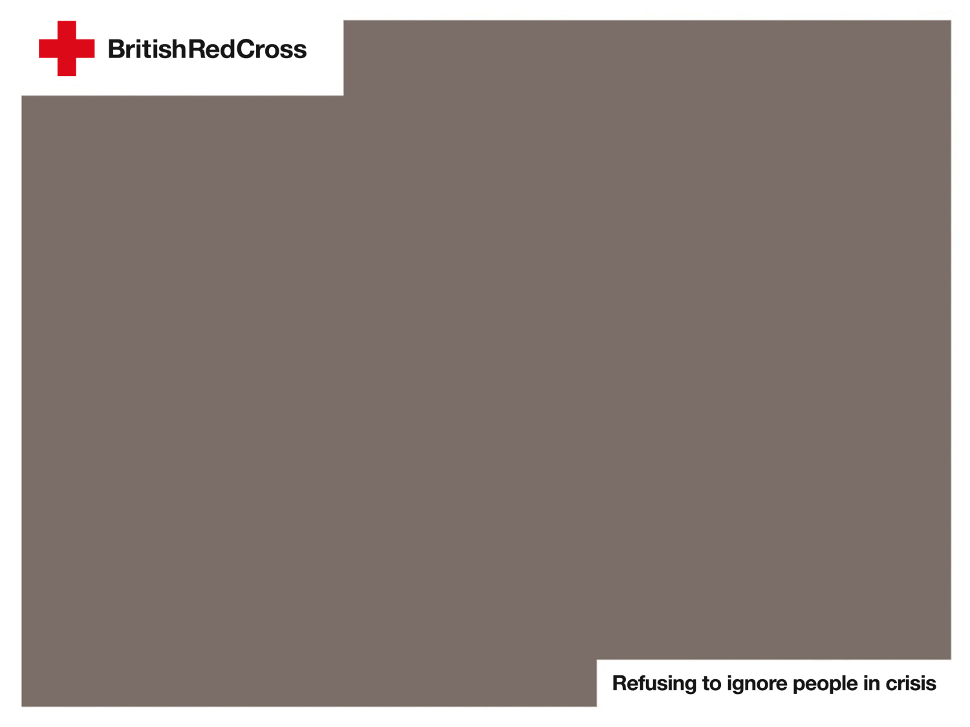
Where and when does it snow and sleet in the UK?
Notes:
Explain to the children that you are going to look at some maps of the UK that show the number of days it snows or sleets in a particular season, and where exactly it is likely to snow and sleet.
This slide contains public sector information licensed under the Open Government Licence v1.0 nationalarchives.gov.uk/doc/open-government-licence/version/3/.

Slide 2
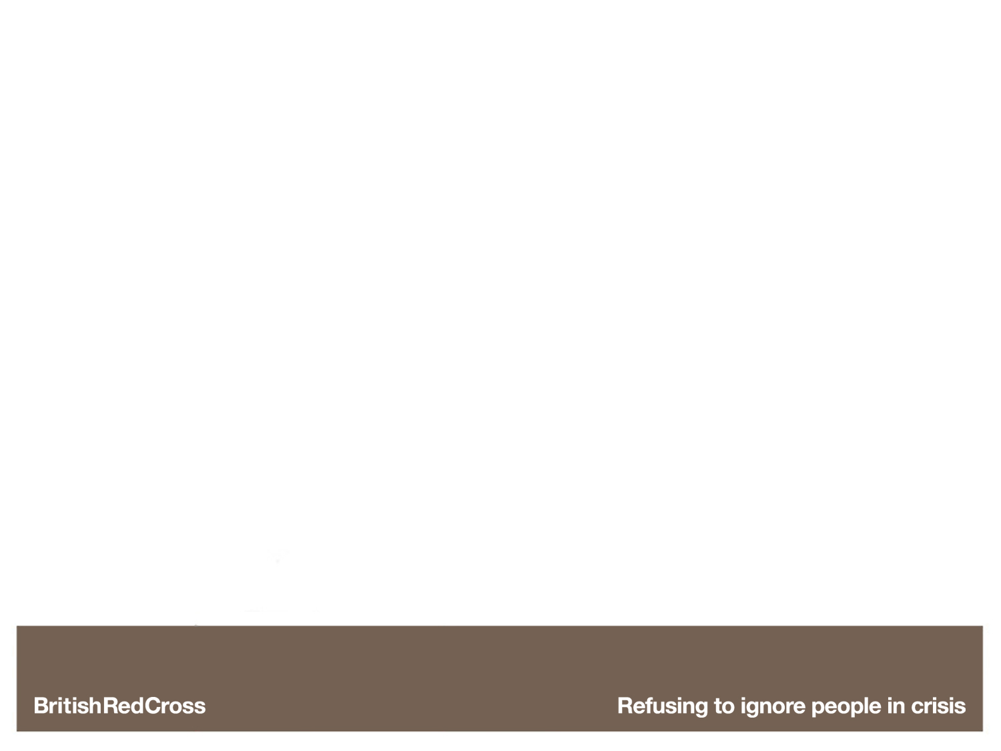
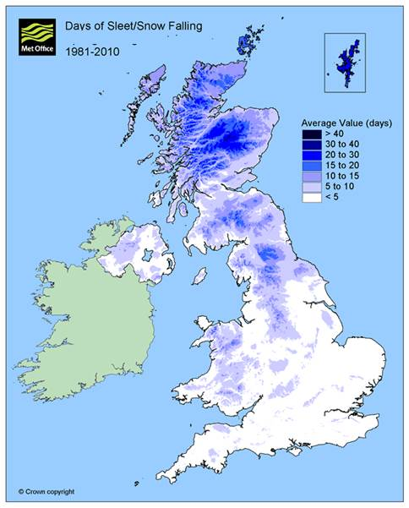
Notes:
Spring – after winter, this is the season it snows and sleets most in.
In spring it snows and sleets most in Scotland, especially in the Scottish Highlands. It snows and sleets least in the south-east of the UK.

Slide 3
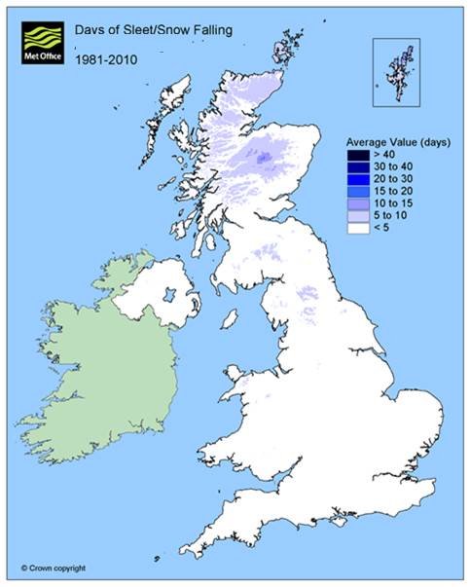
Notes:
Autumn – after summer, this is the season it snows and sleets least in.
This map shows that in autumn it does not snow or sleet much in the UK. It can sometimes snow and sleet in Scotland.

Slide 4
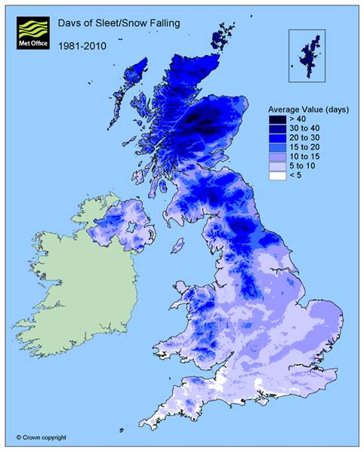
Notes:
Winter – this is the season it snows and sleets most in.
This map shows that in winter it snows and sleets most in Scotland, especially in the Scottish Highlands. It snows and sleets least in the south of England.

Slide 5
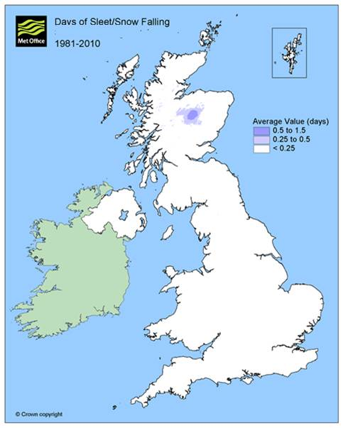
Notes:
Summer – this is the season it snows and sleets least in.
This map shows that the only place where it can snow and sleet in summer is the Scottish Highlands.

